Slide 1
Reviewed by KH – checked by SC
Added mandatory slides
Updated footer
S3 – Recreated
Changed layout, aligned

Slide 2


Slide 3
Hands-on AI in Action with Webex Contact Center: Enhancing Self-Service, Agent Assistance & Customer Insights
Dominic Gonsalves
Solution Manager
Session ID: LTRCCT-2000

Slide 4

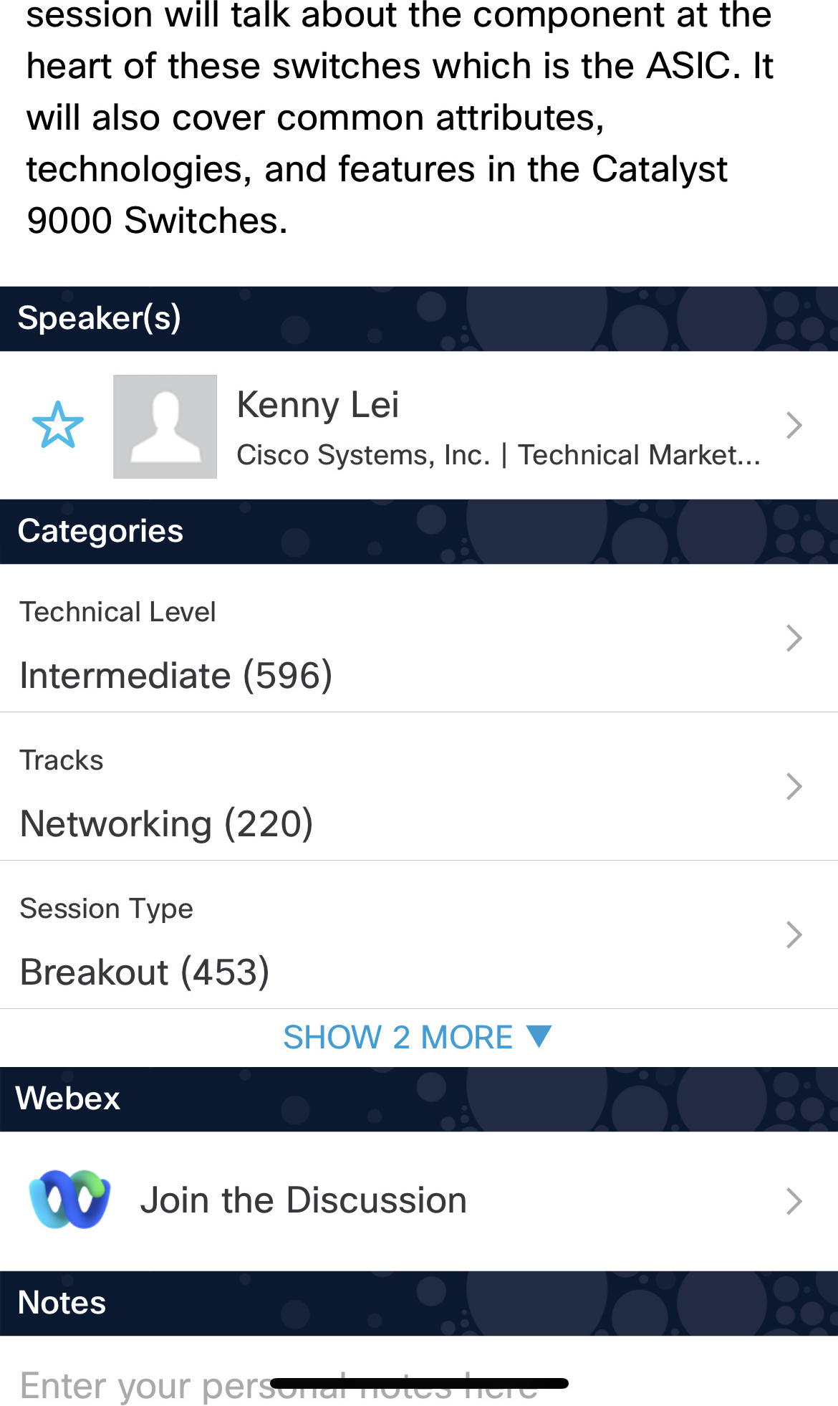

Cisco Webex App
Catalyst 9000 Series Switching Family - …
Questions?
Use Cisco Webex App to chat
with the speaker after the session
How
1
Find this session in the Cisco Live Mobile App
Click “Join the Discussion”
Install the Webex App or go directly to the Webex space
Enter messages/questions in the Webex space
2
3
4
Webex spaces will be moderated by the speaker until November 19, 2026.
Enter your personal notes here
https://ciscolive.ciscoevents.com/clapjc26/LTRCCT-2000

Slide 5
Agenda
01 | Intro
02 | Expectations & Outcomes of the lab
03 | Lab Plan

Slide 6
Building Agentic CX: Consumer Confidence + Business Assurance

Slide 7
The share of interactions resolved by AI is set to rise
2025
30%
2027
50%
Source: Salesforce, State of Service Report, 2025

Slide 8
Customers are open to AI agents
Consumers who trust the information given to them by an AI agent or tool
43%
Consumers who believe AI is used primarily to save money, not to improve service
81%
67% of consumers want to use AI assistants to handle customer service queries
Consumers who would consider a different brand after just one bad AI customer service experience
70%
Source: Zendesk 2025; Attest 2025 Consumer Adoption of AI Report;, 2025; Acquire BPO, 2025.
Notes:
And Gartner recognizes this challenge at both common and costly!
As we can see here, over 80% of organizations struggle with AI data quality
66% percent of data professionals aren't even trusting the data used to build AI applications
And then only 37% of organizations found efforts to actually improve data quality successful
Lastly, we see that data quality can costs organizations roughly $12.9M per year on average
This can be daunting beyond belief.
Which is why today... we'd like to share with you how to set your CX strategy up for success, with a foundation of data and AI that works for your organization.
https://www.gartner.com/en/data-analytics/topics/data-quality?

Slide 9
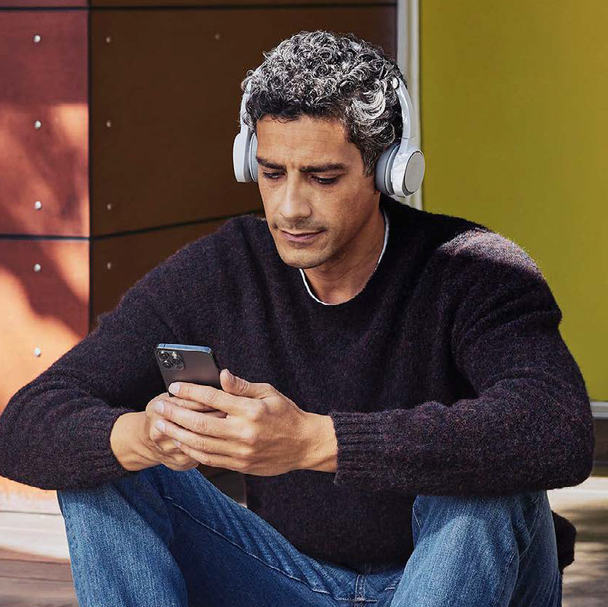
Business of deploying agentic CX
Contact centers’ focus when deploying AI agents
Prompt injection
Knowledge
Knowledge can be files or web URLs
Actions
Define Actions & use responses for next steps
AI Agent
Context can be retained for more seamless flow
Context
Knowledgbase, CRMs…
Interoperability
MCP and A2A capabilities

Slide 10
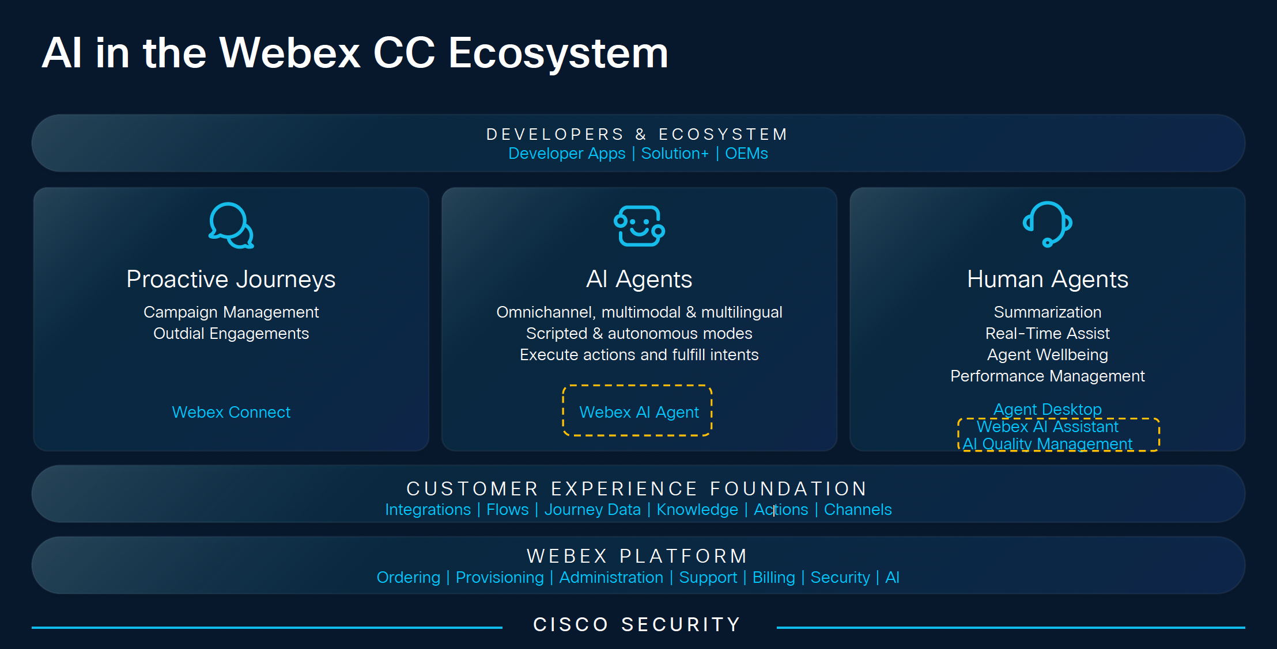

Slide 11
Let’s get started

Slide 12
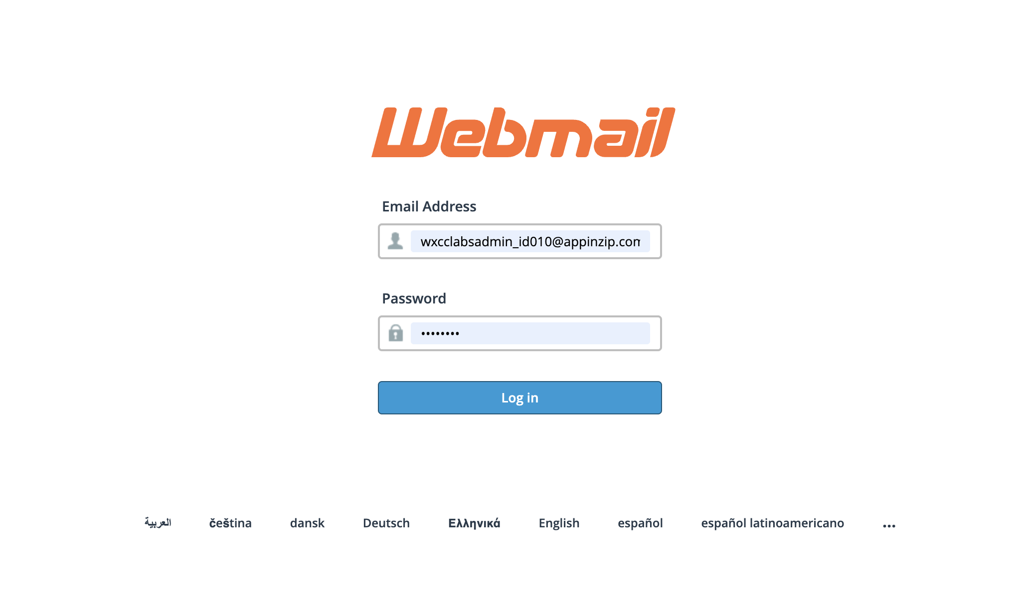
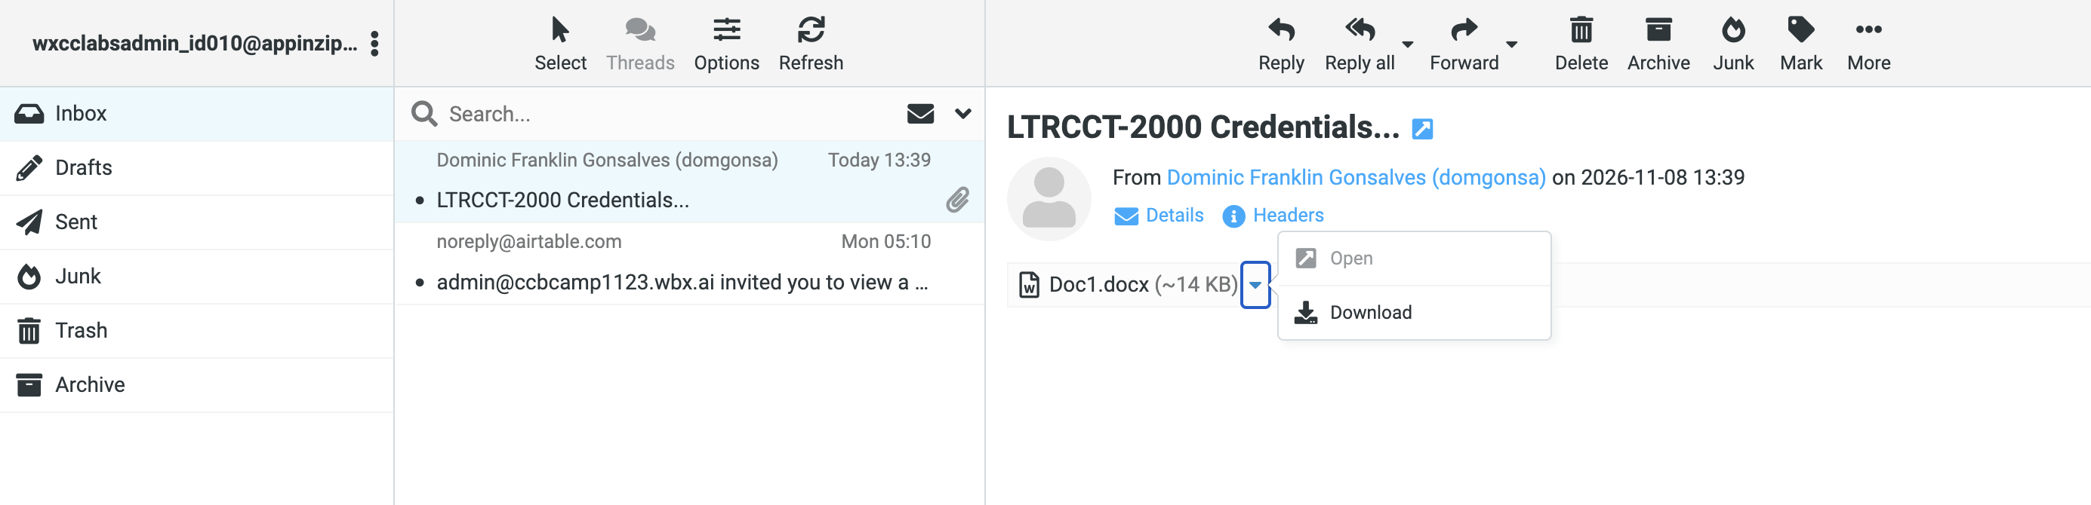
Step 1
You have a piece of paper – email address and password
Go to https://webmail.appinzip.com
Download this docx file

Slide 13
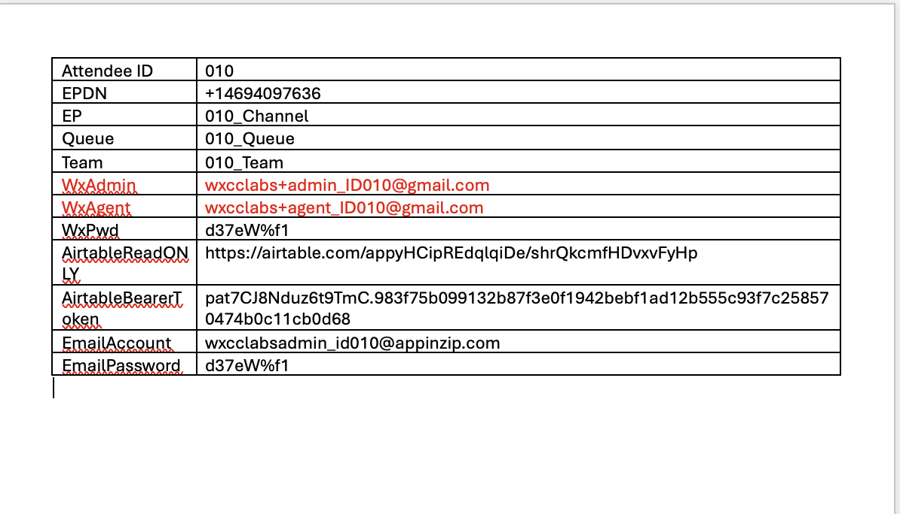
Step 2 – you are seeing this in the email from domgonsa

Slide 14
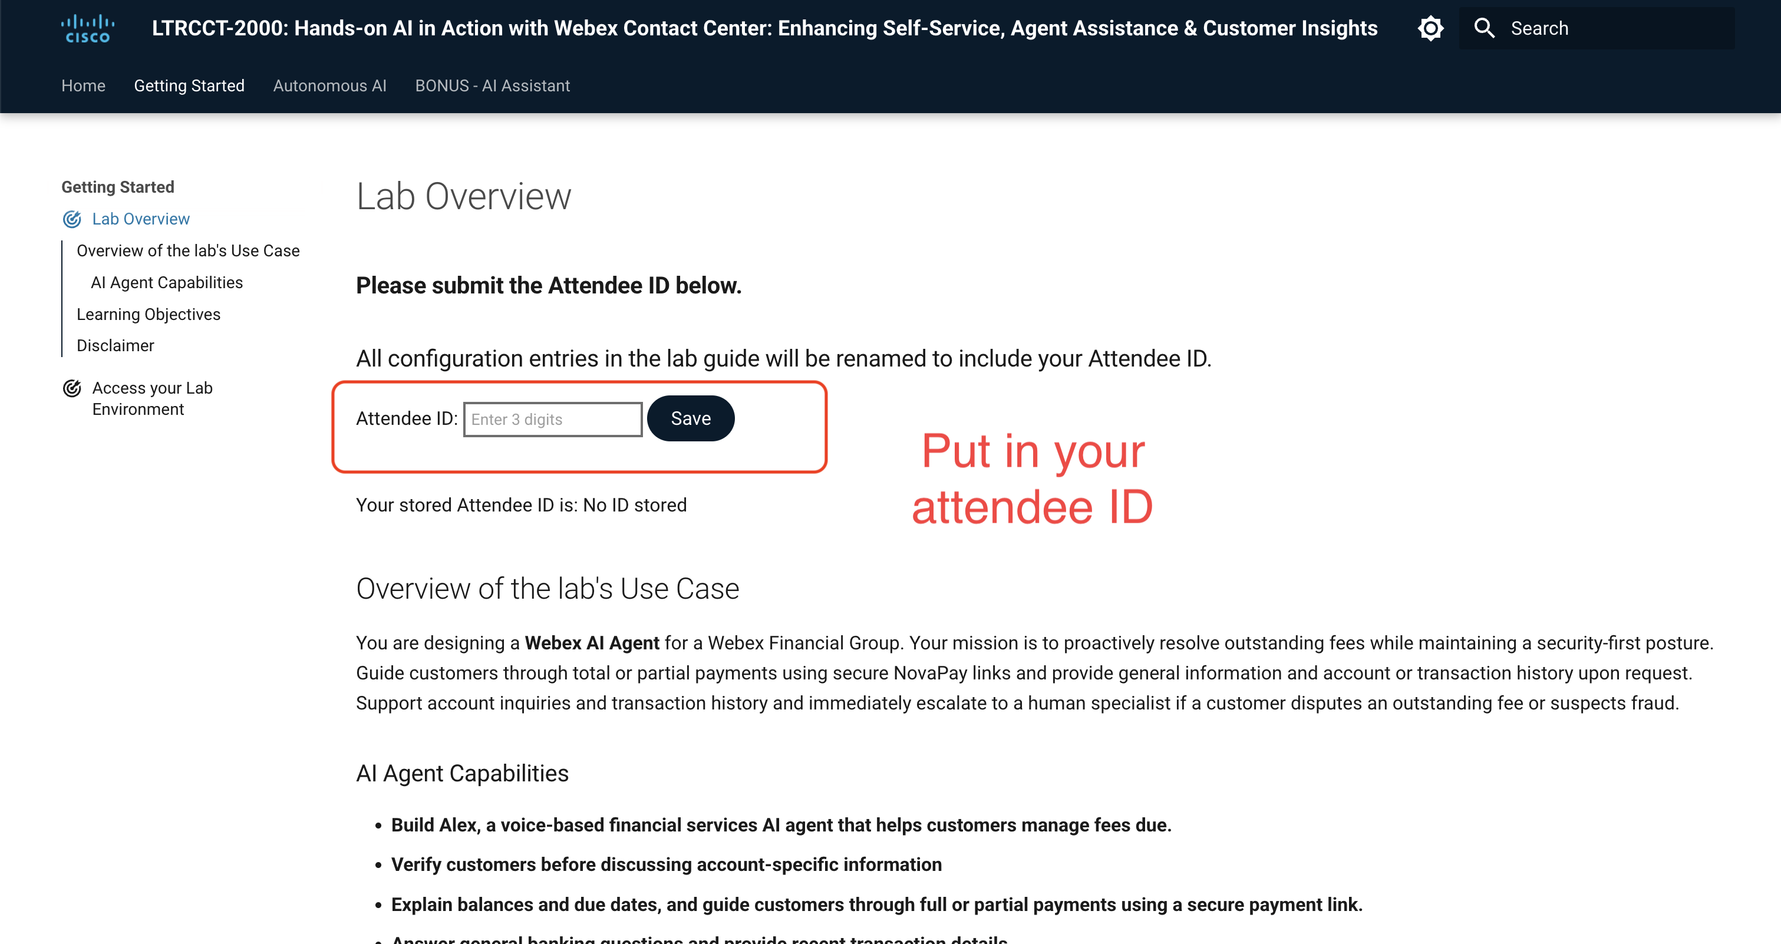
Step 3 – Attendee ID from the docx
https://webexcc-sa.github.io/MEL26LTRCCT-2000/main/overview/

Slide 15
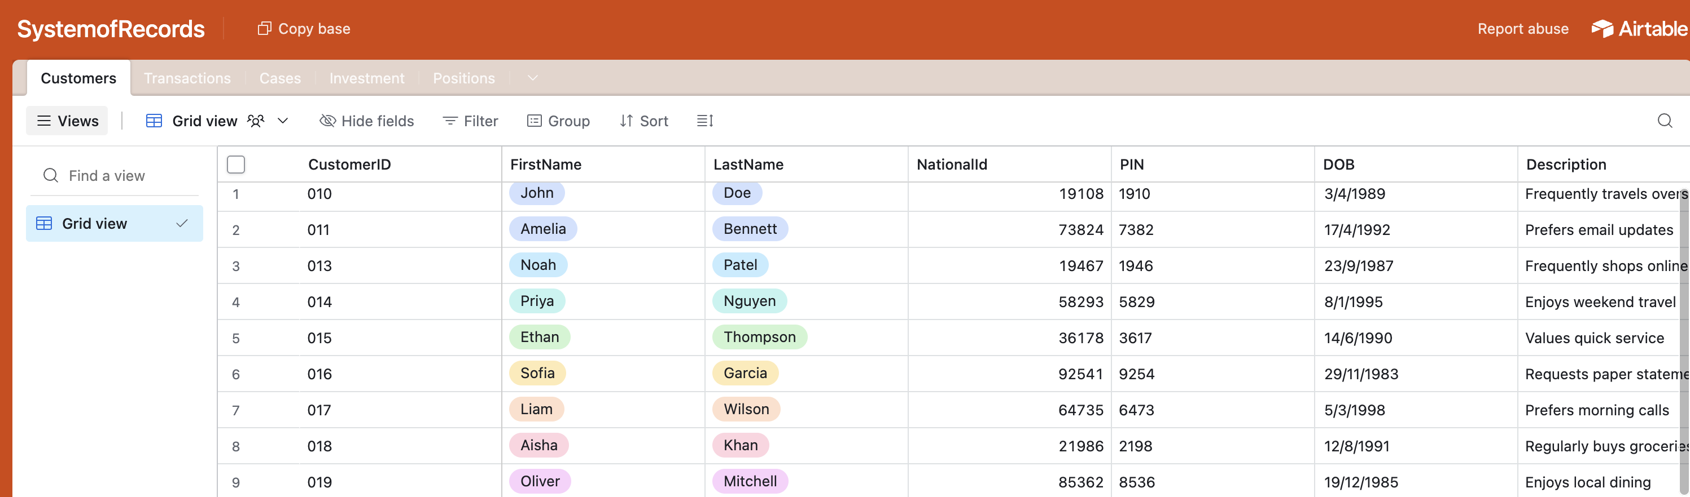
Step 4 - Airtable

Slide 16
Step 5
Login to Webex app
Login to Control Hub
Optional: Login to Agent Desktop

Slide 17




Start Mission 3
Start Mission 1
14:35
Start Mission 4
16:15
Start Mission 2
BONUS – AI Assistant
14:15 – 14:30

Slide 18
CX and AI Breakout sessions (require Full Conference Pass)
Session Code | Session Title | Topics covered | Speaker | Duration | Timeslot
BRKCCT-1552 | Managing end to end customer journeys | Webex CX overview, Journey Data Service | Aamer Ainapore | 90 minutes | Tuesday 8:30am
BRKCOL-2591 | Beyond AI Agents: Building the relationship enterprise with Cisco Dialog | Cisco Dialog, Agentic AI, long-lived conversations, AI Memory. Configuring AI as an employee | Abhiram Kramadhati | 90 minutes | Tuesday 1:45pm
BRKCOL-2589 | AI in Collaboration: Techniques and Architectures for Agentic Collaboration | Responsible AI, AI capabilities across Cisco Collaboration | Keith Griffin | 60 minutes | Tuesday 3:45pm
BRKCOL-2593 | Understanding how AI Assistant addresses both Employee Experiences and Customer Experiences | AI Assistant for Calling & Contact Centre. Summarisation, agent assistance, analytics | Amy Ryan | 90 minutes | Wednesday 8:30am
BRKCCT-2594 | Implementing a context-driven customer experience | CRM Integration: Salesforce Voice, ServiceNow CCIF | Mayur Vyas + Dan Mathews | 90 minutes | Wednesday 1pm
BRKCOL-2590 | Workforce Experience Management - AI QM & WFM + Supervisor | Webex AI QM, Supervisor enhancements, new WFM capabilities | Prasanna Arjunan | 90 minutes | Wednesday 4:15pm
LTRCCT-2000 | Instructor-led lab - Hands-on Al in Action with Webex Contact Center. | AI Assistant, AI Agent, Analytics | Dominic Franklin Gonsalves | 120 minutes | Monday 2:15pm
TECCOL-2595 | Architecting AI-driven Collaboration Experiences (Add-on via technical seminar program) | Designing AI Pilots, off-the-shelf AI vs custom integrations, tracking AI Success | Dan Mathews + Shaun Robinson | 4 hours | Monday 1pm

Slide 19
Collaboration and AI lightning talks in the World of Solutions
Session Code | Session Title | Topics covered | Speaker | Duration | Timeslot
LTSCOL-1875 (Lightning) | The Agentic Workforce: Scaling Quality & Staffing for Humans and AI | AI Quality Management (AI QM), Blended staffing models, Contact centre capacity orchestration, 100% automated evaluation | Shaun Robinson Solutions Engineer | 15 mins | Monday, Nov 9 12:45pm AEDT
LTSCOL-1883 (Lightning) | Cisco Devices: One Room. Every Meeting Platform. | RoomOS multi-platform architecture, AI device experiences across Webex, Microsoft Teams Rooms (MTR), Zoom Rooms, Google Meet | Darren Henwood Senior Solutions Engineer | 15 mins | Wednesday, Nov 11 10:00am AEDT
LTSCOL-1878 (Lightning) | Context is King: The Next Generation of Customer-Centric AI Agents | AI Concierge, Persistent memory, Contextual awareness, Multi-agent orchestration, Actionable digital workforce | Ben Farrell Head of Growth & Alliances | 15 mins | Wednesday, Nov 11 11:00am AEDT
LTSCOL-1879 (Lightning) | Beyond Agents: Building the Relationship Enterprise | Relationship Enterprise OS, Continuous customer context, Cross-department workflow orchestration, Cisco Dialog | Abhiram Kramadhati Director of AI Solutions | 15 mins | Wednesday, Nov 11 12:30pm AEDT

Slide 20
Complete your session evaluations
Complete a minimum of 4 session surveys and the Overall Event Survey to claim a special edition evaluation gift.
Earn up to 800 points by completing all surveys and climb the Cisco Live Challenge leaderboard.
Level up and earn exclusive prizes!
Complete your surveys in the Cisco Live Events app.

Slide 21
Continue your education
Visit the Cisco Stand for related demos
Book your
one-on-one Meet the Expert meeting
Attend the
interactive education with Capture the Flag, and Walk-in Labs
Visit the On-Demand Library for more sessions at www.CiscoLive.com/
on-demand

Slide 22
Thank you

Slide 23
Cisco

