Slide 1
Draft – Last Minute Changes Expected
Hands-on AI in Action with Webex Contact Center: Enhancing Self-Service, Agent Assistance & Customer Insights
LTRCCT-2000
Dominico Gonsalves
Session ID: LTRCCT-2000

Slide 2

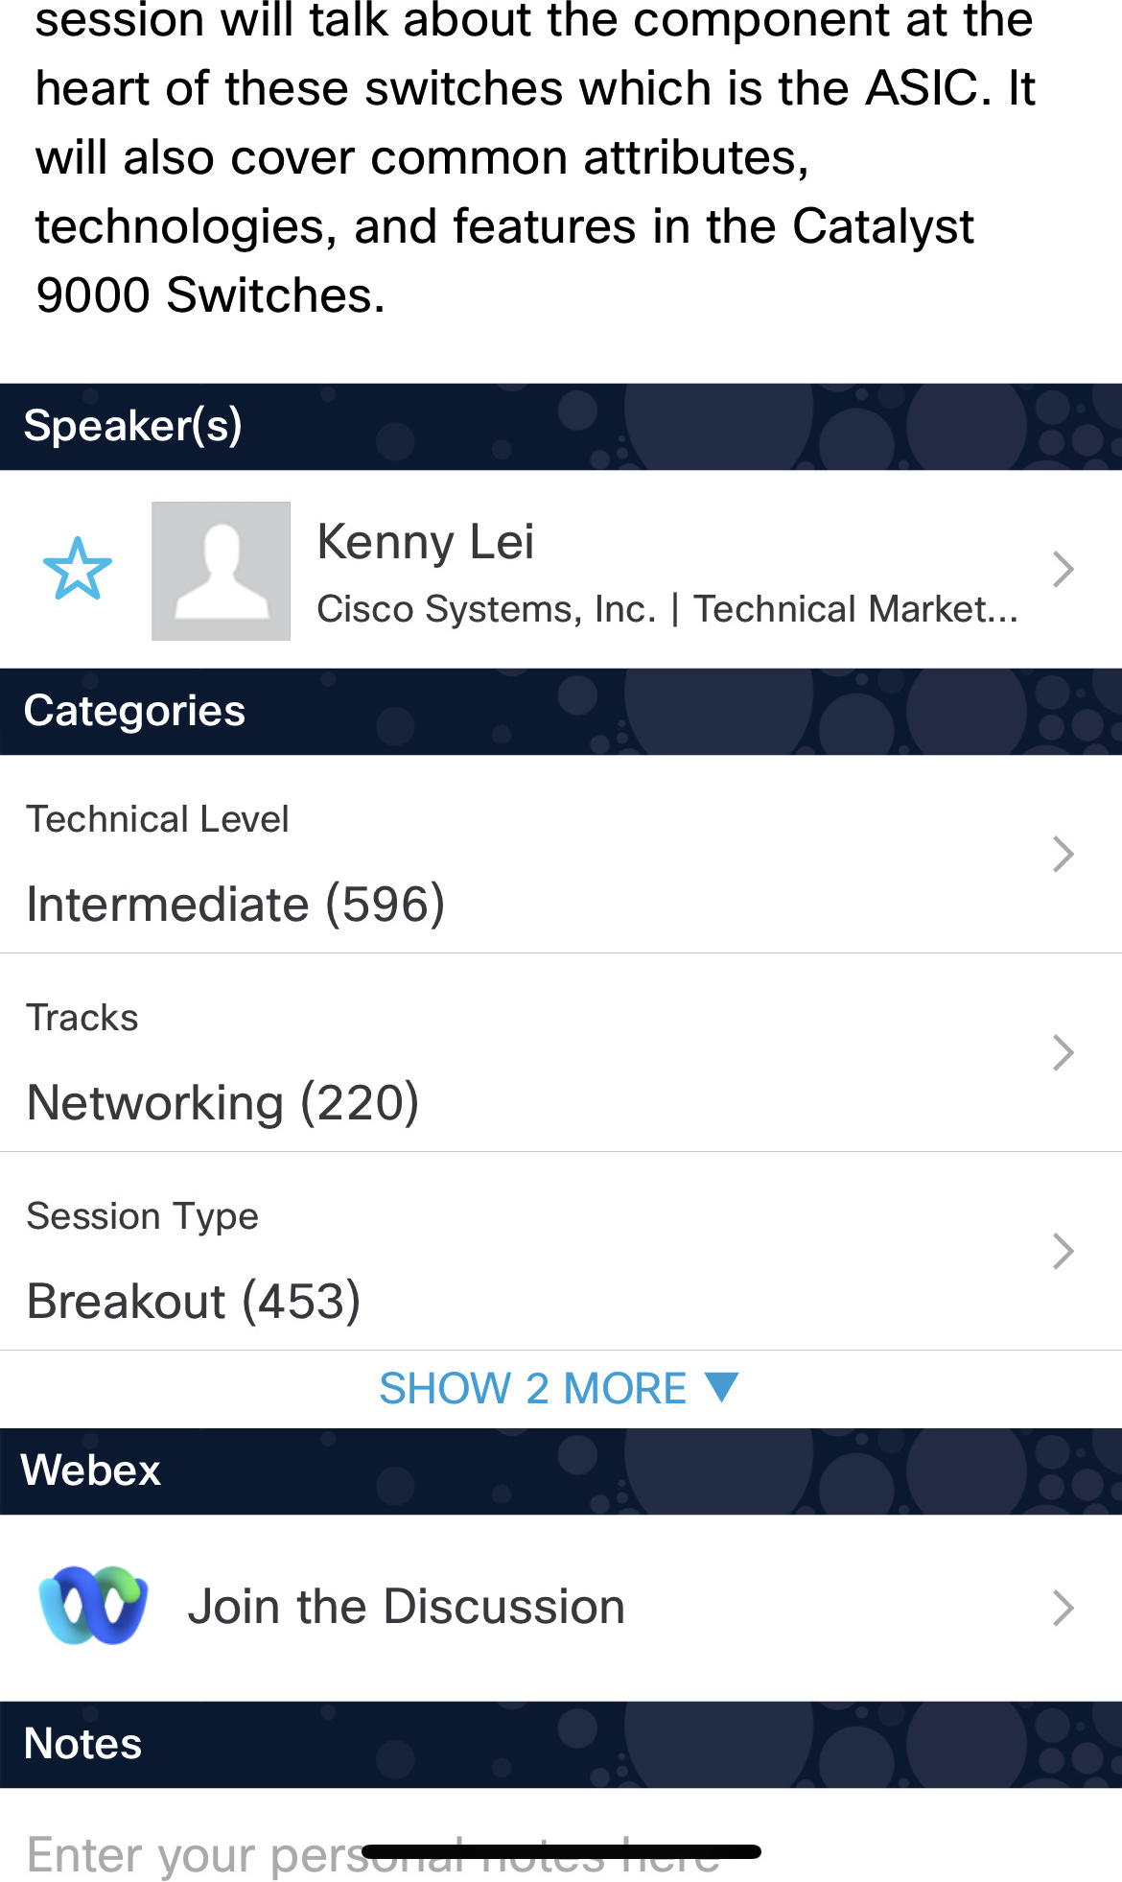

Cisco Webex App
Catalyst 9000 Series Switching Family - …
Questions?
Use Cisco Webex App to chat
with the speaker after the session
How
1
Find this session in the Cisco Live Mobile App
Click “Join the Discussion”
Install the Webex App or go directly to the Webex space
Enter messages/questions in the Webex space
2
3
4
Webex spaces will be moderated by the speaker until Nov 19, 2026.
Enter your personal notes here
https://ciscolive.ciscoevents.com/clamer26/SESSIONCODE

Slide 3
Agenda 1
01 | Intro
02 | Expectations & Outcomes of the lab
03 | Lab Plan

Slide 4
Building Agentic CX: Consumer Confidence + Business Assurance

Slide 5
The share of interactions resolved by AI is set to rise
2025
30%
2027
50%
Source: Salesforce, State of Service Report, 2025

Slide 6
Customers are open to AI agents
Consumers who trust the information given to them by an AI agent or tool
43%
Consumers who believe AI is used primarily to save money, not to improve service
81%
67% of consumers want to use AI assistants to handle customer service queries
Consumers who would consider a different brand after just one bad AI customer service experience
70%
Source: Zendesk 2025; Attest 2025 Consumer Adoption of AI Report;, 2025; Acquire BPO, 2025.
Notes:
And Gartner recognizes this challenge at both common and costly!
As we can see here, over 80% of organizations struggle with AI data quality
66% percent of data professionals aren't even trusting the data used to build AI applications
And then only 37% of organizations found efforts to actually improve data quality successful
Lastly, we see that data quality can costs organizations roughly $12.9M per year on average
This can be daunting beyond belief.
Which is why today... we'd like to share with you how to set your CX strategy up for success, with a foundation of data and AI that works for your organization.
https://www.gartner.com/en/data-analytics/topics/data-quality?

Slide 7

Business of deploying agentic CX
Contact centers’ focus when deploying AI agents
Prompt injection
Knowledge
Knowledge can be files or web URLs
Actions
Define Actions & use responses for next steps
AI Agent
Context can be retained for more seamless flow
Context
Knowledgbase, CRMs…
Interoperability
MCP and A2A capabilities
PSOCOL - 2015

Slide 8
Expectations
Automation & AI Agent Foundations
  autonomous AI Agent capable of authenticating customers, retrieving debt balances, offering payment options and generating and delivering payment links via NovaPay integration.
Advanced Orchestration
  a multi-agent architecture where a Debt Collection AI Agent hands off to an Investment Advisor AI Agent, using Agent transfer capabilities
Human-in-the-Loop AI
  Escalate to a human agent

Slide 9
Quick Demo

Slide 10




Lab 1
14:35
Lab 3
15:55
Lab 4
14:15 – 14:30
Lab 5
Lab 2

Slide 11
Complete your session evaluations
Complete a minimum of 4 session surveys and the Overall Event Survey to be entered in a drawing to win 1 of 5 full conference passes to Cisco Live 2027.
Earn 100 points per survey completed
and compete on the Cisco Live Challenge leaderboard.
Level up and earn exclusive prizes!
Complete your surveys in the Cisco Live
Events app.

Slide 12
Continue your education
Visit the Cisco Stand for related demos
Book your
one-on-one Meet the Expert meeting
Attend the
interactive education with Capture the Flag, and Walk-in Labs
Visit the On-Demand Library for more sessions at www.CiscoLive.com/
on-demand

Slide 13
Thank you

Slide 14
Cisco

