Slide 1
C
CipherPool
RESEARCH DEPLOYMENT · ETHEREUM SEPOLIA
01 / 10
ZAMA FHEVM · CONFIDENTIAL FINANCE
Private prize savings, built for verification.
FHE
Principal stays withdrawable while encrypted balances and ticket weights stay confidential.
cipherpool-beta.vercel.app
PUBLIC CUSTODY
PRIVATE ACCOUNTING
RESEARCH SOFTWARE · NOT PRODUCTION
Verified claims and links: docs/showcase/SUBMISSION_OVERVIEW.md

Slide 2
C
CipherPool
RESEARCH DEPLOYMENT · ETHEREUM SEPOLIA
02 / 10
THE PROBLEM
Public ledgers expose private financial context
Auditability should not require publishing every saver’s position.
01
02
03
Balance exposure
Visible ticket weights
Timing reveals intent
Wallet history can reveal a saver’s position, deposits, withdrawals, and changing financial behavior.
Transparent weights make whale activity easy to track and can disclose each participant’s relative odds.
Pending deposits and last-minute entries expose behavior around a prize round before it settles.
Verified claims and links: docs/showcase/SUBMISSION_OVERVIEW.md

Slide 3
C
CipherPool
RESEARCH DEPLOYMENT · ETHEREUM SEPOLIA
03 / 10
THE SOLUTION
Public custody. Confidential accounting.
CipherPool separates what must be auditable from what should remain private.
PUBLIC · INDEPENDENTLY VERIFIABLE
ENCRYPTED · WALLET-AUTHORIZED
Custody layer
Privacy layer
• Deposited testnet cUSDC • Contract and custody bindings • Transaction receipts • Aggregate solvency
• Running balances as euint64 • Weighted draw intervals • Prize credits • Local balance reveal
Verified claims and links: docs/showcase/SUBMISSION_OVERVIEW.md

Slide 4
C
CipherPool
RESEARCH DEPLOYMENT · ETHEREUM SEPOLIA
04 / 10
ARCHITECTURE
A verifiable path from wallet to confidential settlement
01
02
03
04
React client
Official cUSDC
ConfidentialPool
Zama relayer + KMS
Encrypts input Requests wallet signature
Moves encrypted assets Returns actual transfer
Owns encrypted positions Reserve + draw state
Prepares authorized proofs Verifies public snapshots
IN
05
Public: custody + receipts Private: positions + winner
Sponsor wallet
Indexer + PostgreSQL
Transfers encrypted cUSDC into the prize reserve
Observes public events Persists checkpoints
Verified claims and links: docs/showcase/SUBMISSION_OVERVIEW.md

Slide 5
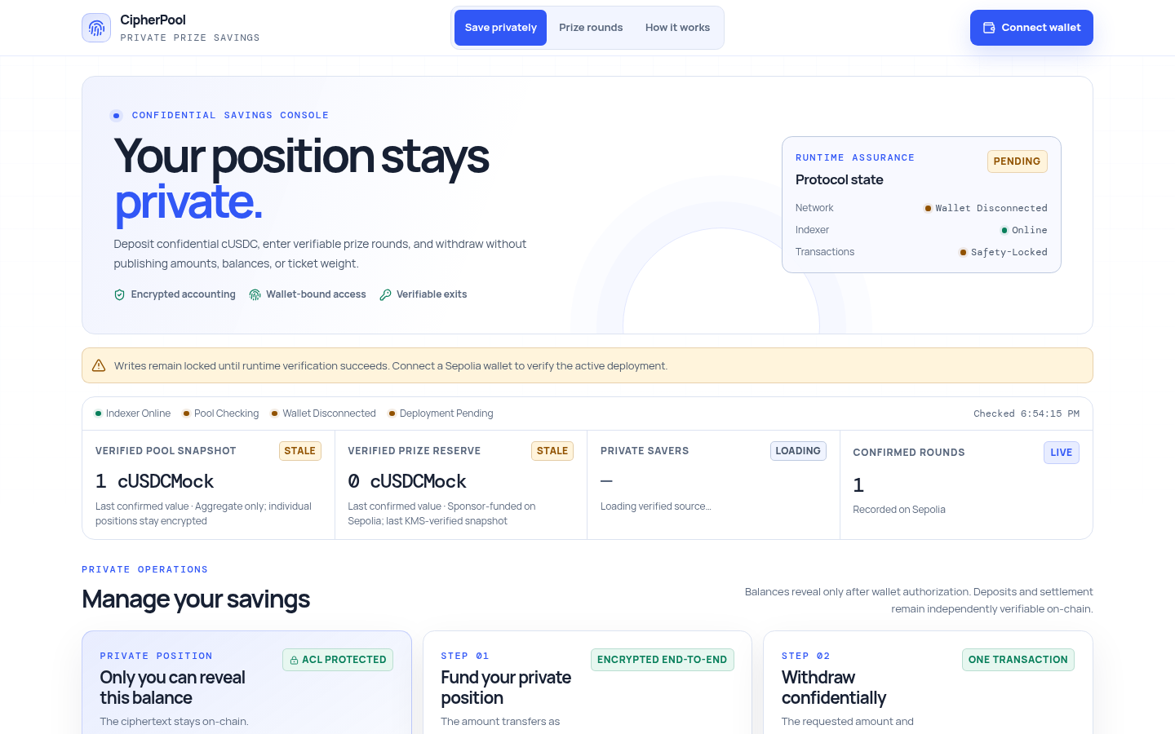
C
CipherPool
RESEARCH DEPLOYMENT · ETHEREUM SEPOLIA
05 / 10
LIVE PRODUCT
The console is live—and honest about connection state
PRODUCTION CAPTURE
Clear wallet state
A disconnected user sees only Connect wallet. An address appears only after the provider returns the selected account.
Runtime assurance
Chain, bytecode, and custody bindings are checked before protocol writes.
Captured from https://cipherpool-beta.vercel.app · 4 Sep 2026

Slide 6
C
CipherPool
RESEARCH DEPLOYMENT · ETHEREUM SEPOLIA
06 / 10
USER JOURNEY
Four explicit steps. No hidden signing.
01
02
03
04
Shield
Save
Prize round
Withdraw
Wrap test USDC into confidential cUSDC with Zama's official Sepolia wrapper.
Deposit an encrypted cUSDC amount; the pool credits only the token-returned result.
Fund or monitor the sponsor reserve, then run a KMS-verified encrypted draw.
Submit an encrypted amount; accounting follows the token-returned transfer result.
Verified claims and links: docs/showcase/SUBMISSION_OVERVIEW.md

Slide 7
C
CipherPool
RESEARCH DEPLOYMENT · ETHEREUM SEPOLIA
07 / 10
SECURITY CONTROLS
Solvency and settlement invariants are enforced in code
01
Asset-bound credit
Encrypted deposit credit is derived from the token-returned custody amount.
02
Reserved prizes
Each draw consumes verified sponsor funds so assets cannot fund repeated awards.
03
Complete liabilities
Winner credit enters both the encrypted position and aggregate at finalization.
04
Bound draw proofs
KMS evidence must match the stored aggregate and reserve handles.
05
Timeout recovery
Anyone can release a stale draw lock after the 24-hour cancellation delay.
Verified claims and links: docs/showcase/SUBMISSION_OVERVIEW.md

Slide 8
C
CipherPool
RESEARCH DEPLOYMENT · ETHEREUM SEPOLIA
08 / 10
VERIFIED EVIDENCE
A complete live prize round—not a simulated receipt
Each transaction below links directly to its confirmed block-explorer record.
01
02
03
cUSDC deposit
KMS draw
Private claim
0xe36db7…b39f
0x504862…ce6c
0x5763be…c969
Encrypted position
Draw 1 finalized
Ordinary withdrawal
Deposit → KMS draw → private claim → principal withdrawal · all confirmed
Full hashes and runtime evidence: docs/operations/sepolia-deployment.md

Slide 9
C
CipherPool
RESEARCH DEPLOYMENT · ETHEREUM SEPOLIA
09 / 10
ENGINEERING PROOF
Reproducible tests—and durable live infrastructure
Vercel
React frontend
PRODUCTION UI
FULL
VALIDATION SUITE
Render
Node indexer/API
PUBLIC API
Foundry contracts · backend API/indexer client encryption · frontend UX
Neon
PostgreSQL checkpoint
RESTART RECOVERY
Indexer checkpoint restored successfully after a live service restart
Verified claims and links: docs/showcase/SUBMISSION_OVERVIEW.md

Slide 10
C
CipherPool
RESEARCH DEPLOYMENT · ETHEREUM SEPOLIA
10 / 10
OPEN RESEARCH · VERIFIABLE EVIDENCE
Confidential savings, without blind trust.
ACTIVE POOL
0x9c939b82 a1B23b77 746f934A 1Ff2b9a5 bCf191e0
Try the live app. Inspect the active Sepolia deployment. Review every invariant and test.
cipherpool-beta.vercel.app
github.com/Webghost01-NG/fhevm-pooltogether-security
ETHEREUM SEPOLIA
CipherPool · Zama fhEVM · Research deployment

