Slide 1

[ WEBGRO / 2026 ] PROPOSAL
A proposal for
Ithaca Roofing.
A custom WordPress rebuild of the existing site, with drag-and-drop editing and ongoing maintenance. Written April 2026.
AI-FIRST eCOMMERCE & WORDPRESS AGENCY · BRACKNELL, UK

Slide 2
01.
Get to know us.
The studio, the record, and the awards before we talk about you.
webgro.co.uk
[ 02 / 13 ]

Slide 3
[ 01 ] WHO WE ARE
Hello.
We're Webgro.
15+ YRS
WordPress & eCommerce
5x
A senior studio building the sharp end of modern web. Fifteen years deep on WordPress and Shopify, with custom design, development, and ongoing care built in. No template bloat, no agency-hopping between teams, no hero launches that crumble the week after.
Award-winning studio
120+
Sites launched & maintained
webgro.co.uk
[ 03 / 13 ]

Slide 4
[ 02 ] WHAT WE DO
Six capabilities, one studio.
No agency-hopping for strategy, build, or marketing. Same team across the whole loop.
01
02
03
Websites
Consultancy
Automation & AI
Shopify & WordPress builds, fast by default.
Senior eCommerce expertise, shaped to your team.
Production AI that earns its keep week one.
04
05
06
SEO
Marketing
Design
Technical foundations, content that compounds.
Paid + email + analytics as one loop.
Systems, not decoration.
webgro.co.uk
[ 04 / 13 ]

Slide 5
[ 03 ] AWARDS
Five-time award winners.
2024
2024
2022
2021
2020
Best Web Design Agency
Best eCommerce Consultant
Best Web Design Agency
Best Web Design Agency
Best Web Design Agency
SOUTH EAST ENGLAND
SOUTH EAST ENGLAND
UNITED KINGDOM
SOUTH EAST ENGLAND
BERKSHIRE
webgro.co.uk
[ 05 / 13 ]

Slide 6
02.
Selected work.
Three WordPress service businesses, rebuilt, launched, and kept current.
webgro.co.uk
[ 06 / 13 ]

Slide 7
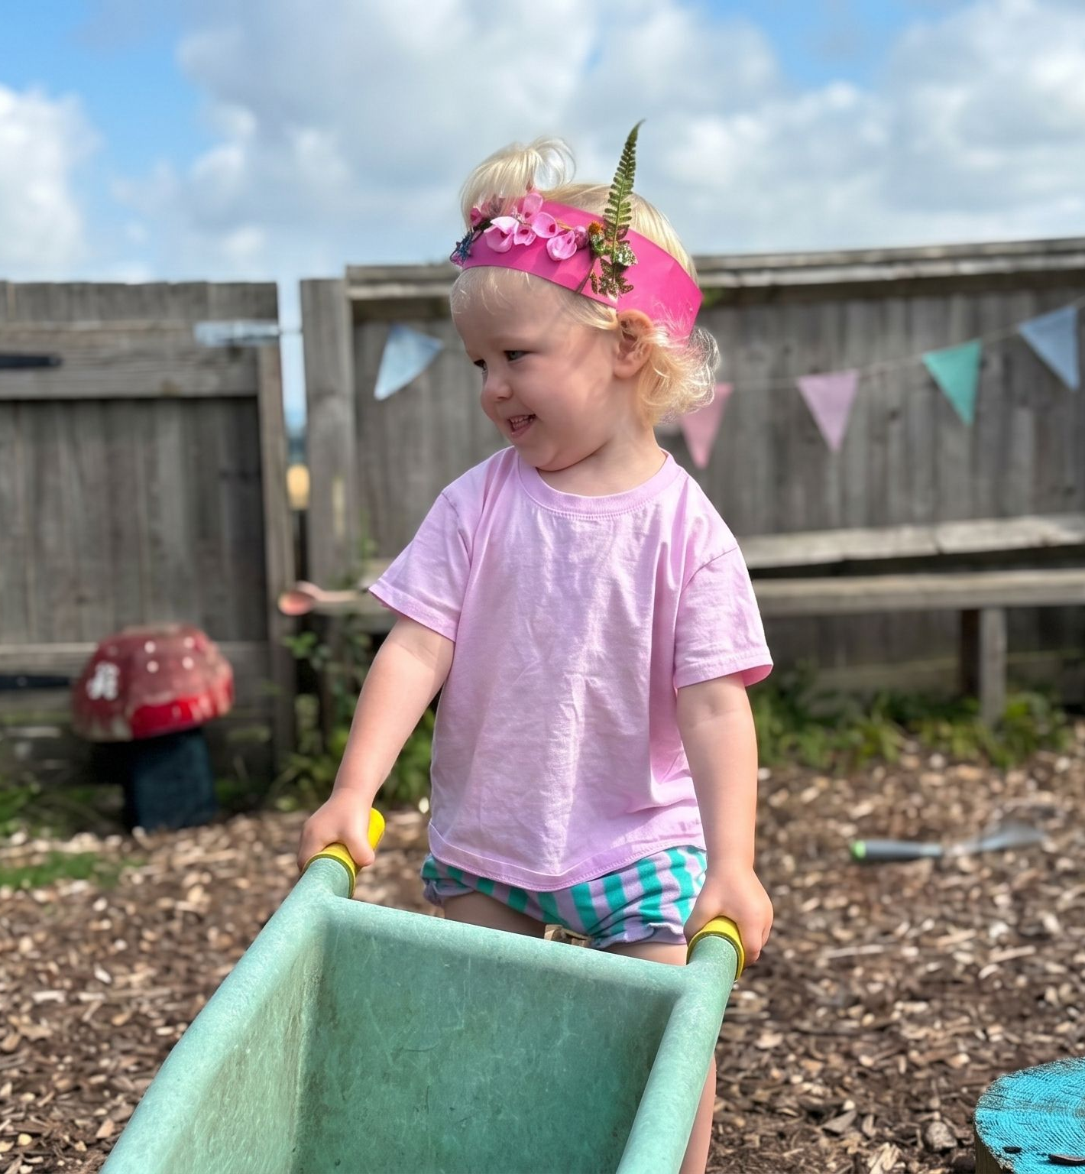
[ CASE STUDY / 2025 ]
Little Muddy Boots
littlemuddyboots.co.uk
A mobile-first WordPress redesign for a service business, with a custom postcode-search tool so visitors know instantly whether the service covers their area.
SERVICES
WordPress redesign, custom postcode search, mobile-first UX
webgro.co.uk
[ 07 / 13 ]

Slide 8

[ CASE STUDY / 2025 ]
Space 4 U Self Storage
space4uselfstorage.co.uk
A WordPress redesign for a regional self-storage operator. Clarity, speed, and a direct path from visitor to unit enquiry.
SERVICES
WordPress redesign, conversion-led UX, ongoing maintenance
webgro.co.uk
[ 08 / 13 ]

Slide 9

[ CASE STUDY / 2025 → PRESENT ]
Paragon Freight
paragonfreight.co.uk
A B2B WordPress rebuild for a freight operator, with a live currency selector and enquiry flow shaped around international buyers.
SERVICES
WordPress build, currency selector, enquiry flow, retainer
webgro.co.uk
[ 09 / 13 ]

Slide 10
03.
What we'll do for you.
From Ithaca Roofing's brief, translated into scope and price.
webgro.co.uk
[ 10 / 13 ]

Slide 11
[ SCOPE ] WHAT YOU GET
Three lines of delivery.
01
Custom WordPress design & build
A fresh design tailored to Ithaca Roofing, then built from the ground up on WordPress. No third-party themes, no template bloat. Every section shaped around your content and your customers.
02
Drag-and-drop editing
Once the build's signed off, we convert every section into editable blocks. Your team can update copy, swap images, and add new pages without touching code or calling a developer.
03
Ongoing maintenance
Managed hosting, daily backups, weekly CMS and plugin updates, plus performance and security checks. Your site stays fast, secure, and current, month after month.
webgro.co.uk
[ 11 / 13 ]

Slide 12
[ INVESTMENT ] FOR ITHACA ROOFING
The numbers.
ONE-OFF BUILD
ONGOING MAINTENANCE
£3,750
£120
per month
Managed hosting, daily backups, weekly CMS and plugin updates, plus performance and security checks. No lock-in, cancel anytime.
Custom WordPress redesign and build, converted to drag-and-drop editing. Delivered, deployed, yours.
webgro.co.uk
[ 12 / 13 ]

Slide 13
[ NEXT ] READY TO GRO?
Let's build it.
Say go and we're rolling.
TALK TO US
THE LEGAL STUFF
hello@webgro.co.uk
50% deposit up front, 50% due before launch. Maintenance is £120/month paid in advance by Direct Debit, starting the month after go-live. All prices exclude VAT. T&Cs on signing.
+44 (0) 1344 231 119
12 Longshot Lane, Bracknell, Berkshire, RG12 1RL
WEBGRO LTD · REG 10889889 · PART OF BROADBRIDGE GROUP
webgro.co.uk
[ 13 / 13 ]

