Slide 1
NEW FLAG
Inspired to make a little change in my country

Slide 2
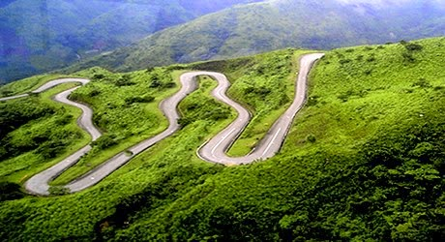
LANDSCAPE
This Photo by Unknown author is licensed under CC BY-SA.

Slide 3
Flag design

