Slide 1
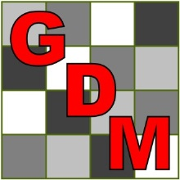
Exploring Treatment By Trial Interaction Using Treatment Stability/Trial Dendrogram Plots
Peter Claussen, Steve Gylling
Gylling Data Management, Inc.
Booth #1020

Slide 2
Software Overview
ARM
Single trial management and analysis
ARM ST
Summarizes ARM trials across locations and years
Treatment x trial analysis
New in 2015 is the Treatment x Trial graph

Slide 3
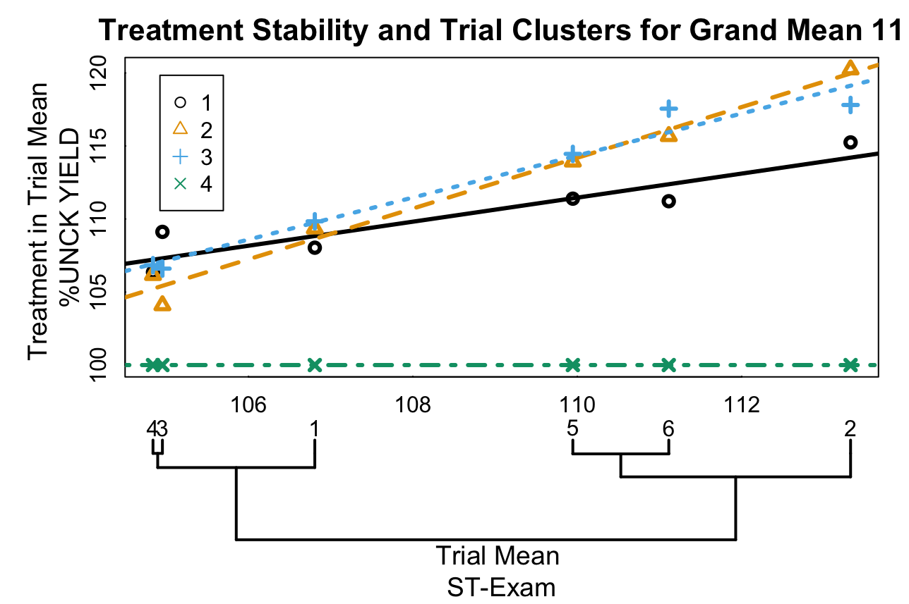
Treatment x Trial Graph
Treatment
Stability
Trial
Dendrogram
(colorblind-safe palette – bconnelly.net/2013/10/creating-colorblind-friendly-figures/)

Slide 4
Trial Dendrogram
Treatment x trial means represented as a matrix, with trials in rows.
Each trial is a single multivariate response comprised of individual treatment means within trials.

Slide 5
Trial Dendrogram
Similarity between rows (trials) is computed using the R function dist()
The R default is Euclidean distance.
The result is a matrix with pairwise similarity measures

Slide 6
Trial Dendrogram
Hierarchical clusters produced using the R hclust()function.
Each item (leaf) is first given its own cluster
Proceeding iteratively, the nearest pair of clusters are joined until there is a single cluster
Dendrogram is plotted by drawing lines linking clusters, where the distance of the link from the leaves is proportional to similarity between clusters

Slide 7
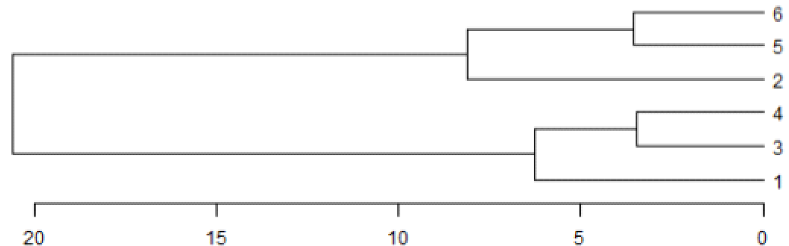
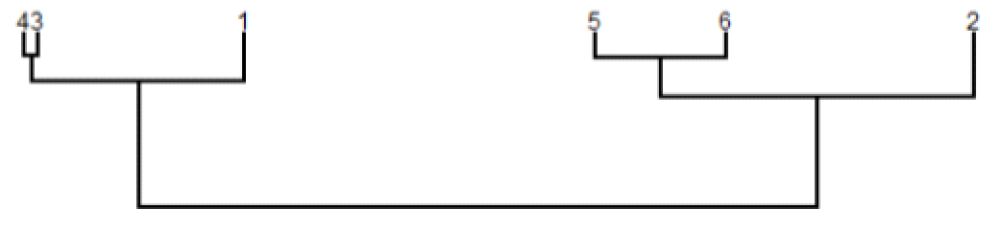
Trial Dendrogram
Leaves are typically reordered to prevent crossing of branches.
The ARM ST trial dendrogram constrains leaves to be aligned with trial means in the stability plot
(trial number)
(distance)
(trial mean)
(distance)

Slide 8
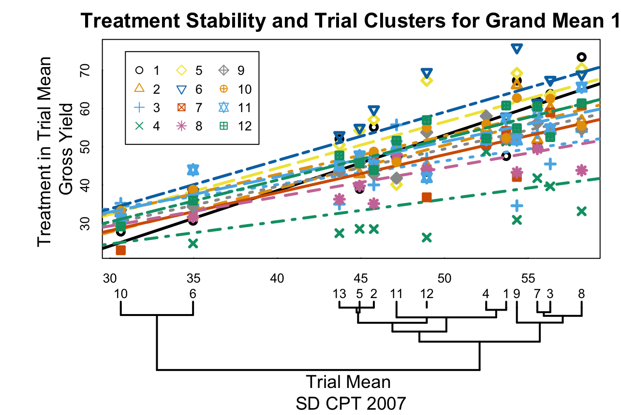
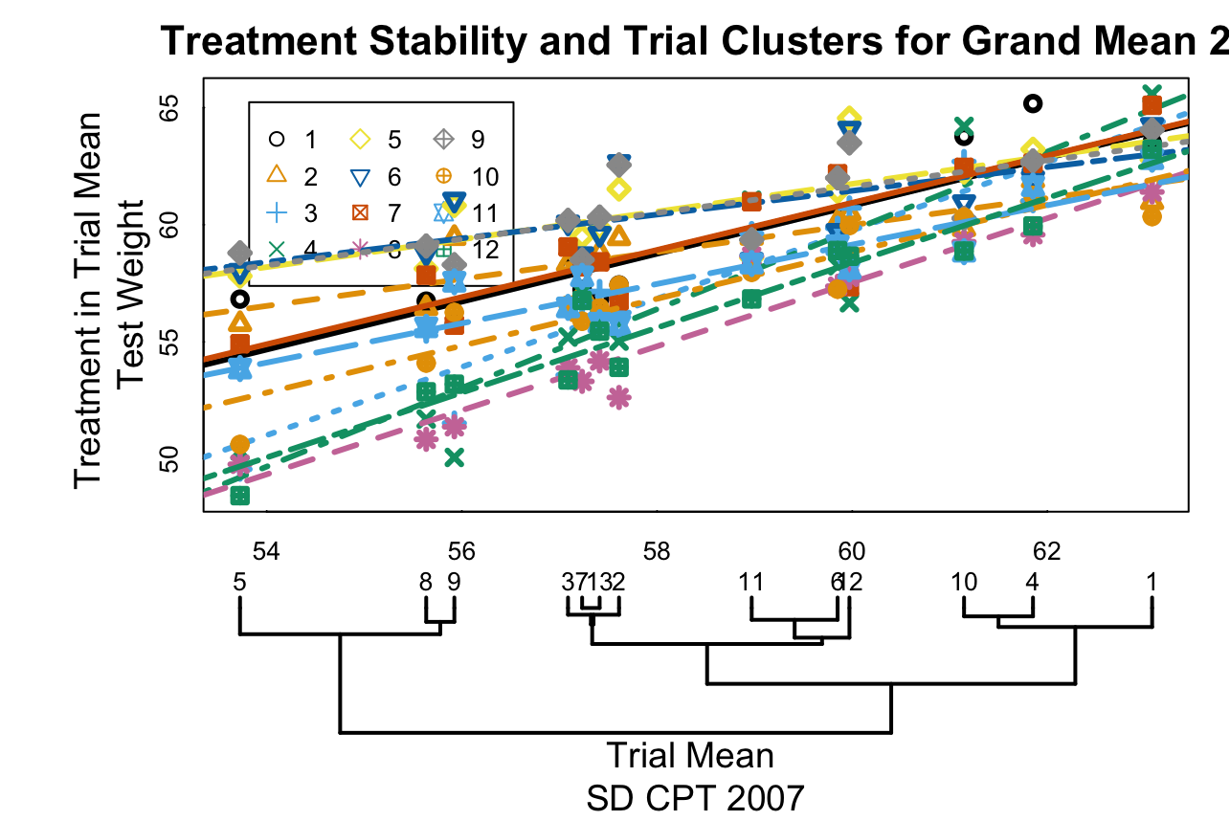
Types of interaction
How does the dendrogram relate to interaction?
Some interactions arise when treatment differences tend to diverge or converge with increasing trial means
(Data from South Dakota Crop Performance Trials, Winter Wheat, 2007)

Slide 9
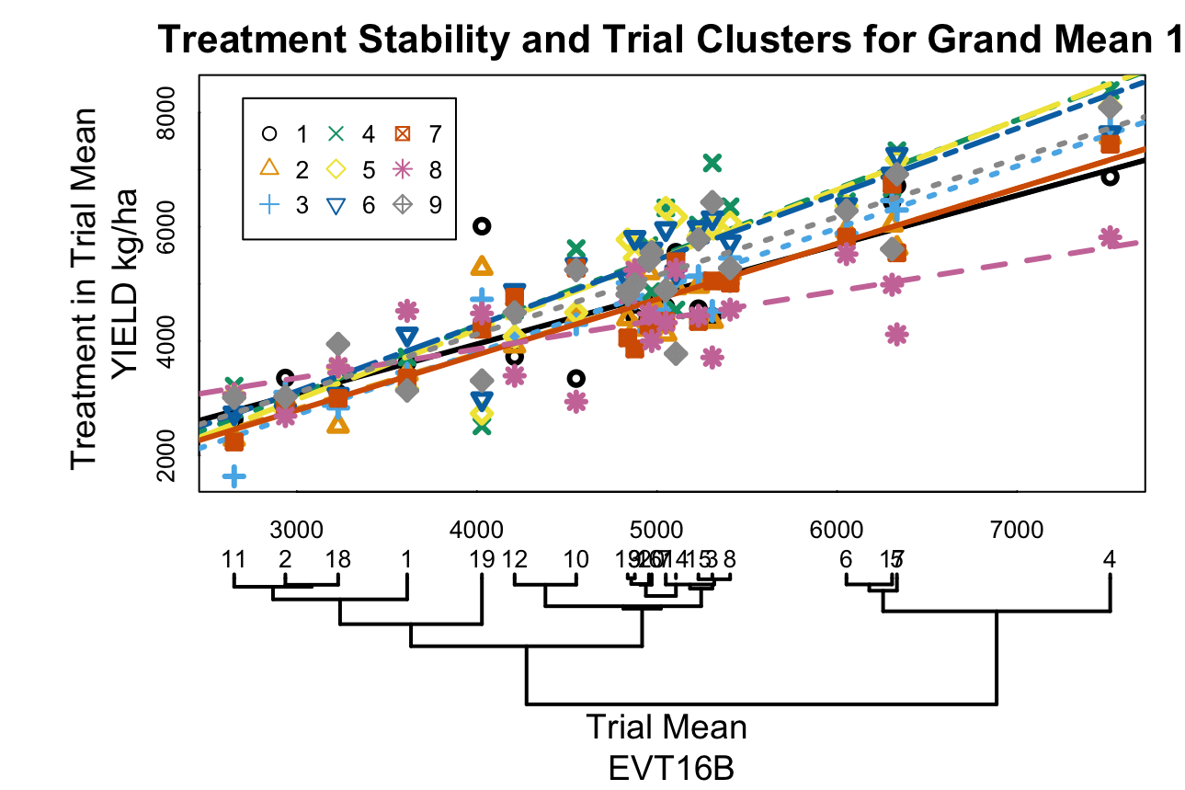
Types of interaction
Other interactions arise when some treatments perform inconsistently across trials
(Data from Cornelius et al., 1997)

Slide 10
Treatment x trial means
Treatment x trial means can be written as the sum of
μ grand mean
α_{ι} treatment effect
β_{ϕ} trial effect
θ_{ιϕ} treatment x trial interaction

Slide 11
Trial similarity
When distances are computed from treatment in trial means, treatment effects cancel and the distance is based on trial effect and treatment x trial interaction.

Slide 12
Trial similarity, no interaction
If interaction is absent, the similarity between two trials is proportional to the difference between trial effects only.

Slide 13
Decomposition of Interaction
Simple additivity
Random effect
Nonadditivity
Tukey 1949
Heterogeneous Slopes (Stability)
Mandel 1961
Other decompositions
Milliken and Johnson 1989, Cornelius, et al., 2001

Slide 14
Reference Dendrogram
To illustrate the effects on interaction on a treatment x trial dendrogram, produce a reference dendrogram based on additive treatment and trial effects only

Slide 15
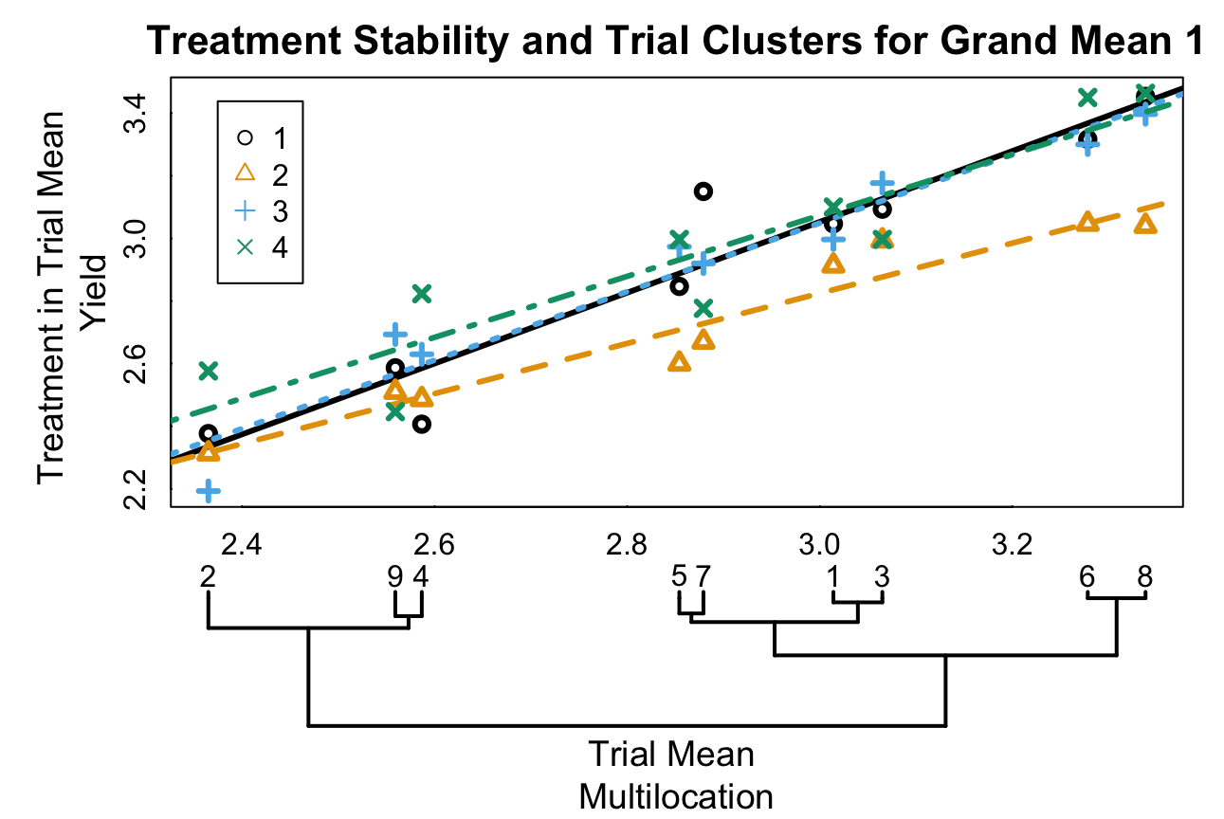
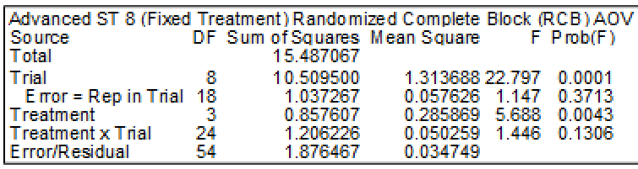
Simple Additivity
(Data from Littell et al., 1996)

Slide 16
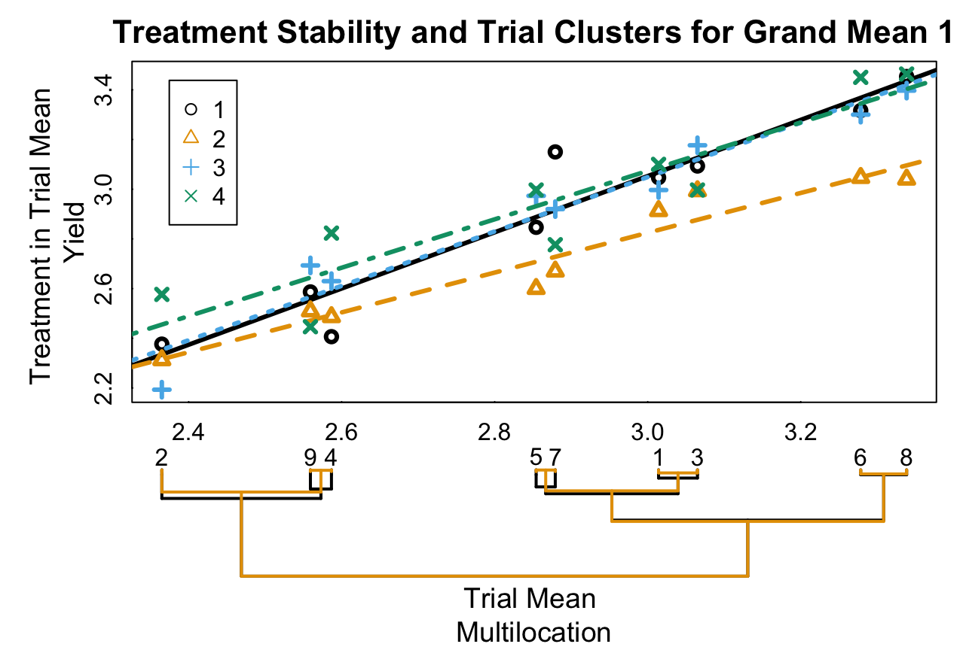
Simple Additivity
Reference dendrogram is nearly identical to the treatment x trial dendrogram

Slide 17
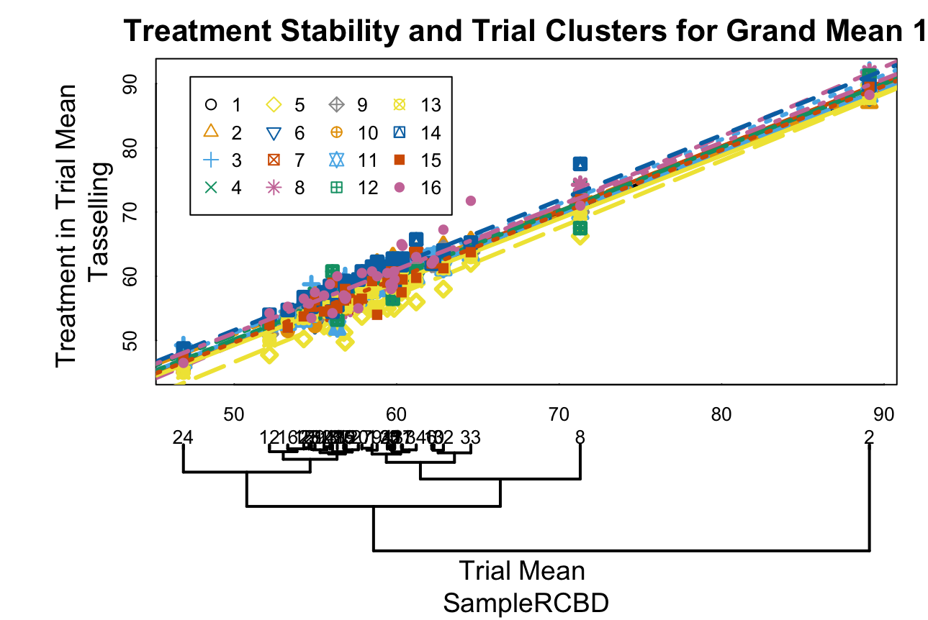
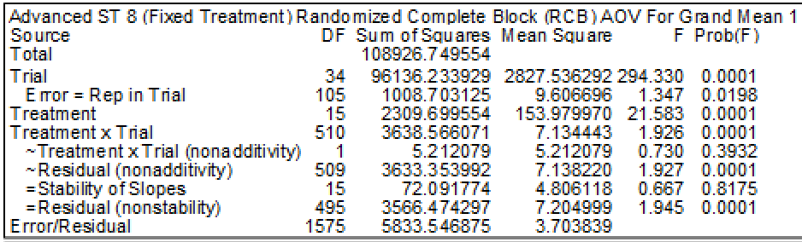
Random Effect
(Data from Vargas, 2013)

Slide 18
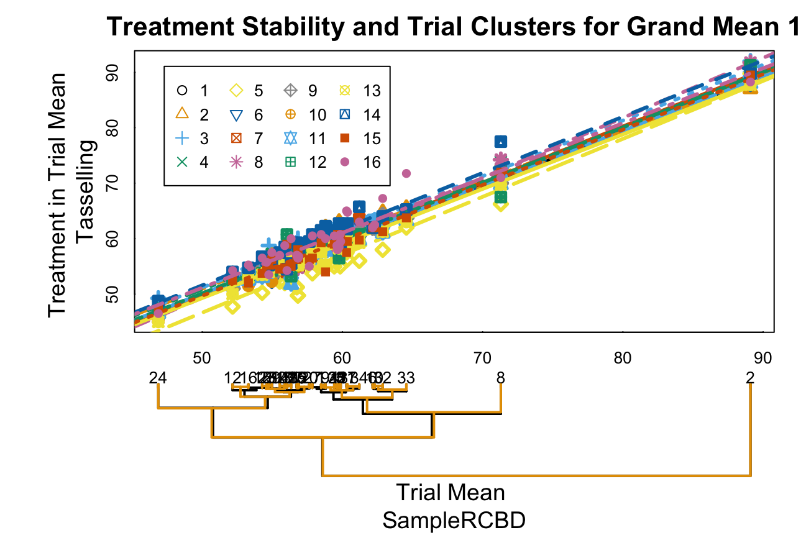
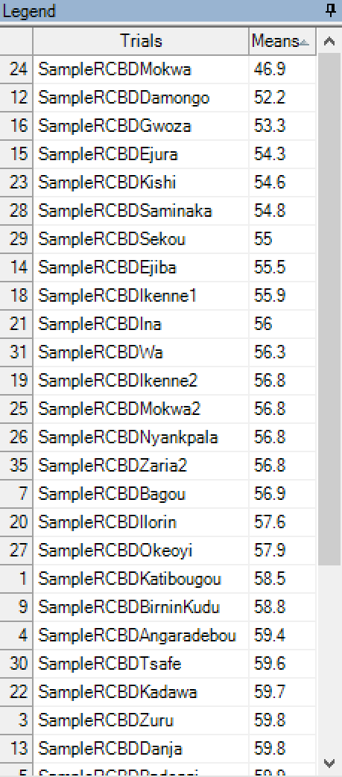
Random Effect
Interaction is present, but interaction effects cancel and dendrogram is preserved

Slide 19
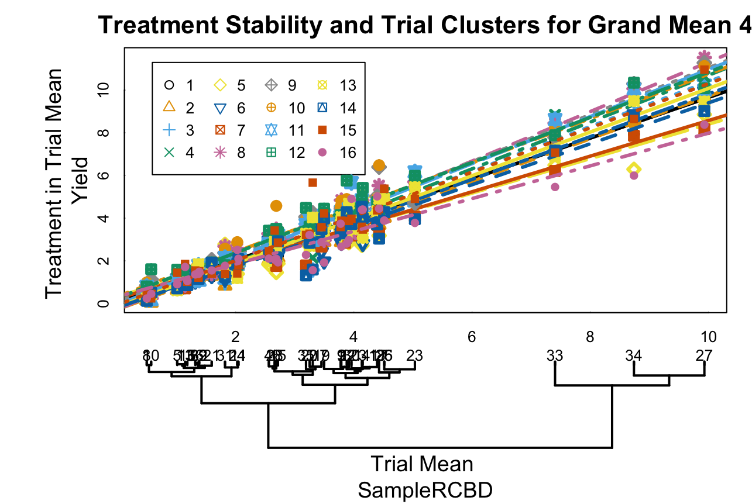
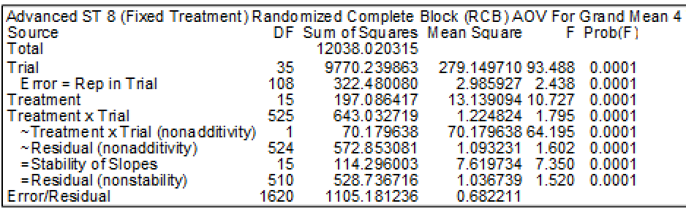
Nonadditivity
(Data from Vargas et al., 2013)

Slide 20
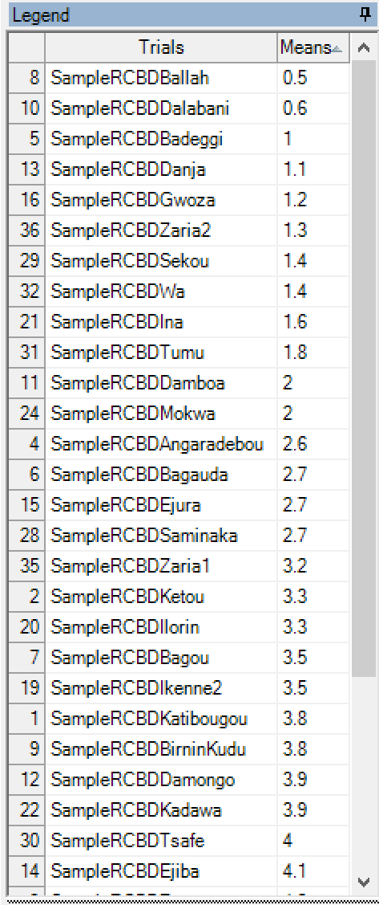
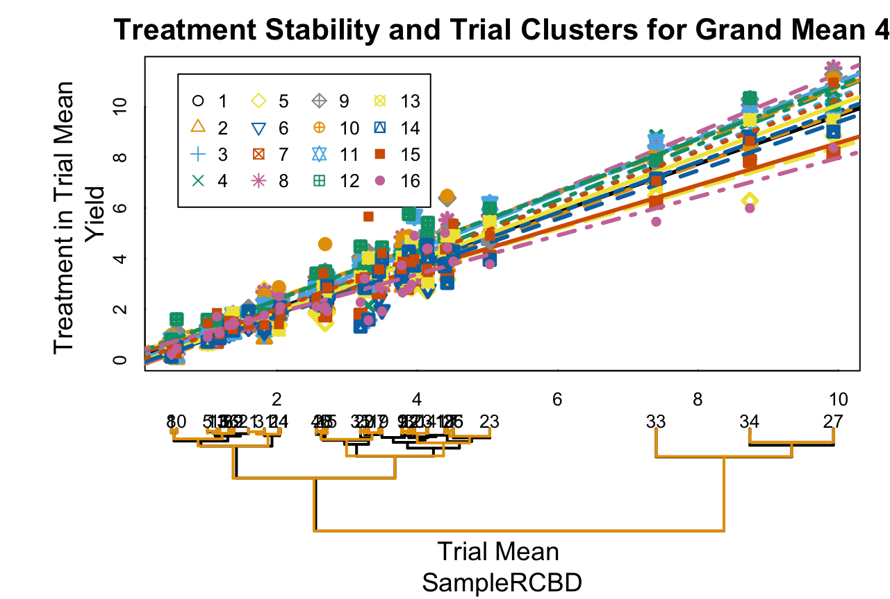
Nonadditivity
Major clusters, relative to trial means, are preserved

Slide 21
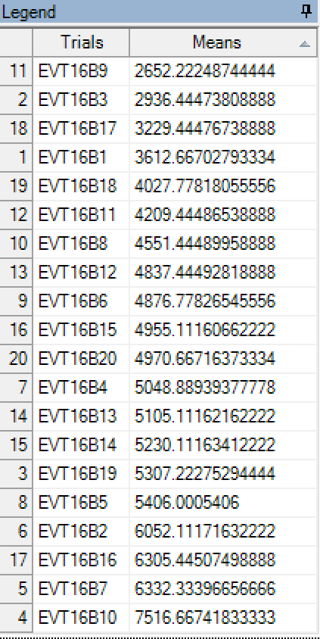
Complex Interaction
(Data from Cornelius et al., 1997)

Slide 22
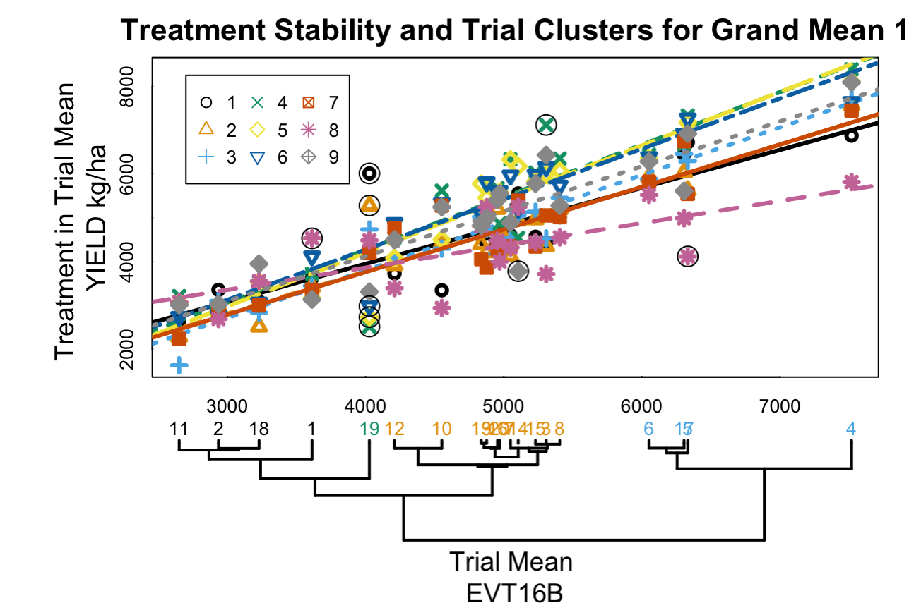
Complex Interaction
Circle the interaction outliers (2 s.d.)
Colors identify clusters
One trial that forms its own cluster contains most of the outliers

Slide 23
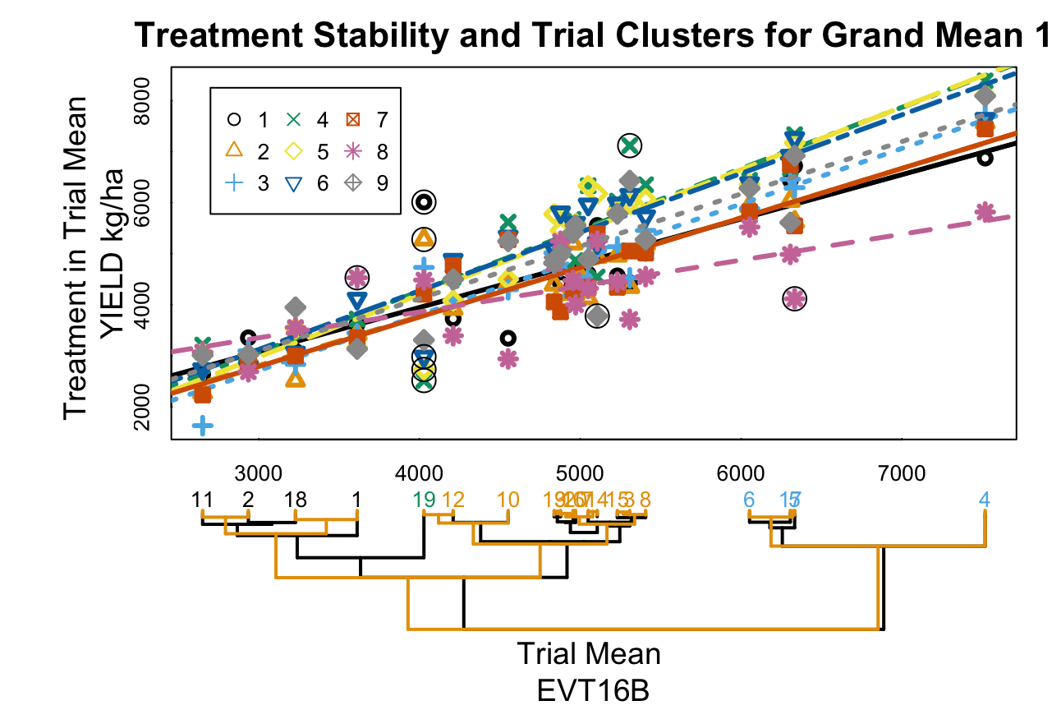
Complex Interaction
Reference dendrogram shows how interaction distorts treatment x trial dendrogram

Slide 24
Future Directions
Different decompositions
Linear-bilinear models (i.e. AMMI, SHMM)
Clustering methods and comparison of dendrograms
Automated analysis of trial groups
Covariate analysis
Use trial specific data to explain interaction
Geospatial maps

Slide 25
Thank You
References
www.gdmdata.com
J Tukey. One degree of freedom for non-additivity. Biometrics, 5(3):232–242, 1949
J Mandel. Non-additivity in the two-way analysis of variance. Journal of the American Statistical Association, 56(296), 1961.
G Milliken, and D Johnson. Analysis of messy data volume 2: nonreplicated experiments. Vol. 1. CRC Press, 1989.
P Cornelius, J Crossa, M Seyedsadr, G Liu, and K Viele. Contributions to multiplicative model analysis of genotype-environment data. Proceedings of the Annual Meeting of the American Statistical Association, 2001
R Littell, G Milliken, W Stroup, and R Wolfinger. SAS system for mixed models. SAS Institute, Cary, NC., 1996.
P Cornelius, J Crossa, and M Seyedsadr. Statistical tests and estimators of multiplicative models for genotype-by-environment interaction. In. M Kang and H Gauch. Genotype-by-environment interaction. CRC Press, 1996.
M Vargas, E Combs, G Alvarado, G Atlin, K Mathews, and J Crossa. META: A suite of SAS programs to analyze multienvironment breeding trials. Agronomy Journal, 105(1):11, 2013
http://igrow.org/agronomy/wheat/winter-wheat-variety-trial-results/

