Slide 1
Arduino Rover Project
Kush Kumar
Febuary 21st 2026

Slide 2
Project Description
We are building a simple, mobile, rover controlled by a remote ring. This was made using arduino code and simple mechanical assembly of parts such as motors, screws, nuts, wires, arduino board, etc.

Slide 3
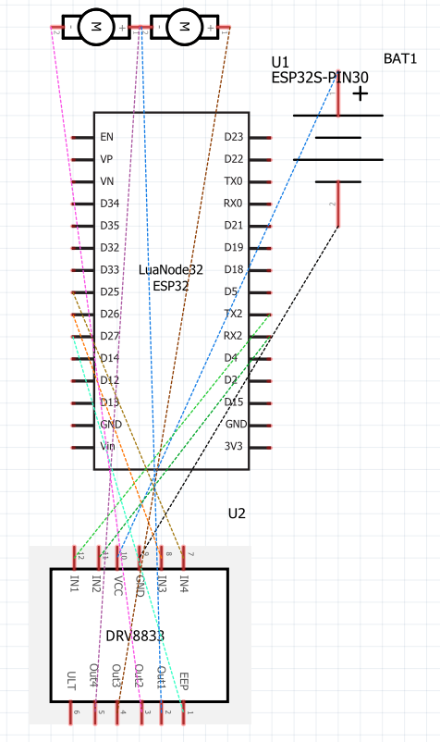
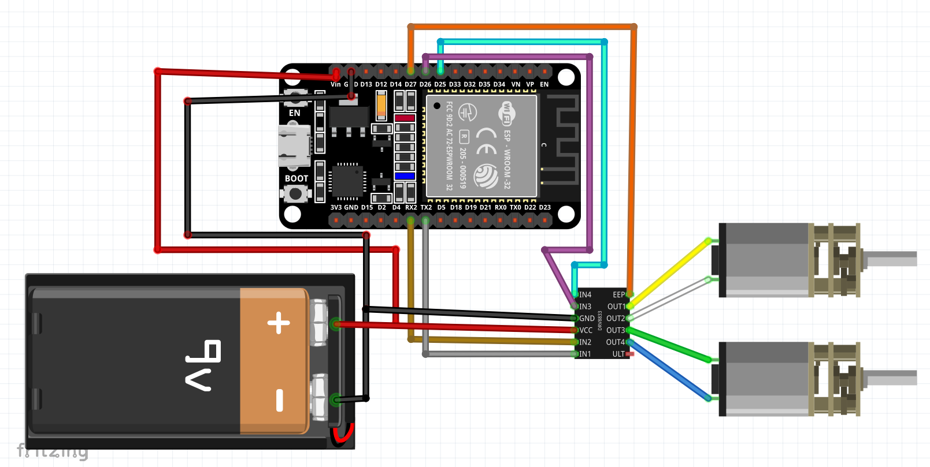
Connection Diagram
To plan out the parts assembly and wire connection I made schematics on how the wires would be connected as well as the components on the fritzing platform. Visualizing this allowed me to better understand my next steps as well as how each step helps and contributes to the end goal.

Slide 4
Dev, Pipeline
I have attached two motors on the bottom of the board so that the whells can be attached later.
I have attached two lego pieces such that they hold the board up so that it is slightly elevated
I have screwed two cylindrical parts which will hold the battery that powers the rover.

Slide 5
Components
DRV 8833
2 Motors
Rover Body(plastic board)
Technic Pieces
Arduino Shaft
ESP-32
9V Battery
Bluetooth Ring
USB Cable

Slide 6
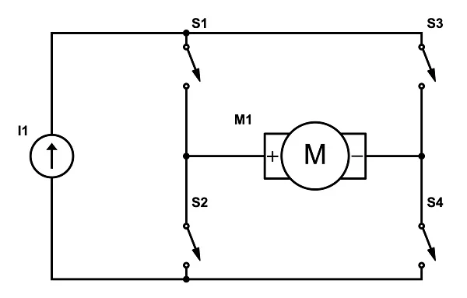
H Bridge
The H bridge is an electronical circuit that consists of four different switches that allow for bidirectional flow. This allows the motor to go forward, backward, or stop by switching the polarity of voltage applied.

Slide 7
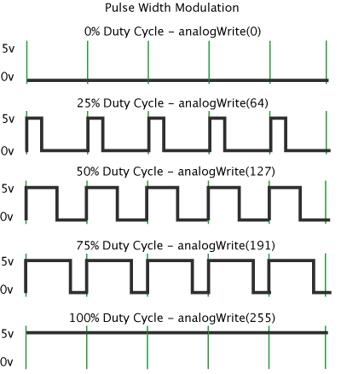
PWM
PWM, Pulse Width Modulation, is an efficient technique that allows analogue devices(LED’s, motors, etc. ) to be controlled by digital means. It works by rapidly switching the power on and off. We can not control the speed of a motor by changing the voltage as they are not linear; 50 percent voltage does not equate to 50 percent motor speed. To achieve this we control the ‘on time’ or the width of the pulse. The longer the pulse width, the higher the speed. This also applies to LED’s and their brightness.

Slide 8
Bluetooth Ring
I used a bluetooth ring that had 4 different buttons; forward, backward, left, right, stop.

Slide 9
Arduino C Code
#include <NimBLEDevice.h>bool doConnect = false;bool isConnected = false;uint32_t scanTimeMs = 5000;
enum CarCommand : uint8_t { STOP, FORWARD, BACKWARD, LEFT, RIGHT };CarCommand currentCommand = STOP;CarCommand prevCommand = STOP;
static bool clickActive = false;static uint8_t clickGroup = 0;static int16_t firstX = 0, firstY = 0;static int16_t lastX = 0, lastY = 0;static uint16_t activeCount = 0;
const char* targetAddrStr = "73:56:17:d7:39:ab";
static NimBLEAddress ringAddr;static bool haveRingAddr = false;
static void startScanNow();static void scanCompleteCB(NimBLEScanResults results);
static uint32_t lastScanKickMs = 0;static volatile uint32_t lastOnResultMs = 0;
static void resetBluetoothStack() { Serial.println("RESET BLE STACK...");
NimBLEScan* s = NimBLEDevice::getScan(); if (s) { s->stop(); s->clearResults(); }
NimBLEDevice::deinit(true); delay(80);
NimBLEDevice::init(""); NimBLEDevice::deleteAllBonds();
lastScanKickMs = millis(); lastOnResultMs = millis();
startScanNow();}
class ClientCallbacks : public NimBLEClientCallbacks { void onConnect(NimBLEClient* pClient) override { isConnected = true; } void onDisconnect(NimBLEClient* pClient, int reason) override { isConnected = false; startScanNow(); }} clientCallbacks;
class ScanCallbacks : public NimBLEScanCallbacks { void onResult(const NimBLEAdvertisedDevice* d) override {
lastOnResultMs = millis(); static uint32_t lastMarkMs = 0; uint32_t now = millis(); if (now - lastMarkMs > 250) { Serial.println("***"); lastMarkMs = now; }
if (!d->isAdvertisingService(NimBLEUUID((uint16_t)0x1812))) return;
std::string macStr = d->getAddress().toString(); Serial.print("\n Found device MAC: "); Serial.println(macStr.c_str());
if (strcasecmp(macStr.c_str(), targetAddrStr) != 0) return;
Serial.println("Found MY device!"); ringAddr = d->getAddress(); haveRingAddr = true;
NimBLEDevice::getScan()->stop(); doConnect = true; }} scanCallbacks;
static void startScanNow() { NimBLEScan* pScan = NimBLEDevice::getScan(); pScan->stop(); pScan->clearResults(); delay(10);
pScan->setScanCallbacks(&scanCallbacks, false); pScan->setInterval(100); pScan->setWindow(100); pScan->setActiveScan(false); Serial.println("Scan start"); pScan->start(scanTimeMs, scanCompleteCB, false); lastScanKickMs = millis();}
static void scanCompleteCB(NimBLEScanResults results) { if (!isConnected && !doConnect) { Serial.println("Scan ended -> restart"); startScanNow(); } else { Serial.println("Scan ended"); }}
static inline int16_t u16le_to_i16(uint8_t lo, uint8_t hi) { uint16_t u = (uint16_t)lo | ((uint16_t)hi << 8); return (int16_t)u;}
void notifyCB(NimBLERemoteCharacteristic* pRemoteCharacteristic, uint8_t* pData, size_t length, bool isNotify) { if (length < 8) return;
bool active = (pData[6] != 0); bool release = (pData[6] == 0 && pData[7] == 0);
if (active) { int16_t x = u16le_to_i16(pData[2], pData[3]); int16_t y = u16le_to_i16(pData[4], pData[5]);
if (!clickActive) { clickActive = true; clickGroup = pData[1]; firstX = lastX = x; firstY = lastY = y; activeCount = 1; } else { lastX = x; lastY = y; activeCount++; } return; }
if (release) { if (!clickActive) return;
if (clickGroup == 6 && activeCount == 1 && firstX == 1200 && firstY == 1012) { currentCommand = STOP; } else if (clickGroup == 7) { currentCommand = STOP; } else if (clickGroup == 4 || clickGroup == 5) { if (lastX < firstX) currentCommand = LEFT; else if (lastX > firstX) currentCommand = RIGHT; else currentCommand = STOP; } else if (clickGroup == 6) { if (lastY < firstY) currentCommand = FORWARD; else if (lastY > firstY) currentCommand = BACKWARD; else currentCommand = STOP; } else { currentCommand = STOP; }
Serial.print("CLICK: "); Serial.println((int)currentCommand);
clickActive = false; clickGroup = 0; activeCount = 0; return; }}
void connectToServer() { Serial.println("Start connectToServer"); doConnect = false;
if (!haveRingAddr) { Serial.println("No ringAddr -> rescan"); startScanNow(); return; }
NimBLEClient* pClient = NimBLEDevice::createClient(); pClient->setClientCallbacks(&clientCallbacks, false);
// connect по адресу if (!pClient->connect(ringAddr)) { NimBLEDevice::deleteClient(pClient); Serial.println("Client is not ready"); delay(100); resetBluetoothStack(); return; }
Serial.println("Client is ready");
NimBLERemoteService* pSvc = pClient->getService(NimBLEUUID((uint16_t)0x1812)); if (!pSvc) { Serial.println("HID service not found"); pClient->disconnect(); delay(100); resetBluetoothStack(); return; }
Serial.println("Get Characteristics"); auto chars = pSvc->getCharacteristics(true); int subCount = 0;
for (auto chr : chars) { if (chr->getUUID().equals(NimBLEUUID((uint16_t)0x2A4D)) && chr->canNotify()) { if (chr->subscribe(true, notifyCB)) { Serial.print("Subscribed to Handle: 0x"); Serial.println(chr->getHandle(), HEX); ++subCount; } else { Serial.print("Failed to subscribe to Handle: 0x"); Serial.println(chr->getHandle(), HEX); } } }
if (subCount == 0) { Serial.println("No notifiable 0x2A4D characteristic found!"); pClient->disconnect(); delay(100); resetBluetoothStack(); return; }
isConnected = true;}
int stopCounter = 0; // global varint in1 = 25; // motorAbool isDriverOn = false;int state = 0; // 0 means stop, 1 will be forwards, 2 will be backwards, 3 will be left, and 4 will be right.
// void driverOff(){// digitalWrite(27, LOW); // eep// digitalWrite(2, LOW);// isDriverOn = false;// }
// void driverOn(){// digitalWrite(27, HIGH); // eep// digitalWrite(2, HIGH);// isDriverOn = true;// }
void goForward() { // function that allows motors to move in forward direction // if(!isDriverOn){ // driverOn(); // } digitalWrite(27, HIGH); analogWrite(17, 0); analogWrite(16, 255); analogWrite(25, 255); analogWrite(26, 0);}
void goBackward() { // function that allows motors to move in backward direction by swapping value from the previous function // if(!isDriverOn){ // driverOn(); // } digitalWrite(27, HIGH); analogWrite(17, 255); analogWrite(16, 0); analogWrite(25, 0); analogWrite(26, 255);}
void goRight() { // if(!isDriverOn){ // driverOn(); // } digitalWrite(27, HIGH); analogWrite(17, 0); analogWrite(16, 255); analogWrite(25, 0); analogWrite(26, 255);}
void goLeft() { // if(!isDriverOn){ // driverOn(); // } digitalWrite(27, HIGH); analogWrite(17, 255); analogWrite(16, 0); analogWrite(25, 255); analogWrite(26, 0);}
void stopAll(){ // this function sets all movements to zero so motors stop. // if(!isDriverOn){ // driverOn(); // } analogWrite(16, 0); analogWrite(17, 0); analogWrite(25, 0); analogWrite(26, 0); digitalWrite(27, LOW);}
void setup(){ Serial.begin(9600); delay(200); NimBLEDevice::init(""); NimBLEDevice::deleteAllBonds(); lastScanKickMs = millis(); lastOnResultMs = millis(); startScanNow();
pinMode(2, OUTPUT); pinMode(27, OUTPUT); // eep pin pinMode(26, OUTPUT); // motorA pinMode(25, OUTPUT); // motorB pinMode(16, OUTPUT); // rx pin pinMode(17, OUTPUT); // tx pin delay(10); // driverOn();
digitalWrite(2, LOW);}void loop(){ if (doConnect) { connectToServer();
} if (isConnected) { digitalWrite(2, HIGH); if (currentCommand == FORWARD) { Serial.println("currentCommand == FORWARD"); if(prevCommand != FORWARD){ goForward(); } } else if (currentCommand == BACKWARD) { Serial.println("currentCommand == BACKWARD"); if(prevCommand != BACKWARD){ goBackward(); } } else if (currentCommand == LEFT) { Serial.println("currentCommand == LEFT"); if(prevCommand != LEFT){ goLeft(); } } else if (currentCommand == RIGHT) { Serial.println("currentCommand == RIGHT"); if(prevCommand != RIGHT) { goRight(); } } else if (currentCommand == STOP) { Serial.println("currentCommand == STOP"); if(prevCommand != STOP) { stopAll(); } } prevCommand = currentCommand; delay(50); } uint32_t now = millis(); if (!isConnected && !doConnect && (now - lastScanKickMs > 2000)) { lastScanKickMs = now;
if (now - (uint32_t)lastOnResultMs > 6000) { Serial.println("WD: scan stuck -> reset BLE"); resetBluetoothStack(); } else { if (!NimBLEDevice::getScan()->isScanning()) { Serial.println("WD: scan not running -> restart"); startScanNow(); } } }
delay(2);}

Slide 10
3D Modelling

