Slide 1



WebCT
Fully Featured Browser-Based Interactive X-Ray Simulations for Scan Planning and Training
Mr Iwan T. Mitchell¹, Dr Franck Vidal¹, Dr Llion Evans², Dr Simon Middleburgh¹, Mr Fabio Martini¹, Mr Gareth Stephens¹
¹ School of Computer Science & Electronic Engineering, Bangor University
² Collage of Engineering, Swansea University

Slide 2
X-Ray Simulation
X-Ray simulation is increasing in popularity with the push towards digital twinning, component testing and machine learning.
Simulated results can answer feasibility questions without requiring beam time. Can you scan this component on your setup? What is the best tube voltage? Etc.
Monte-Carlo methods are highly accurate physically-based approaches, but take a very long time for even a single projection (more than hours on a supercomputer)
This is a very large bottleneck

Slide 3
GPU-Accelerated Simulations
Raytracing is an approach to X-Ray simulation that does not take into account scattering.
Raytracing on CPU is quite slow…
… But GPUs are built for parallelism and are super fast!
gVirtualXRay is an open-source library that is able to provide realtime simulated X-Ray rendering with no cost.
gVXR supports a wide range of languages for its C++ API, including python.
This makes gVXR easily scriptable and integrated alongside popular data analysis toolsets.

Slide 4


Digital X-Ray Ecosystem
Beam Spectra Generation
Fast X-Ray Simulation
CT Reconstruction Libraries
Xpecgen
ASTRA Tomography Toolbox
TIGRE GPU Reconstruction Library
Spekpy

Slide 5
WebCT: What is it?
WebCT: “Interactive Web UI for X-ray CT with Real-Time Results”
WebCT provides an easy-to-learn User Interface for simulated X-Ray capture to reconstruction.
Aims to provide a fully-featured experience while not being complex for those new to X-Ray tomography.
An open-source useful tool for scan planning and training.
… Why talk about it, when you can show it?

Slide 6
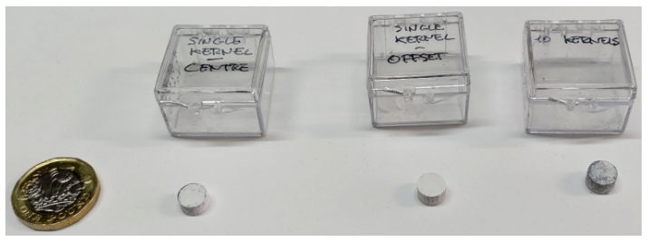
Fuel Pellet Case Study
Nuclear fuel must adhere to strict standards to ensure a safe operation within a reactor.
We can use X-ray CT to inspect pellets, but a high X-ray opacity of uranium makes scanning challenging.
The use of ZrO2 as a surrogate material is quite popular to replicate the behaviour of UO2 dust during manufacturing.
Both real and surrogate pellets contain ZrB2 ceramic kernels we want to detect automatically, but the outer material attenuates more than the pellets.
However…
We have no experience in X-raying surrogate pellets
We don’t know what power we would require
We don’t know what detector resolution is needed
Etc…

Slide 7
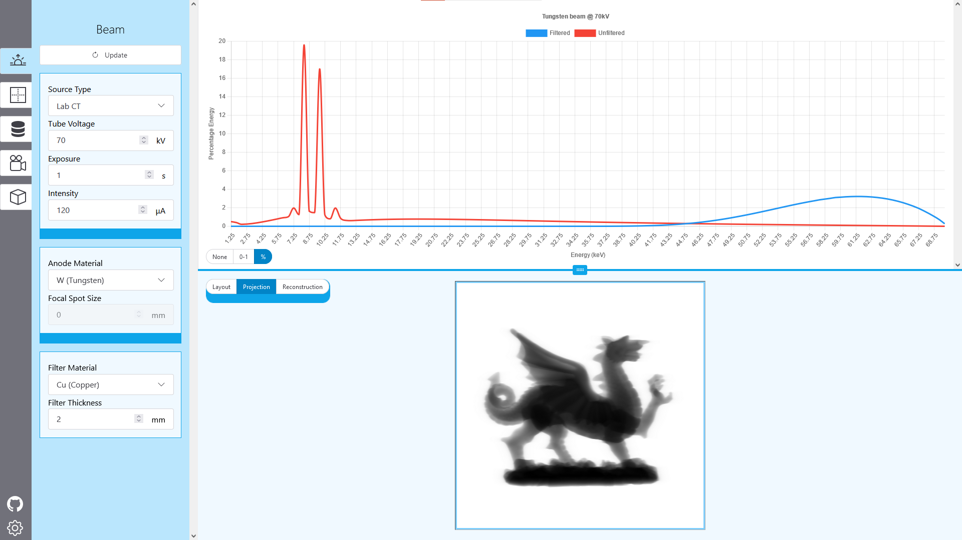
User Interface
Section Pane
Section Tabs
Global preview pane
Section
Parameters

Slide 8
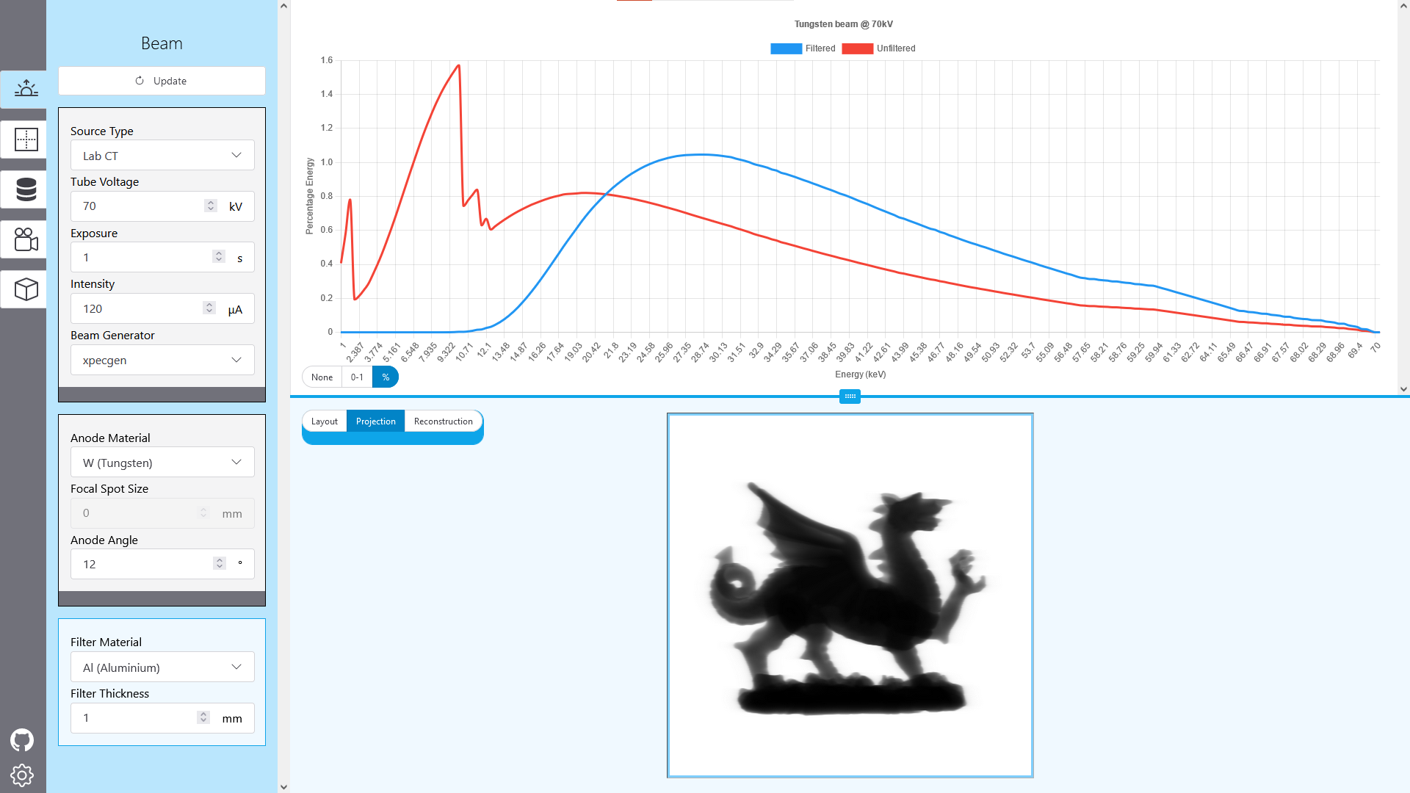
Beam Source
X-Ray Spectra Graph
Source type and generator
Anode parameters
Filter

Slide 9
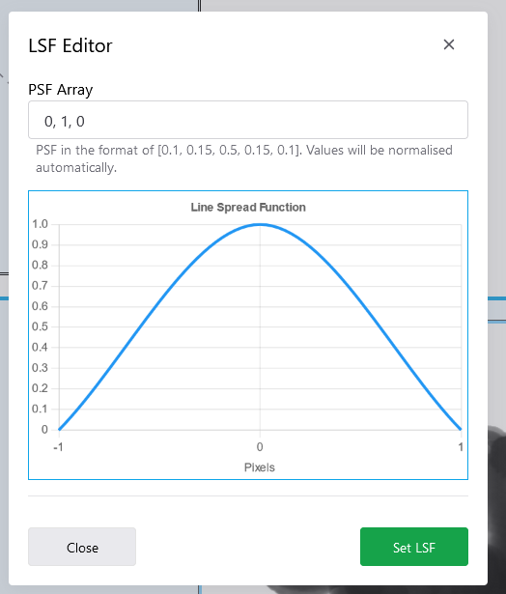
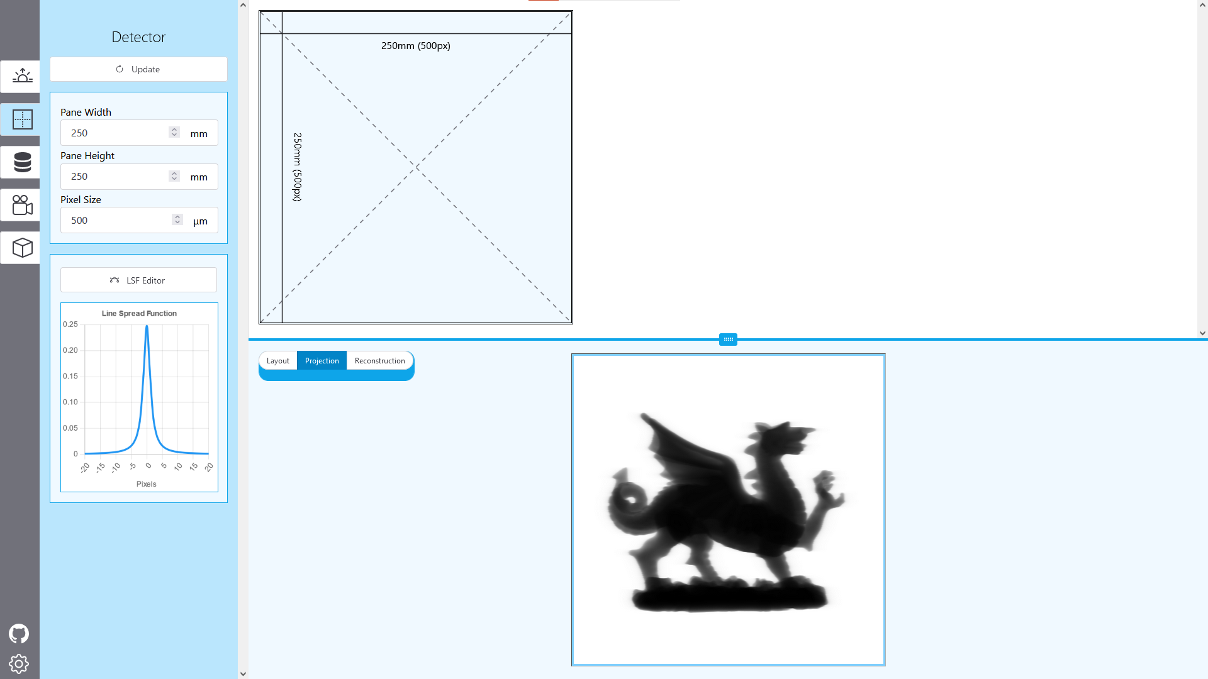
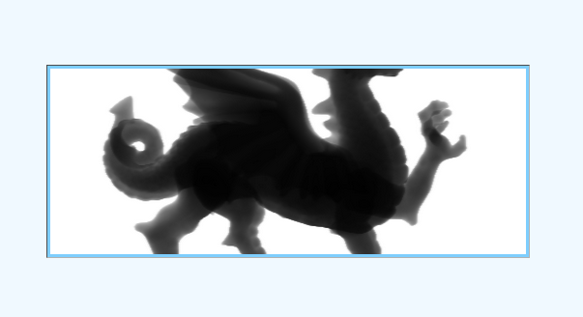
X-Ray Detector
Resizing Detector Visualisation
Resizing Detector Visualisation
Resizing Detector Visualisation
LSF Editor
Live Size Preview

Slide 10
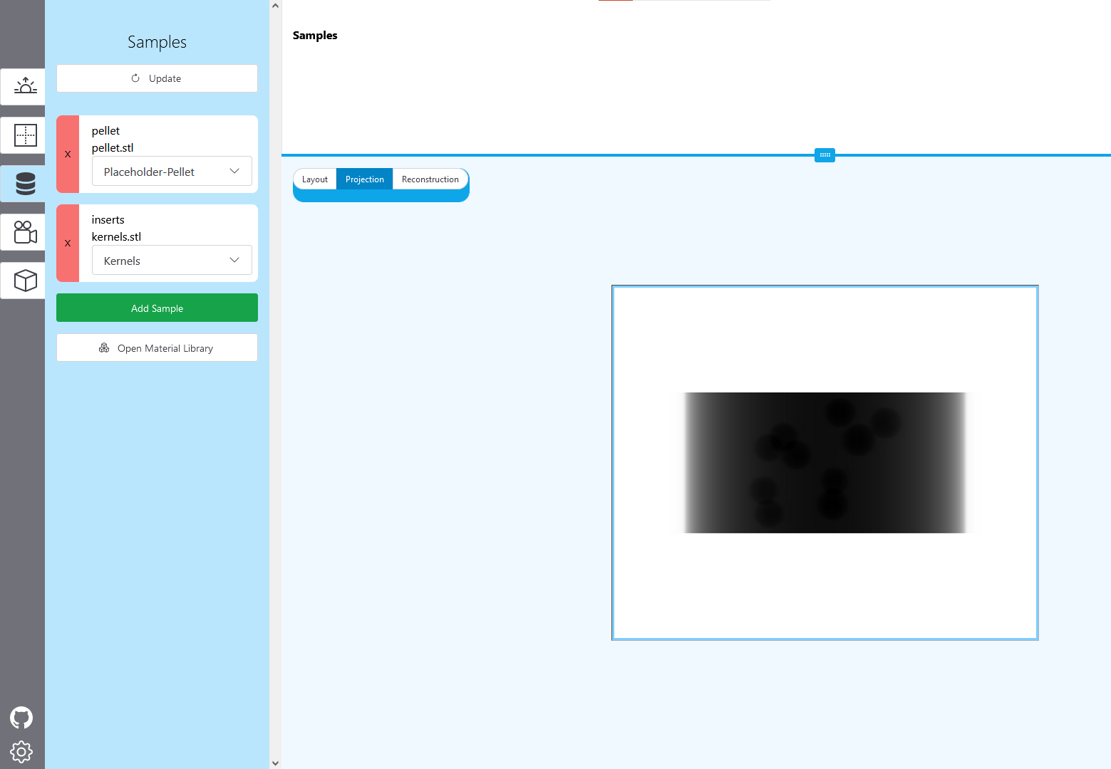
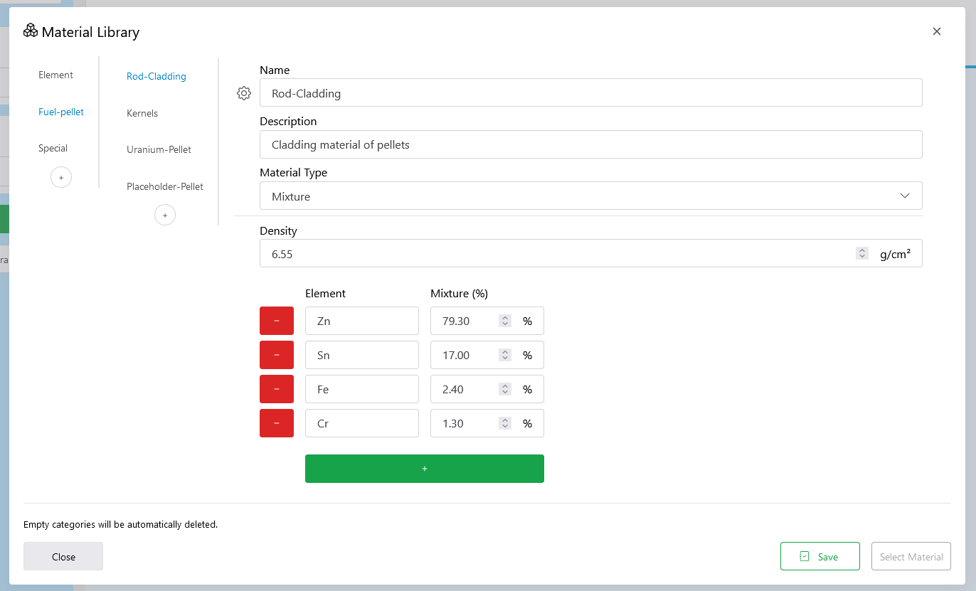
Samples and Materials
Sample cards
Material Library
Categories and Materials
Mixture editor

Slide 11
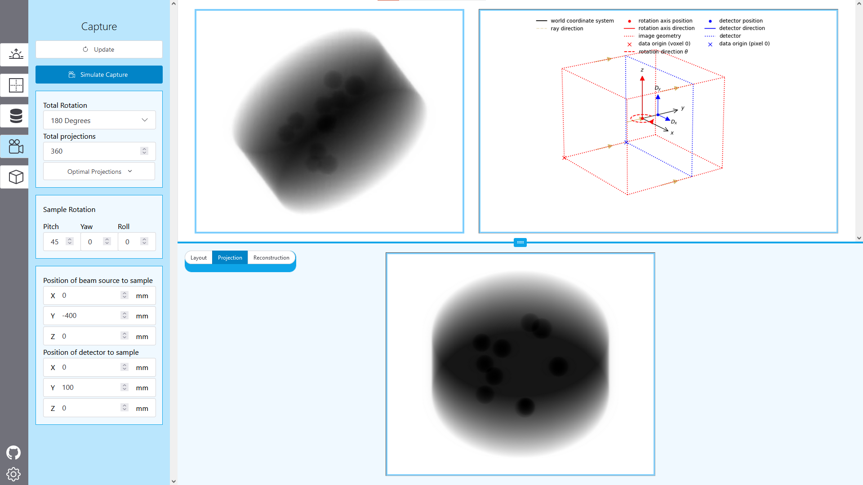
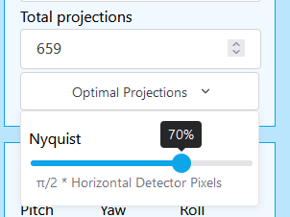
Capture Plan
Animated capture preview
Geometry Diagram
Nyquist projection count slider
Free axis translation of source and detector

Slide 12
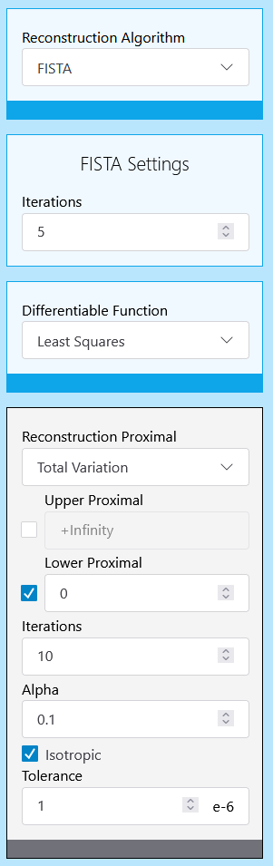
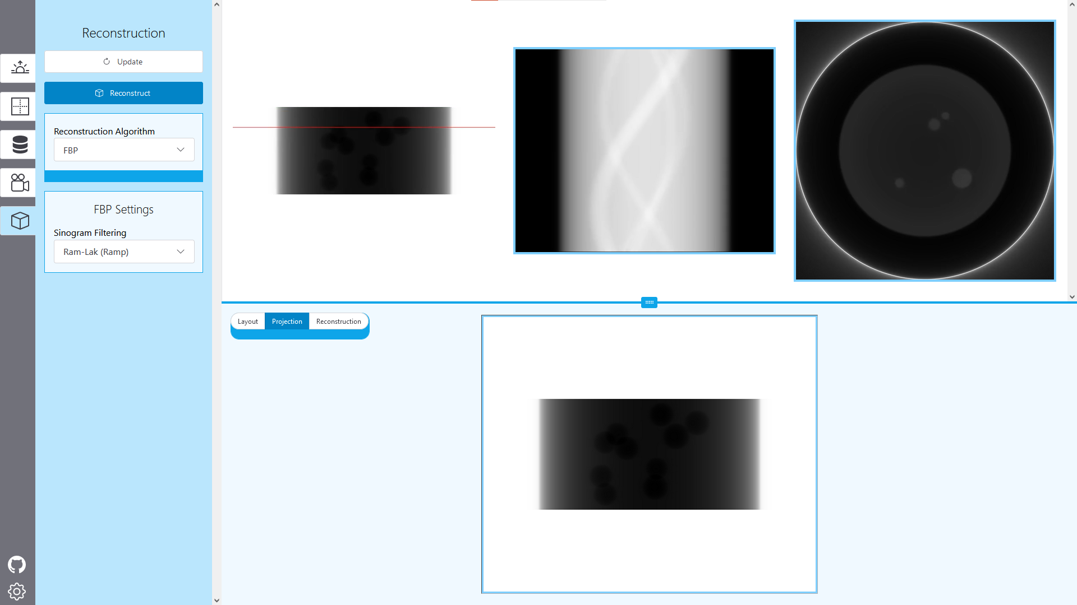
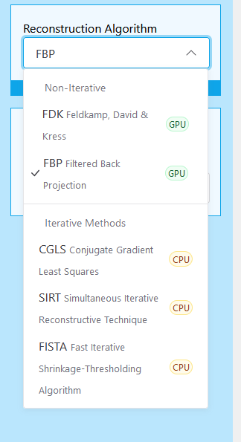
Reconstruction
Animated reconstruction preview
Support for many different reconstruction methods
All parameters exposed for even iterative methods

Slide 13

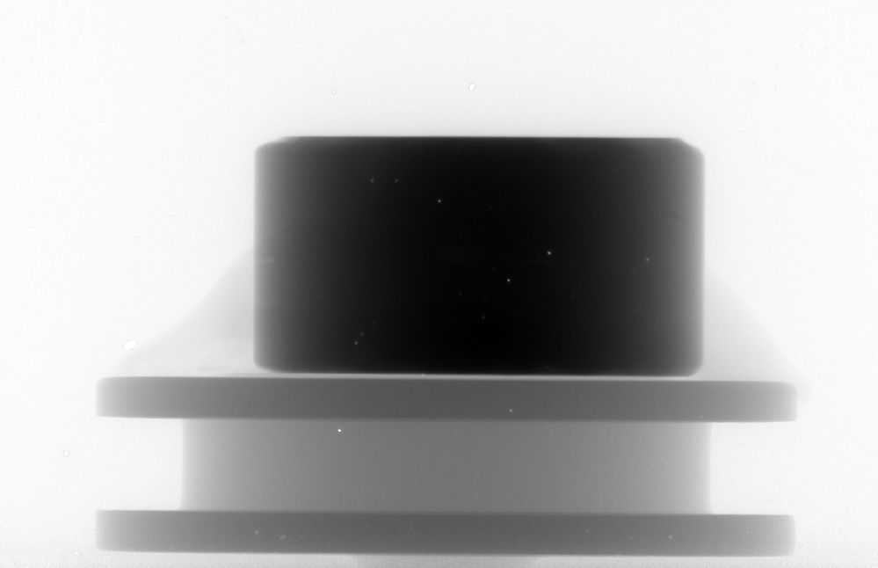
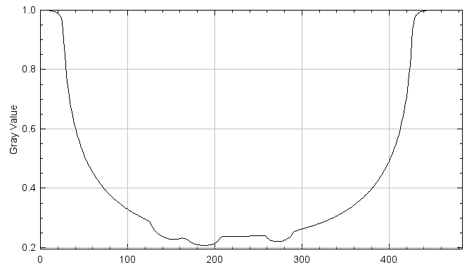
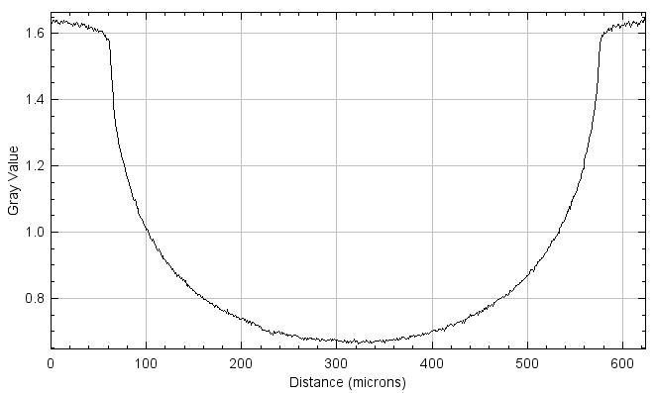
Case Study Results
Simulated Surrogate Sample | Real Scan at Diamond

Slide 14
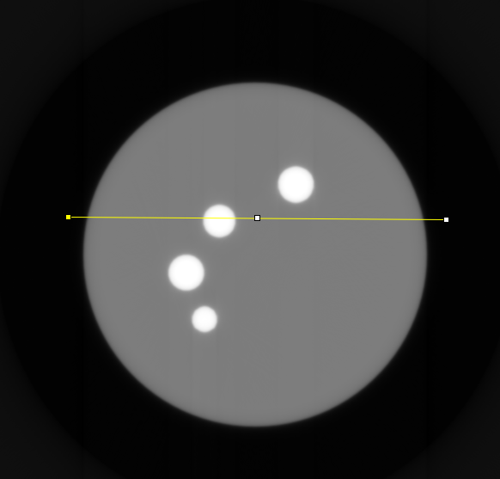
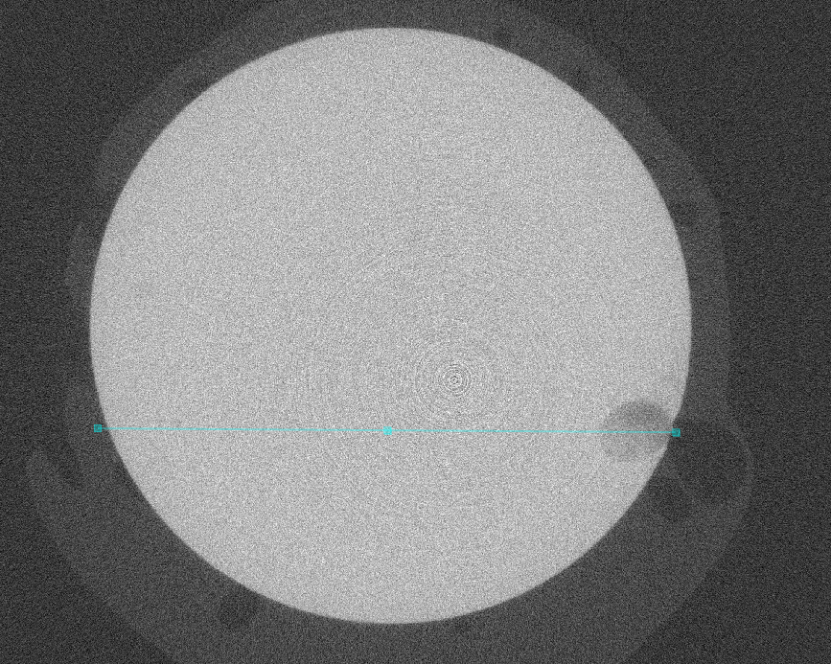
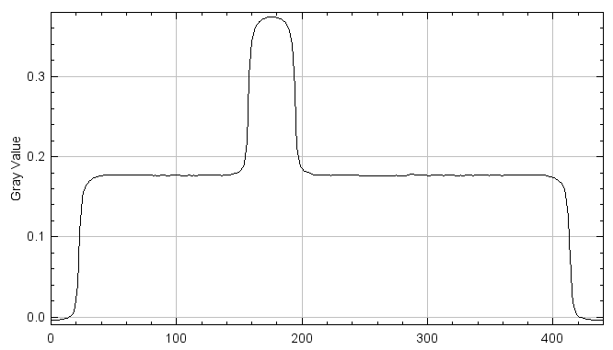
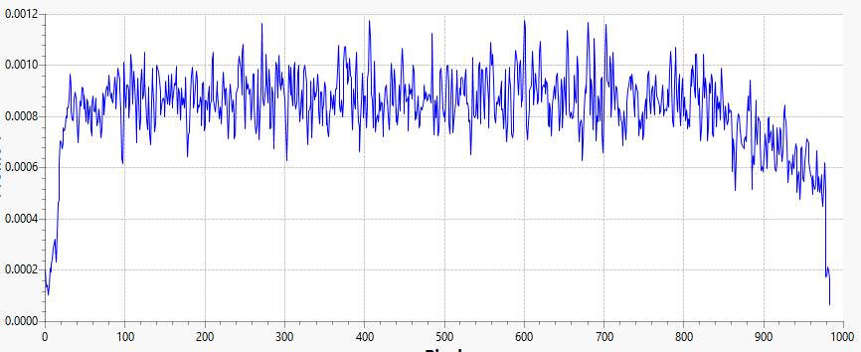
Case Study Results
Simulated Surrogate Sample | Real Scan at Diamond
Not a kernel
Resultant grey value much smaller than expected assumedly due to powder compaction

Slide 15
Accessible Configuration
WebCT aims to fit a specific task and understands it can’t do everything.
All the configuration settings are exportable into WebCT’s JSON format, and even GVXR JSON format for use with your own python applications.
Reproducible and shareable environments!
This makes WebCT powerful, interactively setup your scan geometry with WebCT, and use a simple python script to simulate hundreds of samples…
WebCT also supports importing other system’s configurations.
We can load in a GVXR setup, and support for other scanning metadata formats (XTEK, etc) is coming soon!

Slide 16
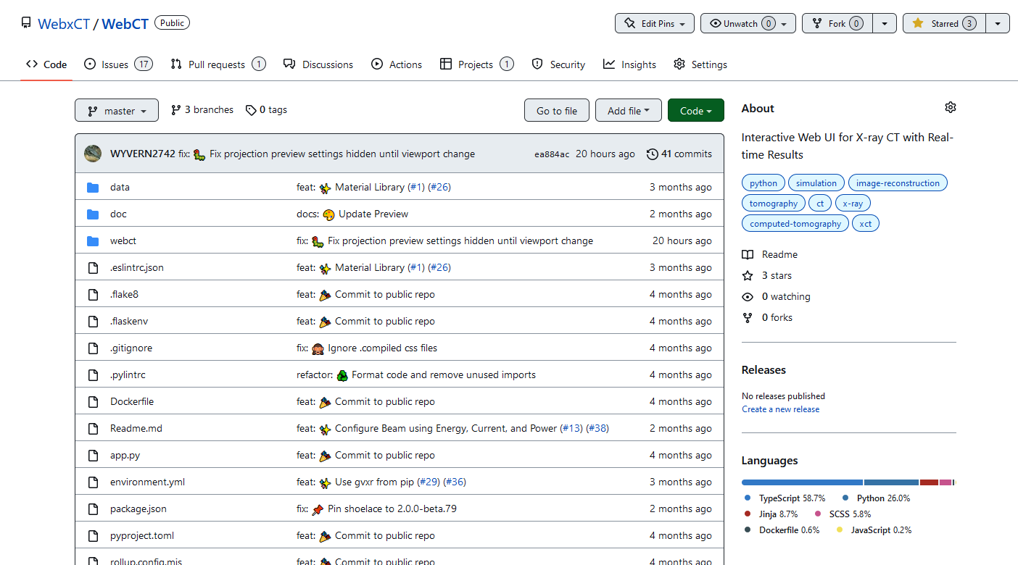
Open Source
Development all open on Github
https://webct.io

Slide 17
Thanks for Listening

