Slide 1
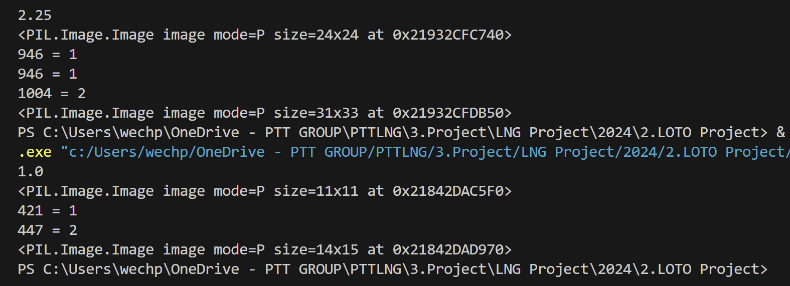

Slide 2
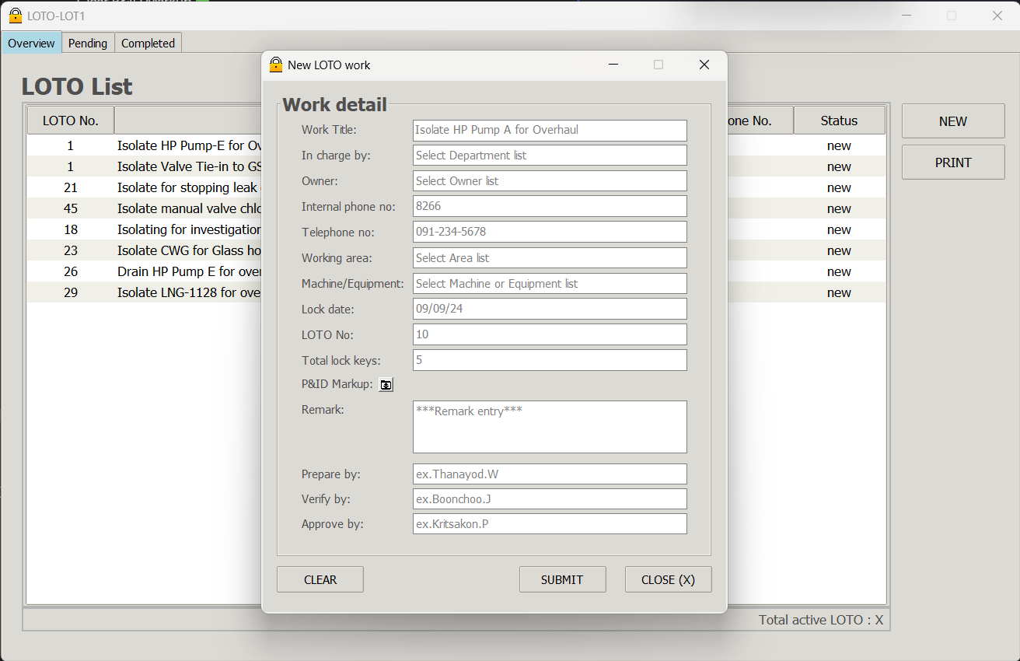

Slide 3
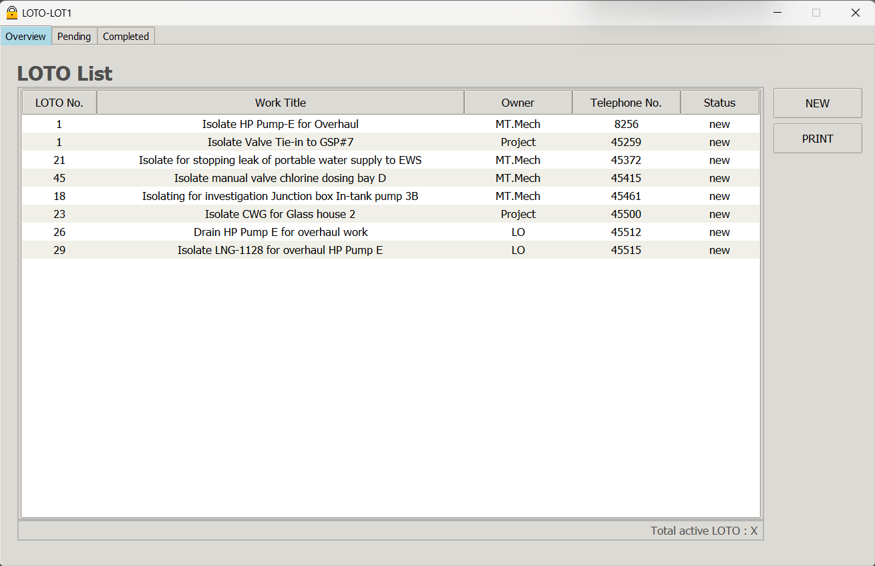
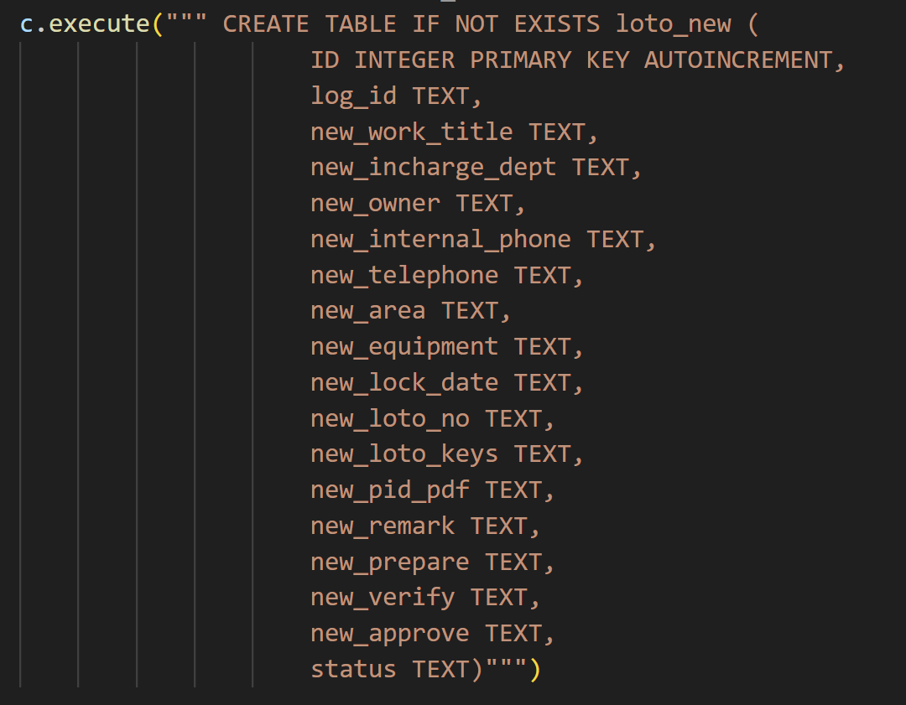
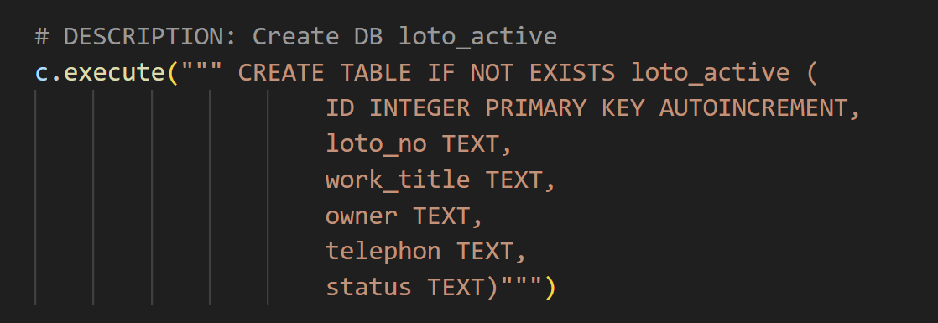

Slide 4
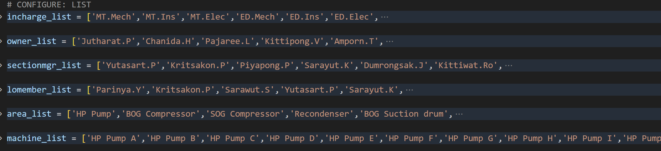

Slide 5
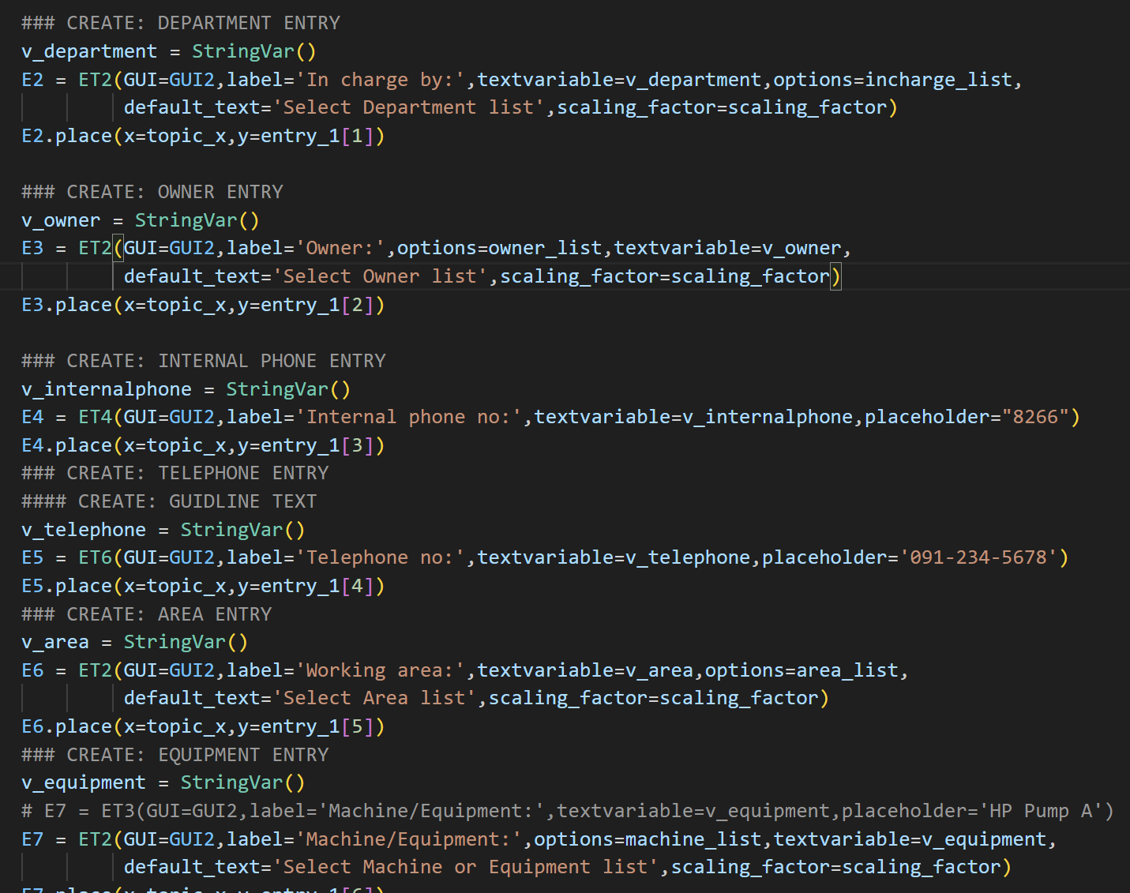

Slide 6
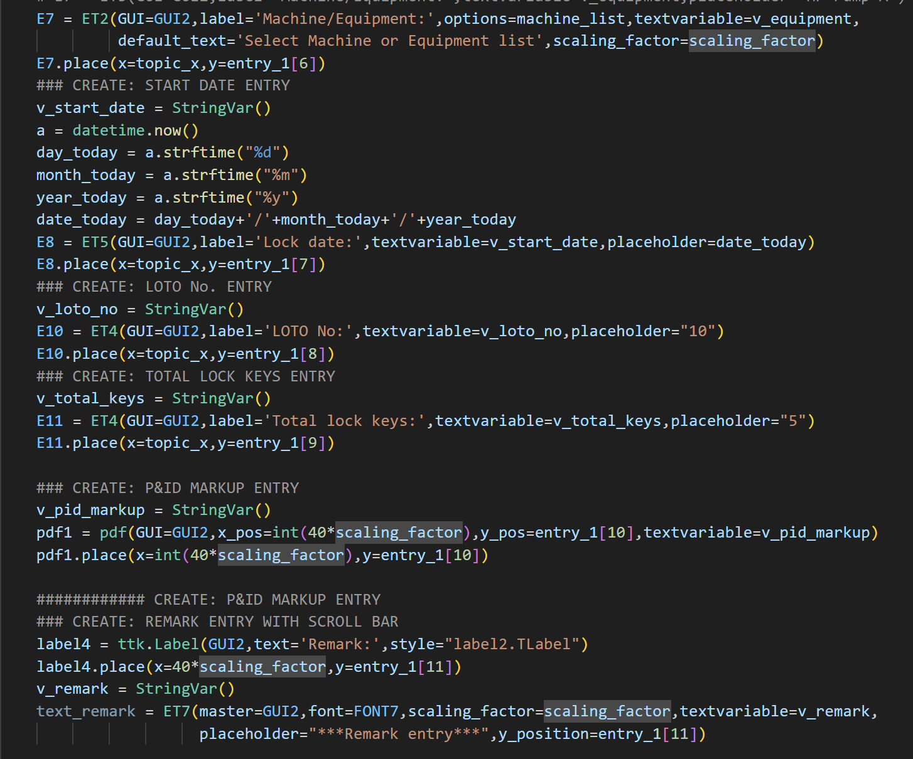

Slide 7
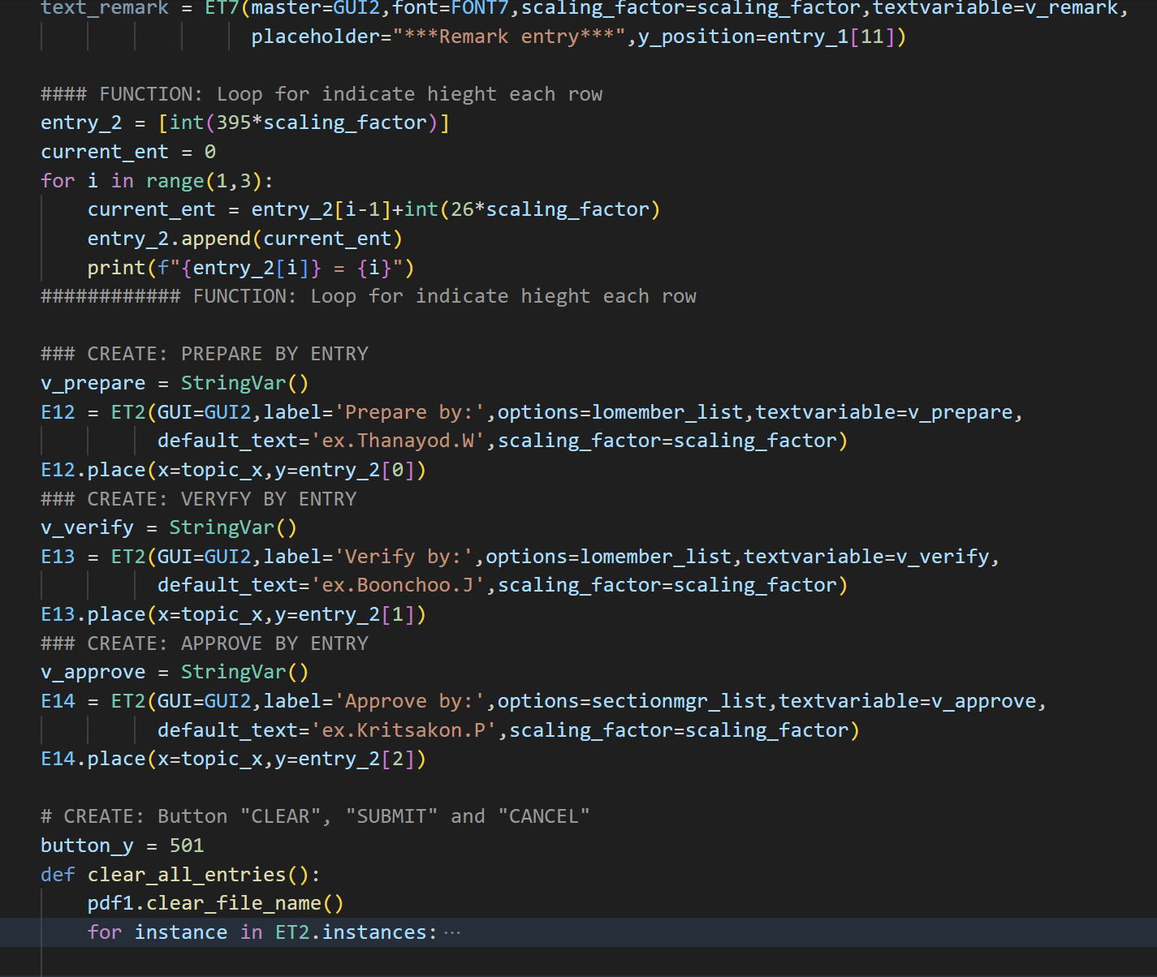

Slide 8
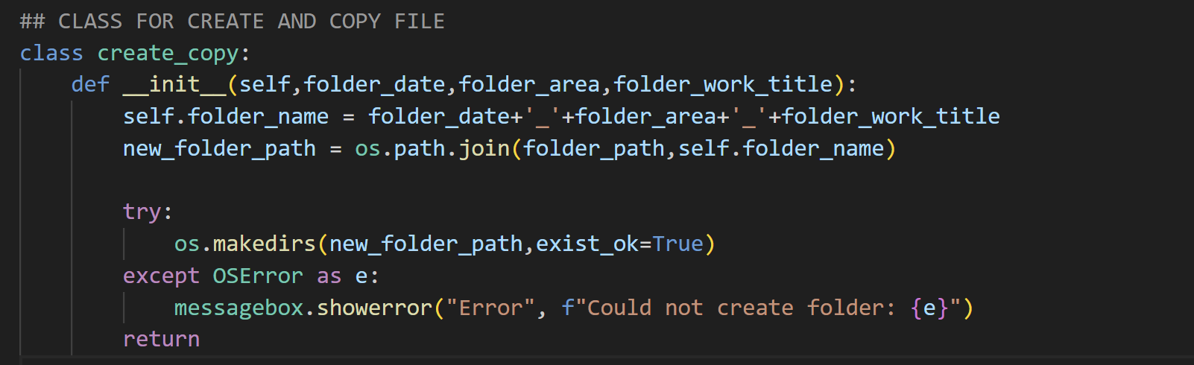

Slide 9
 | Lock box No. | Job description | Lock by | In charge | Effective date
1 | 1 | Isolate Valve Tie-in to GSP#7 | Weerawat.N | Project | 29/11/23
2 | 21 | Isolate for stopping leak of portable water supply to EWS | Thanadon.T | MT.Mech | 21/03/24
3 | 45 | Isolate manual valve chlorine dosing bay D | Komtanut.c | MT.Mech | 03/05/24
4 | 18 | Isolating for investigation Junction box In-tank pump 3B | Veeraphat.K | MT.Mech | 18/06/24
5 | 23 | Isolate CWG for Glass house 2 | Suphachot.P | Project | 27/07/24
6 | 7 | Isolate for replace new wash water pump A | Nawin.S | Project | 02/09/24
7 | 5 | overhaul HP Pump I | Weerawat.N | MT.Mech | 29/08/24
8 | 28 | Sanding off rust and painting structure ORV Unit G | boonchoo.J | MT.Mech | 30/08/24
9 | 27 | Yearly PM ULA berth#3 | boonchoo.J | MT.Mech | 30/08/24
10 | 6 | Isolate DFBS-B for Support Wash water pump A work | Thanadon.T | Project | 02/09/24
11 | 25 | Rust removal and painting structure ORV-C | Nawin.S | MT.Mech | 09/09/24
12 | 8 | Isolate Metering Run B for Inst. calibration | Boonchoo.J | MT.Ins | 08/09/24

