Slide 1
One Slave
One Master

Slide 2
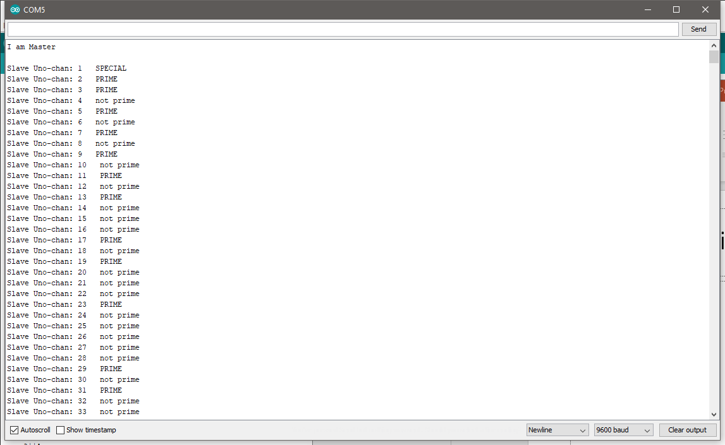

Slide 3
Master Code
#include <Wire.h>
int LED = 13;
unsigned long start, finished, elapsed;
long a = 1;
char c;
void setup() {
pinMode (LED, OUTPUT);
Serial.begin(9600); /* begin serial comm. */
Wire.begin(); /* join i2c bus as master */
Serial.println("I am Master");
start = micros();
Serial.println();
}
void loop() {
// receive from slave
Serial.print("Slave Uno-chan: ");
Serial.print(a);
//send to slave
Wire.beginTransmission(8);
Wire.write(a);
Wire.endTransmission();
Serial.print(" ");
Wire.requestFrom(8, 11); /* request & read data of size ? from slave */
while(Wire.available()){
c = Wire.read();/* read data received from slave */
Serial.print(c);
}
Serial.println();
a++;
if(a > 1000){
// print time elapsed
Serial.println();
finished = micros();
Serial.print("Finished in ");
elapsed = finished - start;
Serial.print(elapsed);
Serial.println(" microseconds!");
delay(500);
exit(0);
}
}

Slide 4
Slave Code
#include <Wire.h>
int LED = 13;
int start;
long a;
void setup() {
Wire.begin(8); /* join i2c bus with address 8 */
Wire.onReceive(receiveEvent);
Wire.onRequest(requestEvent); /* register request event */
Serial.begin(9600); /* start serial comm. */
Serial.println("I am Slave Uno-chan");
}
void loop() {
}
void receiveEvent(){
a = Wire.read();
}
// function that executes whenever data is requested from master
char requestEvent() {
if(a == 1){
Wire.write(" SPECIAL ");
}
else if(a == 2){
Wire.write(" PRIME ");
}
else if(a == 3){
Wire.write(" PRIME ");
}
else if(a == 5){
Wire.write(" PRIME ");
}
else if(a == 7){
Wire.write(" PRIME ");
}
else if(a == 9){
Wire.write(" PRIME ");
}
else if(a % 2 == 0){
Wire.write(" not prime ");
}
else if(a % 3 == 0){
Wire.write(" not prime ");
}
else if(a % 5 == 0){
Wire.write(" not prime ");
}
else if(a % 7 == 0){
Wire.write(" not prime ");
}
else if(a % 9 == 0){
Wire.write(" not prime ");
}
else{
for(int i = 2; i <= (a / 2); ++i){
if((a % i) == 0){
Wire.write(" not prime ");
break;
}
else Wire.write(" PRIME ");
}
}
}

Slide 5

One slave result

Slide 6
Two Slaves
One Master

Slide 7
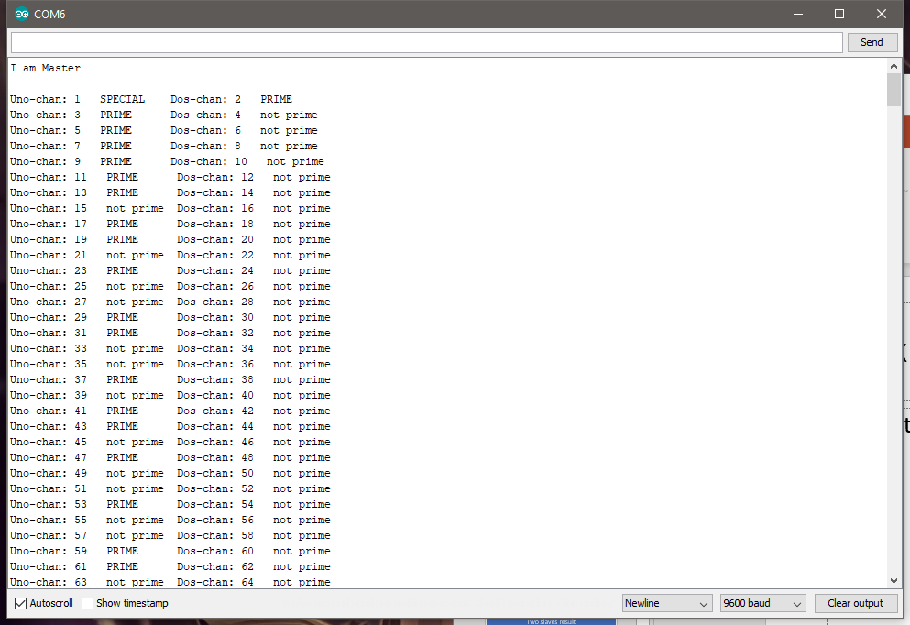

Slide 8
Master Code
#include <Wire.h>
int LED = 13;
unsigned long start, finished, elapsed;
int a = 1;
char c;
void setup() {
pinMode (LED, OUTPUT);
Serial.begin(9600); /* begin serial comm. */
Wire.begin(); /* join i2c bus as master */
Serial.println("I am Master");
start = micros();
Serial.println();
}
void loop() {
// receive from slave
Serial.print("Uno-chan: ");
Serial.print(a);
//send to slave
Wire.beginTransmission(1);
Wire.write(a);
Wire.endTransmission();
a++;
Serial.print(" ");
Wire.requestFrom(1, 11); /* request & read data of size ? from slave */
while(Wire.available()){
c = Wire.read();/* read data received from slave */
Serial.print(c);
}
Serial.print(" Dos-chan: ");
Serial.print(a);
Wire.beginTransmission(2);
Wire.write(a);
Wire.endTransmission();
a++;
Serial.print(" ");
Wire.requestFrom(2, 11); /* request & read data of size ? from slave */
while(Wire.available()){
c = Wire.read();/* read data received from slave */
Serial.print(c);
}
Serial.println();
if(a > 1000){
// print time elapsed
Serial.println();
finished = micros();
Serial.print("Finished in ");
elapsed = finished - start;
Serial.print(elapsed);
Serial.println(" microseconds!");
delay(500);
exit(0);
}
}

Slide 9
Slave 1 Code
#include <Wire.h>
int LED = 13;
int start;
int a;
void setup() {
Wire.begin(1); /* join i2c bus with address 8 */
Wire.onReceive(receiveEvent);
Wire.onRequest(requestEvent); /* register request event */
Serial.begin(9600); /* start serial comm. */
Serial.println("I am Slave Uno-chan");
}
void loop() {
}
void receiveEvent(){
a = Wire.read();
}
// function that executes whenever data is requested from master
char requestEvent() {
if(a == 1){
Wire.write(" SPECIAL ");
}
else if(a == 2){
Wire.write(" PRIME ");
}
else if(a == 3){
Wire.write(" PRIME ");
}
else if(a == 5){
Wire.write(" PRIME ");
}
else if(a == 7){
Wire.write(" PRIME ");
}
else if(a == 9){
Wire.write(" PRIME ");
}
else if(a % 2 == 0){
Wire.write(" not prime ");
}
else if(a % 3 == 0){
Wire.write(" not prime ");
}
else if(a % 5 == 0){
Wire.write(" not prime ");
}
else if(a % 7 == 0){
Wire.write(" not prime ");
}
else if(a % 9 == 0){
Wire.write(" not prime ");
}
else{
for(int i = 2; i <= a / 2; ++i){
if(a % i == 0){
Wire.write(" not prime ");
break;
}
Wire.write(" PRIME ");
}
}
}

Slide 10
Slave 2 Code
#include <Wire.h>
int LED = 13;
int start;
int a;
void setup() {
Wire.begin(2); /* join i2c bus with address 8 */
Wire.onReceive(receiveEvent);
Wire.onRequest(requestEvent); /* register request event */
Serial.begin(9600); /* start serial comm. */
Serial.println("I am Slave Dos-chan");
}
void loop() {
}
void receiveEvent(){
a = Wire.read();
}
// function that executes whenever data is requested from master
char requestEvent() {
if(a == 1){
Wire.write(" SPECIAL ");
}
else if(a == 2){
Wire.write(" PRIME ");
}
else if(a == 3){
Wire.write(" PRIME ");
}
else if(a == 5){
Wire.write(" PRIME ");
}
else if(a == 7){
Wire.write(" PRIME ");
}
else if(a == 9){
Wire.write(" PRIME ");
}
else if(a % 2 == 0){
Wire.write(" not prime ");
}
else if(a % 3 == 0){
Wire.write(" not prime ");
}
else if(a % 5 == 0){
Wire.write(" not prime ");
}
else if(a % 7 == 0){
Wire.write(" not prime ");
}
else if(a % 9 == 0){
Wire.write(" not prime ");
}
else{
for(int i = 2; i <= a / 2; ++i){
if(a % i == 0){
Wire.write(" not prime ");
break;
}
Wire.write(" PRIME ");
}
}
}

Slide 11

Two slaves result

Slide 12

For every 1 thousand number input is more than 6 seconds difference.

Slide 13

END

