Slide 1

Haitian referendum on a new constitution

Slide 2
Understanding the problem
The understanding of the problem on which I have to work and find solutions from Data Science is based on 5 pillars:
The government wants to hold the referendum anyway
It faces a credibility deficit
The socio-political climate is tense and uncertain
There is a need to rally people to the idea of the need to change the constitution
Have a good participation and especially the participation of young people.

Slide 3
In order to be able to propose a solution that can take into account all aspects of the problem, the question is approached point by point in the following way:
To find out the characteristics of the citizen against the referendum and the one who is for it
Evaluate people's knowledge about the constitutional project by referendum
To draw up the motivations of those who will not go to vote
To draw up the reasons of those who will vote NO to the draft of the new constitution
Identify factors that may influence the choice of this individual
Implementation of a policy that could influence them to vote YES

Slide 4
Problematic
What are the different levers that the Haitian government should use to increase participation in the referendum and encourage citizens to vote yes?
Research hypothesis
Haitian citizens, especially youth, want a change in the constitution but do not intend to participate in the referendum because they do not trust the process.

Slide 5
data processing
In order to achieve our main objective, which is to propose a solution that can improve the participation in the referendum and pass the new constitution, we use dozens of variables, some of which depend on others already defined. Roughly speaking, some variables will allow us to profile the average citizen who seems hostile to the referendum and to understand why he has this behavior. Some others allow us to know how to train our policy in order to convince them
.

Slide 6
Sex
Gender is an important variable in our study. It allows us to measure trends by gender and to see if certain behaviors are related to gender.
2. Age
We need to check the behavior of each age group and if certain characteristics of the referendum are related to this group.
3. Residence
It is necessary to see how each person reacts globally according to his place of residence.
4. Actual occupation
Still with the aim of drawing up the socio-demographic profile of individuals, a variable such as current occupation allows us to understand whether belonging to a group has an influence on individuals in relation to the referendum.

Slide 7
5.Definition of referendum
This variable tells us about each person's knowledge of the referendum.
6. Reading of the draft constitution document
This variable is very important. It allows us to see how people act after having read the document and to see if making the document accessible is a good thing to do to encourage people to vote.
7. Reason for not reading
This variable helps us understand why the individual who does not read the draft constitution document does not read it.
8. Discussion about the referendum
This is to see how people are interested in the referendum, for or against, and if they participate in the debate.

Slide 8
9. Support for the referendum
At the time of data collection, it is important to know each respondent's position on the referendum and to identify and try to influence those who are against it.
10. Constitutionality of the referendum
It is debated in the academic community and the media that there are no legal provisions for holding a referendum in Haiti. It is important to know the opinion of the people and understand if they are making choices based on their opinion of the legality of the process itself.
11. Need to change the constitution
We need this data to analyze the behavior of each individual in terms of what they understand about our current constitution and whether it would really be a hindrance to good governance and development.

Slide 9
12. Participation in the referendum
This variable shows which respondents are likely to vote and which are not.
13. Voting choice
For each respondent who decides to vote, we felt it was appropriate to ask their choice of vote for
14. Reason for not voting
15. Reason for voting NO

Slide 10
DATA MODELING
We created a google form to collect the data. 170 people participated in our study and agreed to answer the questions. The choice of individuals is not random and therefore the results concern only our sample. Through graphs, interpretations and analyses, we will expose our findings. Before we watch if every data make sense and if not, we make sure that the data is consistent with each question asked above.

Slide 11
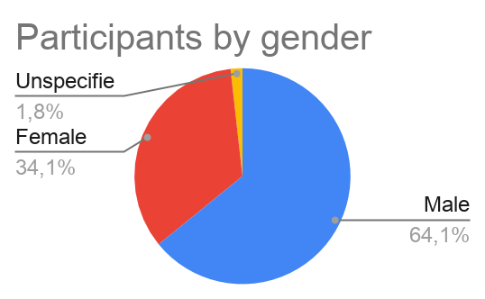
Of the 170 people who agreed to answer the questionnaire, 34.1% are women and 64.1% are men. This reflects the lack of interest of women in political activities.

Slide 12
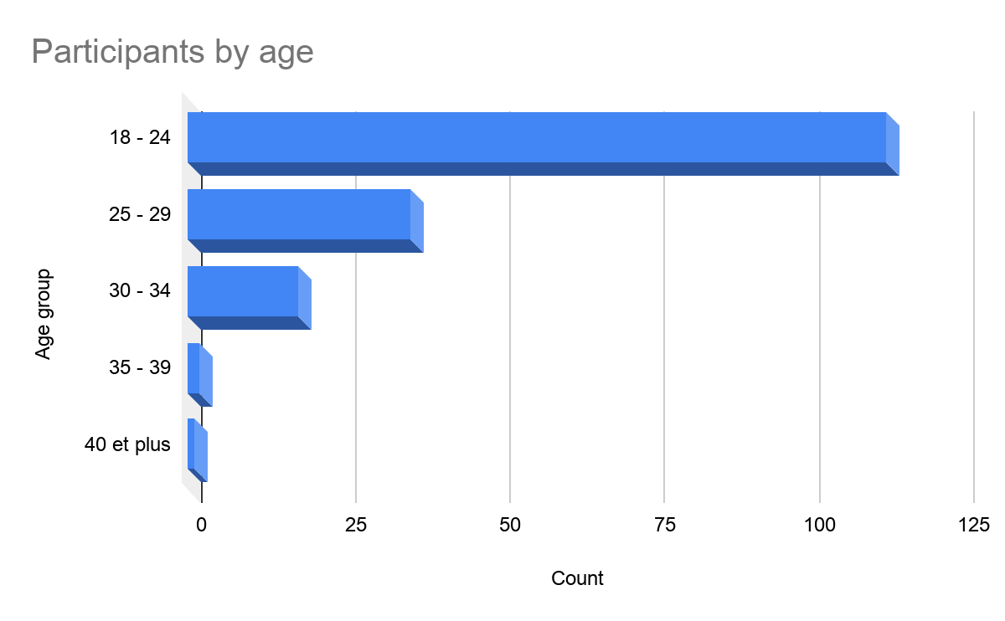
Generally speaking, respondents aged 18 to 24 years old represent 66.37% of the sample. Next are those aged 25 to 29, who make up 21.18%. The least represented are those 40 and over.
This is due in large part to the electronic questionnaire collection method and the fact that we have a very young population.

Slide 13
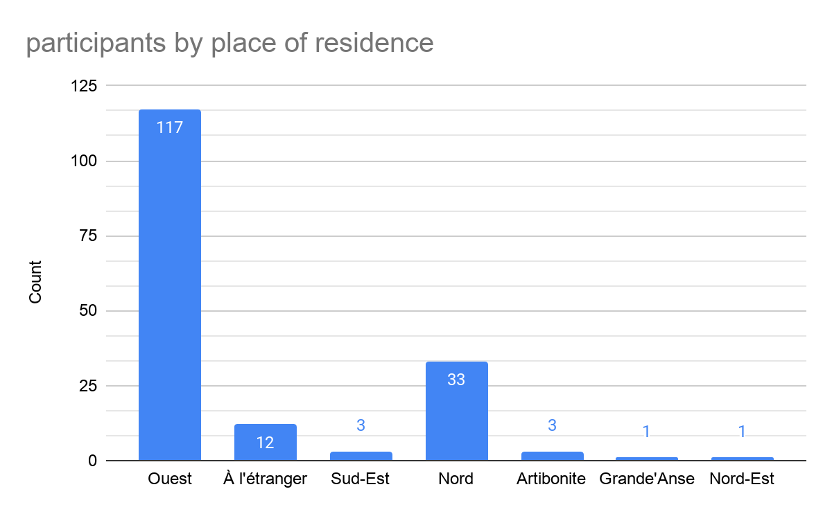
The West department is the most represented. 68.8% of respondents live in this department. The West department is the most populated department in the country and the questionnaire is deployed there. The other departments are very poorly represented.

Slide 14
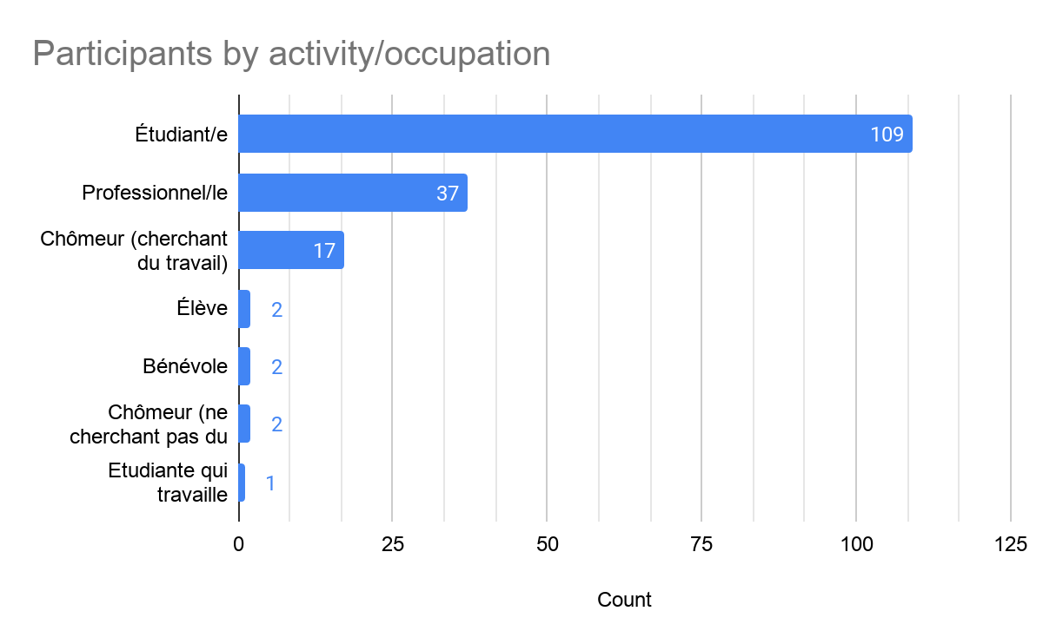
The vast majority of respondents are students, 64.12%, which is part of the reason why there are so many young people. And, 21.76% are professionals.

Slide 15
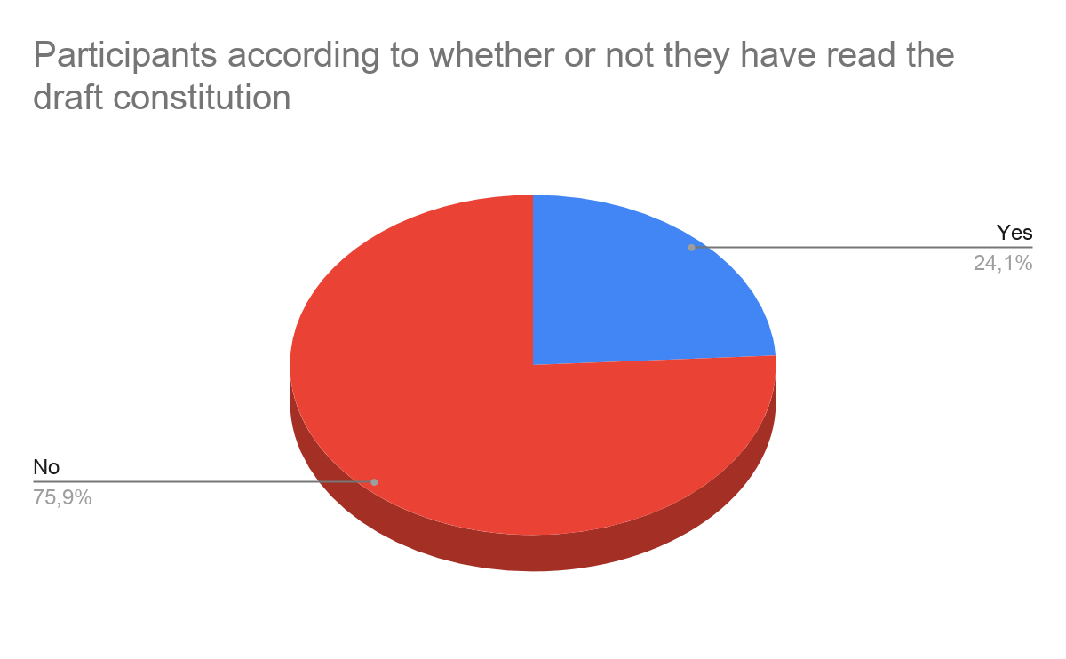
The debates around the draft of the new constitution are very present in the media. 75.9% of respondents have read the draft document. It will be important to analyze the behavior of these people in relation to the change of the constitution and the referendum

Slide 16
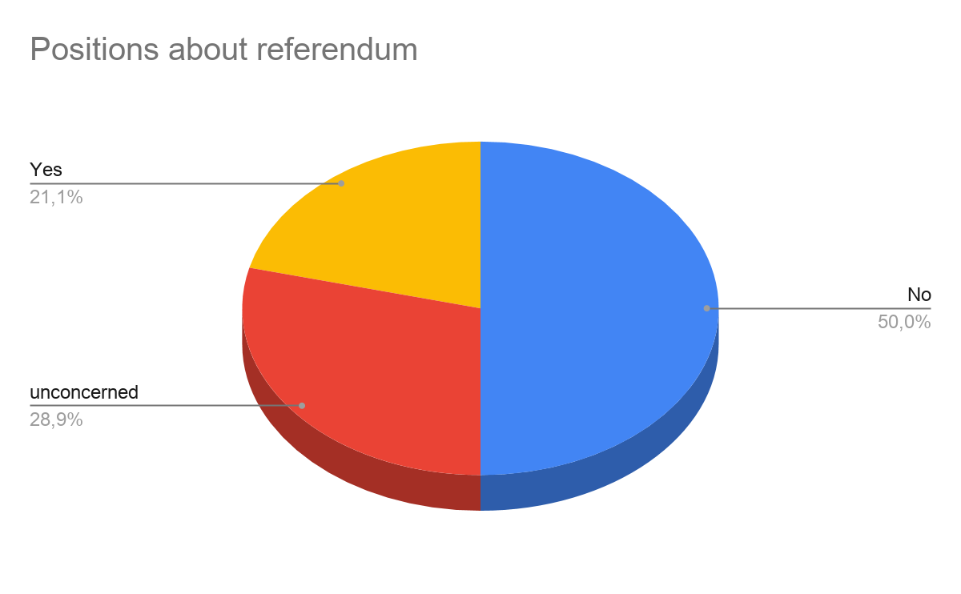
Half of the respondents think that the referendum should not be carried out. The study is designed to profile these people and design the best policy to influence them.

Slide 17
COUNTA de Précisez votre tranche d'âge : | Lecture du document
Quel est votre sexe ? | Non | Oui | Total général
Femme | 82,76% | 17,24% | 100,00%
Homme | 71,56% | 28,44% | 100,00%
Je ne souhaite pas le préciser | 100,00% |  | 100,00%
Total général | 75,88% | 24,12% | 100,00%
82.7% of the women who answered the questionnaire have not yet read the document. We have seen earlier that they are not interested.

Slide 18
For people have not yet read the document. Of these people, 47,97% have decided not to vote and 42,28% have not yet decided. Does reading the document have any influence on the decision to vote? A chi-square test is important.
COUNTA de Lecture du document | Lecture du document
Si vous irez voter, quelle sera votre choix? | Non | Oui | Total général
Je ne sais pas | 47,97% | 8,11% | 38,75%
NON, Je rejette la nouvelle constitution | 42,28% | 70,27% | 48,75%
OUI, J'accepte la nouvelle constitution | 9,76% | 21,62% | 12,50%
Total général | 100,00% | 100,00% | 100,00%

Slide 19
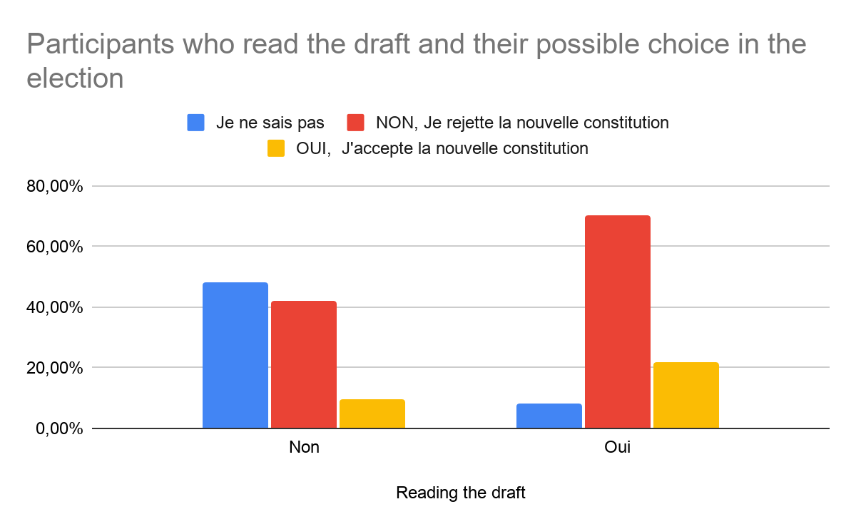
I note that over 70% of those who read the document and decide to vote intend to vote no in the elections.
Of those who have not yet read, there are more who are still undecided.

Slide 20
more than 64% of those who believe that the referendum is not constitutional do not decide to go to the polls. in order to encourage people to vote, it will be necessary to try to convince them of the constitutionality and necessity of the process.
As a result, about 65% of those who believe in the constitutionality of the vote decide to vote.
COUNTA de Lecture du document | Selon vous, le référendum est-il constitutionnel?
Decision de voter | Je ne sais pas | Non | Oui | Total général
Je ne sais pas | 35,00% | 8,45% | 10,34% | 18,75%
Non | 33,33% | 64,79% | 24,14% | 45,63%
Oui | 31,67% | 26,76% | 65,52% | 35,63%
Total général | 100,00% | 100,00% | 100,00% | 100,00%

Slide 21
84% of respondents who think that there is no need to change the constitution do not want a referendum and will not vote.
COUNTA de Decision de voter | Decision de voter
Pensez-vous que cette constitution (1987 amendée) doit être changée ? | Je ne sais pas | Non | Oui | Total général
Je ne sais pas | 38,71% | 38,71% | 22,58% | 100,00%
Non | 3,85% | 84,62% | 11,54% | 100,00%
Oui | 16,51% | 38,53% | 44,95% | 100,00%
Total général | 18,67% | 45,78% | 35,54% | 100,00%

Slide 22
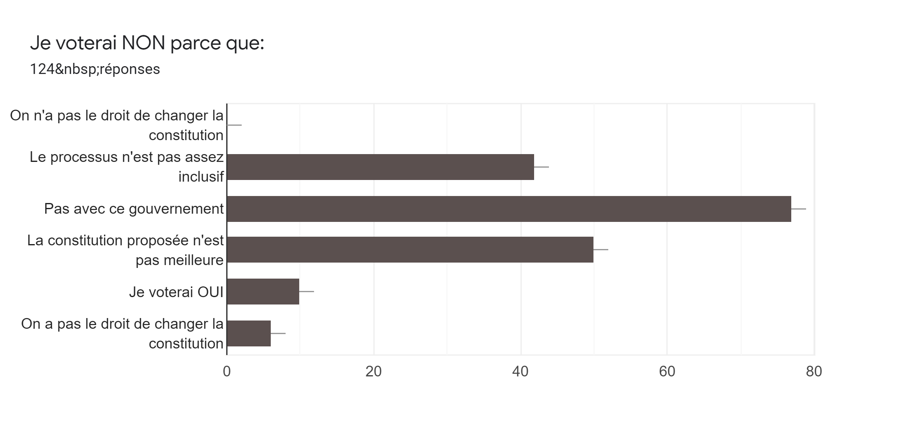

Slide 23
The graph above shows the reasons why respondents tend to vote NO on the referendum. The majority of them think that it should not be done with this government. More than 77% of them think the same. 50% think that the draft constitution is not better.

Slide 24
RECOMMENDATIONS
The government must conduct a campaign against the 1987 constitution to push them to want a new constitution. It should also be noted that just because they are against the current constitution, it does not mean that they will support the new one. But at least it will reduce the number of people who are hostile to the referendum.
Since a large majority of people who read the document decide not to vote or vote against it, this implies that there are flaws in the project. If we want to win the battle of the opinion, we need to make sure that there is a sustained debate about the issue among young people in order to explain them the grey areas that make them suspicious.

Slide 25
3. Since the majority of people believe that the constitution should be changed and complain about the credibility of the government, it is proposed to project a different image by attracting influencers close to the youth. The young people want a new constitution but they hesitate to take it this time because they don’t trust.
4. it is necessary to make sure that the older people go to vote because the young people are very reluctant to be convinced because of the timing and the time it will take to convince them.
5. Overall, reading the document and participating in the debate demotivates people to vote. Considering that the more one reads and participates in the debate on the referendum the less one feels like voting. The government must be careful about the type of debate it can raise that can sway some people against the referendum.

