Slide 1
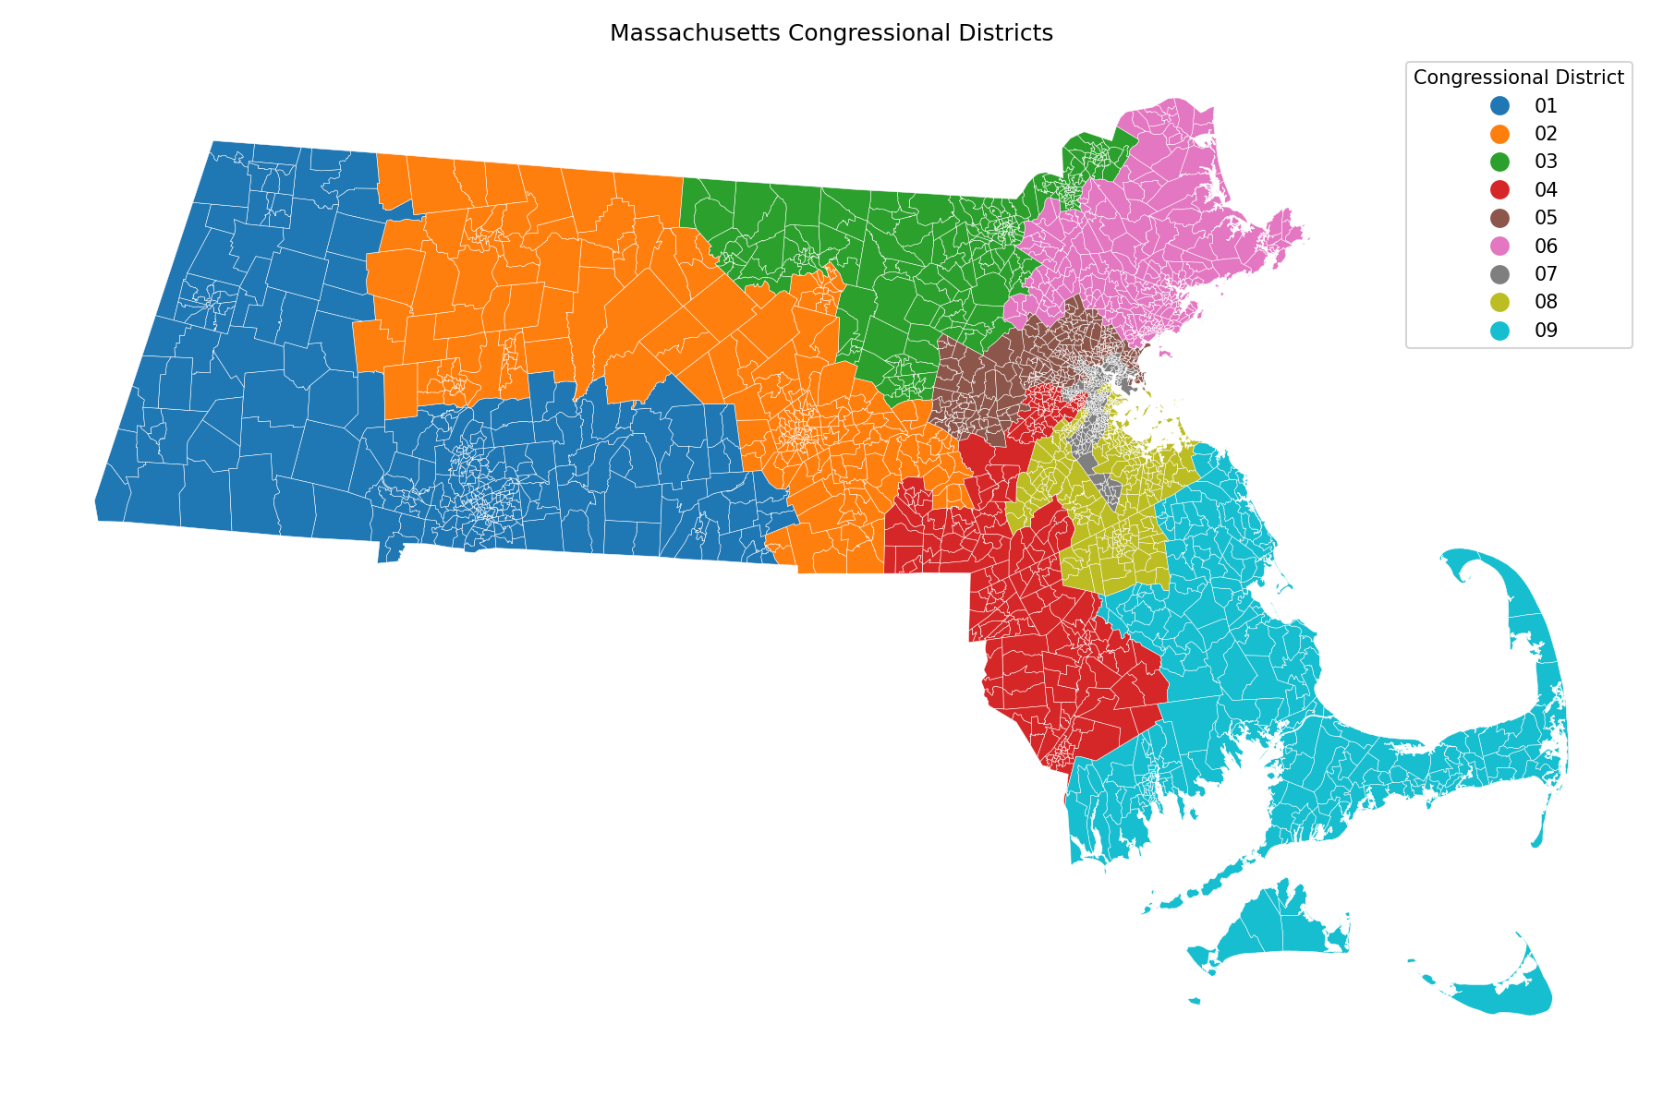
AI for Redistricting — Spring 2026
Gerrymandering Analysis of
Massachusetts Congressional Districts
2024 Presidential & Senate Elections | ReCom Ensemble Analysis
University of San Francisco • CS 464
Notes:
Open by framing Massachusetts as a hard case: it is already a very Democratic state, so the question is not simply whether Democrats win. The question is whether the enacted plan is unusually Democratic-favoring compared with many legal ReCom alternatives.

Slide 2
STATE CONTEXT
The Massachusetts dilemma
Massachusetts already votes strongly Democratic. So the project is not asking why Democrats win; it asks whether the enacted map makes that result stronger than other reasonable Massachusetts maps.
9 / 9
D +25
Democratic wins
how MA voted for president
Key terms in plain English
What makes MA different
• Presidential lean = how the state voted for president.
• District 7 = the Boston-area congressional seat.
• No independent commission = state lawmakers drew the map.
• The state is blue before map drawing.
• Boston-area voters are very dense, which can create packed districts.
• We compare the enacted plan with many ReCom maps.
Main idea: compare Massachusetts to other possible Massachusetts maps, not to a perfectly balanced swing state.
Notes:
Layman terms: presidential lean is explained as a roughly 25-point statewide Democratic win, CD7 is called District 7, and IRC is explained as a citizens panel/commission rather than an acronym.

Slide 3
MASSACHUSETTS MAP BACKGROUND
Population and legal context
How the map was made
• The current congressional map became law in 2021.
• State lawmakers drew it through the normal lawmaking process.
• The governor can veto it; lawmakers can override with a two-thirds vote.
Geography pattern
• Western MA and Cape/Island districts cover much larger areas.
• Boston-area districts are geographically smaller but much denser.
• District 7 is the Boston/Cambridge/Somerville-area seat.
• District 9 includes the South Coast, Cape, and Islands, which complicates compactness scores.
Notes:
This slide uses plain language and fixes the overlap by spacing the three sections separately.

Slide 4
MAUP PIPELINE
Data cleaning: making the map usable
Before running GerryChain, we had to turn messy real-world files into one clean precinct graph. Each precinct needed population, election data, and correct neighbor connections.
107,278
2,383
7,029,917
True
census blocks assigned
precinct nodes
population preserved
maup.doctor check
What we cleaned
Why this matters
• Reprojected the files so they lined up.
• Fixed tiny gaps, overlaps, and invalid geometries.
• Added/cleaned neighbor connections for the graph.
• Wrong population or broken graph connections would make the ensemble unreliable.
• This step makes the ReCom comparison meaningful.
Notes:
Use “making the files usable” rather than heavy technical wording. Still include the rubric points: nesting/repair, small rook lengths, doctor True, population preserved.

Slide 5
RECOM ANALYSIS
Ensemble method and parameter choices
ReCom creates comparison maps by merging two neighboring districts and splitting them back into two population-balanced districts. Repeating this gives us many reasonable maps to compare with the enacted map.
Main settings
Why this matters for Massachusetts
• Population tolerance: ±2%, so districts stay close in size.
• Node repeats: 2, matching the simple class-style setup.
• Compactness bound: no plan can exceed 2× the enacted map’s cut edges.
• Election data: 2024 President and 2024 U.S. Senate.
• Massachusetts is already blue, so raw seat count is not enough.
• The ensemble gives us a fair “what else could MA have looked like?” baseline.
• The 20k and 40k runs check that the result is stable.
Main idea: ReCom is our comparison set, not a prediction of one perfect map.
Notes:
Overlaps were fixed by shortening the text and giving each column separate vertical space.

Slide 6
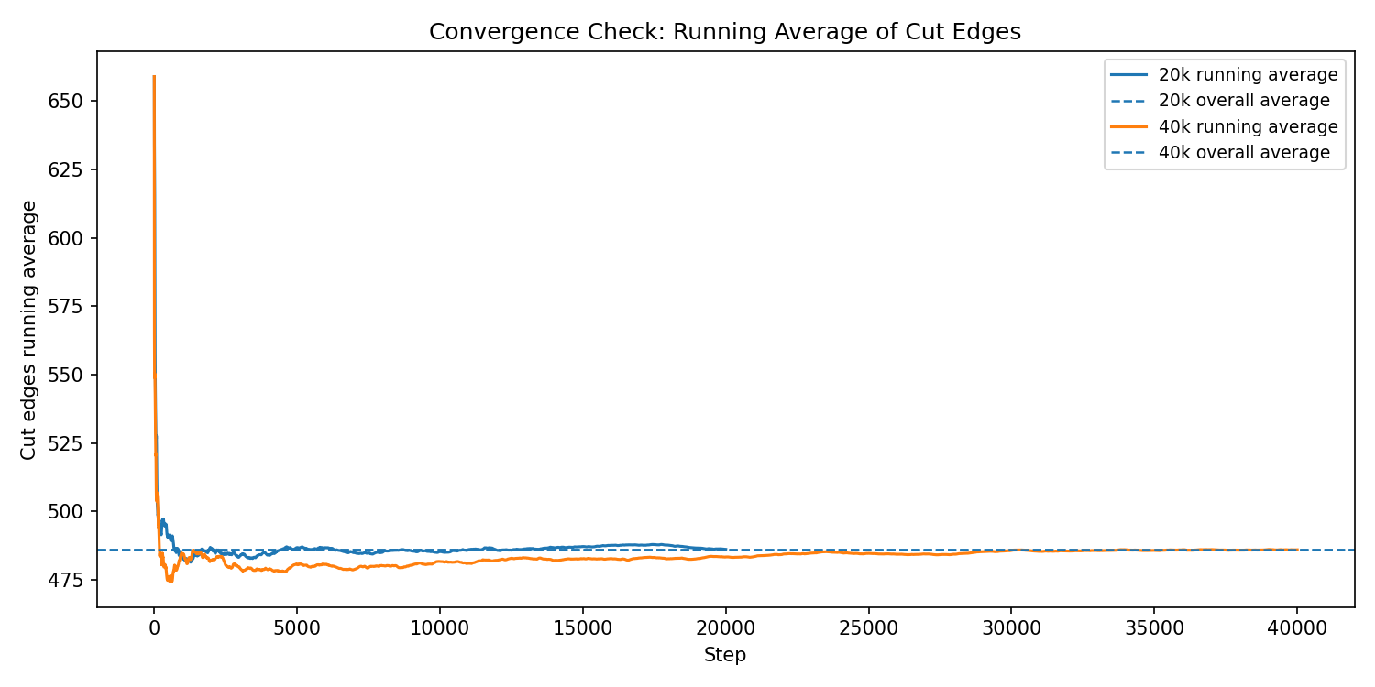
CHAIN LENGTH
Convergence check: 20k vs 40k
What we want to see
• Running averages stop drifting after the early part of the chain.
• The 20k and 40k lines settle near the same value.
• Doubling the run improves confidence, but does not change the story.
Takeaway
We use the 40k ensemble as the final comparison set. The 20k run already gives the same basic result, so the longer run mainly strengthens confidence.
Notes:
Do not overclaim perfect mixing. Say this is evidence that our chosen run length is reasonable because doubling the run does not meaningfully change the observed summary behavior.

Slide 7
ACTUAL MAP METRICS
Actual Massachusetts map: comparison baseline
9 / 9
659
Democratic wins in both races
cut edges in enacted plan
−0.2409
−0.3015
Efficiency Gap, 2024 President
Efficiency Gap, 2024 Senate
How to read these numbers
• 9/9 means every district is Democratic in both races.
• Negative Efficiency Gap points toward a Democratic advantage.
• Cut edges count precinct-neighbor links split by district lines.
Notes:
This is the setup slide before showing outlier graphs. It explains what the summary numbers mean in plain language.

Slide 8
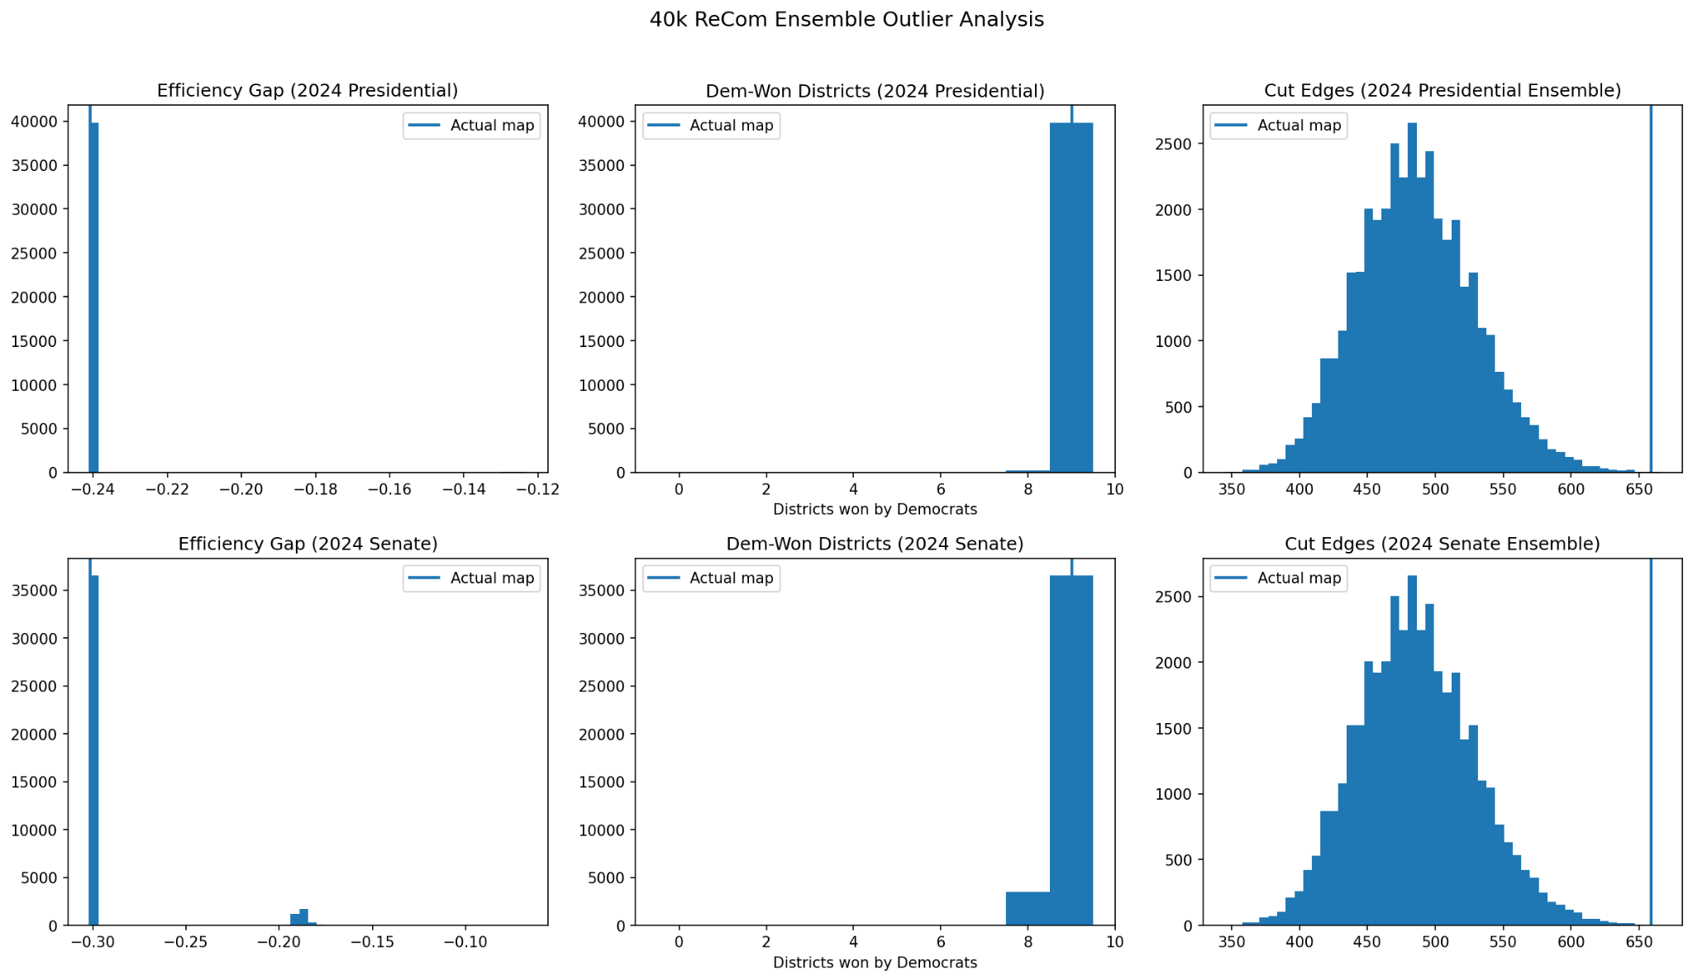
OUTLIER ANALYSIS
Efficiency Gap: close to the ensemble average
40k verified values
2024 President
Ensemble mean: −0.2403
Actual map: −0.2409
2024 Senate
Ensemble mean: −0.2915
Actual map: −0.3015
What this means
The actual map is very Democratic, but on Efficiency Gap alone it is close to the 40k ensemble mean.
The stronger outlier story comes from cut edges and marginal box plots.
Notes:
The previous deck listed ensemble means that were not backed by saved notebook output and did not visually match the histogram. This version avoids inventing those values and uses the histogram visually.

Slide 9
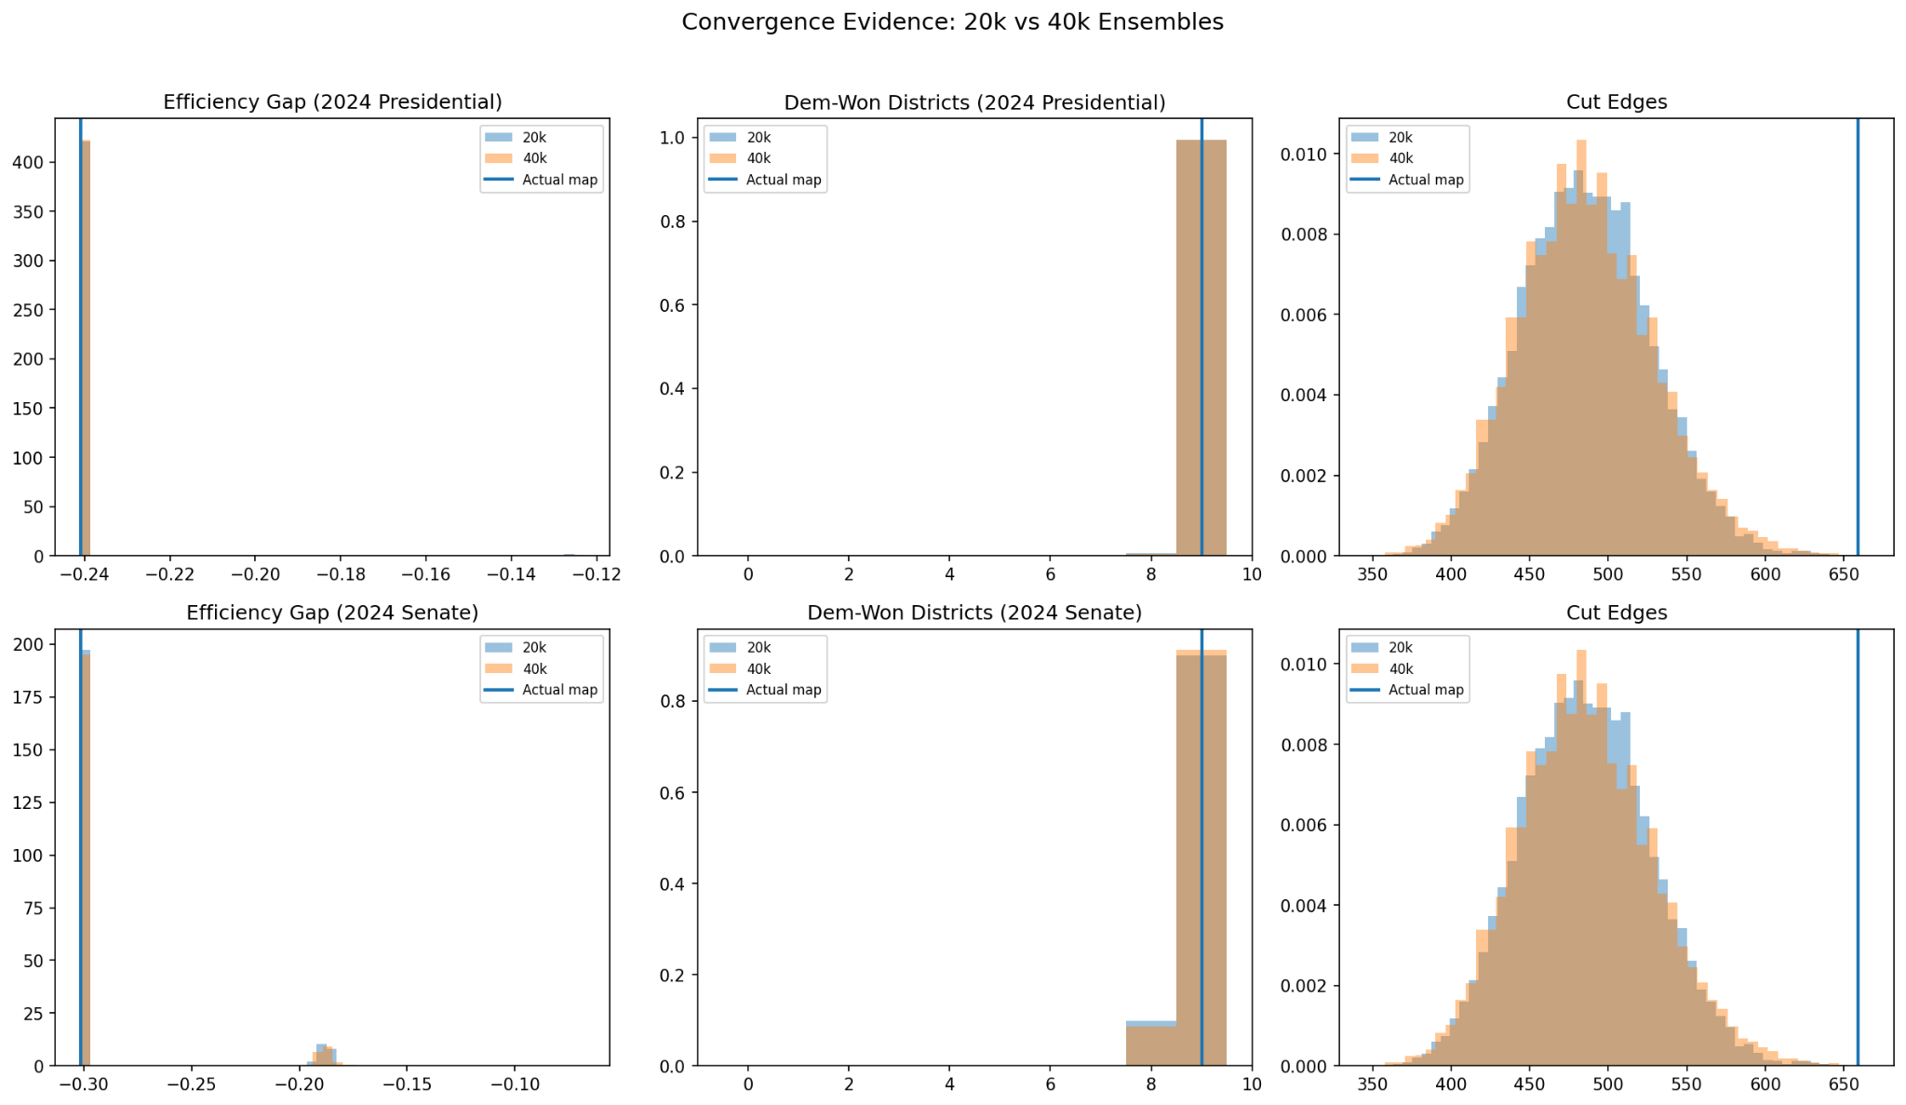
CUT EDGES AND COMPACTNESS
Cut edges: unusually fragmented boundaries
Cut edges count how often district lines split neighboring precincts.
659
≈486
actual cut edges
running average center
• Some fragmentation is real because the Cape, islands, and coastline complicate Massachusetts geography.
• But the enacted map still sits far to the right of the ensemble cut-edge distribution.
• This is one of our strongest outlier signals.
Sources: convergence_20k_vs_40k.png; convergence_running_average.png; analysis notebook outputs.
Notes:
This should not be framed as “all coastal weirdness equals gerrymandering.” The stronger claim is comparative: even with Massachusetts geography included in the same precinct graph, the actual map has unusually many cut edges.

Slide 10
RACIAL AND PARTISAN CONTEXT
Majority-minority representation: District 7
Only one congressional district has people of color as a majority of the population:
District 7
61.33%
Boston / Cambridge / Somerville core
minority population in 2021 mapbook
82.6%
82.3%
Harris two-party share in our precinct data
Warren two-party share in our precinct data
This is the main Massachusetts tension: District 7 helps preserve minority representation, but it is also the bluest district and contributes to the “packed urban voters” pattern seen in the box plots.
Sources: Massachusetts Legislature Congressional Mapbook 2021; project precinct aggregation.
Notes:
Answer the direct question here: the majority-minority district is District 7. It is 61.33% minority in the 2021 Congressional Mapbook and gave Democrats about 82% of the two-party vote in both project elections.

Slide 11
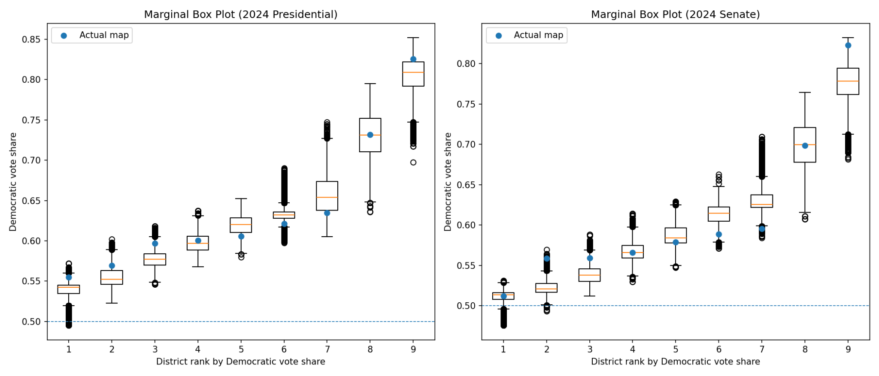
SIGNATURE OF GERRYMANDERING
Marginal box plots: what the ranks mean
How to read the x-axis
• Each map is sorted from least Democratic district to most Democratic district.
• Rank 9 means “the bluest district,” not Congressional District 9.
• The blue dot shows the enacted map at that rank.
What the graph says
The clearest pattern is at the Democratic end. The bluest enacted district is very blue, which fits the Boston-area packing story.
Senate outliers mostly reflect rank changes after small geographic swaps.
Notes:
Make sure the audience understands the x-axis. The numbers 1 to 9 are ranks, not district numbers. This corrects a common mistake: the “9th” point is the most Democratic district, which is the District 7 Boston-area seat.

Slide 12
INTERPRETING THE DOTS
Why the Senate box plot has many outliers
The black circles are not data errors. In a standard box plot, they are plans outside the whiskers, usually beyond 1.5× the interquartile range.
• The Senate race has more local variation than the presidential race in several areas, especially the South Coast, Cape, and outer suburbs.
• Because each plan is sorted by rank, one small geographic change can move a district into a different rank and appear as an outlier.
• Rare ReCom plans either isolate more Republican-leaning areas or connect more Boston-area Democratic voters into one ranked district.
• So the outliers show real Massachusetts geography and ranking effects, not a failed ensemble.
Concrete example: in the enacted map, District 9 is only about 51.2% Warren two-party vote, while District 7 is about 82.3%. That huge spread gives the Senate ranked distributions longer tails.
Sources: marginal_boxplots_40k.png; project precinct aggregation by congressional district.
Notes:
This answers the box-plot question. The outliers are a consequence of ranking + geography + a Senate race with local variation. They are not saying the data is wrong.

Slide 13
RESULTS
Final interpretation
Massachusetts is strongly Democratic, so Democratic-favoring results are expected. The stronger question is whether the enacted map is unusual compared with other possible Massachusetts maps.
• The actual map wins all 9 seats for Democrats in both elections.
• Efficiency Gap is strongly negative in both races: −0.2409 for President and −0.3015 for Senate.
• The clearer outlier is boundary fragmentation: 659 cut edges versus a running-average center around 486.
• District 7 is the only majority-minority district and also the bluest seat, making Boston-area packing central to the story.
• The best conclusion is not “Massachusetts is secretly competitive.” It is: a naturally Democratic state has a map that still shows unusually fragmented boundaries and very concentrated Democratic strength in its bluest district.
Presentation takeaway: the unique MA dilemma is separating real Democratic geography and minority representation from extra partisan advantage.
Sources: project notebooks and outputs.
Notes:
End with nuance. The strongest supported claim is comparative and empirical: the map is unusual in cut edges and the rank pattern, while the efficiency gap should be reported carefully.

Slide 14
REFERENCES
Sources and project files
• Project notebooks: cleaning.ipynb and analysis.ipynb; generated images from the 40k ReCom analysis.
• Massachusetts Legislature Redistricting pages and 2021 Congressional Mapbook for map process and district demographics.
• MA ElectionStats / PD43 for official 2024 presidential and U.S. Senate election results.
• Princeton Gerrymandering Project and All About Redistricting for Massachusetts process summaries.
• Census Reporter / U.S. Census resources for congressional district context.
Key file outputs used in slides: ma_districts_map.png, histograms_40k.png, marginal_boxplots_40k.png, convergence_20k_vs_40k.png, convergence_running_average.png.
Prepared for CS 464 — AI for Redistricting.

