Slide 1
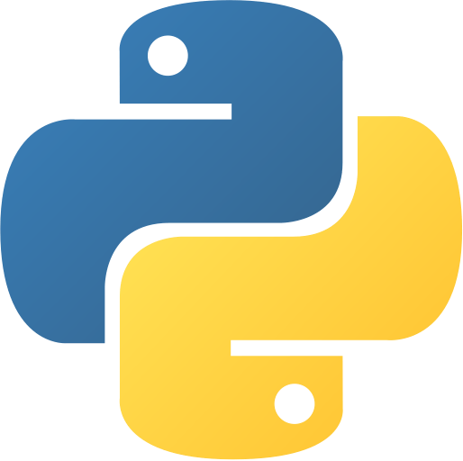
Python Programming
By Steve’s teacher

Slide 2
What is Python?
Python is a high-level, dynamically typed, general purpose programming language created by Guido van Rossum in 1991.
Jargon Overview:
High-Level: It’s an easy-to-understand language for humans that makes coding easier.
Dynamically Typed: Python automatically figures out the data type of all the values in your code (so you don’t have to!)
General Purpose: It can be used for anything! (Yes, games and AI too)

Slide 3
Why use Python?
Easy for beginners to programming!
High-level language and platform independant.
Dynamic typed.
Extensive standard library and third-party packages.
Versatility in application domains (web development, data analysis, automation, etc.).

Slide 4
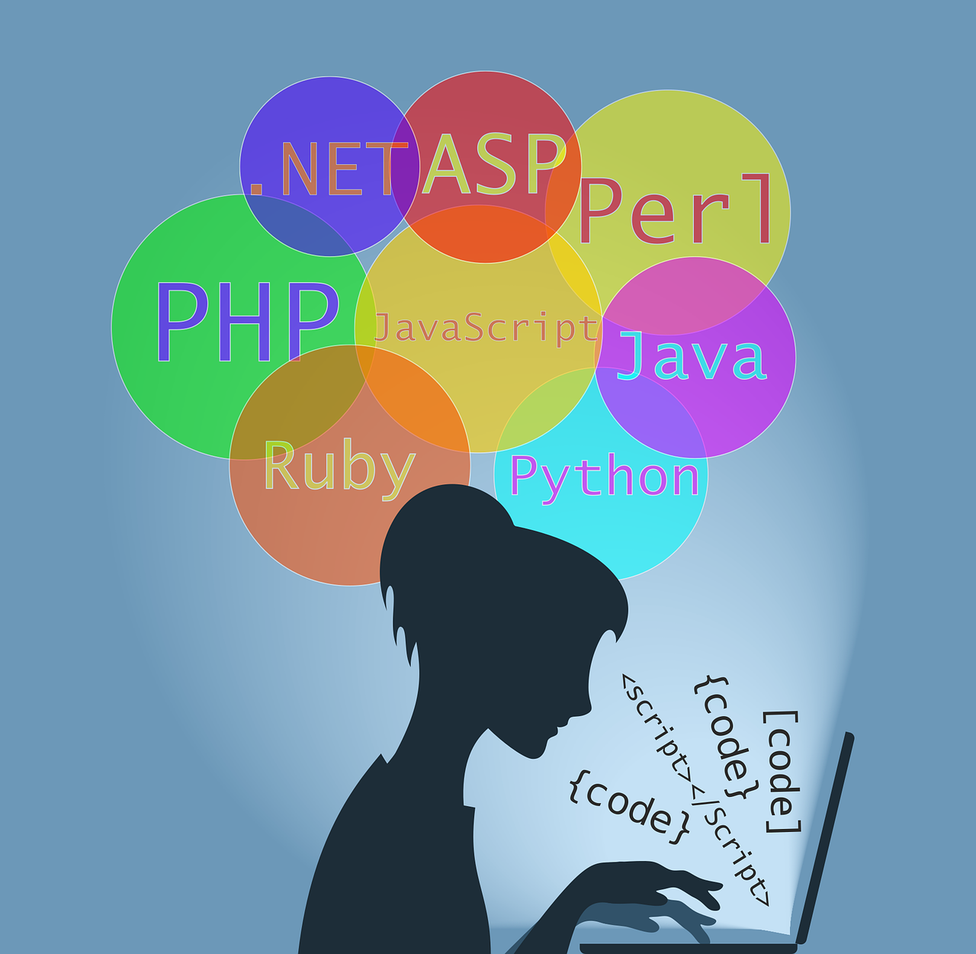
When to use Python?
Web development.
Data analysis and visualization.
Machine learning and artificial intelligence.
Automation and scripting for repetitive tasks.
Game development.

Slide 5

Python as a career?
High demand in the job market.
Various job roles: software development, data analysis, machine learning engineer, etc.
The potential for remote work and freelancing.
Salary (Yearly):
  US: $113639
  India: ₹586000
  South Africa: R600000
  UK: £62283
Source: https://www.glassdoor.co.in/Salaries/index.htm

Slide 6
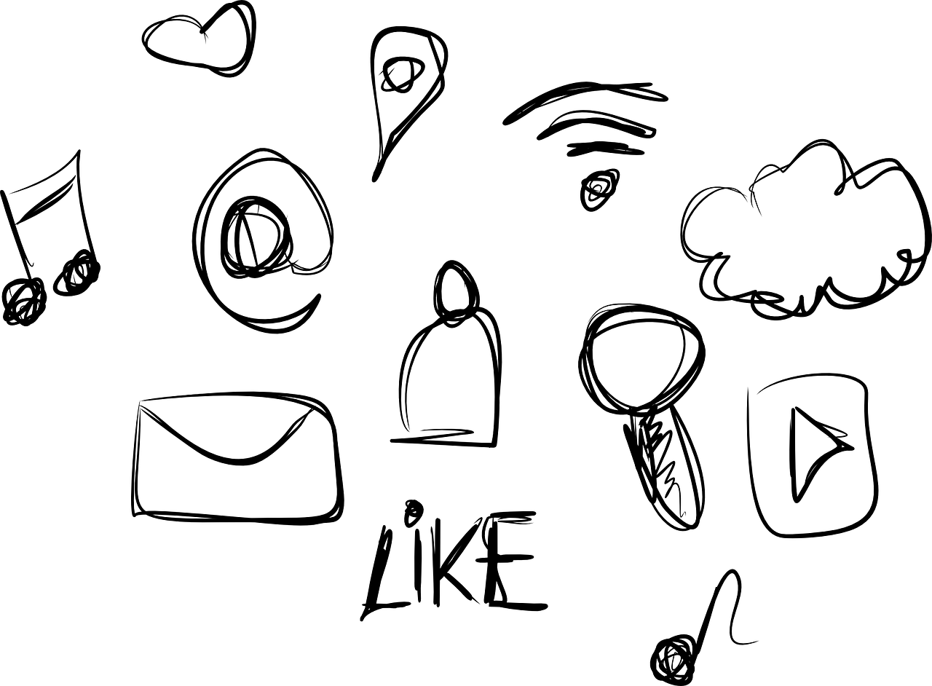
Interesting Python projects
Note these projects use Python for development, but may not be entirely written just in Python.
Django
Blender
Instagram
Disqus
Dropbox
Reddit
EVE Online
The Sims 4

Slide 7

FAQs
Course difficulty -> Easy/Beginner
Python 2 vs 3
What IDE to use
  Sublime Text
  PyCharm
  VSCode
  Anything

