Slide 1
The First question
To build which kind of website?

Slide 2
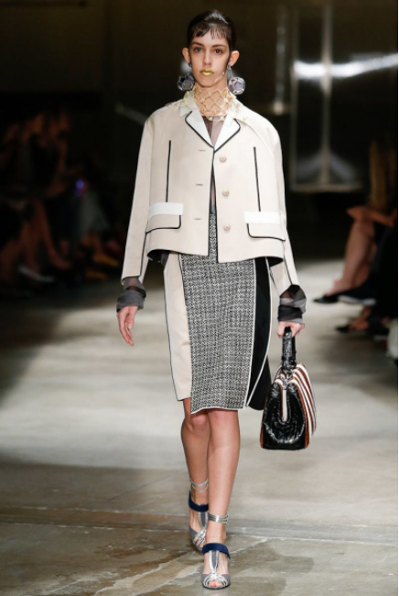
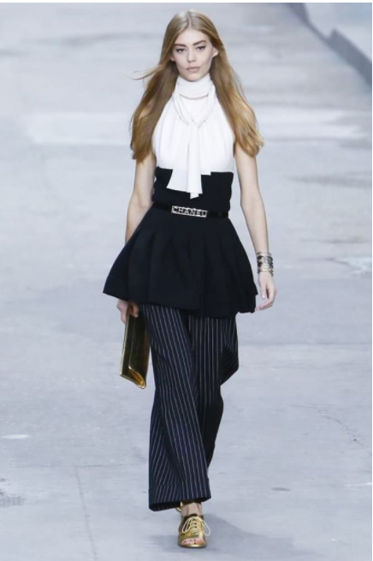
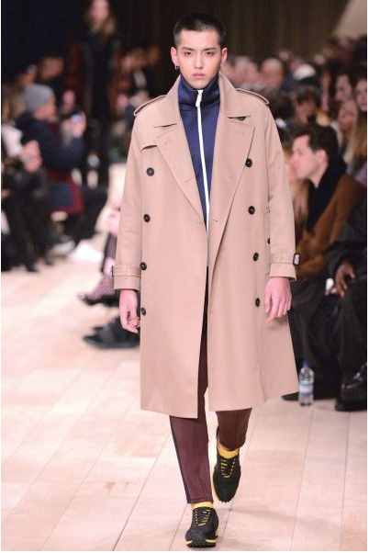
More and more people are paying attention to fashion development and all kinds of fashion show
I think they need a website to satisfy them, so I decided to build a fasion one
prada
chanel
burberry

Slide 3
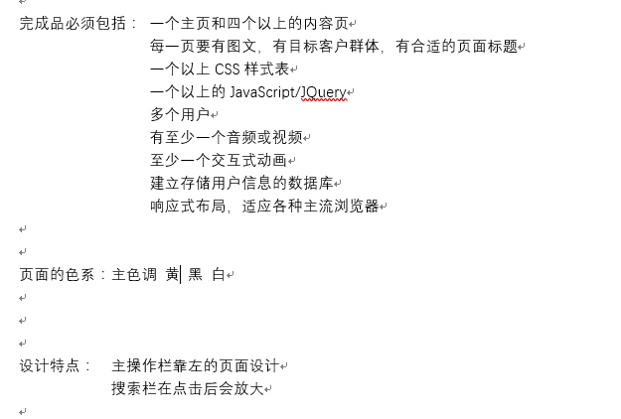
At first, I analyze the teacher’s requirement, confirm the main color and some characteristic of my website

Slide 4
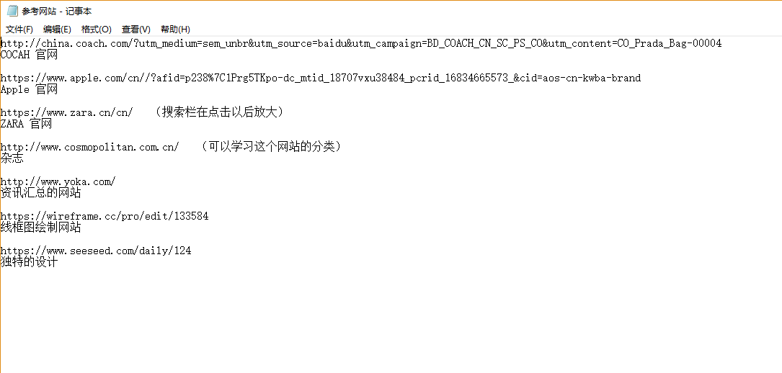
For reference, I search some fashion style website on the Internet, and write down their characteristic

Slide 5
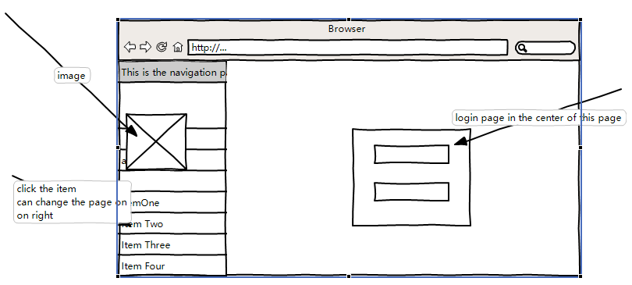
After referring to those websites, I draw the wireframe to confirm the style of my website. I draw two paint, one is login page and the other is the place showing commodity.
This is the login page.

Slide 6
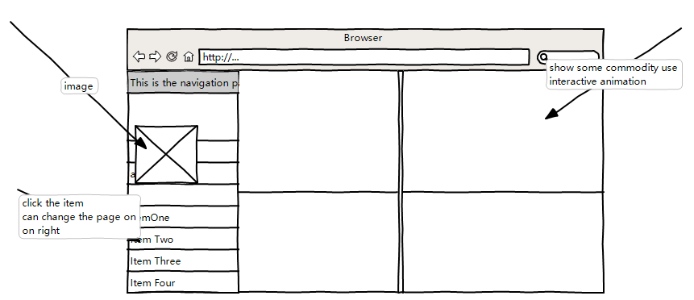
This it the commodity place.

