Slide 1
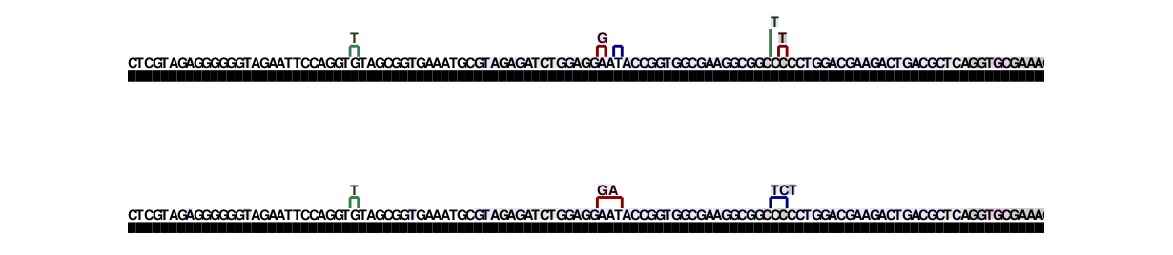
read sequence (mutations):
reference sequence:
collapse nearby mutations

Slide 2
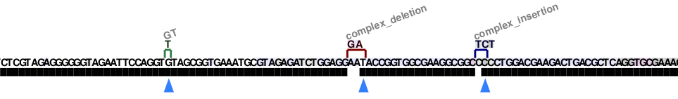
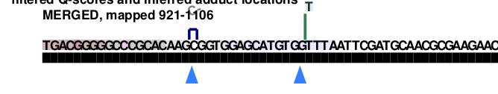
single nuc.
mismatch
multinuc.
deletion
multinuc.
insertion
mutations:
reference sequence:
effective read depth
inferred adduct locations
single nuc.
insert
single nuc.
deletion

Slide 3
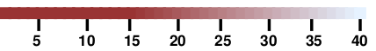
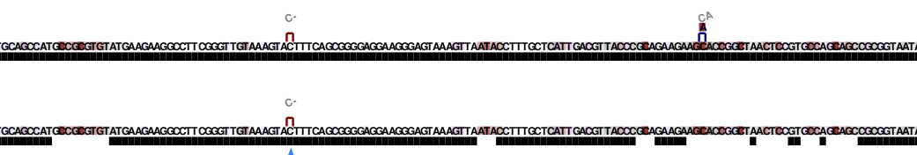
Basecall quality (phred score)
mutations:
single nuc.
deletion
single nuc.
mismatch
reference sequence
effective read depth
apply basecall quality filter
inferred adduct location
Basecall quality (phred score)
sequence:
effective read depth:

Slide 4
