Slide 1
Crypto Portfolio Risk Analysis
Adanma Adah
Weesam Ammar
Victor Pinto
Sergio Reyes
Team:
Project 1_Group 1
October 18th, 2023

Slide 2
Motivation and Summary
Hypothesis: Cryptocurrencies can be analyzed using python and a weighted portfolio can be recommended based on risk profile
Question asked and why was asked: With the available information, is it possible to form a risk-weighted crypto portfolio? Although crypto information is abundant, there is a need to analyze the data for proper portfolio formation
Describe whether question was satisfactorily answered. Summarize findings: Yes, question was answered. Our findings show that an equal-weighted portfolio of crypto assets provides satisfactory returns while reducing risk

Slide 3
Questions and Data
Questions asked:
With the available information, is it possible to form a risk-weighted crypto portfolio?
Which crypto asset is the most volatile?
Which crypto asset has the highest trading volume?
Which crypto asset has the highest rate of return?
Which crypto asset has the best risk/reward ratio?
Data needed to answer:
Key data needed was price and volume of selected cryptocurrencies
Crypto data is difficult to come by. Although there are free sources, some of them require a specific format to request the data
Even when data is obtained, it requires a double checking of the information received

Slide 4
Data Cleanup and Exploration
Initially, the team selected 4 cryptocurrencies for analysis based on market cap
Google Sheets was used to download the data
Sample formulas used:
=GOOGLEFINANCE("BTCUSD","price",DATE(2013,1,1), DATE(2023,10,3), "DAILY")
=GOOGLEFINANCE("BTC","volume",DATE(2013,1,1), DATE(2023,10,3), "DAILY")
Of note, if wrong ticker is used (e.g. If “BTC” is used to search for prices, Google results are not market prices. Same goes for volume. The ticker to use is BTC and not BTC USD.)
Insight: Always double check and review data for consistency and ideally run against another data source
Example: If formula used were BTC-price, data result for Oct 2nd is 0.04, but if formula used is "BTCUSD", "price" then result is 27,504, the correct price of Bitcoin on that date
As data was downloaded in CSV files for each of the selected cryptocurrencies we found the following issues:
Price and Volume dates not matching: even though cryptocurrencies trade daily, volume is recorded only on market trading days. Hence, there are discrepancies in the price and volume dates
So, python code was used to clean up data and match dates on price and volume columns
After clean-up, data needed to be combined in one master csv file to analyze and compare the four cryptocurrencies
In this last stage, it was necessary to run again the code developed to match price and volume dates among the four cryptocurrencies
Later the team discovered that the library yfinance - import yfinance as yf – could be used to download the data directly from the data source into a workable data frame
Still data needed to be cleaned to account for Nulls but the output already resolved the data inconsistencies providing a usable source of data

Slide 5
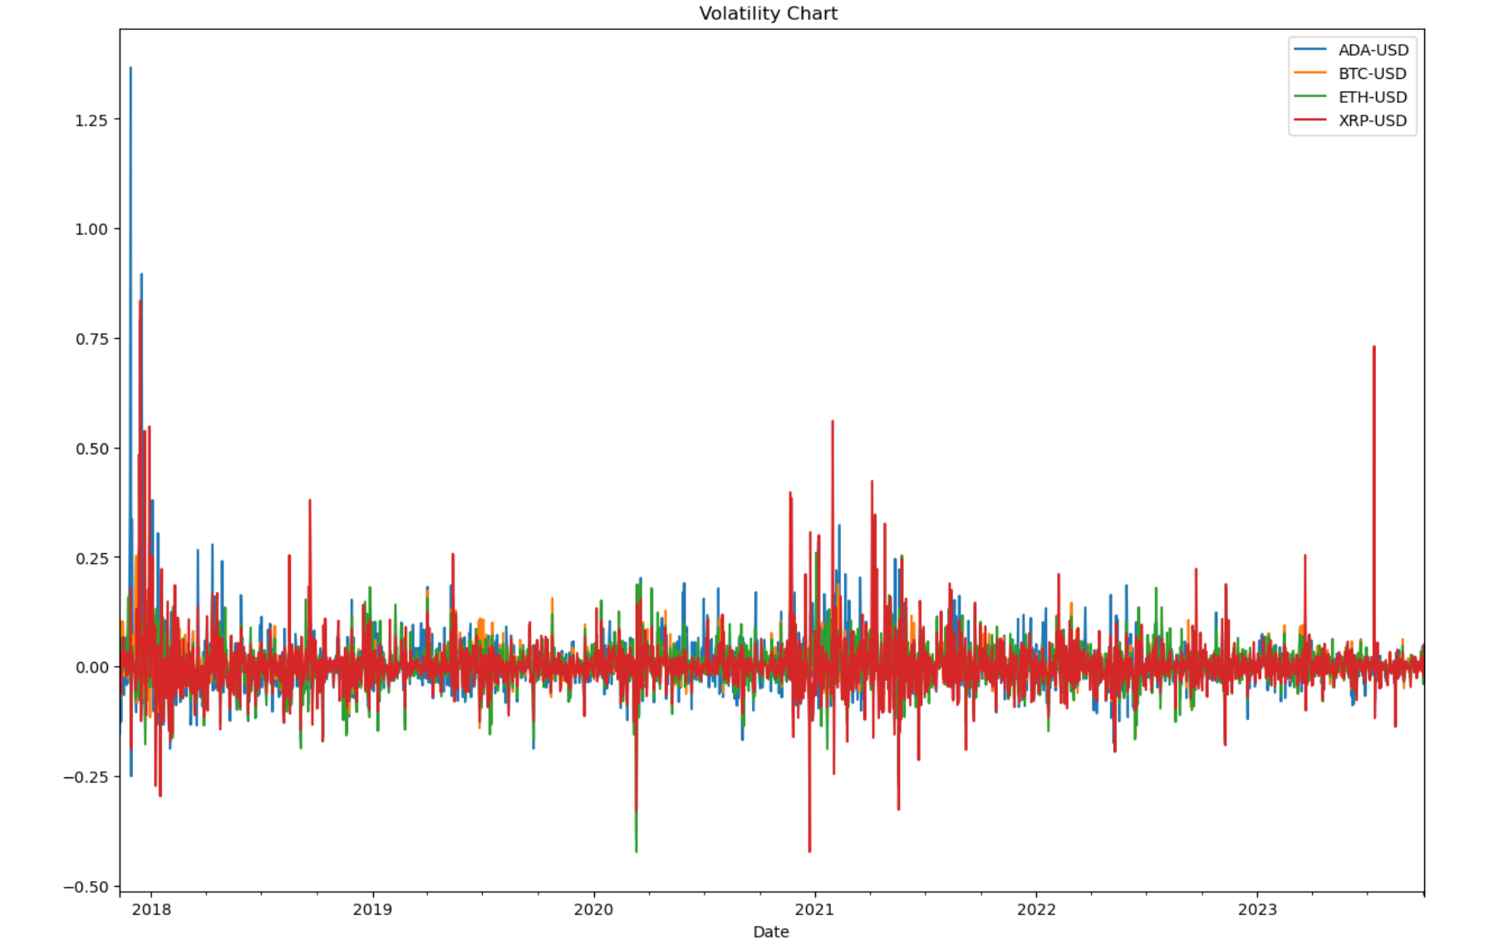
Jupyter Notebook Results - Volatility

Slide 6
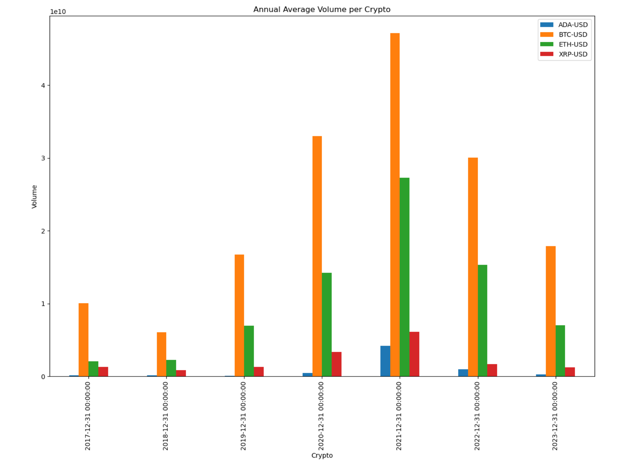
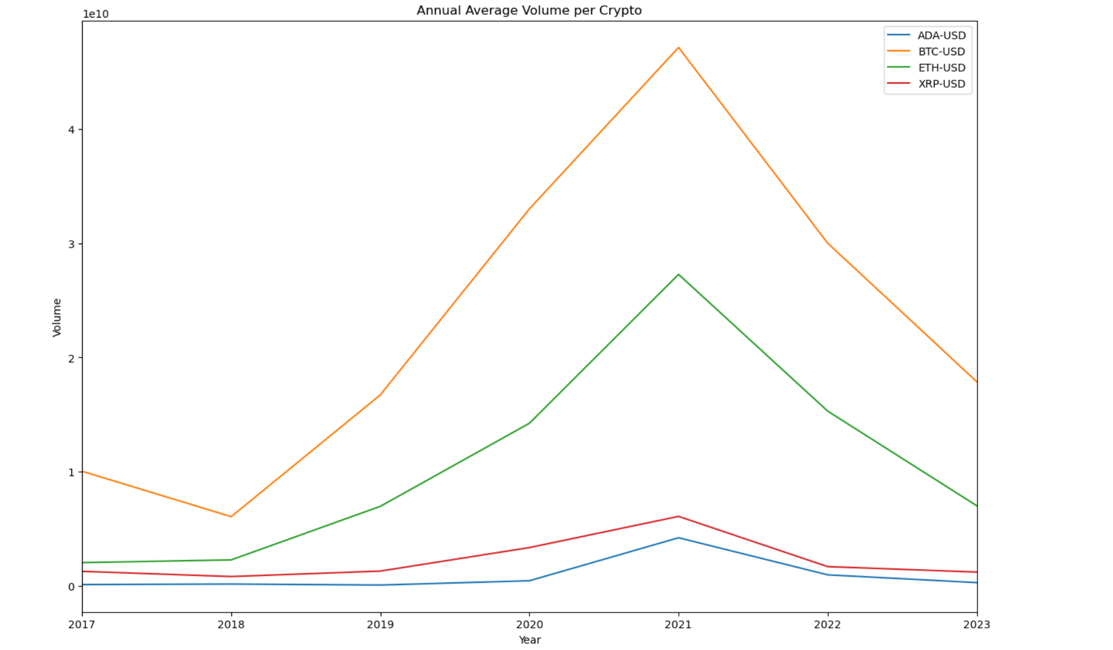
Jupyter Notebook Results - Volume
Bar Plot
Line Plot

Slide 7
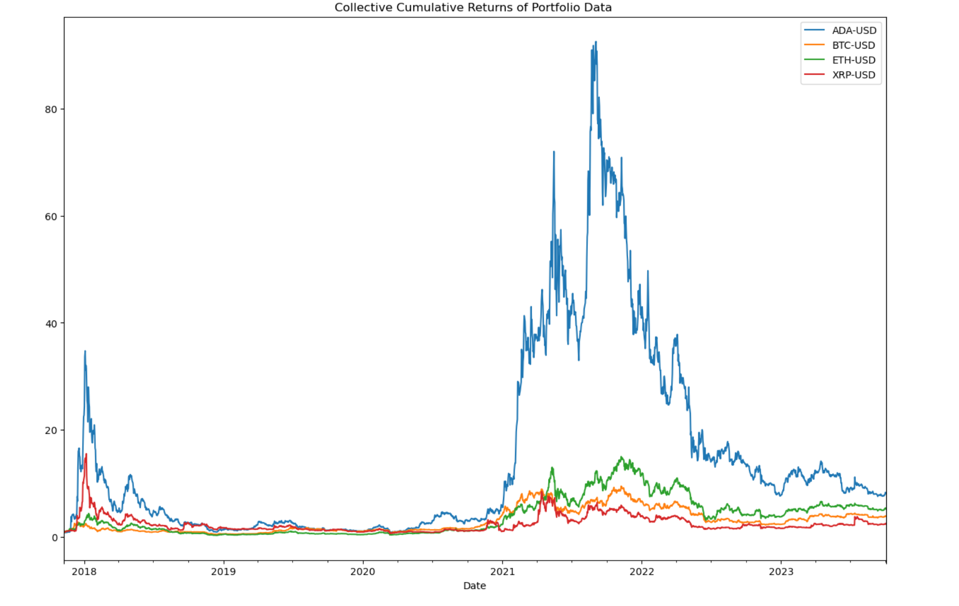
Jupyter Notebook Results - Return

Slide 8
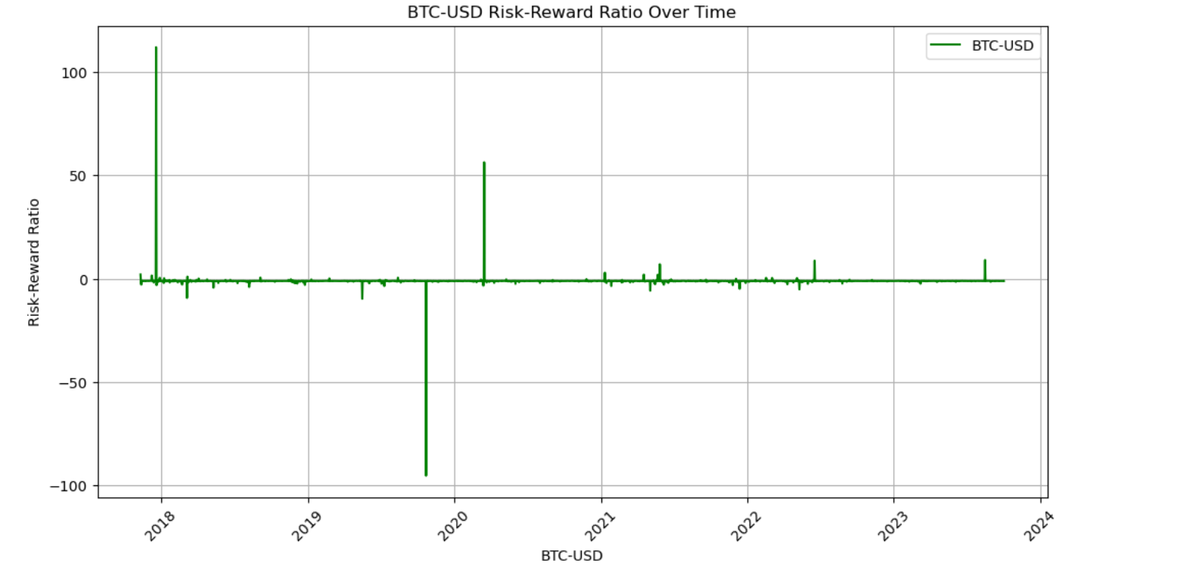
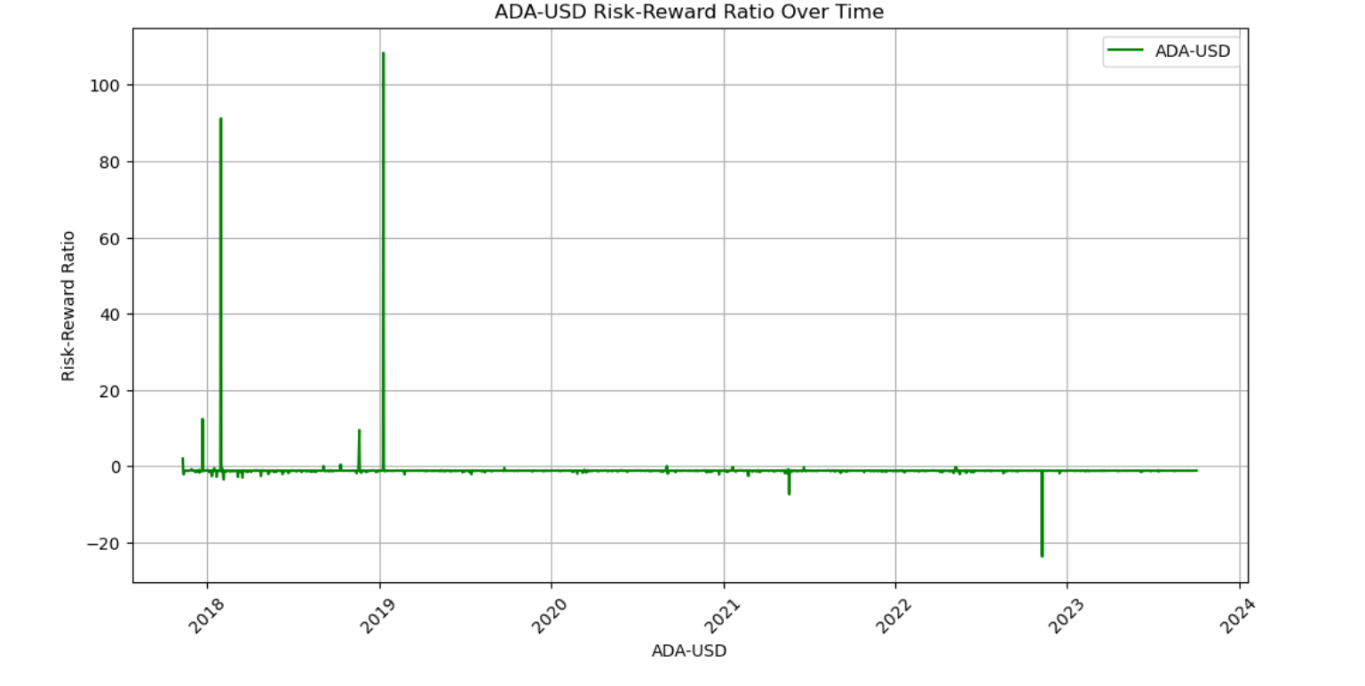
Jupyter Notebook Results – Risk/Reward

Slide 9
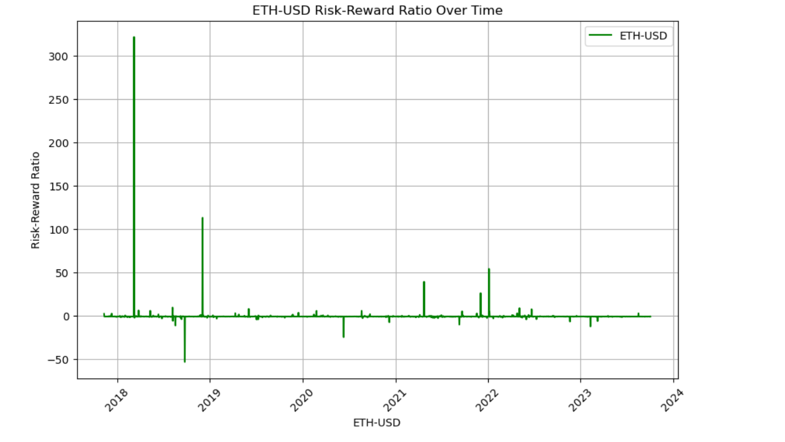
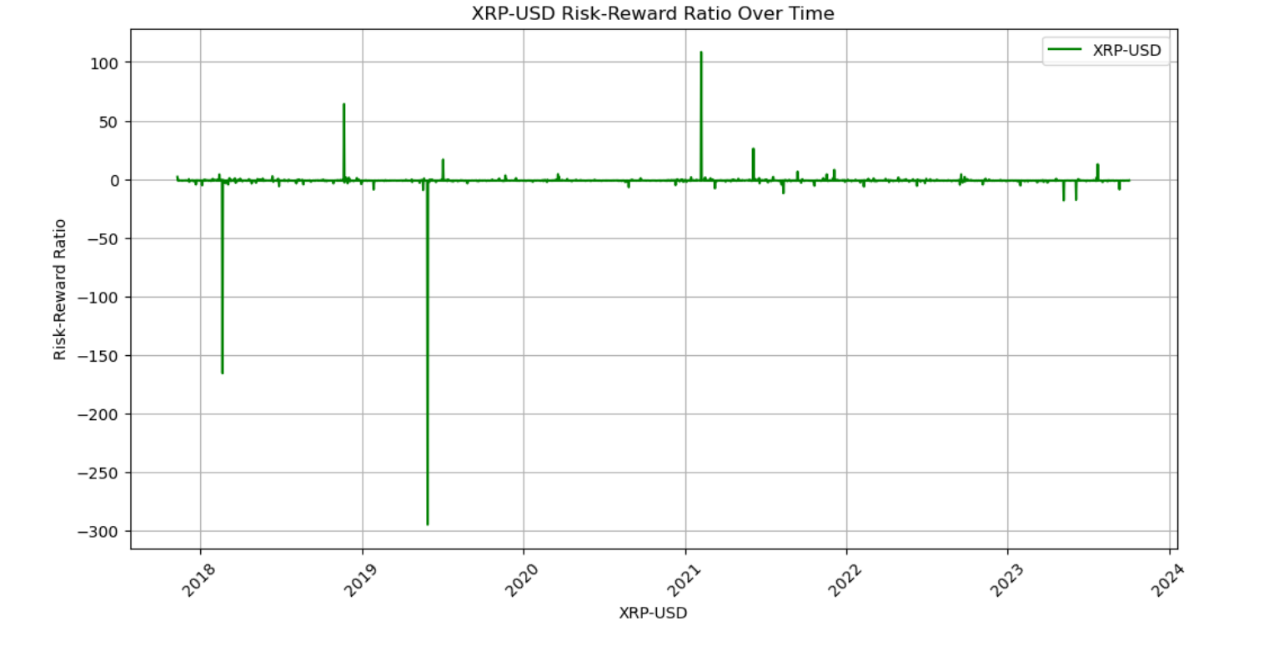
Jupyter Notebook Results – Risk/Reward

Slide 10
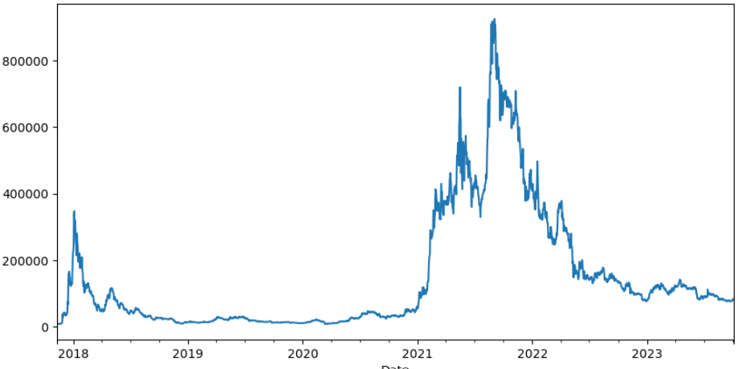
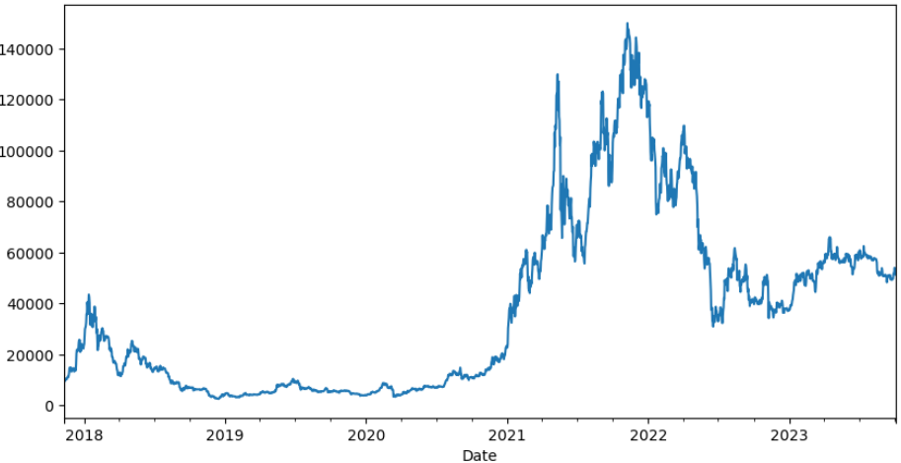
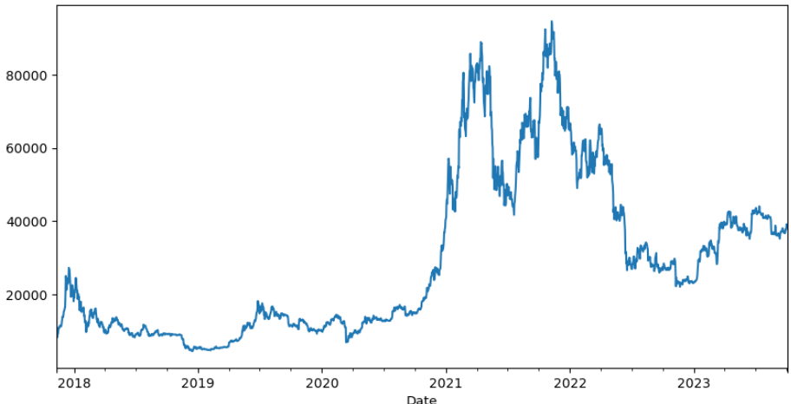
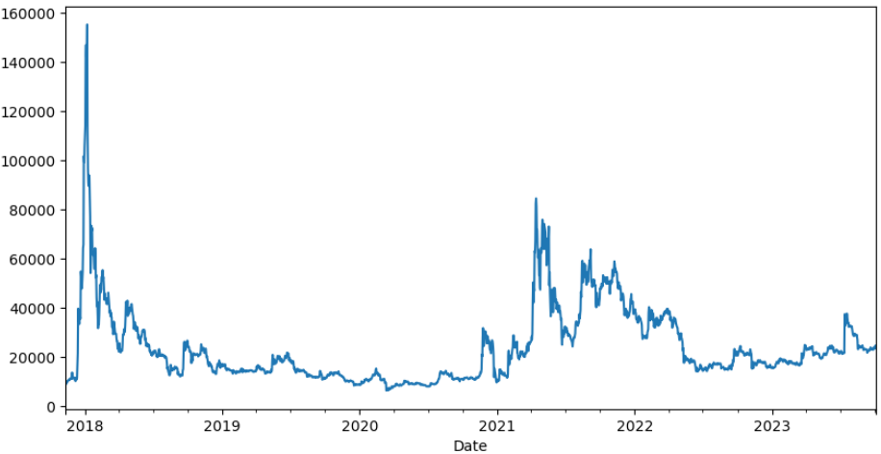
Jupyter Notebook Results - Portfolio
100% Cardano
100% Ethereum
100% Bitcoin
100% Ripple

Slide 11
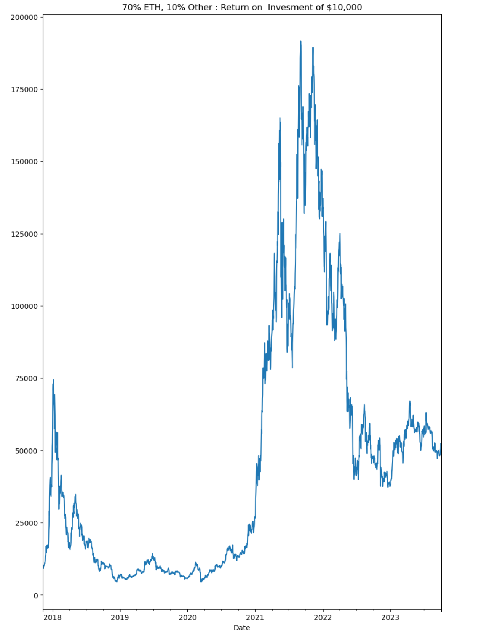
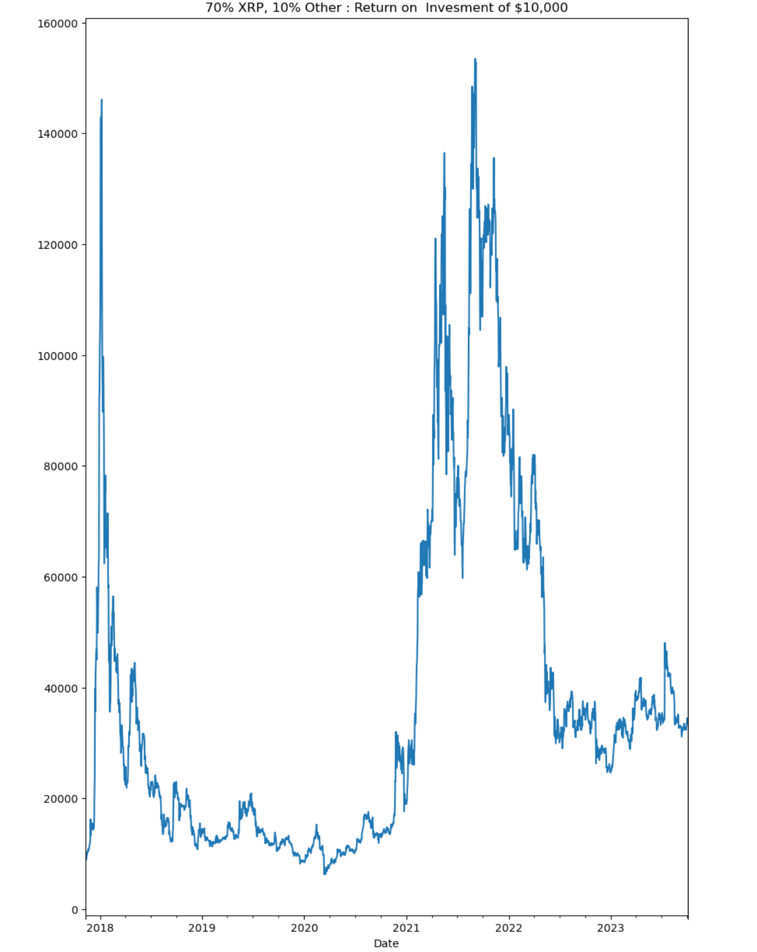
Results Majority Weighted Portfolio
Majority XRP
Majority Ethereum
Majority BTC
Majority Cardano

Slide 12
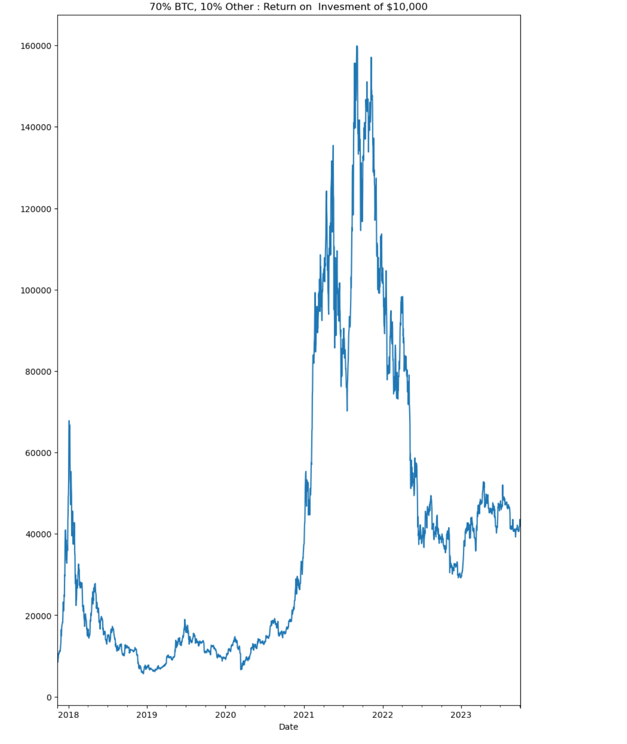
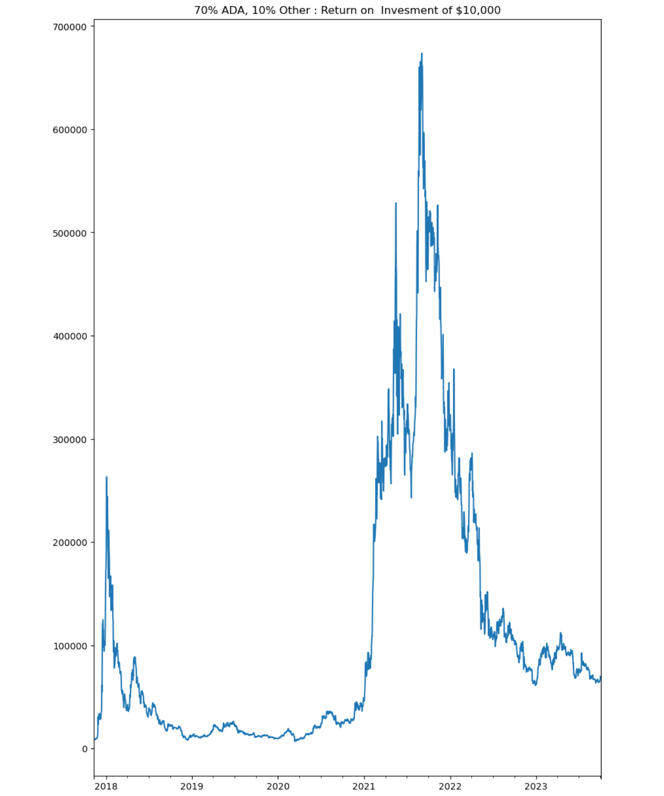
Results Majority Weighted Portfolio
Majority BTC
Majority ADA

Slide 13
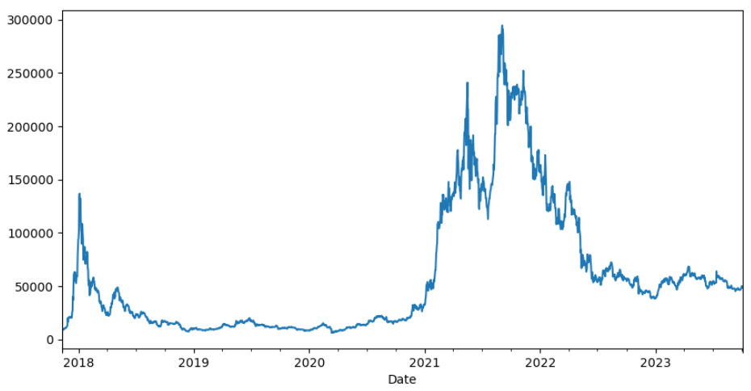
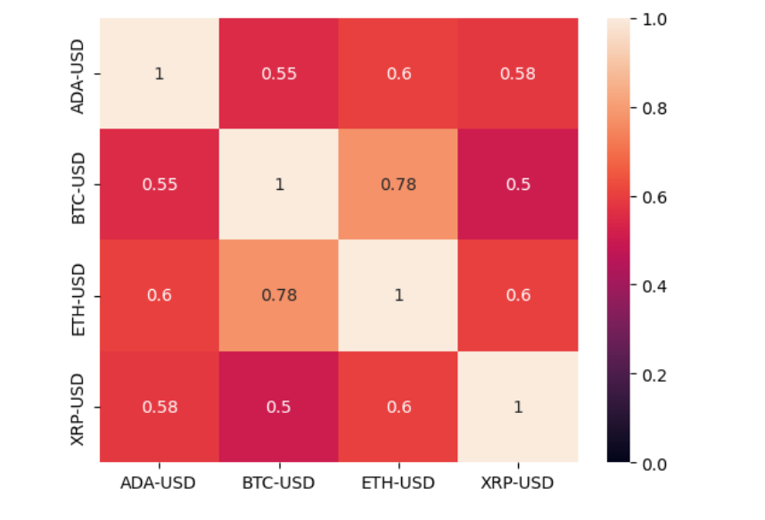
Results Equal Weighted Portfolio
25% Equal Weight
Portfolio Correlation Heatchart

Slide 14
Discussion
Cryptocurrencies present different degrees of volatility which relates to the trading volume
While each of the four currencies invested independently provide positive returns, an equal weighted portfolio would reduce volatility risk
The objective of the project was to determine the appropriate weights of a crypto portfolio. In this sense, the objective was reached
A crypto currencies portfolio would reduce its volatility if invested in equal weights

Slide 15
Postmortem
Difficulties: Data must be reviewed in-depth before working with it. Also, data can be costly, but there are free resources, so need to research
Additional questions unable to answer: How would other cryptos behave? How could this portfolio be updated automatically?
Additional research: Back-testing of EW Portfolio and Projection of crypto prices using machine learning such as scikit-learn library

Slide 16
Q&A

