Slide 1


Slide 2
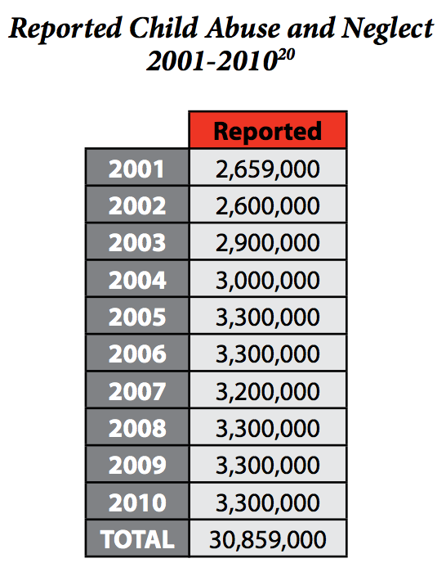
The problem
There are over 50,000 children reported being abused and/or neglected on a weekly basis.
Over half a million of these kids wind up in the foster care system every year
6% of women are infertile, or an astounding 1.5 million.
However, 40% of infertility issues stem from the male
Sources: US Dept of health & human services & childwelfare.gov

Slide 3
Bridging the gap
Not a perfect fix
Help connect two groups who could use each other for help
Adopted children are less likely than are children in the general population to live in households with incomes below the poverty threshold
Slightly over half of children adopted from foster care (54 percent) have special health care needs, compared with 19 percent of the general child population.
However, fully 92 percent of parents .. that if they knew then everything they know now they would have made the same decision to adopt.
Sources: US Department of health & human services

