Slide 1
Let‘s talk about … functions by looking at its graph!

Slide 2
Vocabulary
Deutsch | English
Funktion | function
Abbildungsvorschrift | mapping rule
Definitionsbereich | domain of definition
Funktionswert | function value
periodisch | periodic
(streng) monoton wachsend | (strictly) monotonically increasing
(streng) monoton fallend | (strictly) monotonically decreasing
beschränkt (nach oben, nach unten) | bounded (from above, from below)
symmetrisch (punkt-, achsensymmetrisch) | symmetric (odd, even)
Nullstelle einer Funktion | root of a function
Asymptotisches Verhalten | asymptotic behaviour

Slide 3
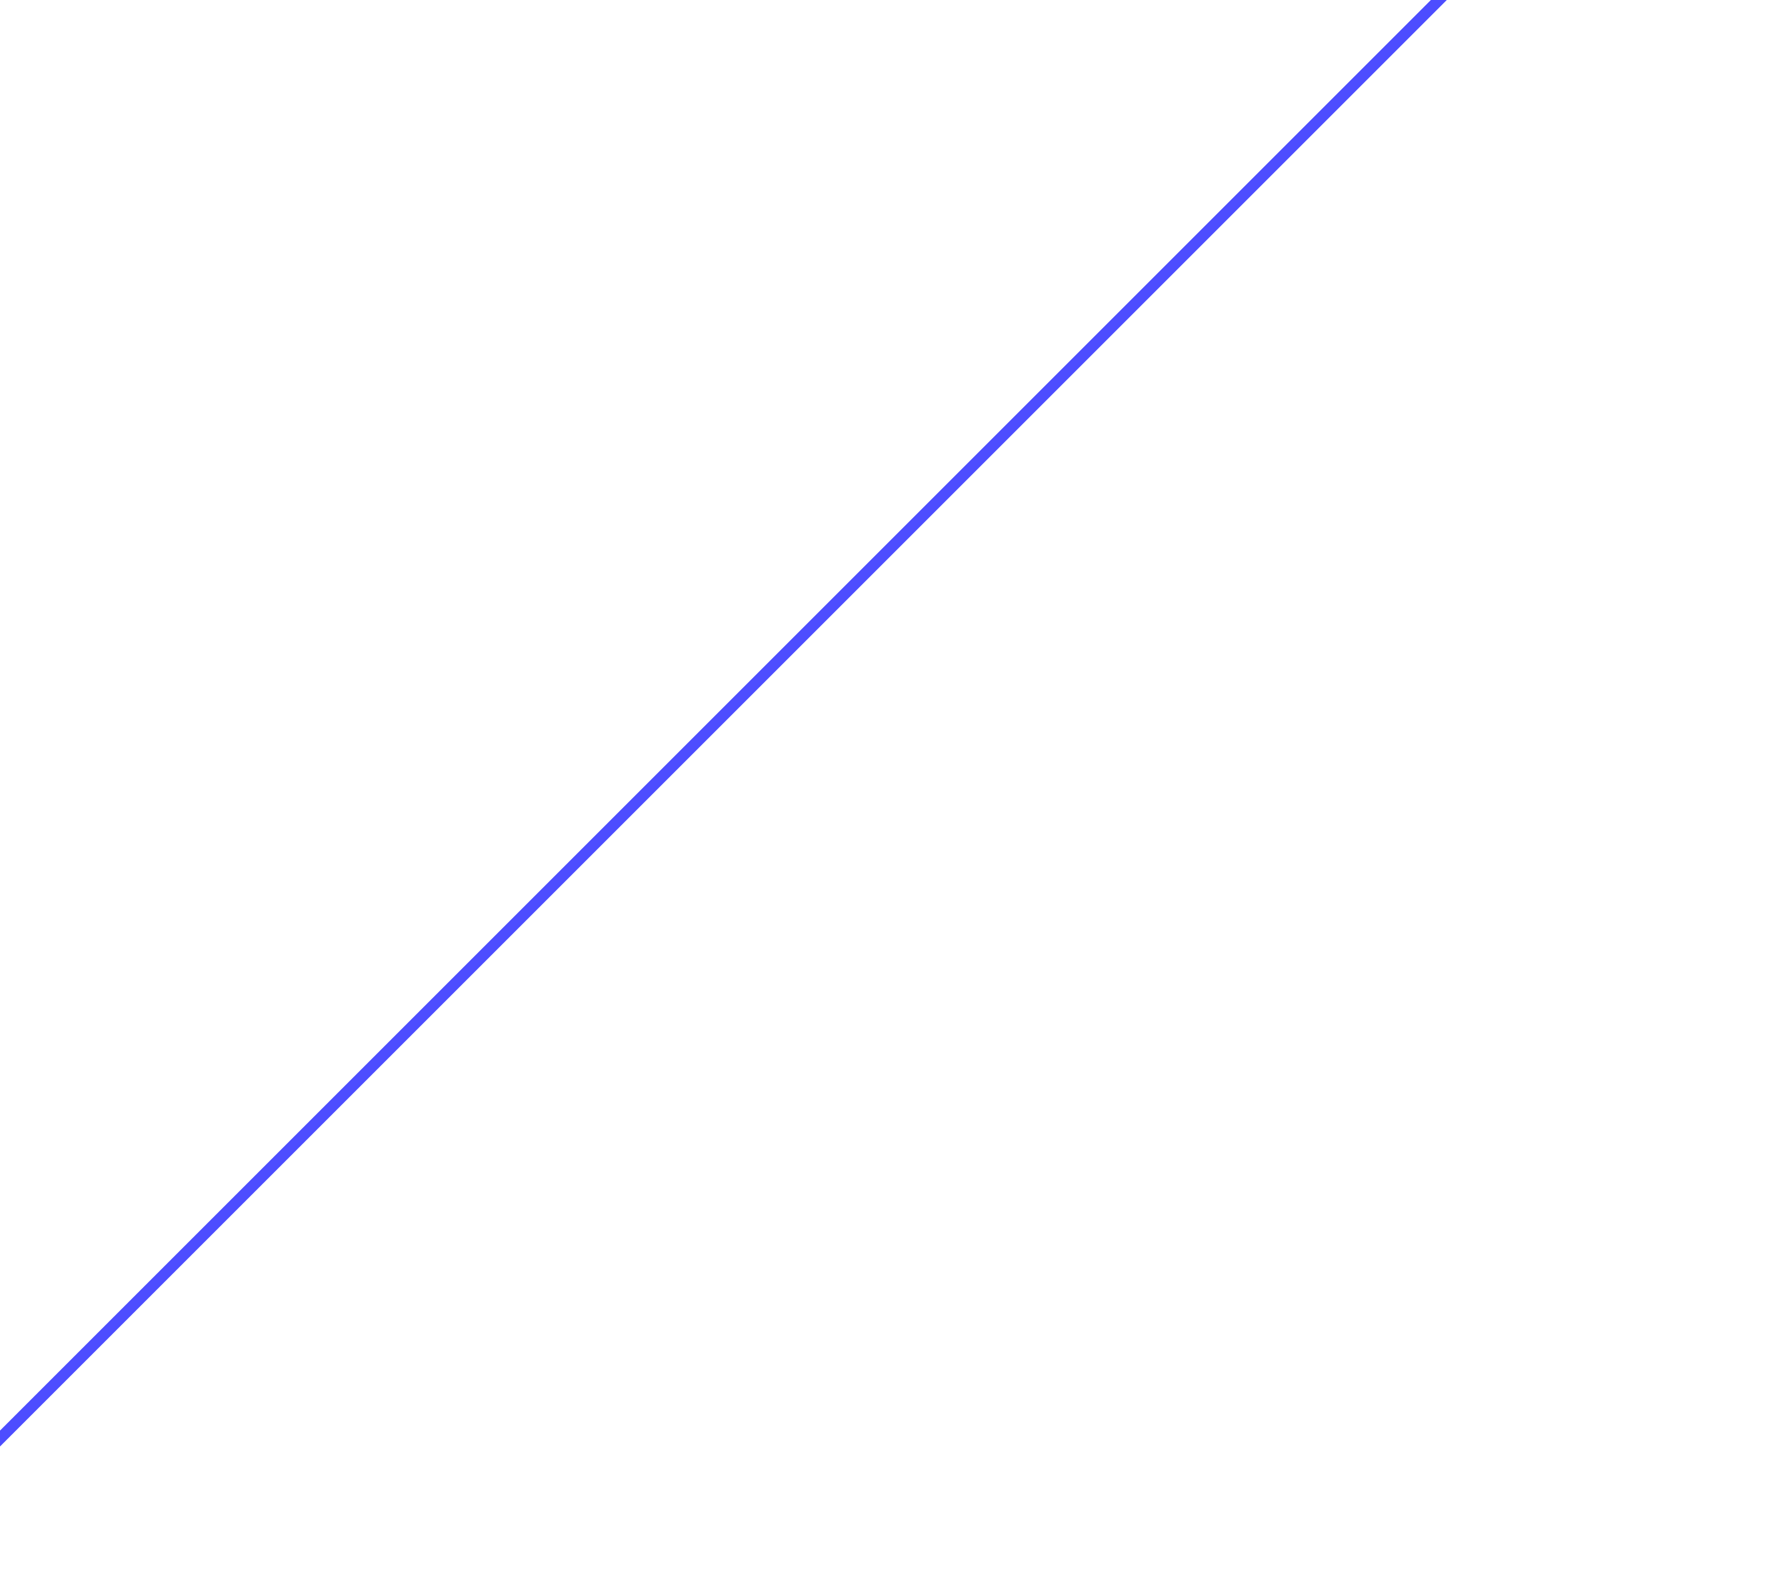


How to describe this function?
$$y$$
$$x$$

Slide 4
How to describe this function?
$$y$$
point symmetric to the origin (odd)
strictly monotonically increasing
unbounded
a root at the origin
$$x$$

Slide 5
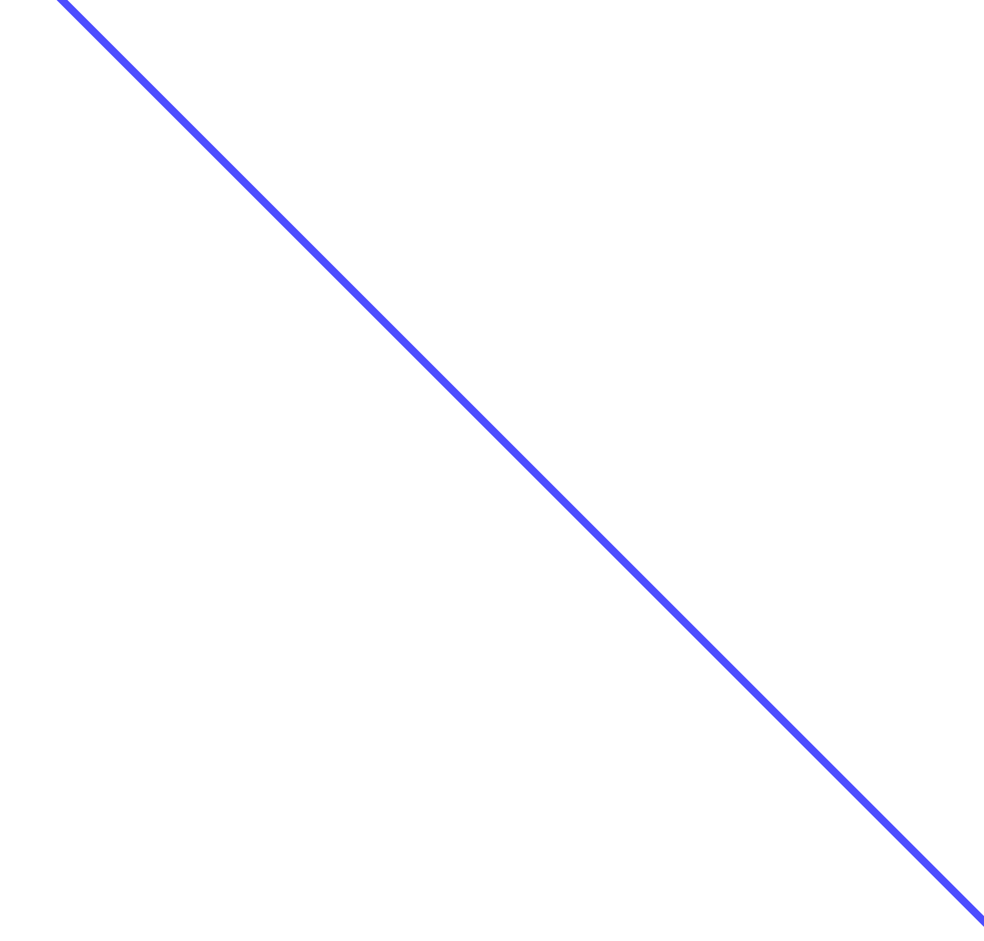
How to describe this function?
$$y$$
$$x$$

Slide 6
How to describe this function?
$$y$$
no simple symmetry
strictly monotonically decreasing
unbounded
one root
$$x$$

Slide 7
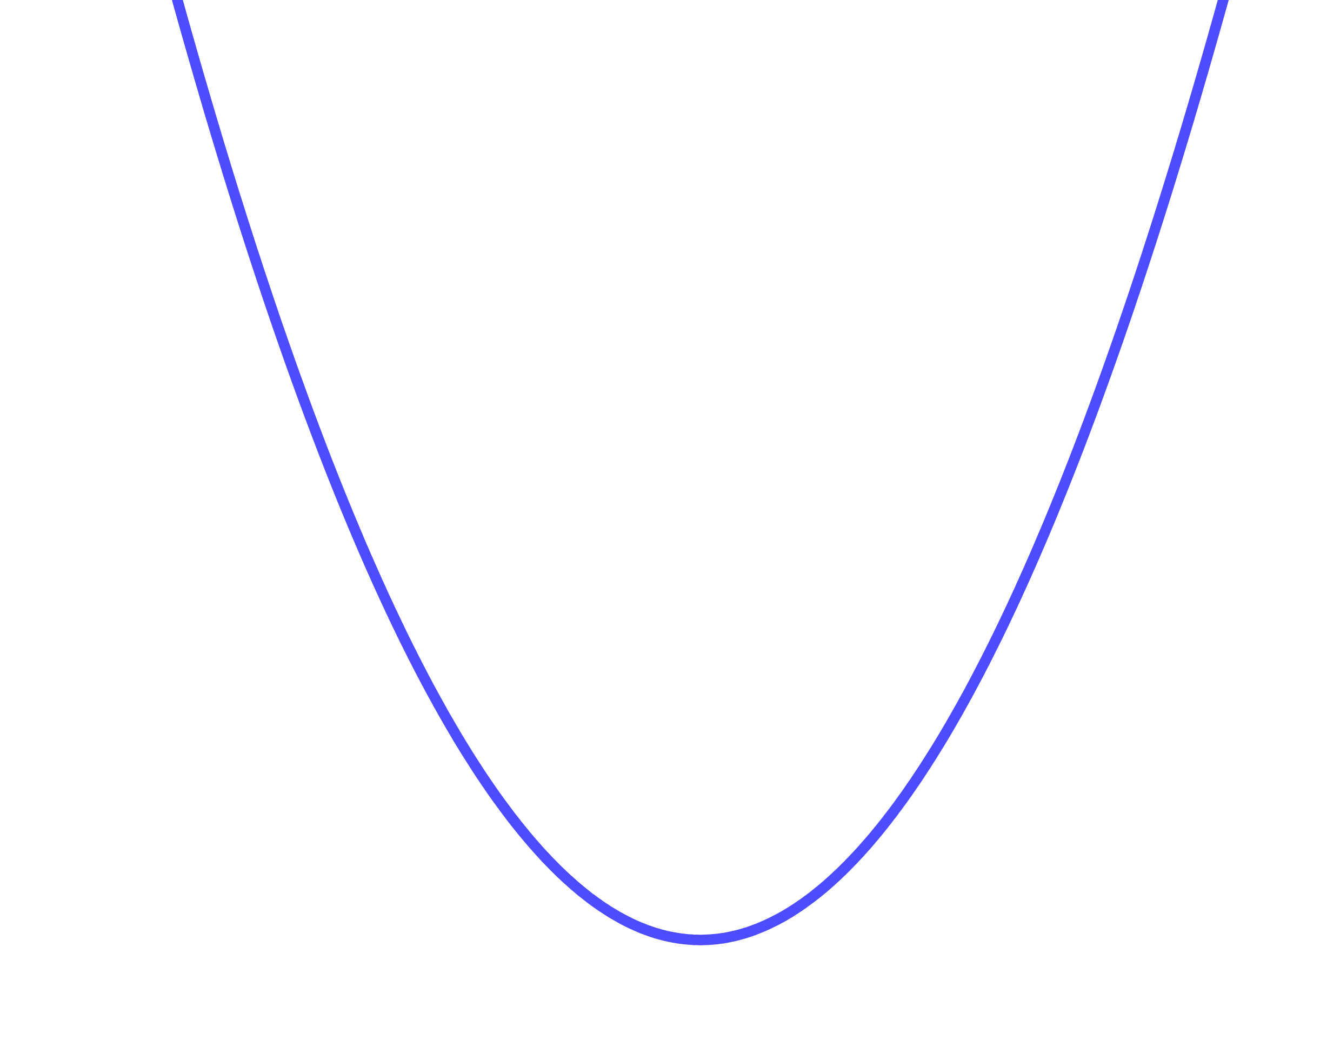
How to describe this function?
$$y$$
$$x$$

Slide 8
How to describe this function?
$$y$$
axially symmetric (even)
not monotoneous
bounded from below
no upper bound
two roots
$$x$$

Slide 9
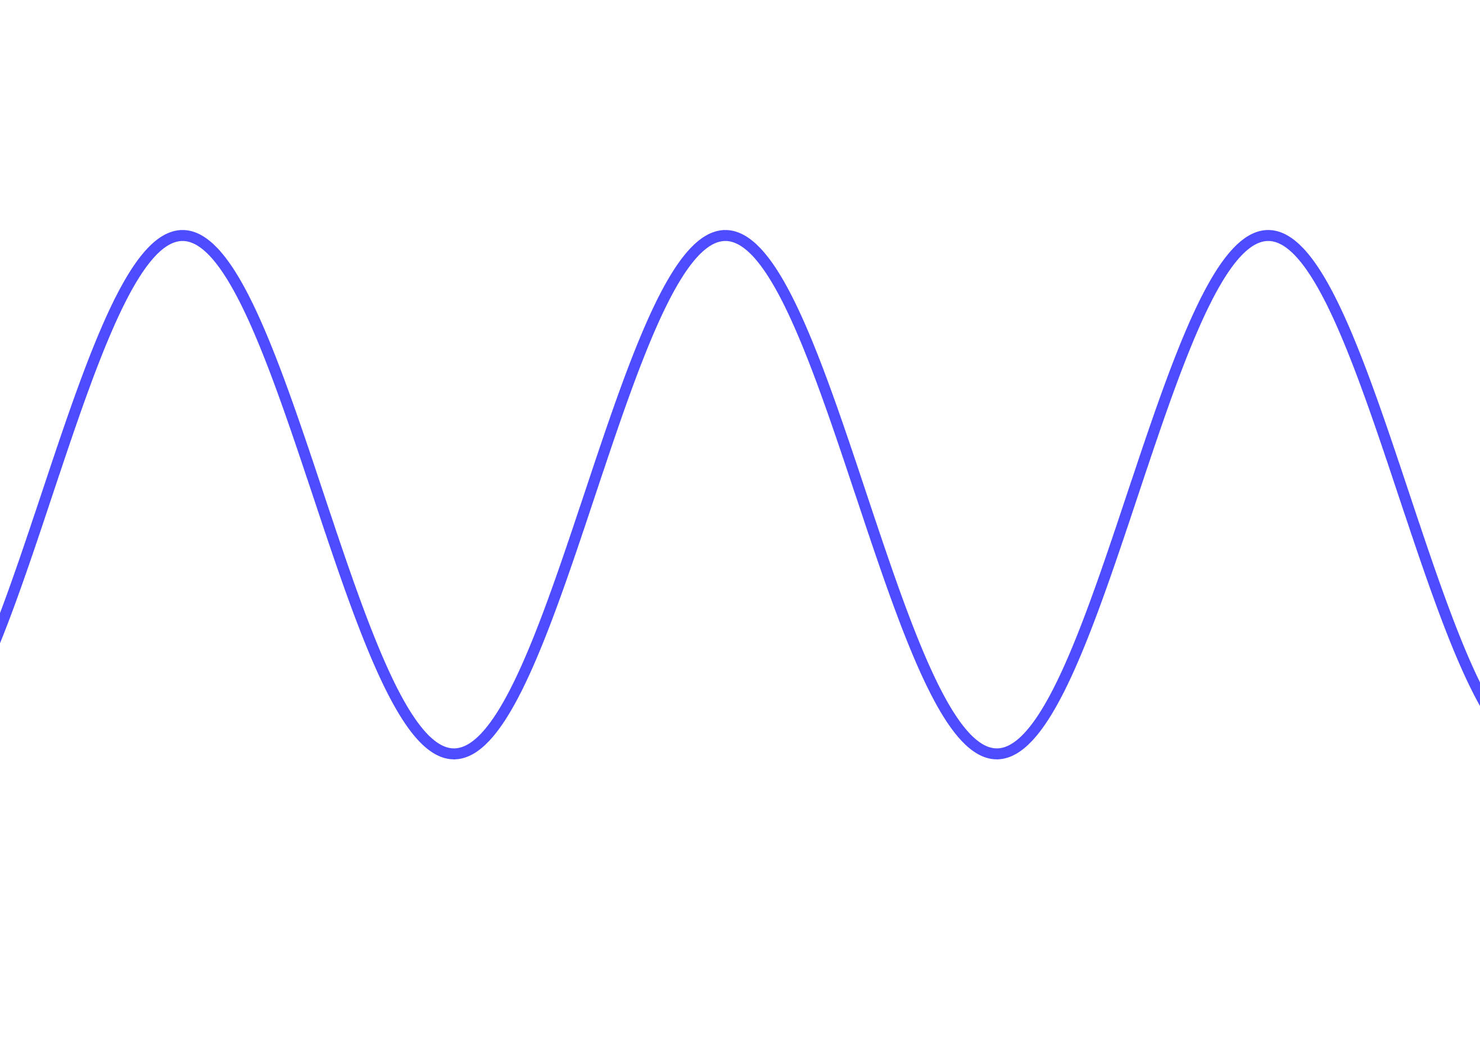
How to describe this function?
$$y$$
$$x$$

Slide 10
How to describe this function?
$$y$$
no simple symmetry
not monotoneous
bounded from below and below
periodic
infinitely many roots
$$x$$

Slide 11
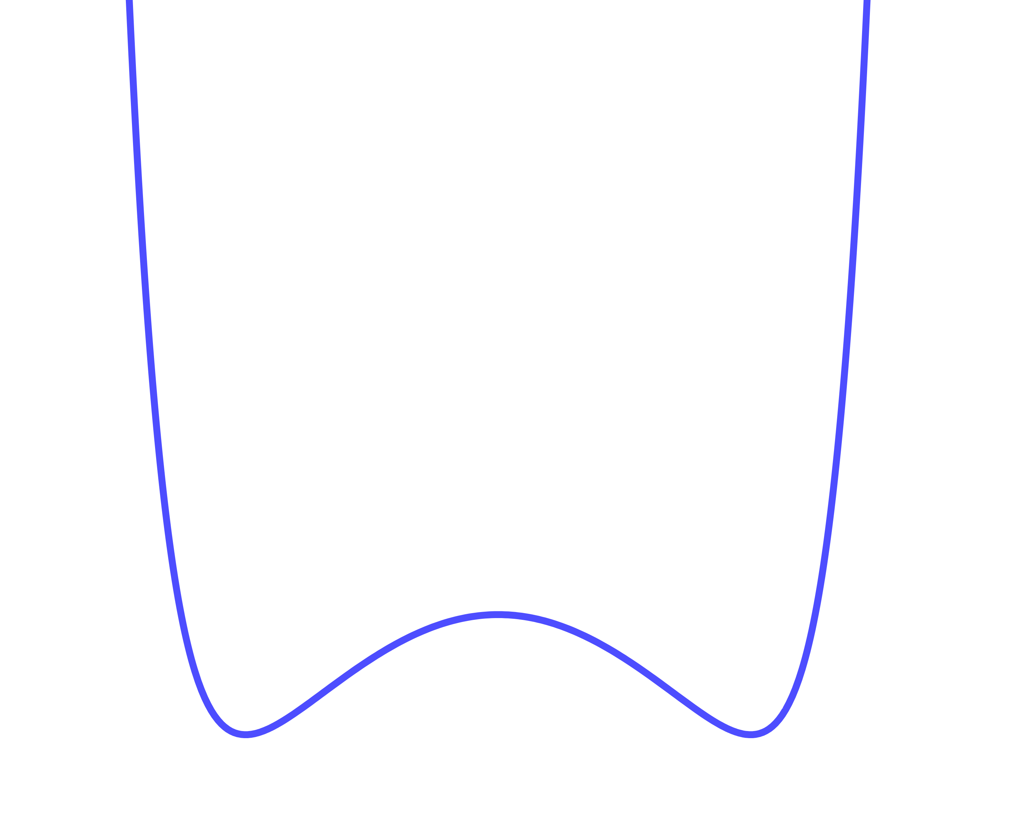
How to describe this function?
$$y$$
$$x$$

Slide 12
How to describe this function?
$$y$$
axially symmetric (even)
not monotoneous
bounded from below
no upper bound
two roots
$$x$$

Slide 13
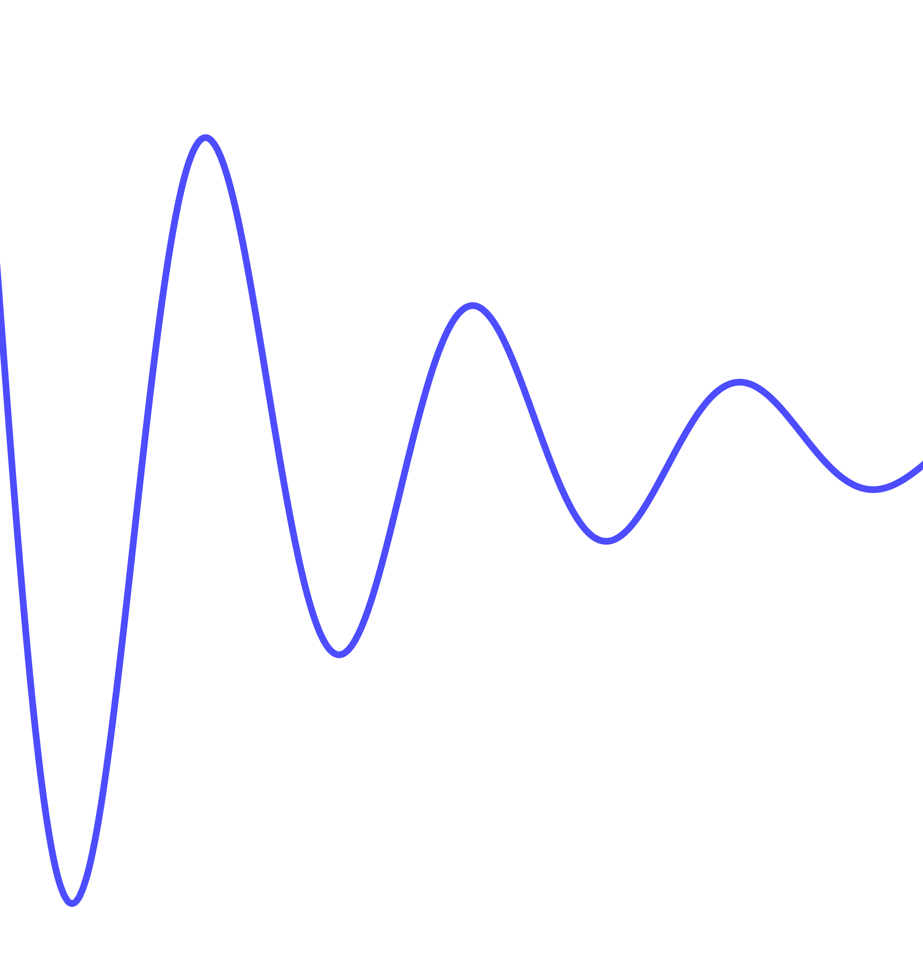
How to describe this function?
$$y$$
$$x$$

Slide 14
How to describe this function?
$$y$$
not symmetric
not monotoneous
oszillating (not periodic!)
infintely many roots
like cosine but with the amplitude changes (damped oszillation)
$$x$$

Slide 15
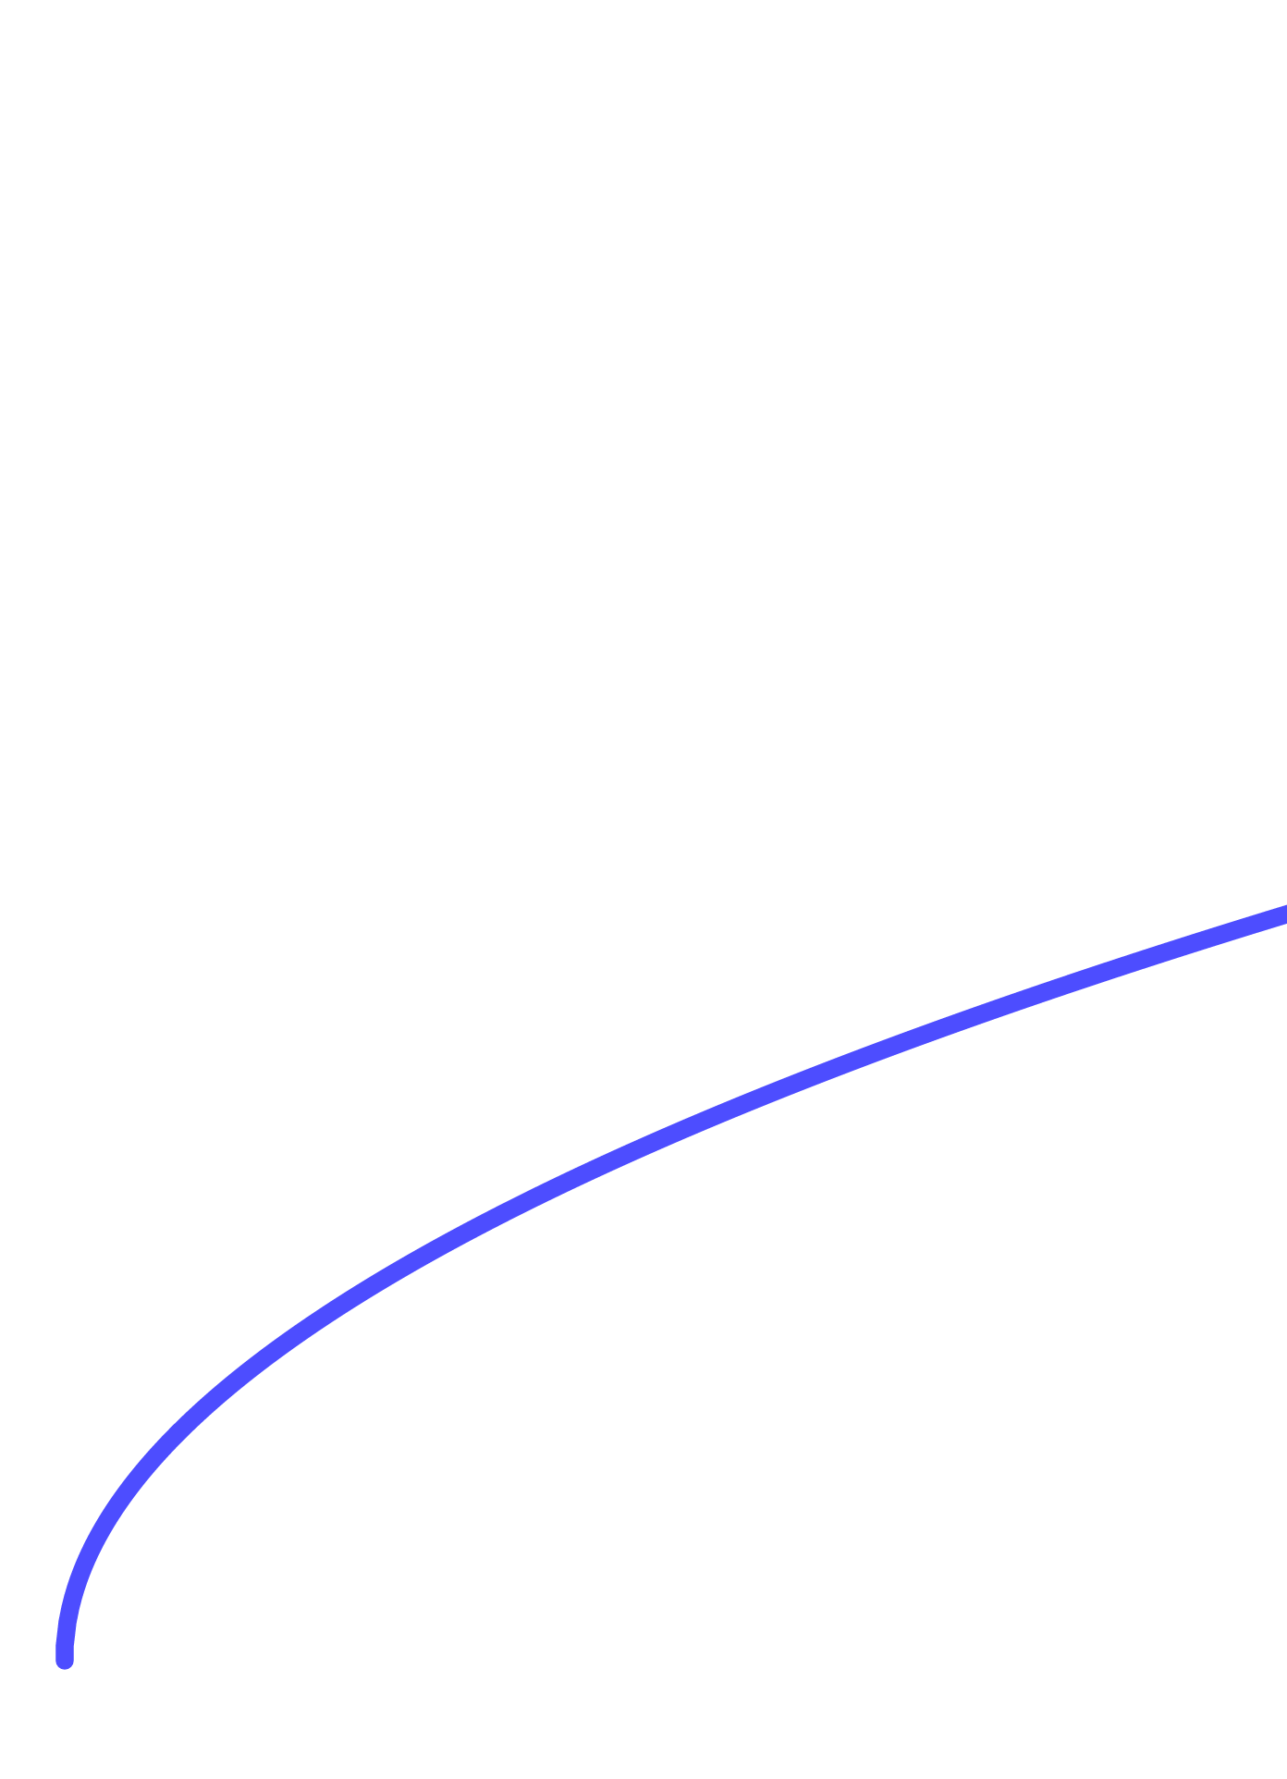
How to describe this function?
$$y$$
$$x$$

Slide 16
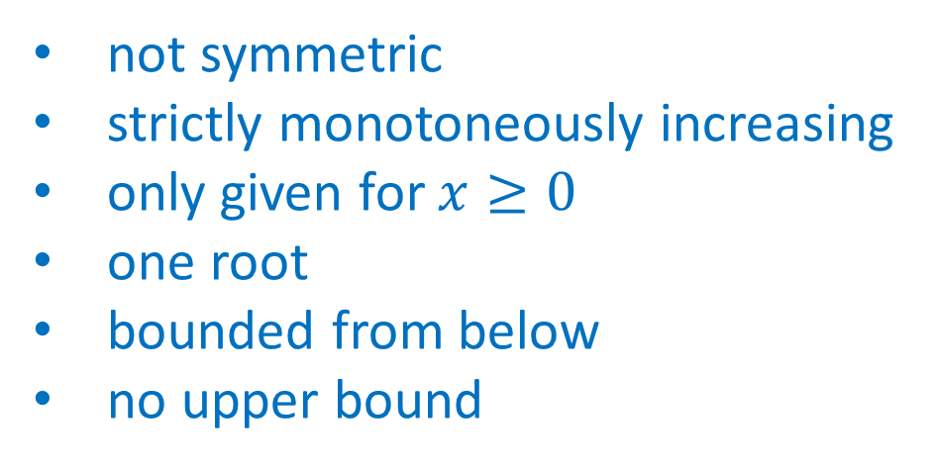
How to describe this function?
$$y$$
not symmetric
strictly monotoneously increasing
only given for $x≥0$
one root
bounded from below
no upper bound
$$x$$

Slide 17
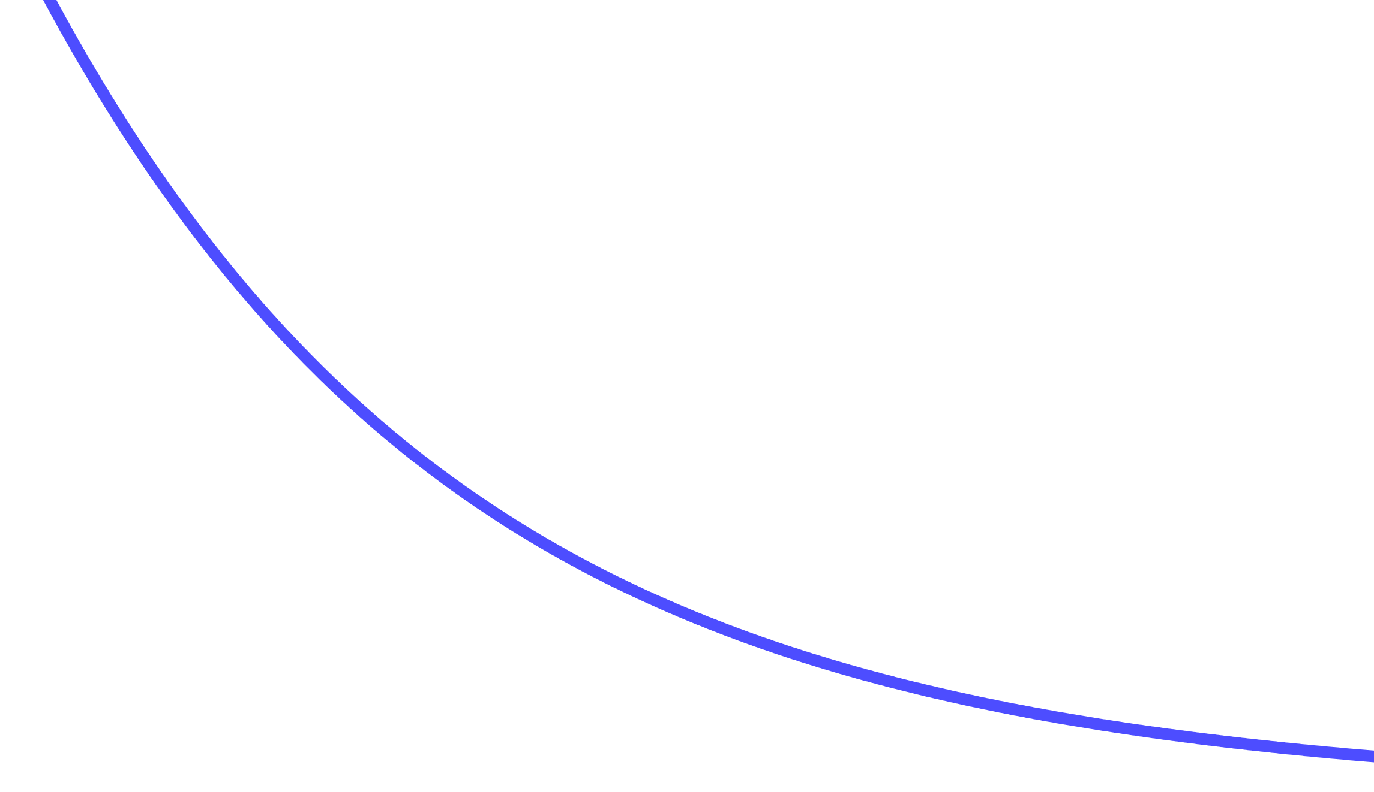
How to describe this function?
$$y$$
$$x$$

Slide 18
How to describe this function?
$$y$$
not symmetry
Strictly monotoneously decreasing
no roots
only positiv function values
bounded from below
no upper bound
$$x$$

Slide 19
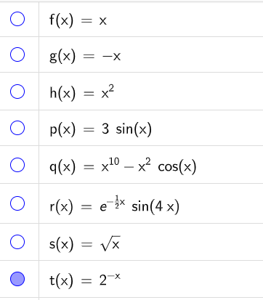
What is it actually?

