Slide 1

Xarray: An introduction to Python’s Labeled Array Package
A Lunch byte by Kayla Besong

Slide 2
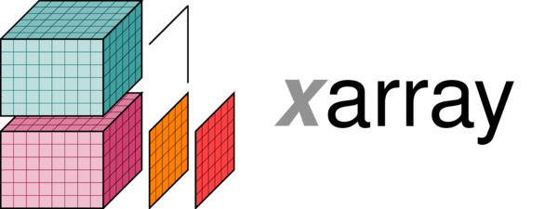
Xarray: what it is it
Xarray = NumPy-like arrays with labels in the form of dimensions, coordinates and attributes
Use labels to perform numerical operations, indexing
Helps eliminate for loops!!
Linked heavily with pandas
NetCDF = base of the data model –hooray!

Slide 3
Xarray: Pros
Apply operations over dimensions by name: x.sum(’lon'), x.mean(‘lat’), x.var(‘time’)
Select values/ranges by label instead of integer location:
x.sel(time='2014-01-01'))
x.sel(lat=slice(90, 0))
Mathematical operations (e.g., x - y)
Vectorize across multiple dimensions based on dimension names, not shape
Eliminate for loops!!
Split-apply-combine operations with groupby: x.groupby('time.year').mean()
“year”, “month”, “day”, “hour”, “minute”, “second”, “microsecond”, “season”, “dayofyear”, “dayofweek”

Slide 4

Xarray: Cons
Very slow for ’for-loops’ when required
Drags a lot of metadata behind
Best for simple analysis post for loops

Slide 5
