Slide 1
NASA GISS Panoply and the Grid Analysis and Display System (GrADS)
Introduction and Tutorial
Fall 2015 – Lunch Bytes

Slide 2
NASA GISS Panoply
http://www.giss.nasa.gov/tools/panoply/
FREE!!! netCDF, HDF, and GRIB data viewer
Available for Mac OS X, Windows, and Linux with a very easy download
Plot geo-referenced and other arrays from various datasets
Limited analysis tools available
Easily view netCDF data and header information

Slide 3
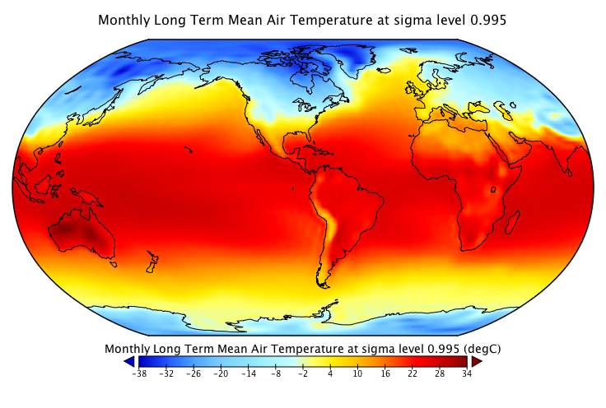
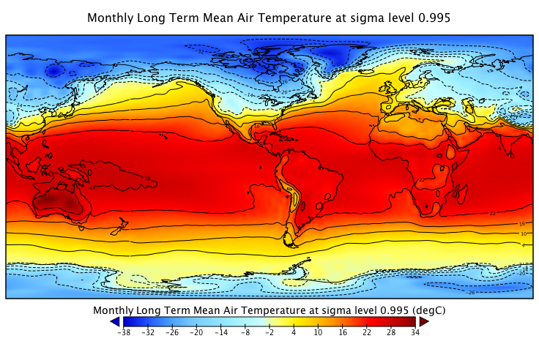
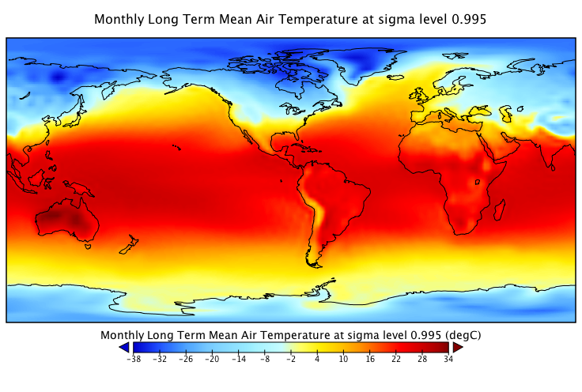
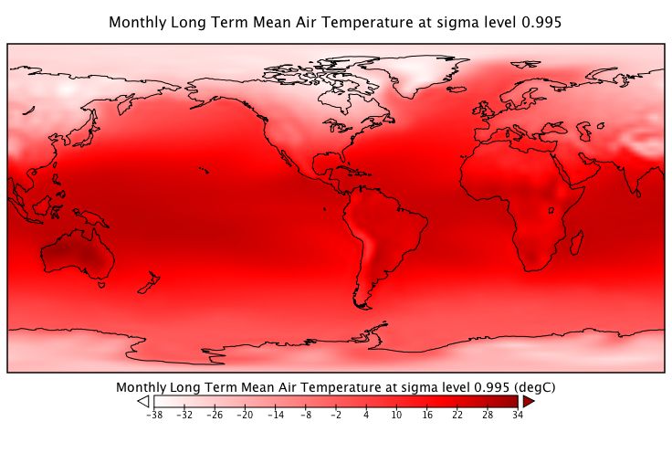
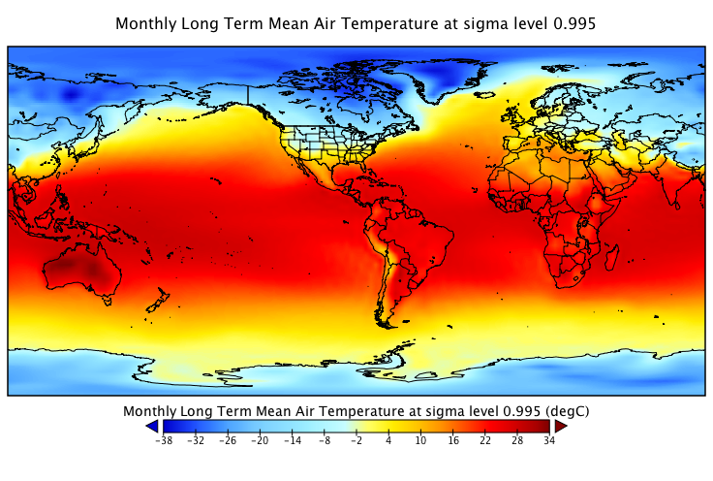
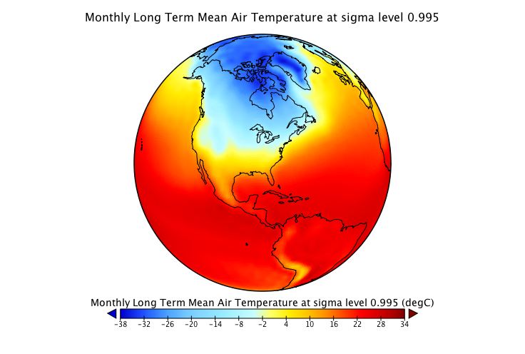
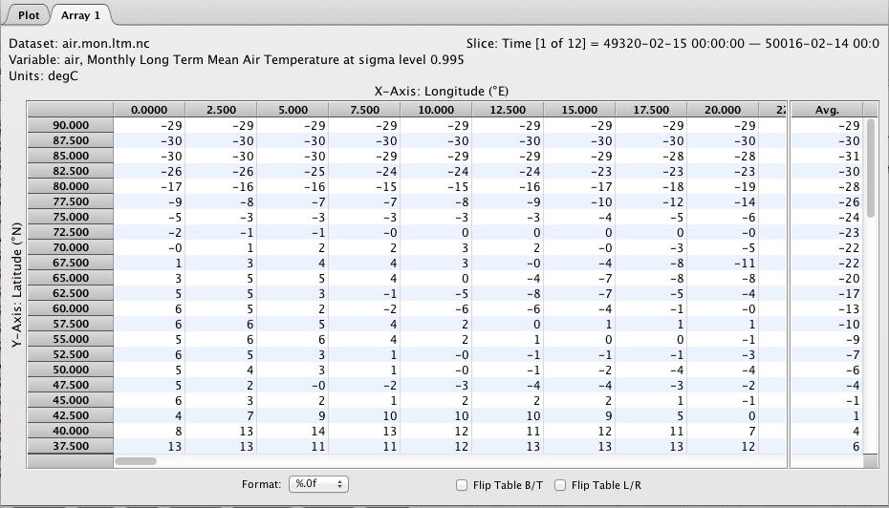
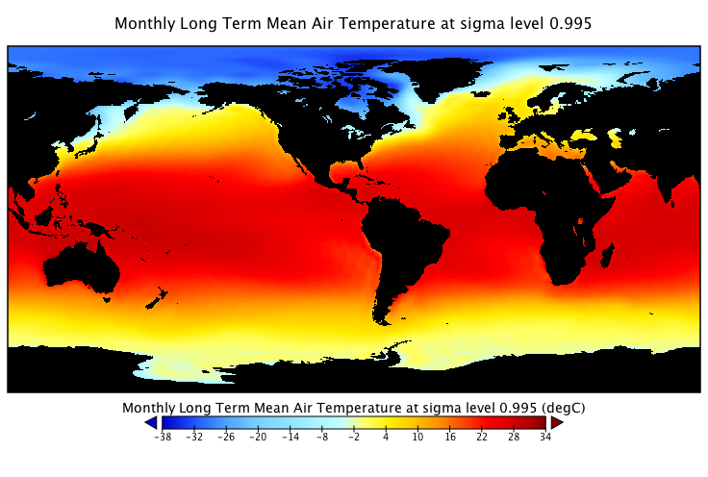
Panoply Plotting and Analysis Tools
Single Array Plotting Tools (one click!)
Various color tables and scales
Contours
Various Map Projections
State/Country Outlines and Land Mask
View Data Values in Array

Slide 4
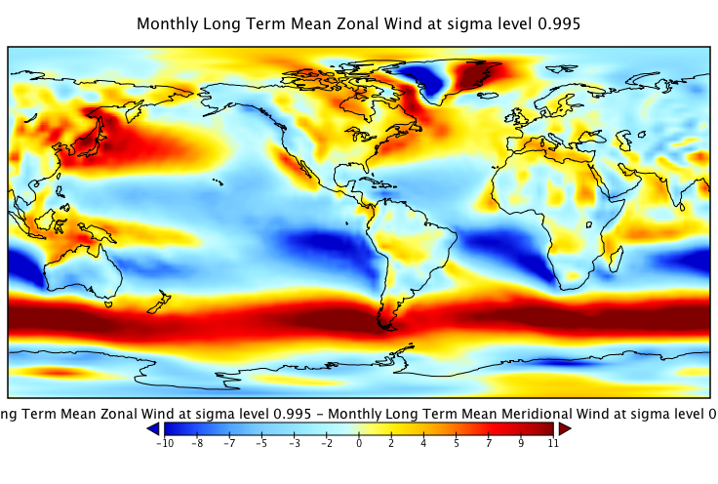
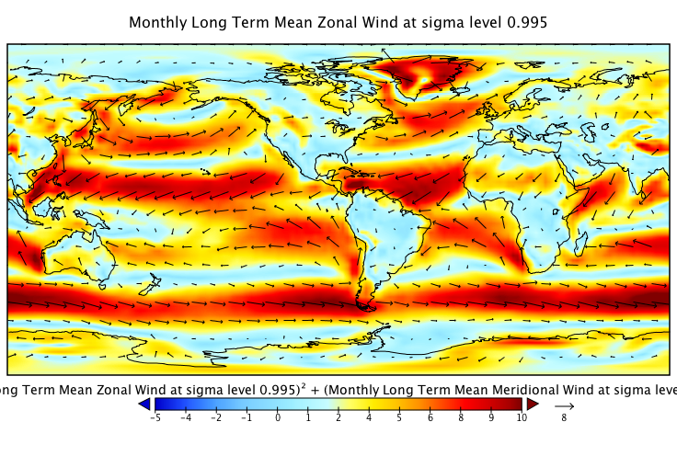
Panoply Plotting and Analysis Tools
Multi-Array Analysis (one click!)
Easily add, subtract, multiply, divide, average, and plot vector magnitude of up to 2 arrays
And… Easily Make Animations!!

Slide 5
NASA GISS Panoply
QUICK TUTORIAL!
Dataset(s): NCEP-NCAR Reanalysis
http://mpo581-hw1-basicstat.wikispaces.com/Getting+data

Slide 6
GrADS
Introduction and Tutorial
Dataset(s): NCEP-NCAR Reanalysis
http://mpo581-hw1-basicstat.wikispaces.com/Getting+data

Slide 7
Grid Analysis and Display System (GrADS)
Center for Ocean Land Atmosphere Studies (COLA) http://iges.org/grads/ - also FREE!!
Easy access, manipulation, and visualization of earth science data
Supports NetCDF, HDF, BUFR (for station data), GRIB
5-Dimensional data environment (lat, lon, vertical level, time, ensemble)
Execute operations at command line or through scripting
Built-in functions are provided

Slide 8
GrADS: Getting Started
Download and Configure **:
Download the software and follow instructions here http://iges.org/grads/downloads.html
GrADS is also available on the UM Supercomputing cluster
Open a terminal window and type “grads”
You will be prompted with a landscape vs. portrait question, press enter (default is landscape)
A graphics output window (X11) should open
You should now see a prompt: “ga->” This is where you enter grads commands, results will be displayed in the graphics output window
Open a NetCDF File:
ga-> sdfopen file.netcdf
Note that you can open multiple files
You will see the range of longitudes, latitudes, levels, time, and ensemble
See what is in the file
ga-> q file shows file description
ga-> q vars shows variable names and description in file

Slide 9
GrADS: Getting Started (Optional)
Setup GrADS Script Environment in your bash profile (or csh, etc)
GASCRP=$HOME/Documents/Work/GradsScripts/
export GASCRP
Some very useful scripts:
color.gs (easy color manipulation) http://kodama.fubuki.info/wiki/wiki.cgi/GrADS/script/color.gs?lang=en
xcbar.gs (colorbar) http://kodama.fubuki.info/wiki/wiki.cgi/GrADS/script/xcbar.gs?lang=en
basemap.gs (land/ocean mask)
http://www.iges.org/grads/gadoc/basemap.html

Slide 10
GrADS: Displaying Data
Some basic commands
set display color white sets the X11 background color
set grid off/on turns off/on grid lines
set grads off/on turns off/on GrADS label
d variable displays the given variable
c clear the display
set lon value or set lon value1 value2 set the range of longitudes in the display
set lat value or set lat value1 value2 set the range of latitudes in the display
set lev value or set lev value1 value2 set the range of levels in the display
set t value or set t value1 value2 set the time or time range to display
set gxout shaded shading between contours
set gxout contour contours without shading
reinit all files closed, defined objects released

Slide 11
GrADS: cint, gxout, titles, image output
Changing contour intervals
set cint value set the interval between labels
set clevs values set specific contour labels
Change the graphics output type
set gxout bar, contour, shaded, vector, print, etc
http://www.iges.org/grads/gadoc/gradcomdsetgxout.html
Add titles
draw title name main title
draw xlab name x-axis label
draw ylab name y-axis label
Output file
printim filename.png Output a PNG
MORE COMMANDS http://www.iges.org/grads/gadoc/commandsatt.html

Slide 12
GrADS: Basic Analysis http://mpo581-hw1-basicstat.wikispaces.com/GrADS+code
Average over months
timemean = ave(var,t=1,t=2)
d ave(var,t=1,t=2)
Average over longitude
d ave(var,lon=0,lon=359)
Average over latitude
d ave(var,lat=-90,lat=90)
Average over latitude and longitude (plot time series)
set t 1 12
set lat 0
set lon 0
timeseries = aave(var,lon=0,lon=359,lat=-90,lat=90)
d timeseries
MORE FUNCTIONS
http://www.iges.org/grads/gadoc/functionsatt.html

Slide 13
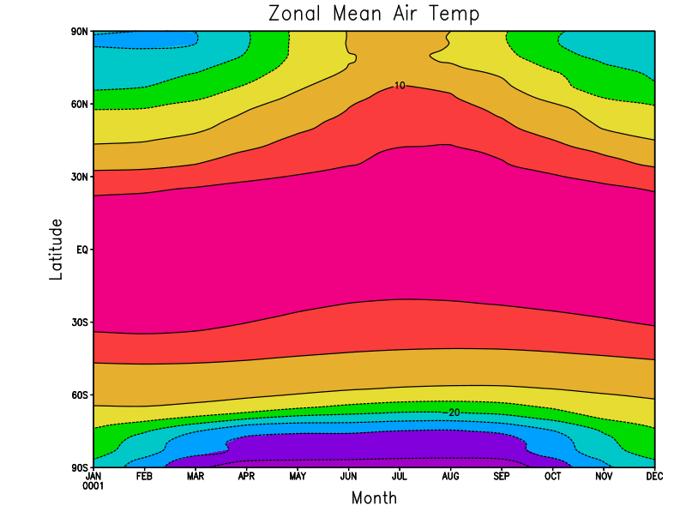
GrADS: Basic Analysis http://mpo581-hw1-basicstat.wikispaces.com/GrADS+code
Calculate zonally averaged temperature, make a plot of lat vs. time
set t 1 12 Time is set to 1 when you open a file, reset it to capture the times you want to plot
define alon=ave(air,lon=0,lon=360) Average over longitude
set lon 0 Have to set the longitude to a value to plot
set grads off Turn off GrADS logo
set gxout shaded Use shaded contours
set xyrev on Reverse Axes so lat is y and time is x
d alon Display variable
set gxout contour Want contours instead of shading
set clab masked Don’t put the white box around contour labels
d alon Display variable
draw title Zonal Mean Air Temp Write a plot title
draw xlab Month Write X-Axis Label
draw ylab Latitude Write Y-Axis Label
gxprint ZonalMeanAir.png Make the image file (can also use printim)

Slide 14
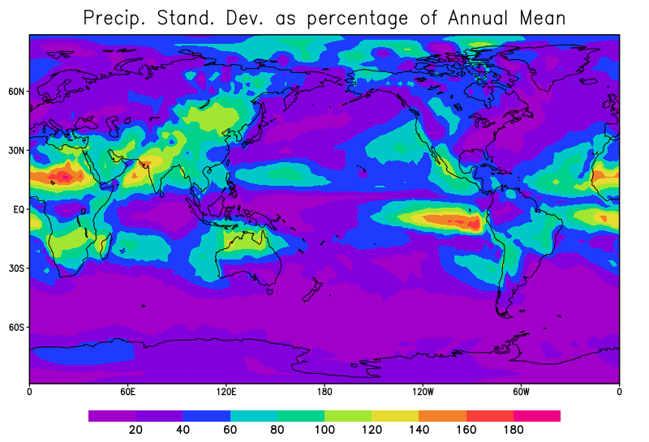
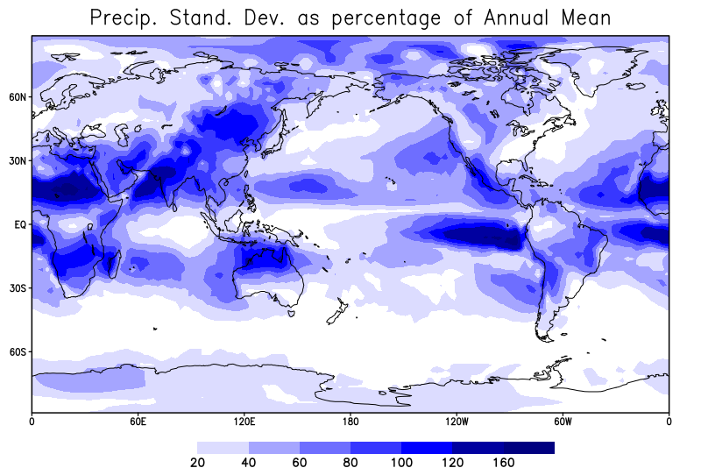
GrADS: Basic Analysis http://mpo581-hw1-basicstat.wikispaces.com/GrADS+code
Variance and Standard Deviation of Precipitation
sdfopen precip.mon.ltm.nc open precipitation file
precipt=ave(precip,t=1,t=12) time average
variance=(sum((precip-precipt)*(precip-precipt),t=1,t=12))/12 variance calculation
stddev=sqrt(variance) standard dev calculation
set grads off turn off grads logo
set gxout shaded want shaded plot
d 100*stddev/precipt plot as ratio of standard deviation and mean precip multiplied by 100 to make a percentage
xcbar draw a colorbar
Nice(er) Plot – Using mostly built-in Functions
set rgb 22 0 0 128
set rgb 21 0 0 160
set rgb 20 0 0 255
set rgb 19 55 55 255
set rgb 18 110 110 255
set rgb 17 165 165 255
set rgb 16 220 220 255
set clevs 20 40 60 80 100 120 160
set ccols 0 16 17 18 19 20 21 22
d 100*stddev/precipt

Slide 15
GrADS: Making “pretty” plots
* Basic Plot
set display color white
c
set grid off
set grads off
set gxout shaded
d air
set gxout contour
d air
draw title Basic Plot
gxprint BasicPlot.pdf
* Fancy Plot
set display color white
c
set grid off
set grads off
set parea 1 10 1 7.5
set xlopts 1 5 0.2
set ylopts 1 5 0.2
set mpdset mres
set gxout shaded
color -35 35 5 -kind darkblue->lightblue->white->red->darkred
d air
xcbar -line on -edge triangle -fw 0.15 -fh 0.18
set gxout contour
set clab masked
set clopts -1 7 0.12
d air
draw title Fancy Plot
gxprint FancyPlot.pdf

Slide 16
GrADS: Climate Anomalies http://www.iges.org/grads/gadoc/gradcomdmodify.html
modify command
modify var type
type can be seasonal (monthly or multi-monthly climatologies) or diurnal (climatologies over time period less than a day)
Example
set t 1 12
define clim = ave(var,t+0,t=last value,12)
modify clim seasonal
set t 1 last
define anom = var - clim

Slide 17
GrADS: Scripting http://www.iges.org/grads/gadoc/script.html http://www.wishingwork.com/grads/beginner-category/chapter8-scripting-language.html
Why script?
Certain functionalities possible in script that are not possible at command line interface
Assignment records
If/else constructs
While construct and counts
Etc.
Remembering what you did!
Basic how to:
Comment with *
Enclose all GrADS functions with ‘ ‘
Run the script with script.gs

Slide 18
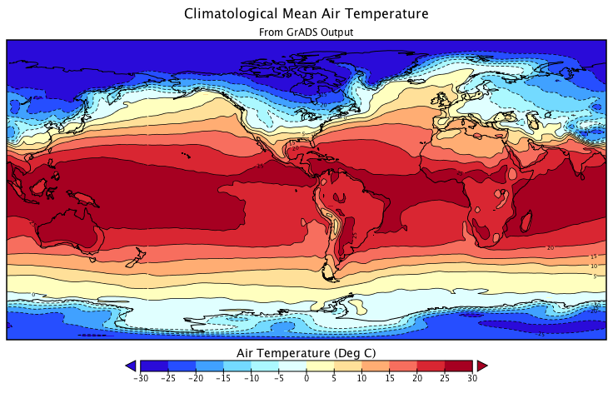
GrADS: Output a new NetCDF File http://www.iges.org/grads/gadoc/gradcomdsdfwrite.html
GrADS can be used to output a NetCDF file of your analyzed data, to make a smaller dataset, etc.
Use command sdfwrite
Example: Output a netCDF file with only 1 time step, rename the variable
sdfopen air.mon.ltm.nc
set t 1
define temp = air
set sdfwrite temp.t1.nc
sdfwrite temp
Can even now open in Panoply to plot!!

