Slide 1
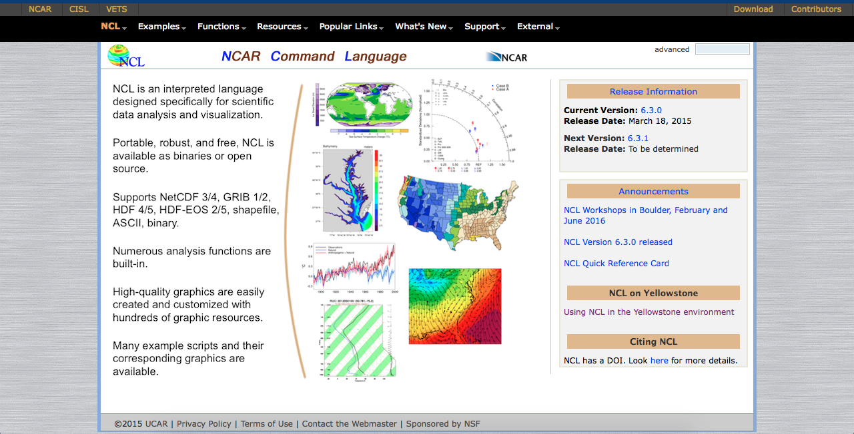
https://www.ncl.ucar.edu

Slide 2
What is NCL? Why use it?
NCL is a “real” programming language
Designed for scientific data analysis and visualization (earth science focus)
Creates high-quality graphics, hundreds of resources available to customize graphics
Lots of support (example scripts, email list, etc.)
Fortran/C-Code wrappers

Slide 3
Caveats
Steep learning curve
Function/procedure naming conventions not consistent
You can spend a LOT of time beautifying your plot

Slide 4
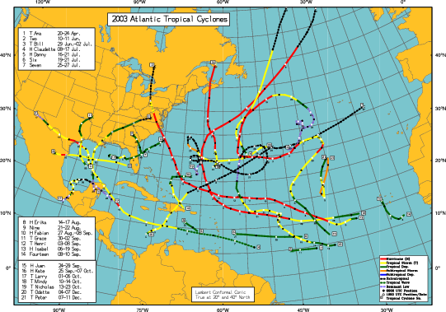
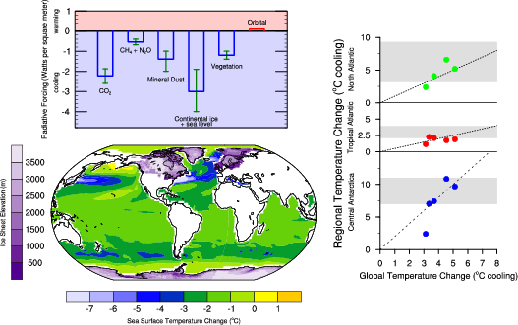
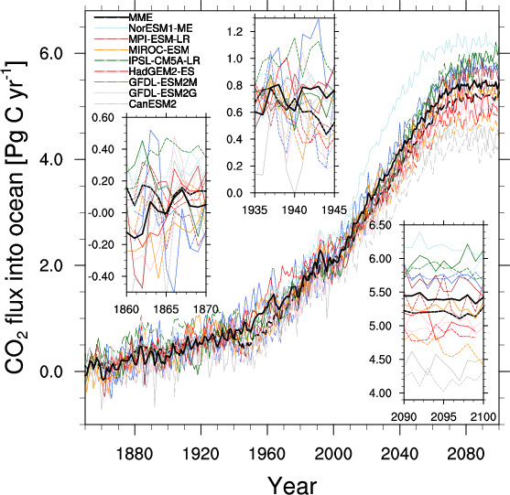
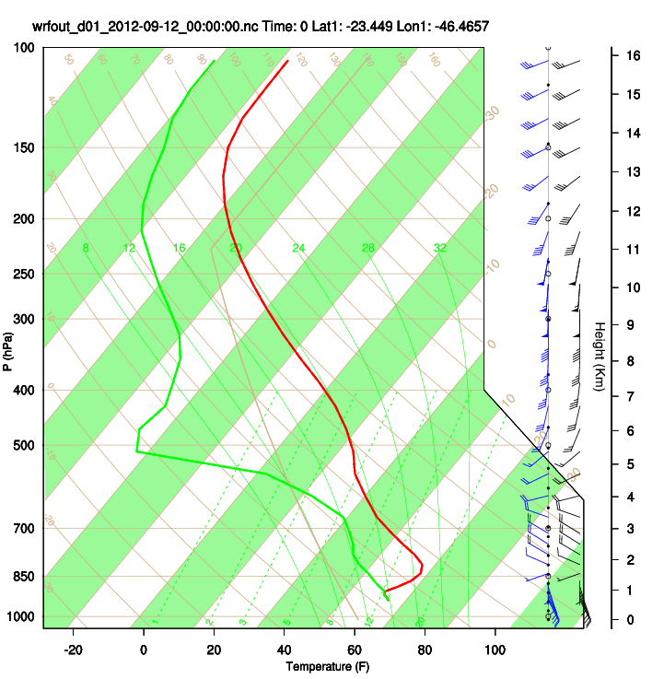

Slide 5
