Slide 1
WIE-CHING-DU National University of Tainan, Dept of Computer Science and Information Engineering,NUTN
Activity Recognition using Cell Phone Accelerometers
On-line

Slide 2
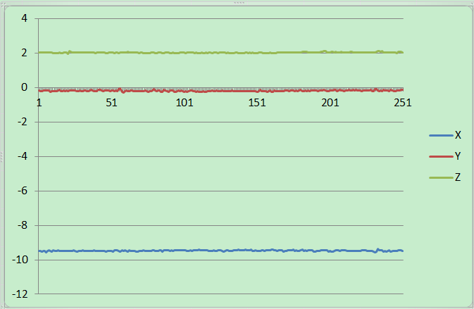
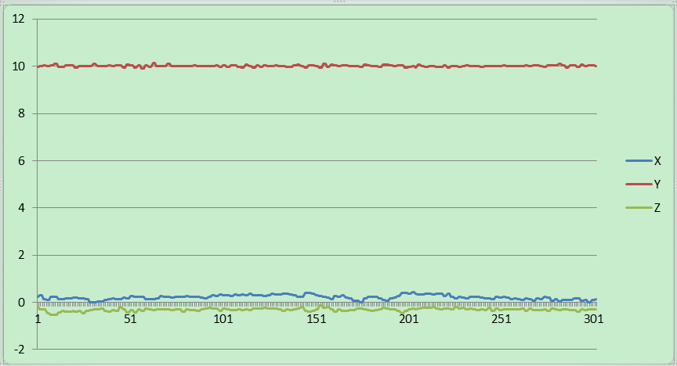
The Activities 1/3
Fig1.sit
Fig2.stand

Slide 3
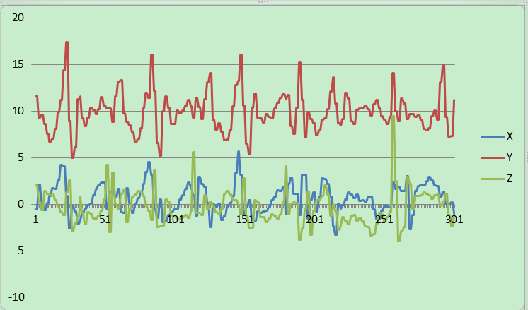
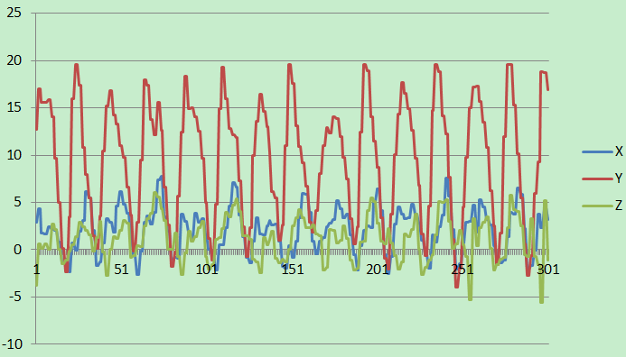
The Activities 2/3
Fig3.Walk
Fig4.jog

Slide 4
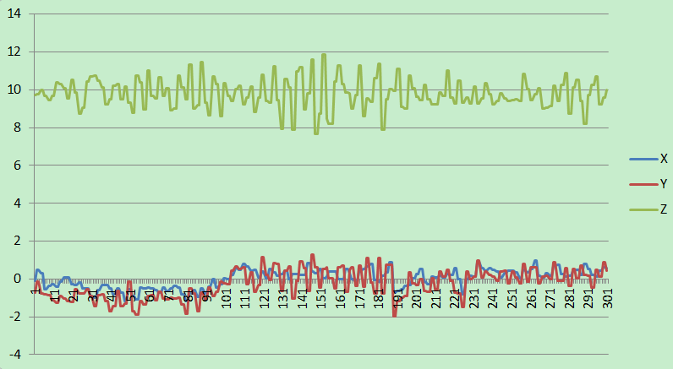
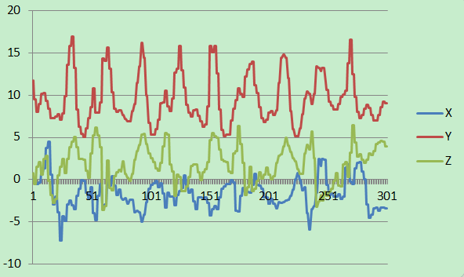
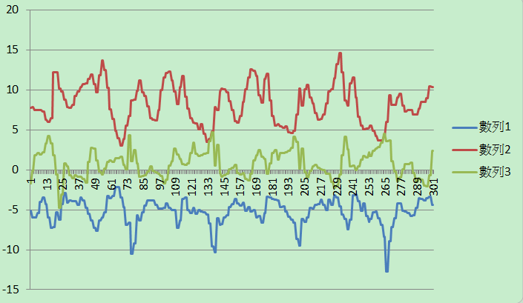
The Activities 3/3
Fig5.Ride
Fig7. Ascending Stairs
Fig6. Descending Stairs

Slide 5
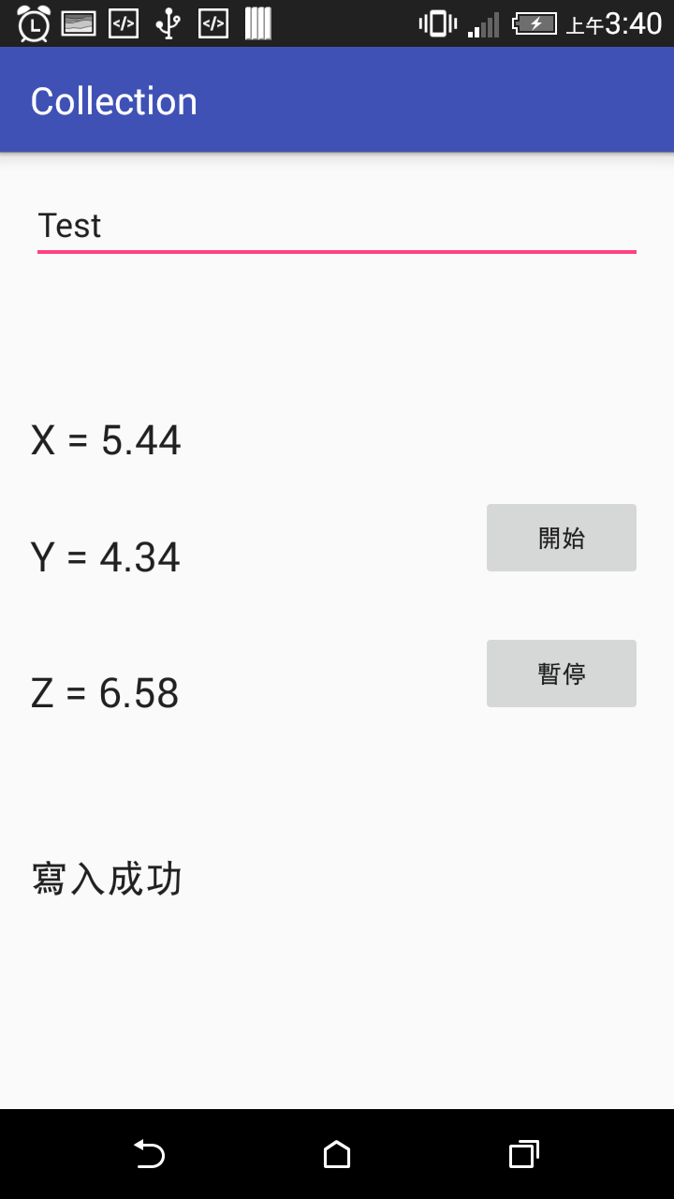
APP
Fig8. VIEW

Slide 6
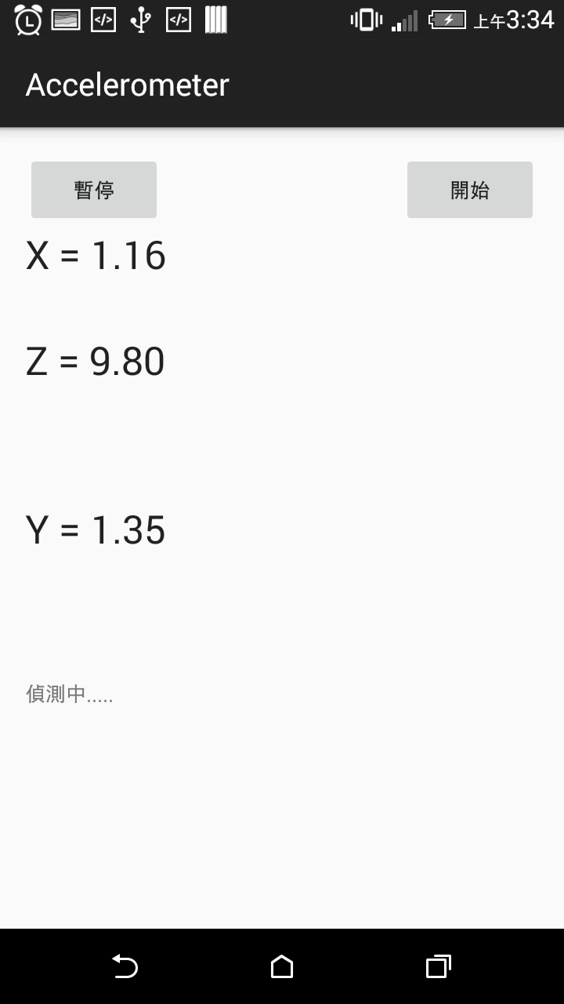
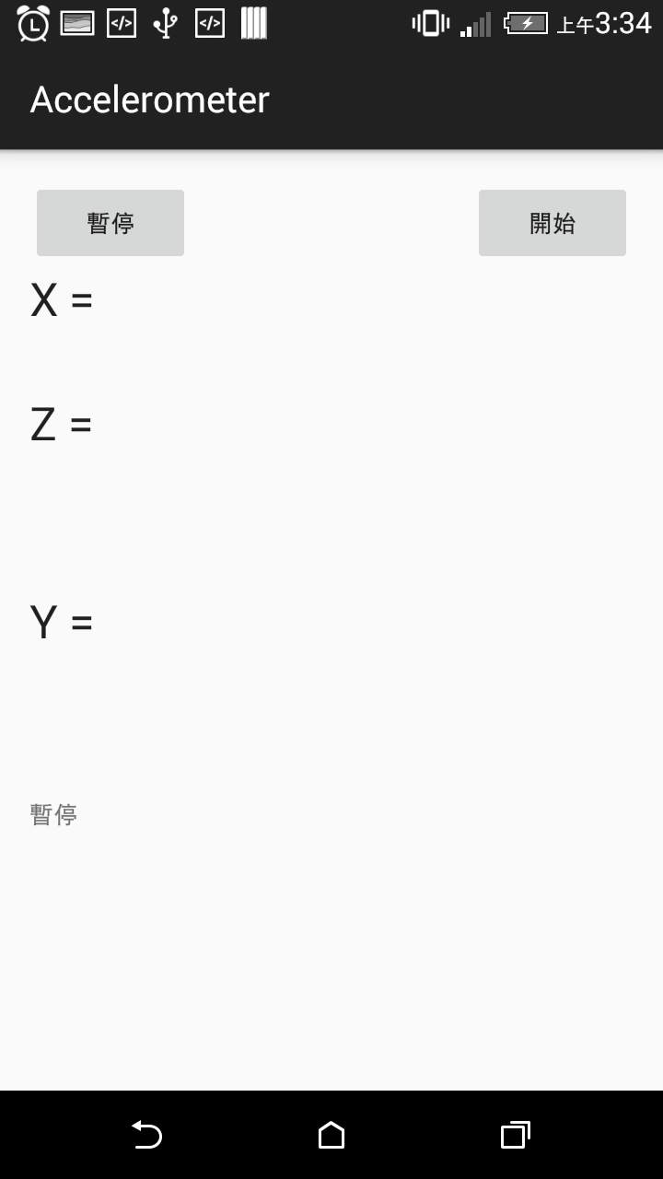
app

Slide 7
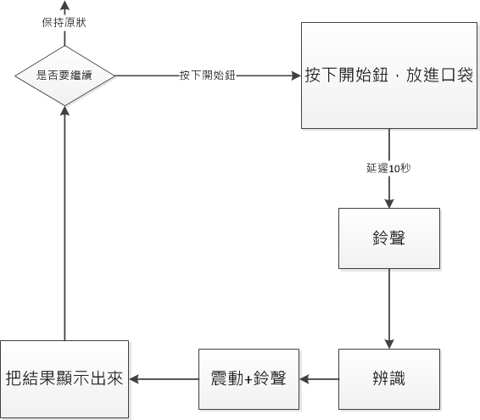
flow

Slide 8
confuse matrix
 | SIT | STAND | WALK | RIDE | JOG | ASCENDING STAIRS | DESCENDING STAIRS
SIT | 9 | 1 | 0 | 1 | 0 | 0 | 0
STAND | 0 | 9 | 0 | 0 | 0 | 0 | 0
WALK | 0 | 0 | 9 | 0 | 0 | 0 | 8
RIDE | 1 | 0 | 0 | 8 | 0 | 1 | 0
JOG | 0 | 0 | 0 | 0 | 10 | 0 | 0
ASCENDING STAIRS | 0 | 0 | 0 | 1 | 0 | 8 | 0
DESCENDING STAIRS | 0 | 0 | 1 | 0 | 0 | 1 | 2
Precision | 81% | 100% | 52% | 88% | 100% | 88% | 50%
Recall | 90% | 90% | 90% | 80% | 100% | 80% | 20%
accuracy | 78%

Slide 9


