Slide 1

Chapter 2 Solutions of Equations in
One Variable
Find a root of f (x) = 0
☑ 2.1 The Bisection Method
Theorem: (Intermediate Value Theorem)
If f ∈ C[a, b] and K is any number between f(a) and f(b), then there exists a number p ∈ (a, b) for which f(p) = K.
a
p₁
p
a
b
b
p₂
1/16

Slide 2

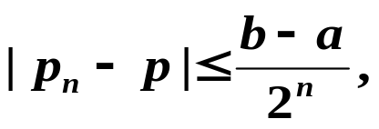
Chapter 2 Solutions of Equations in One Variable -- The Bisection Method
Discussion 4: When to stop?
Theorem: Suppose that f ∈ C[a, b] and f(a) · f(b) < 0. The Bisection method generates a sequence { p_{n} } (n = 0, 1, 2, …) approximating a zero p of f with
when n ≥ 1.
Proof: p.52
2/16

Slide 3
Chapter 2 Solutions of Equations in One Variable -- The Bisection Method
Algorithm: Bisection
To find a solution to f (x) = 0 given the continuous function f on the interval
[ a, b ], where f (a) and f (b) have opposite signs.
Input: endpoints a, b; tolerance TOL; maximum number of iterations N_{max}.
Output: approximate solution p or message of failure.
Step 1 Set i = 1;
FA = f (a) ;
Step 2 While ( i ≤ N_{max}) do steps 3-6
Step 3 Set p = a + ( b – a ) / 2 ; /* compute p_{i} */
FP = f (p) ;
Step 4 If ( FP == 0 ) or ( b − a ) / 2 < TOL then Output (p);
STOP; /* successful */
Step 5 Set i ++;
Step 6 If sign(FA) · sign(FP) > 0 then set a = p ; FA = FP ;
Else set b = p ; /* update a_{i}, b_{i} */
Step 7 Output (Method failed after N_{max} iterations); /* unsuccessful */
STOP.
Why not
p = ( a + b ) / 2 ?
Why not
FA · FP > 0?
3/16

Slide 4

Chapter 2 Solutions of Equations in One Variable -- The Bisection Method
① Simple, only requires a continuous f ;
② Always converges to a solution.
① Slow to converge, and a good intermediate approximation can be inadvertently discarded;
② Cannot find multiple roots and complex roots.
Note:
Practically, we can sketch a graph of f(x) before applying the bisection method. Or use a subroutine to partition the interval into several sub-intervals [a_{k}, b_{k}] so that f (a_{k})·f (b_{k}) < 0 even when
f (a)·f (b) > 0.
HW: p.54 #13, 15
4/16

Slide 5

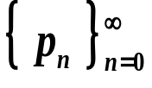
Chapter 2 Solutions of Equations in One Variable -- Fixed-Point Iteration
☑ 2.2 Fixed-Point Iteration
equivalent
f (x) = 0
x = g (x)
Root of f (x)
Fixed-point of g (x)
Start from an initial approximation p₀ and generate the sequence
by letting p_{n} = g( p_{n – 1} ), for each n ≥ 1. If the sequence
converges to p and g is continuous, then
Idea
So basically we are done! I can’t believe it’s so simple!
What’s the problem?
Oh yeah? Who tells you that the method is convergent?
5/16

Slide 6
Chapter 2 Solutions of Equations in One Variable -- Fixed-Point Iteration
Discussion 5: Which ones are convergent and why?
y
y = x
y
y = x
t₀
y=g(x)
t₀
y=g(x)
x
x
p₀
p
p₀
p
y
y = x
y
y = x
y=g(x)
y=g(x)
t₀
t₀
x
x
p₀
p
p₀
p
6/16

Slide 7
Chapter 2 Solutions of Equations in One Variable -- Fixed-Point Iteration
Theorem: (Fixed-Point Theorem)
Let g ∈ C[a, b] be such that g(x) ∈ [a, b], for all x in [a, b]. Suppose, in addition, that g’ exists on (a, b) and that a constant 0 < k < 1 exists with
|g’(x)| ≤ k for all x ∈ (a, b). Then, for any number p₀ in [a, b], the sequence defined by p_{n} = g( p_{n – 1} ), n ≥ 1, converges to the unique fixed point p in [a, b].
Discussion 6: How many points must we prove? Please list them out.
7/16

Slide 8
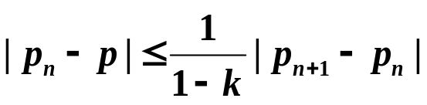
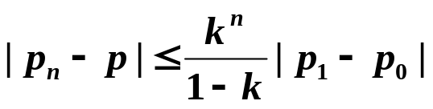
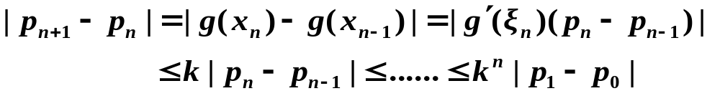
Chapter 2 Solutions of Equations in One Variable -- Fixed-Point Iteration
Corollary: If g satisfies the hypotheses of the Fixed-Point Theorem, then bounds for the error involved in using p_{n} to approximate p are given by (for all n ≥ 1)
and
Proof:
Discussion 7: What does the above corollary tell us? Why do we need two different inequalities?
8/16

Slide 9
Chapter 2 Solutions of Equations in One Variable -- Fixed-Point Iteration
Algorithm: Fixed-Point Iteration
Find a solution to p = g(p) given an initial approximation p₀.
Input: initial approximation p₀; tolerance TOL; maximum number of
iterations N_{max}.
Output: approximate solution p or message of failure.
Step 1 Set i = 1;
Step 2 While ( i ≤ N_{max}) do steps 3-6
Step 3 Set p = g(p₀); /* compute p_{i} */
Step 4 If | p − p₀ | < TOL then Output (p); /* successful */
STOP;
Step 5 Set i ++;
Step 6 Set p₀ = p ; /* update p₀ */
Step 7 Output (The method failed after N_{max} iterations); /* unsuccessful */
STOP.
9/16

Slide 10




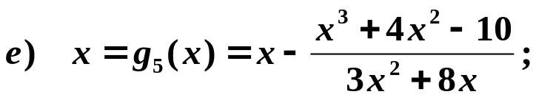
Chapter 2 Solutions of Equations in One Variable -- Fixed-Point Iteration
Example: Find the unique root of the equation x³ + 4x² – 10 = 0 in [1, 2]. Using the following equivalent fixed-point forms with p₀ = 1.5, which one is the best? (The root is approximately 1.365230013.)
❒
❒
✓
✓

But why?
✓
OK in [1, 1.5].
k ≈ 0.66
k ≈ 0.15
HW:
p.64 #3, p.65 #19
10/16

Slide 11
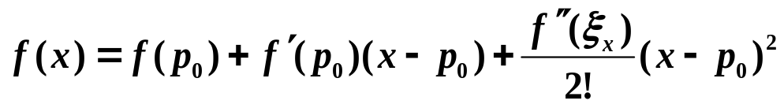
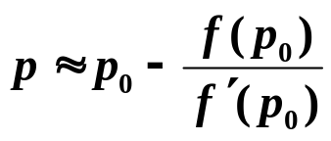

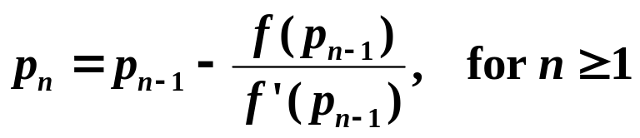
Chapter 2 Solutions of Equations in One Variable – Newton’s Method
☑ 2.3 Newton’s Method (Newton-Raphson Method)
Idea: Linearize a nonlinear function using Taylor’s expansion.
Let p₀ ∈ [a, b] be an approximation to p such that f ’(p₀) ≠ 0. Consider the first Taylor polynomial of f (x) expanded about p₀ :
where ξ_{x} lies between p₀ and x .
Assume that | p − p₀| is small, then (p − p₀)² is much smaller. Then:
y
linear
p
x
p₀
11/16

Slide 12
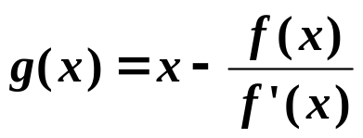
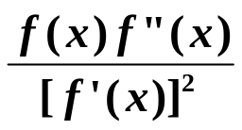
Chapter 2 Solutions of Equations in One Variable – Newton’s Method
Theorem: Let f ∈ C²[a, b]. If p ∈[a, b] is such that f(p) = 0 and f ’(p) ≠ 0, then there exists a δ > 0 such that Newton’s method generates a sequence { p_{n} } (n = 1, 2, …) converging to p for any initial approximation
p₀ ∈ [p – δ, p + δ].
Proof: Newton’s method is just p_{n} = g( p_{n – 1} ) for n ≥ 1 with
✓
a. Is g(x) continuous in a neighborhood of p?
f ’(p) ≠ 0 and is continuous
f ’(x) ≠ 0 in a neighborhood of p
✓
b. Is g’(x) bounded by 0 < k < 1 in a neighborhood of p?
g’(x) =
g’(p) =
0
f ”(x) is continuous
g’(x) is small and is continuous in a neighborhood of p
12/16

Slide 13
Chapter 2 Solutions of Equations in One Variable – Newton’s Method
Proof (continued):
✓
c. Does g(x) map [p – δ, p + δ] into itself?
| g(x) – p |
= | g(x) – g(p) | = | g’(ξ) | | x – p | ≤ k | x – p | < | x – p |
< δ
Note: The convergence of Newton’s method depends on the selection of the initial approximation.
✗
✓
p₀
p₀
p₀
p
13/16

Slide 14

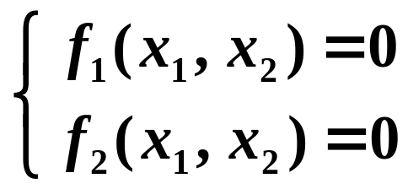
Chapter 2 Solutions of Equations in One Variable – Newton’s Method
Research topic 2:
Please extend Newton's method to solve systems of nonlinear equations. Start from a simple case of 2 variables and 2 equations:
14/16

Slide 15
Chapter 2 Solutions of Equations in One Variable – Newton’s Method
Research topic 3:
Self-study Secant Method.
Try to answer the following questions:
What is the advantage of Secant Method comparing to Newton's Method?
What are the disadvantages?
15/16

Slide 16
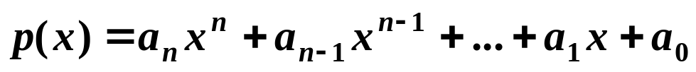
Chapter 2 Solutions of Equations in One Variable – Newton’s Method
Lab 02. Root of a Polynomial
Time Limit: 1 second; Points: 3
A polynomial of degree n has the common form as
Your task is to write a program to find a root of a given polynomial in a given interval.
16/16

