Slide 1


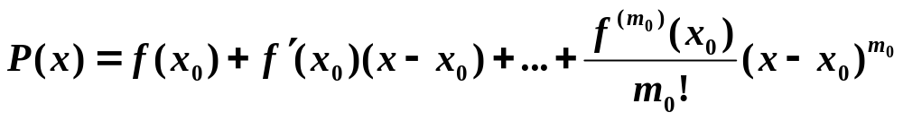
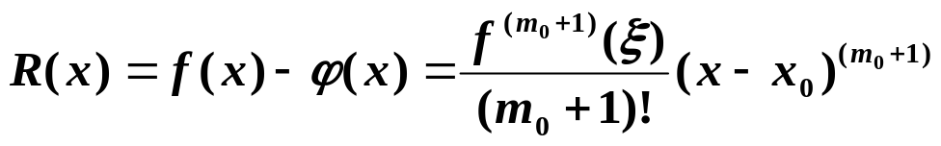
Chapter 3 Interpolation and Polynomial Approximation -- Hermite Interpolation
☑ 3.3 Hermite Interpolation
Find the osculating polynomial P(x) such that P(x_{i}) = f (x_{i}), P’ (x_{i}) = f ’ (x_{i}), …, P^{(m_i)} (x_{i}) = f ^{(m_i)} (x_{i}) for all i = 0, 1, …, n.
Note:
☞ Given N conditions (and hence N equations), a polynomial of degree can be determined.
N − 1
The osculating polynomial that agrees with f and all its derivatives of order ≤ m₀ at one point x₀ is just the Taylor polynomial
with remainder
The case when m_{i} = 1 for each i = 0, 1, …, n gives the Hermite polynomials.
1/13

Slide 2
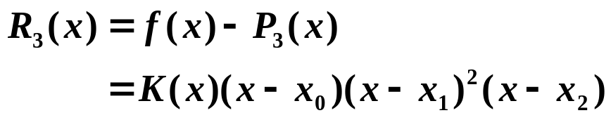


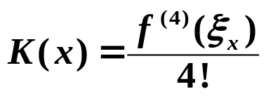
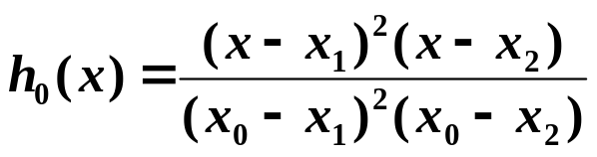
Chapter 3 Interpolation and Polynomial Approximation -- Hermite Interpolation
Example: Suppose x₀ ≠ x₁ ≠ x₂. Given f(x₀), f(x₁), f(x₂) and f ’(x₁), find the polynomial P(x) such that P(x_{i}) = f (x_{i})，i = 0, 1, 2, and P’(x₁) = f ’(x₁). Analyze the errors.
Solution: First of all, the degree of P(x) must be …
3.
Similar to Lagrange polynomials, we may assume the form of Hermite polynomial as
Similar to Lagrange error analysis
2
∧
P
(
x
)
=
Σ
f
(
x
)
h
(
x
)
+
f ’

(
x₁
)
h
(
x
)
3
i
=
0
i
i
1
∧
∧
where h_{i}(x_{j}) = δ_{ij} , h_{i}’(x₁) = 0, (x_{i}) = 0, ’(x₁) = 1
h₁
h₁
h₀(x)
Has roots
x₁, x₂, and h₀’(x₁) = 0 ⇒ x₁ is a multiple root.
h
(
x
)
=
C
(
x
−
x
)
2
(
x
−
x
)
0
0
1
2
h₀(x₀) = 1 ⇒ C₀
h₂(x)
Similar to h₀(x).
Has roots x₀, x₂ ⇒
=
+
−
−
h₁(x)
h
(
x
)
(
Ax
B
)(
x
x
)(
x
x
)
1
0
2
A and B can be solved with h₁(x₁) = 1 and h₁’(x₁) = 0.
∧
∧
(x)
Has roots x₀, x₁, x₂ ⇒
h₁
=
−
−
−
h₁
(
x
)
C
(
x
x
)(
x
x
)(
x
x
)
∧
1
0
1
2
’(x₁) = 1 ⇒ C₁ can be solved.
h₁
2/13

Slide 3
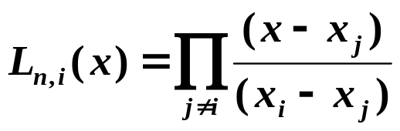

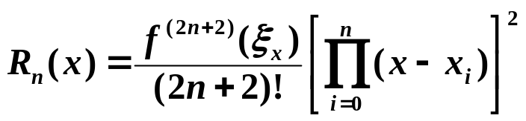

Chapter 3 Interpolation and Polynomial Approximation -- Hermite Interpolation
In general, given x₀ , …, x_{n}; y₀ , …, y_{n} and y₀’ , …, y_{n}’ . The Hermite polynomial H_{2n+1}(x) satisfies H_{2n+1}(x_{i}) = y_{i} and H’_{2n+1}(x_{i}) = y_{i}’ for all i.
n
n
∧
Solution: Let
H_{2n+1}
(
x
)
=
Σ
y_{i}
h
(
x
)
+
Σ
y_{i}’
h
(
x
)
i
i
i
=
0
i
=
0
∧
∧
where h_{i}(x_{j}) = δ_{ij}, h_{i}’(x_{j}) = 0, (x_{j}) = 0, ’(x_{j}) = δ_{ij}
h_{i}
h_{i}
∧
h_{i}(x)
x₀ , …, x_{i} , …, x_{n} are all roots with multiplicity 2 ⇒
h
(
x
)
=
(
A
x
+
B
)
L²
(
x
)
i
i
i
n, i
A_{i} and B_{i} can be solved by h_{i}(x_{i}) = 1 and h_{i}’(x_{i}) = 0 ⇒
Such a Hermite interpolating polynomial is unique
∧
(x)
All the roots x₀ , …, x_{n} have multiplicity 2 except x_{i} ⇒
h_{i}
∧
h_{i}
=
−
(
x
)
C
(
x
x
)
L_{n, i}²(x)
∧
i
i
h_{i}
=
−
∧
(
x
)
(
x
x
)
L_{n, i}²(x)
’(x_{i}) = 1 ⇒ C_{i} = 1
i
h_{i}
If
, then
3/13

Slide 4
Chapter 3 Interpolation and Polynomial Approximation -- Hermite Interpolation
∧
Quiz: Given x_{i} = i +1, i = 0, 1, 2, 3, 4, 5. Which one is h₂(x)?
y
y
✓
1
-
1
-
slope=1
0.5
-
0.5
-
0
1
2
3
4
5
6
x
-
0
1
2
3
4
5
6
x
HW:
p.140 #7
4/13

Slide 5
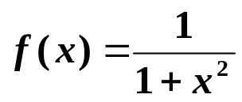
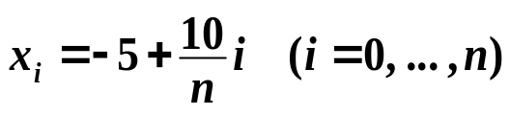


Chapter 3 Interpolation and Polynomial Approximation -- Cubic Spline Interpolation
☑ 3.4 Cubic Spline Interpolation
Example: Consider the Lagrange polynomial P_{n}(x) of on
[−5, 5]. Take
2.5
Remember what I have said?
Increasing the degree of interpolating polynomial
will NOT guarantee a good result,
since high-degree polynomials are
oscillating.
×
P_{n}(x) → f (x)
2
1.5
Discussion 18: How would you solve this problem?
1
0.5
0
-
0.5
-
5
-
4
-
3
-
2
-
1
0
1
2
3
4
5
5/13

Slide 6

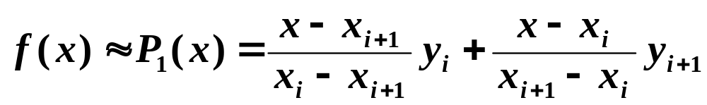




Chapter 3 Interpolation and Polynomial Approximation -- Cubic Spline Interpolation
➢ Piecewise linear interpolation
Approximate f (x) by linear polynomials on each subinterval :
uniform
Let . Then as
No longer smooth.
How can we make a smooth interpolation without asking too much from f ?
Headache …
➢ Hermite piecewise polynomials
Given
Construct the Hermite polynomial of degree 3 with y and y’ on the two endpoints of .
It is not easy to obtain the derivatives.
6/13

Slide 7
Chapter 3 Interpolation and Polynomial Approximation -- Cubic Spline Interpolation
➢ Cubic Spline
Definition: Given a function f defined on [a, b] and a set of nodes
a = x₀ < x₁ < … < x_{n} = b, a cubic spline interpolant S for f is a function that satisfies the following conditions:
S(x) is a cubic polynomial, denoted S_{i}(x), on the subinterval
[ x_{i} , x_{i+1}] for each i = 0, 1, …, n – 1;
S(x_{i}) = f (x_{i}) for each i = 0, 1, …, n;
S_{i+1}(x_{i+1}) = S_{i}(x_{i+1}) for each i = 0, 1, …, n – 2;
S’_{i+1}(x_{i+1}) = S’_{i}(x_{i+1}) for each i = 0, 1, …, n – 2;
S”_{i+1}(x_{i+1}) = S”_{i}(x_{i+1}) for each i = 0, 1, …, n – 2;
f(x)
H(x)
S(x)
7/13

Slide 8
Chapter 3 Interpolation and Polynomial Approximation -- Cubic Spline Interpolation
❖ Method of Bending Moment
Let h_{j} = x_{j} – x_{j – 1} and S(x) = S_{j}(x) for x ∈ [ x_{j – 1}, x_{j} ].
The bending moment
Then S_{j}”(x) is a polynomial of degree , which can be determined by the values of f on nodes.
1
2
Assume S_{j}”(x_{j−1}) = M_{j−1}， S_{j}”(x_{j}) = M_{j} . Then for all x ∈ [ x_{j – 1}, x_{j} ],
For each j it is a cubic polynomial
x
−
x
x
−
x
S_{j}”(x) =
j
+
j
−
1
M
M
j
−
1
h
j
h
j
j
Integrate S_{j}”(x) twice, we obtain S_{j}’(x) and S_{j} (x) ：
S_{j}’(x) =
(
x
−
x
)
2
(
x
−
x
)
2
−
M
j
+
M
j
−
1
+
A
Can be
solved by
S_{j}(x_{j−1}) = y_{j−1}
S_{j}(x_{j}) = y_{j}
j
−
1
2
h
j
−
1
2
h
j
j
j
S_{j}(x) =
(
x
−
x
)
3
(
x
−
x
)
3
M
j
+
M
j
−
1
+
A
x
+
B
j
−
1
6
h
j
6
h
j
j
j
j
8/13

Slide 9
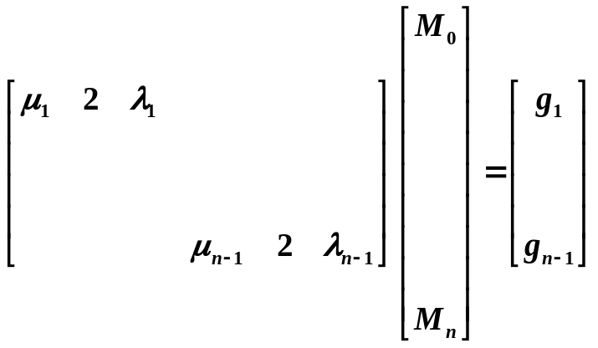
Chapter 3 Interpolation and Polynomial Approximation -- Cubic Spline Interpolation
y
−
y
M
−
M
M
x
−
x
M
x
−
x
A
=
j
j
−
1
−
j
j
−
1
h
A
x
+
B
=
(
y
−
j
−
1
h
2
)
j
+
(
y
−
j
h
2
)
j
−
1
j
h
6
j
j
j
j
−
1
6
j
h
j
6
j
h
j
j
j
Now solve for M_{j} ：
Since S’ is continuous at x_{j}
(
x
−
x
)
2
(
x
−
x
)
2
M
−
M
[x_{j−1}, x_{j} ]: S_{j}’(x) =
j
j
−
1
j
j
−
1
−
M
+
M
+
f
[
x
,
x
]
−
h
j
−
1
2
h
j
2
h
j
−
1
j
6
j
j
j
(
x
−
x
)
2
(
x
−
x
)
2
M
−
M
[x_{j} , x_{j+1}]: S_{j+1}’(x) =
−
M
j
+
1
+
M
j
+
f
[
x
,
x
]
−
j
+
1
j
h
j
2
h
j
+
1
2
h
j
j
+
1
6
j
+
1
j
+
1
j
+
1
From S_{j}’(x_{j}) = S_{j+1}’(x_{j}), we can combine the coefficients for M_{j−1}, M_{j}, and M_{j+1}. Define , , and
h
6
λ
=
j
+
1
μ
=
1
−
λ
g
=
(
f
[
x
,
x
]
−
f
[
x
,
x
])
j
h
+
h
j
j
j
h
+
h
j
j
+
1
j
−
1
j
j
j
+
1
j
j
+
1
μ
M
+
2
M
+
λ
M
=
g
j
j
−
1
j
j
j
+
1
j
for ≤ j ≤
1
n−1
That is, we have unknowns but only
equations.
n+1
n−1
Extra 2 boundary conditions are needed.
9/13

Slide 10

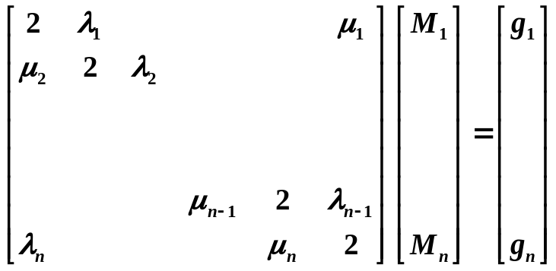
Chapter 3 Interpolation and Polynomial Approximation -- Cubic Spline Interpolation
 S’(a) = y₀’， S’(b) = y_{n}’ /* Clamped boundary */
[ a , x₁ ]: S₁’(x) =
(
x
−
x
)
2
(
x
−
a
)
2
M
−
M
−
M
1
+
M
+
f
[
x
,
x
]
−
1
0
h
0
2
h
1
2
h
0
1
6
1
1
1
Similar for S_{n}’(x) on [ x_{n−1}, b ]
2
M
+
M
=
6
(
f
[
x
,
x
]
−
)
=
g
0
1
0
1
y₀’
0
h
1
M
+
2
M
=
6
(
y_{n}’
−
f
[
x
,
x
])
=
g
n
−
1
n
h
n
−
1
n
n
 S”(a) = y₀” = M₀， S”(b) = y_{n}” = M_{n}
n
Then
The case when M₀ = M_{n} = 0 is called a free boundary, and when that occurs, the spline is called a Natural Spline.
 Periodic boundary:
If f is a periodic function,
that is, y_{n} = y₀ and
S’(a⁺) = S’(b⁻)
⇒ M₀ = M_{n}
10/13

Slide 11
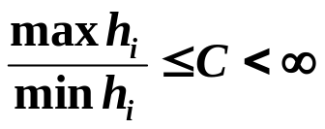

Chapter 3 Interpolation and Polynomial Approximation -- Cubic Spline Interpolation
Note:
☞ Cubic Spline can be uniquely determined by its boundary conditions as long as the coefficient matrix is strictly diagonally dominant.
If f ∈ C[ a, b ] and . Then
as max h_{i} → 0.
Discussion 19: What does this conclusion tell us? How can we obtain more accurate approximation with splines?
Sketch of the Algorithm: Cubic Spline
^{①} Compute μ_{j} , λ _{j} , g_{j} ; ^{②} Solve for M_{j} ;
^{③} Find the subinterval which contains x
(i.e. find the corresponding j );
^{④} Approximate f(x) by S_{j}(x).
HW:
p.153-154 #9, 17
11/13

Slide 12
Chapter 3 Interpolation and Polynomial Approximation -- Cubic Spline Interpolation
Lab 06. Cubic Spline
Time Limit: 1 second; Points: 4
Construct the cubic spline interpolant S for the function f, defined at points x₀ < x₁ < … < x_{n}, satisfying some given boundary conditions. Partition an given interval into m equal-length subintervals, and approximate the function values at the endpoints of these subintervals.
12/13

Slide 13


Chapter 3 Interpolation and Polynomial Approximation -- Cubic Spline Interpolation
Research topic 10:
Try to interpolate the profile of the following red bull. Can any of the interpolation methods that we have discussed be applied directly?
13/13

