Slide 1
Team 20
Final Demo
R07922106 曾俊為
T08902311 林伯叡

Slide 2
Paper Title
Character Recognition under Severe Perspective Distortion
Author : Linlin Li, Chew Lim Tan
School of Computing, National University of Singapore
Published in 2009 10th International Conference on Document Analysis & Recognition by IEEE
Four-page paper

Slide 3
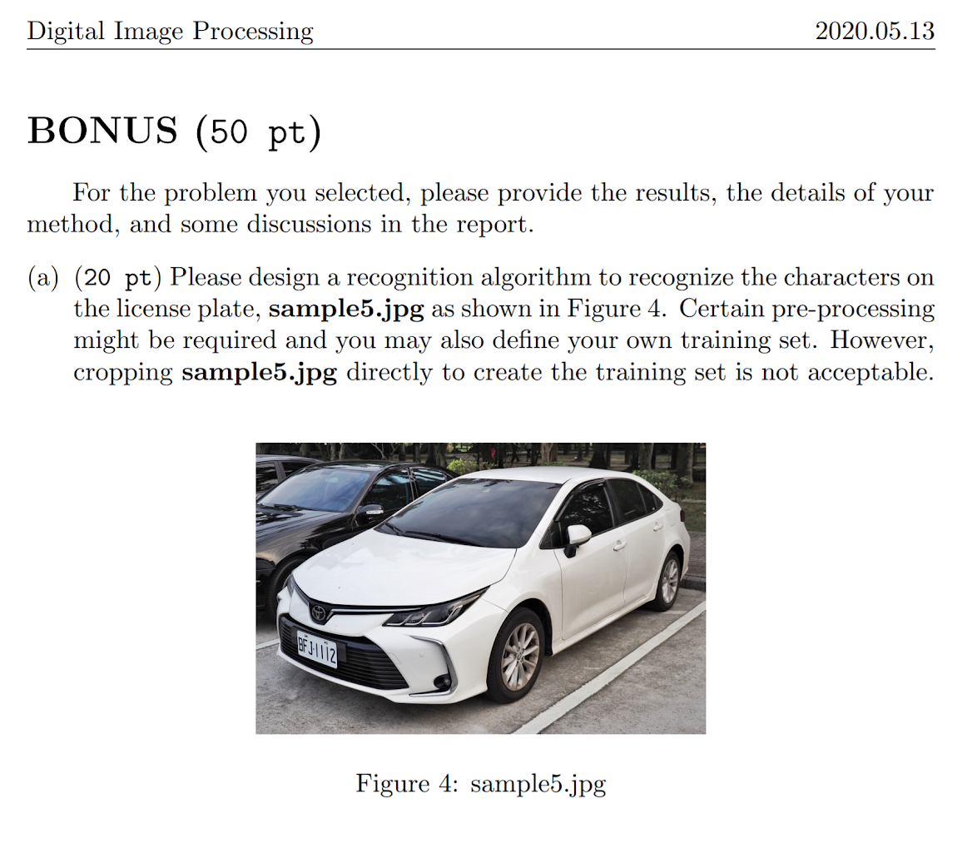
Motivation
Bonus question in HW3:
How can we perform OCR on extremely distorted characters?
Traditional algorithmic approach? ML? DL?
Tesseract (v4): supports deep learning-based OCR

Slide 4
Problem Definition
Character Recognition under Severe Perspective Distortion:
Identify a fundamental invariant under perspective distortion (cross ratio spectrum)
Recognize distorted characters utilizing such invariant (Dynamic Time Warping)

Slide 5
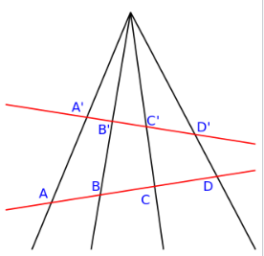
Cross Ratio Spectrum
(A'-C')*(B'-D')和(B'-C')*(A'-D')的比值 相等於
(A-C)*(B-D)和(B-C)*(A-D)的比值

Slide 6
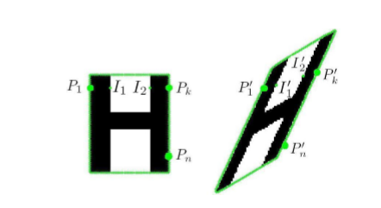
CRS(cont’d)
利用幾何的不變量來定義不同字母的特徵

Slide 7
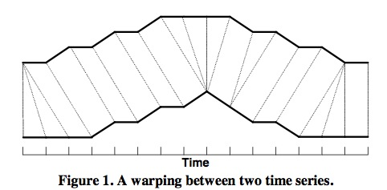
Dynamic time warping
用以衡量兩個時間序列之間的相似度

Slide 8
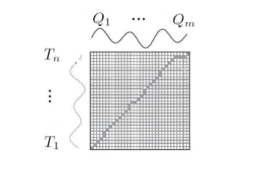
DTW(cont’d)
利用動態時間規整來衡量不同長之spectrum的相似度

Slide 9
Experimental
Results

Slide 10

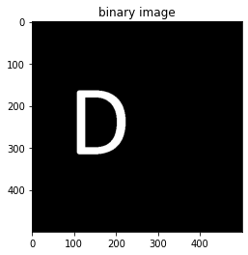
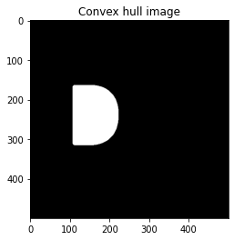

Slide 11
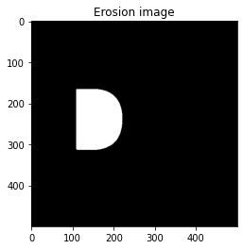
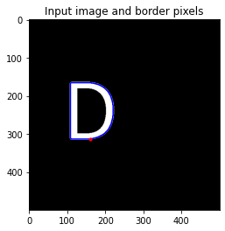
Notes:
NOTE: measure.find_contours may not be ideal as it uses
# marching cubes (standard algorithm) to find contours. The
# issue is that marhcing cube points sit *between* pixels
# whereas it seems to me that ideally we want the locations,
# in order, of the exact outer pixel locations
# Because of the above limitation, I added some erosion
# to make sure that the pixel-points detected sit roughly on the outline
# pixels (fine for letters with lines more than a couple of pixels wide)

Slide 12
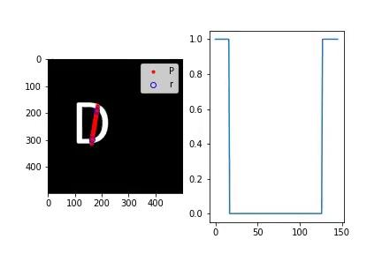

Slide 13
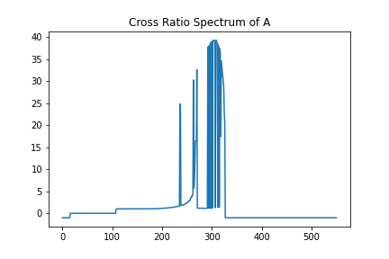
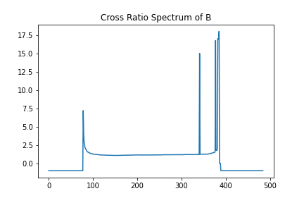
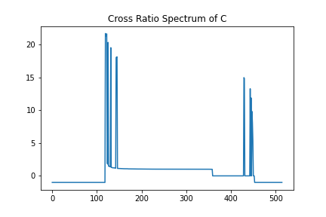
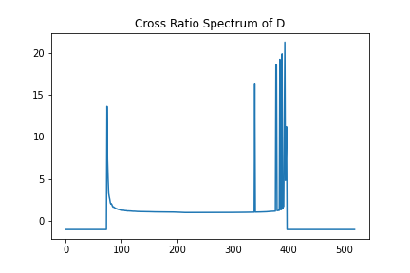

Slide 14
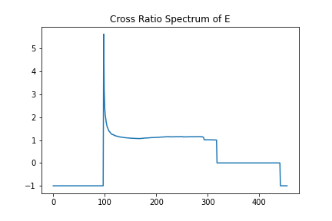
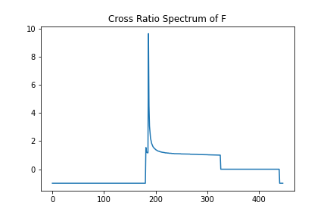
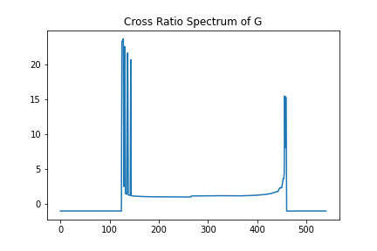
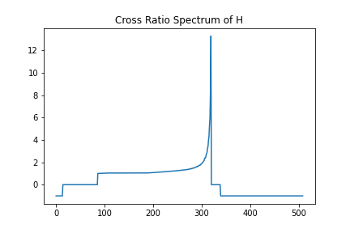

Slide 15
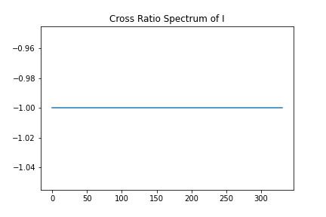
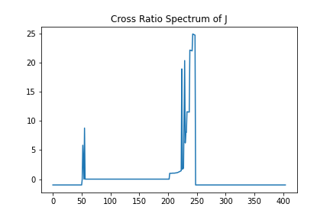
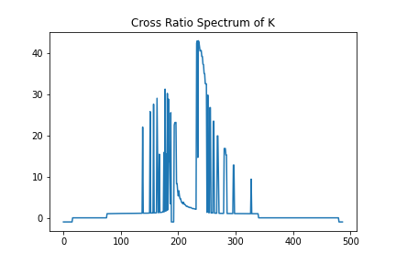
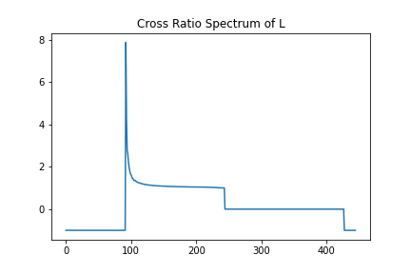

Slide 16
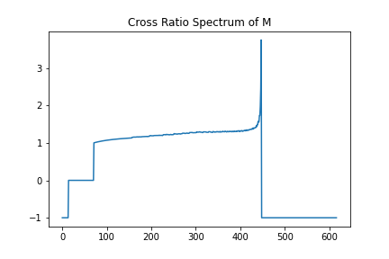
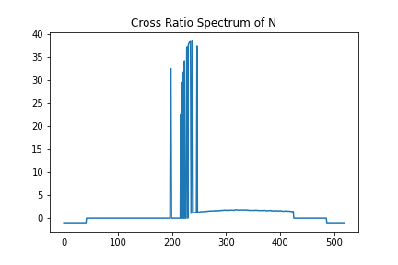
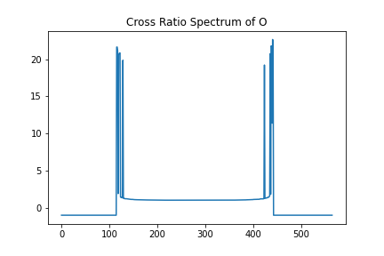
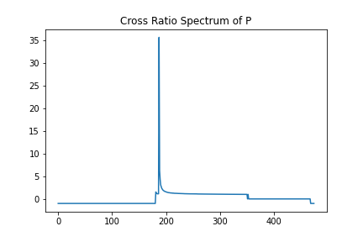

Slide 17
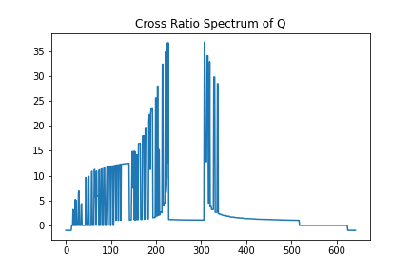
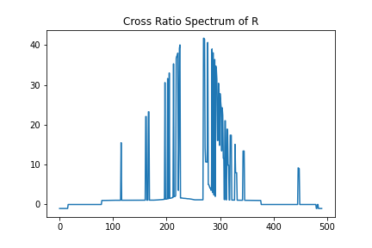
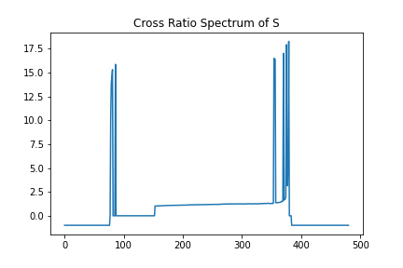
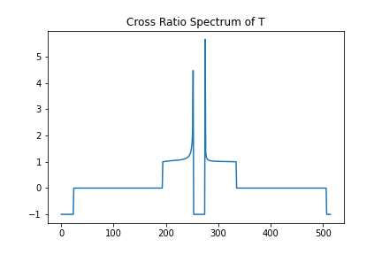

Slide 18
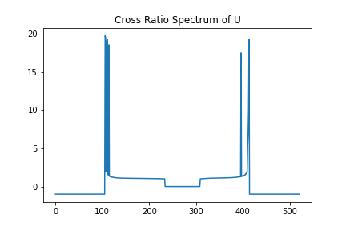
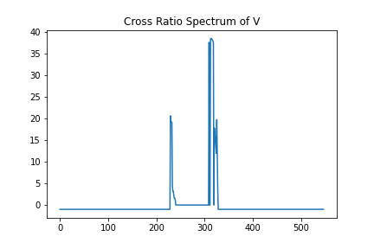
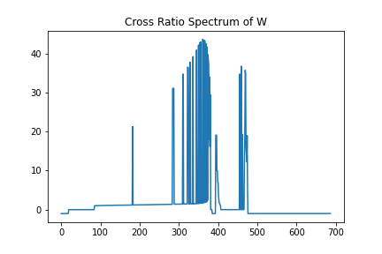
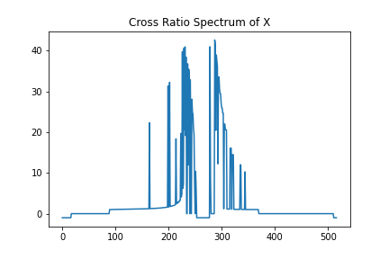

Slide 19
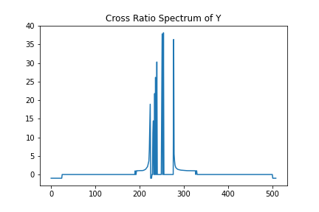
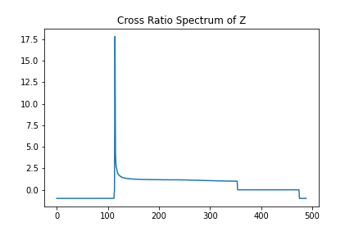

Slide 20
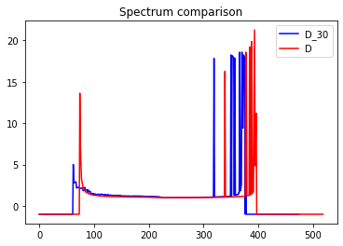
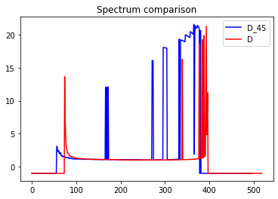

Slide 21
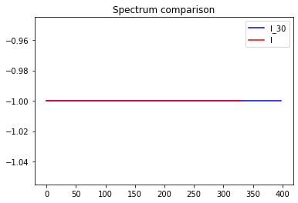
Notes:
if len(intersections) == 0:
return -1
if len(intersections) == 1:
return 0

Slide 22
經過CRS的實測發現不同的字母有各自的規律性存在
例如:D的spectrum裡面沒有0值；I的值只有-1等等

Slide 23
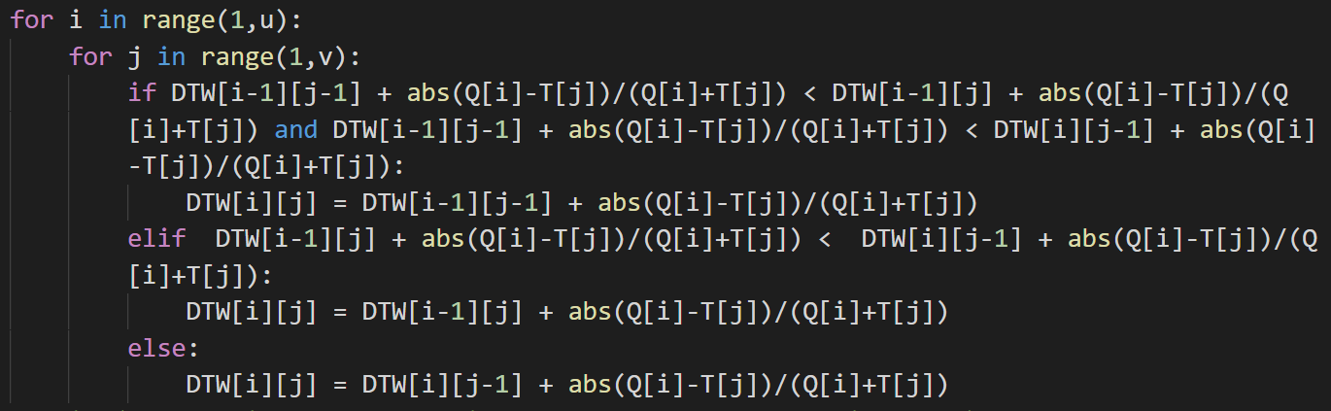


Slide 24
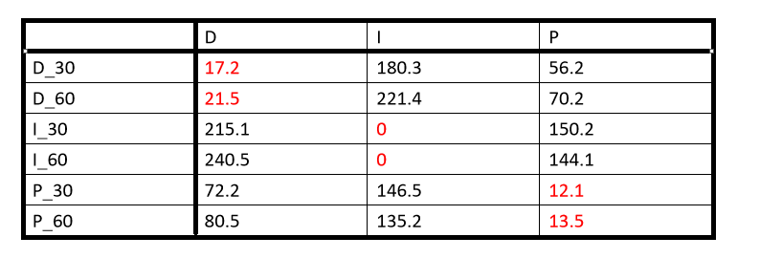

Slide 25
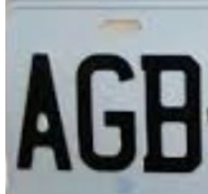
Test on images
這邊選用的是homework3的sample2.jpg和sample3.jpg當作test image ， 我們利用CRS做的部分去當作字母的feature針對英文字母去做辨識。
第一張image預測結果表現良好，預測結果為AGB

Slide 26
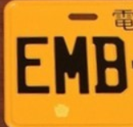
第二張有歪斜的image，預測結果為 AMB
E的地方預測錯誤，trainingset的字和test image的字長的不一樣，加上A和E的CRS分布相似，造成誤判

Slide 27
Conclusion
這篇paper提供的方法的確能為不同的字母建立出一套屬於自己的feature，進而去預測字母。
但是結果仍然有待加強，且也有其他缺點需要去解決，像是noise的處理，character的大小需要大於固定值否則CRS的分布圖會有很多不規則spike的出現等等。

Slide 28
Reference

Slide 29
P. Clark and M. Mirmehdi. Recognizing text in real scenes. (IJDAR 2002)
S. Lu and C. L. Tan. Camera text recognition based on perspective invariants. (ICPR 2006)
M.Pilu. Extraction of illusory linear clues in perspectively skewed documents. (CVPR 2001)
T. Yamaguchi, M. Maruyama, H. Miyao, and Y. Nakano. Digit recognition in a natural scene with skew and slant normalization. (IJDAR 2005)
https://www.itread01.com/content/1548764116.html(DTW)
.

