Slide 1
Tutorial 4 Assignment 1
CSIS0402/COMP3402 System Architecture and Distributed Computing

Slide 2





Overview
A 24-game game system played with poker playing card
Consists of:
A server that handle user login, user matching, and gaming support
A client that allow users to login and play games
Solution: 4*(7-3)+8 = 24

Slide 3
Tentative assignments
Assignment 1: RMI – handles user registration and login
Assignment 2: JDBC – handles data storage and retrieval
Assignment 3: JMS – handle client-server communication
Assignment 4: Final submission – handle game logic

Slide 4
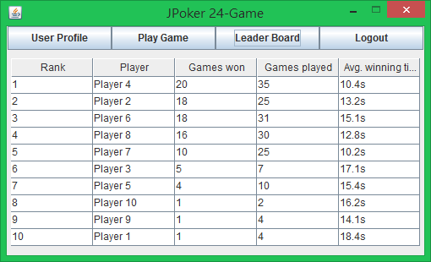
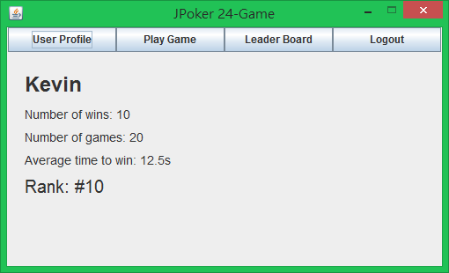
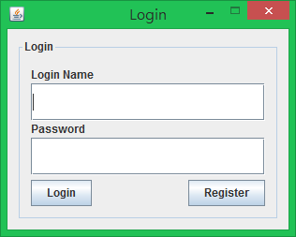
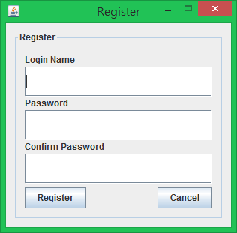
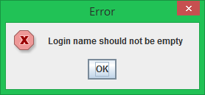
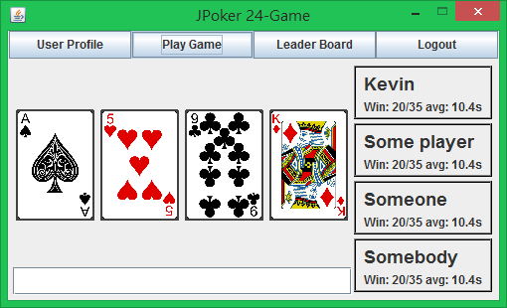
UI flow
Note that you only need to follow the flow. You can design your own UI, this is just an example.
Login
Use arbitrary data in assignment 1
Use arbitrary data in assignment 1
Register
Section changes
Register
Error
Error
Not needed in assignment 1

Slide 5
Assignment 1 – user data
In assignment 1, the server must maintain two files
UserInfo.txt – storing registered user information
Persistence across server execution
Used to authenticate user
Updated in successful user registration
Checked to avoid duplicating user name during registration
OnlineUser.txt – keeping a list of online users
Cleared when server start
Updated when user login/logout
Checked to avoid multiple login
Note that this will be replaced by the use of database in assignment 2
You may want to plan ahead

Slide 6
Assignment 1 - RMI
The server must use RMI to support the following functions:
Login
validate user from UserInfo.txt
avoid repeated login using OnlineUser.txt
update OnlineUser.txt
Register
avoid duplicating user name with UserInfo.txt
login user (update OnlineUser.txt)
Logout
update OnlineUser.txt

Slide 7
New policy file
grant {
permission java.net.SocketPermission "*:1024-65535", "connect,accept";
permission java.net.SocketPermission "*:80", "connect";
permission java.io.FilePermission "UserInfo.txt", "read,write";
permission java.io.FilePermission "OnlineUser.txt", "read,write";
};
Need these because of security manager

Slide 8
Exercise
Modify the sample program in tutorial 3 so that the server will save the message to a file when the count() method is called
Submit all necessary *.java files and a word document. The doc should contain screen shots and some short description on how you ran the GUI, including login, register, and logout.

