Slide 1
Tutorial: JMS
CSIS0402/COMP3402 System Architecture and Distributed Computing

Slide 2
JMS setup for this tutorial
JMS provider: GlassFish 4
https://glassfish.java.net/download.html (Download Full Platform)
GlassFish is available in lab under C:\Program Files\glassfish-4.0 folder
Connection factory: jms/TestConnectionFactory
Destination (Queue): jms/TestQueue
Destination (Topic): jms/TestTopic

Slide 3
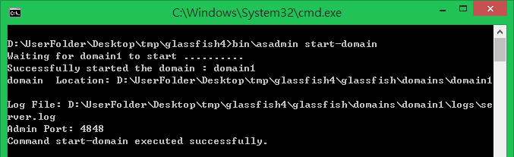
Starting GlassFish server
Server can be started using command line utilities
Command-line utilities: asadmin
In a command console, execute “asadmin start-domain” to start a domain
Admin console will be accessible after a domain is started
Admin console: http://localhost:4848

Slide 4
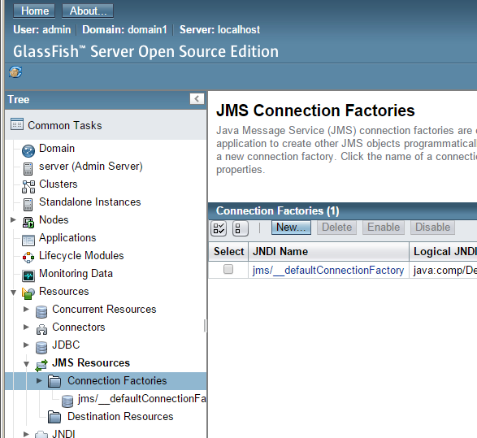
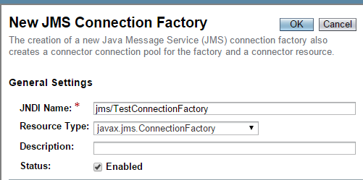
Connection Factory
Admin console: http://localhost:4848
Visit http://localhost:4848
Name: jms/TestConnectionFactory
Type: javax.jms.ConnectionFactory

Slide 5
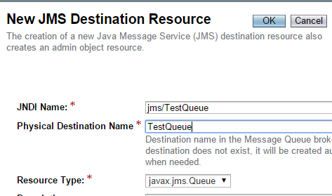
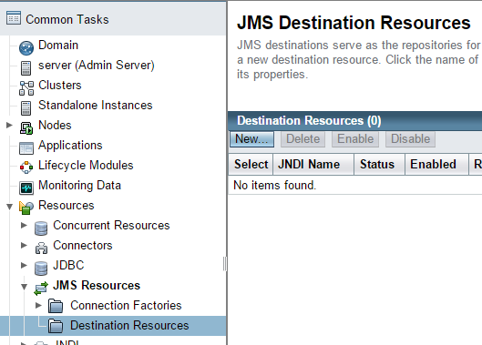
Destinations
JNDI Name: jms/TestQueue
Physical name: TestQueue
Type: javax.jms.Queue
JNDI Name: jms/TestTopic
Physical name: TestTopic
Type: javax.jms.Topic
NEW!

Slide 6
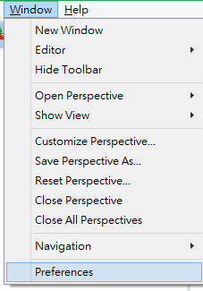
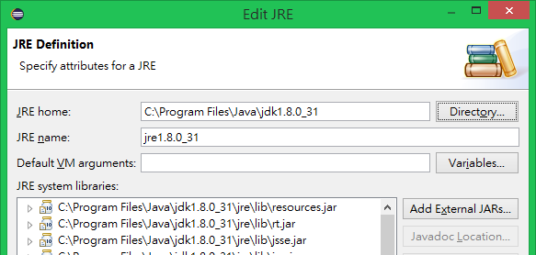
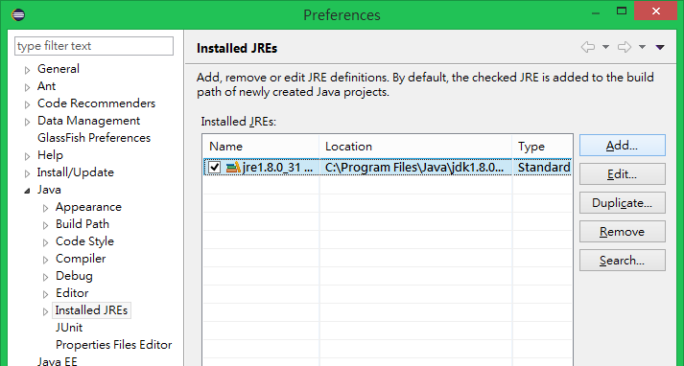
Setting up Eclipse execution environment
It is advised to use the JRE in JDK installation instead of the default JRE installation
Change to JDK installation folder

Slide 7
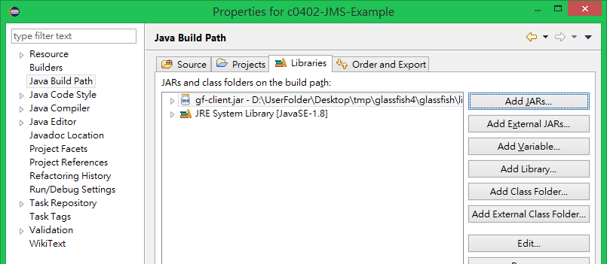
Set up project in Eclipse
Create a new project for this tutorial
Add gf-client.jar to external library in Eclipse (right-click on project → properties)
It can be found in <GlassFish folder>/glassfish/lib
You can now execute the programs in Eclipse

Slide 8
JMS overview
JMS Client
Connection Object
Create
Session Object
Lookup
Create
JNDI Directory
Message Sender
Message Receiver
bind
Create
Connection Factory
Destination (queue/topic)

Slide 9
Tasks
Download the source files from Moodle, which consists of 4 files
ChatServer.java - the server of a chat service
ChatClient.java - the client GUI of a chat service
JMSHelper.java - used by server and client to initiate JMS communications
ChatMessage.java - the message object used in communication
We will complete the implementation in this tutorial
Send message
Client
JMS Queue
Receive message
Server
Client
JMS Topic
Broadcast message
Subscribe topic
Client

Slide 10
Preparing JMS communication
In order to use JMS communication, JNDI lookup is done to get the connection factory and destinations
ChatClient.java
public ChatClient(String host) throws NamingException, JMSException {
jmsHelper = new JMSHelper(host);
//...
}
JMSHelper.java
Also used in ChatServer.java
public JMSHelper(String host) throws NamingException, JMSException {
int port = DEFAULT_PORT;
System.setProperty("org.omg.CORBA.ORBInitialHost", host);
System.setProperty("org.omg.CORBA.ORBInitialPort", ""+port);
try {
jndiContext = new InitialContext();
connectionFactory = (ConnectionFactory)jndiContext.lookup(JMS_CONNECTION_FACTORY);
queue = (Queue)jndiContext.lookup(JMS_QUEUE);
topic = (Topic)jndiContext.lookup(JMS_TOPIC);
} catch (NamingException e) {
System.err.println("JNDI failed: " + e);
throw e;
}
// ...
}

Slide 11
Connect to JMS provider
Start a connection to the JMS provider
JMSHelper.java
public JMSHelper(String host) throws NamingException, JMSException {
// ...following what is added in the previous page
try {
connection = connectionFactory.createConnection();
connection.start();
} catch (JMSException e) {
System.err.println("Failed to create connection to JMS provider: " + e);
throw e;
}
}

Slide 12
Checkpoint 1
Start the server:
Message showing that a connection to JMS provider is achieved
Kill the server
Start the client:
Message showing that a connection to JMS provider is achieved
GUI is shown
Close and leave (or just kill it)

Slide 13
Session and message
createSession() will be called when a session is needed.
Keep using one session for all operations.
When sending messages, createMessage is used to get a JMS message to send.
JMSHelper.java
public Session createSession() throws JMSException {
if(session != null) {
return session;
} else {
try {
return connection.createSession(false, Session.AUTO_ACKNOWLEDGE);
} catch (JMSException e) {
System.err.println("Failed creating session: " + e);
throw e;
}
}
}
public ObjectMessage createMessage(Serializable obj) throws JMSException {
try {
return createSession().createObjectMessage(obj);
} catch (JMSException e) {
System.err.println("Error preparing message: " + e);
throw e;
}
}

Slide 14
Prepare queue sender (MessageProducer)
ChatClient.java
private void init() throws JMSException {
//... Note the following line (already in code)
queueSender = jmsHelper.createQueueSender();
//...
}
JMSHelper.java
public MessageProducer createQueueSender() throws JMSException {
try {
return createSession().createProducer(queue);
} catch (JMSException e) {
System.err.println("Failed sending to queue: " + e);
throw e;
}
}
To send a message to queue, we need a MessageProducer object

Slide 15
Send message to queue
ChatClient.java
messageBox.addKeyListener(new KeyAdapter() {
public void keyPressed(KeyEvent e) {
if(e.getKeyCode() == KeyEvent.VK_ENTER) {
sendMessage();
}
}
});
public void sendMessage() {
ChatMessage chatMessage = getChatMessage();
messageBox.setText("");
if(chatMessage != null) {
System.out.println("Trying to send message: "+chatMessage);
Message message = null;
try {
message = jmsHelper.createMessage(chatMessage);
} catch (JMSException e) {
}
if(message != null) {
try {
queueSender.send(message);
} catch (JMSException e) {
System.err.println("Failed to send message");
}
}
}
}
Client will send a message when user pressed enter

Slide 16
Prepare queue reader (MessageConsumer)
ChatServer.java
public void start() throws JMSException {
MessageConsumer queueReader = jmsHelper.createQueueReader();
//...
}
JMSHelper.java
public MessageConsumer createQueueReader() throws JMSException {
try {
return createSession().createConsumer(queue);
} catch (JMSException e) {
System.err.println("Failed reading from queue: " + e);
throw e;
}
}
To read from a queue, we need a MessageConsumer object

Slide 17
Read message from queue
ChatServer.java
while(true) {
Message jmsMessage = receiveMessage(queueReader);
broadcastMessage(topicSender, jmsMessage);
}
ChatServer.java
public Message receiveMessage(MessageConsumer queueReader) throws JMSException {
try {
Message jmsMessage = queueReader.receive();
ChatMessage chatMessage = (ChatMessage)((ObjectMessage)jmsMessage).getObject();
System.out.println(chatMessage);
return jmsMessage;
} catch(JMSException e) {
System.err.println("Failed to receive message "+e);
throw e;
}
}
Server will read from the queue, send to topic and read again

Slide 18
Checkpoint 2
Start the server
Start the client
Input a name to start the client
Try to send out a message
Message must be send to server, check the console of the server for the message received
Close/kill all the client and server

Slide 19
Prepare topic sender (MessageProducer)
ChatServer.java
private void start() throws JMSException {
//... Note the following line (already in code)
MessageProducer topicSender = jmsHelper.createTopicSender();
//...
}
JMSHelper.java
public MessageProducer createTopicSender() throws JMSException {
try {
return createSession().createProducer(topic);
} catch (JMSException e) {
System.err.println("Failed sending to queue: " + e);
throw e;
}
}
To send message to a topic, a MessageProducer object is needed

Slide 20
Send message to topic
ChatServer.java
while(true) {
Message jmsMessage = receiveMessage(queueReader);
broadcastMessage(topicSender, jmsMessage);
}
ChatServer.java
public void broadcastMessage(MessageProducer topicSender, Message jmsMessage) throws JMSException {
try {
topicSender.send(jmsMessage);
} catch(JMSException e) {
System.err.println("Failed to boardcast message "+e);
throw e;
}
}
Server will relay the message received to the topic

Slide 21
Prepare topic reader (MessageConsumer)
ChatServer.java
private void init() throws JMSException {
//...
topicReceiver = jmsHelper.createTopicReader(name);
}
JMSHelper.java
public MessageConsumer createTopicReader() throws JMSException {
try {
return createSession().createConsumer(topic);
} catch (JMSException e) {
System.err.println("Failed reading from queue: " + e);
throw e;
}
}
No need to be durable in our case
To receive message from topic, a MessageConsumer object is needed

Slide 22
Prepare topic reader (MessageConsumer)
ChatServer.java
private void init() throws JMSException {
//...
topicReceiver = jmsHelper.createTopicReader(name);
topicReceiver.setMessageListener(this);
}
public class ChatClient implements MessageListener {
public void onMessage(Message jmsMessage) {
try {
ChatMessage chatMessage = (ChatMessage)((ObjectMessage)jmsMessage).getObject();
messageArea.append(chatMessage.toString()+System.lineSeparator());
messageArea.invalidate();
} catch (JMSException e) {
System.err.println("Failed to receive message");
}
}
Client register a message listener to handle incoming message from topic

Slide 23
Checkpoint 3
Start the server
Start the client
Input a name to start the client
Try to send out a message
Message must be send to server, server will relay the message back to the client
Start another client
Input another name to start the client
Try to send some messages
Message must be send to server, server will relay the message back to all clients
Close/kill all the client and server

Slide 24
Private message
The ChatMessage object support private message
The “to” field is used to specify the receiver
public class ChatMessage implements Serializable {
private static final long serialVersionUID = -1675867563027817666L;
public String from;
public String to;
public String message;
public ChatMessage(String from, String message) {
this(from, null, message);
}
public ChatMessage(String from, String to, String message) {
this.from = from;
this.to = to;
this.message = message;
}
public String toString() {
if(to == null) {
return from+": "+message;
} else {
return from+": (private message to "+to+") "+message;
}
}
}
To use this we change how the client works

Slide 25
Change in client
private ChatMessage getChatMessage() {
String message = messageBox.getText().trim();
int colonPos = message.indexOf(":");
if(colonPos >= 0) {
String target = message.substring(0, colonPos).trim();
String newMessage = message.substring(colonPos+1).trim();
if(!target.isEmpty() && !newMessage.isEmpty()) {
return new ChatMessage(name, target, newMessage);
}
}
if(!message.isEmpty()) {
return new ChatMessage(name, message);
}
return null;
}
Add this to allow user to type a name followed by a “:” to send private message

Slide 26
JMS Selector
Client can check the “to” field in the message to see if the message is for them, but that is a waste of resources
We can actually set up the MessageConsumer (topic receiver) to filter the message to read
Filter can be applied on the header of message
Two steps:
Add header to message
Specify JMS Selector when creating MessageConsumer

Slide 27
Adding header to message
ChatServer.java
public void start() throws JMSException {
MessageConsumer queueReader = jmsHelper.createQueueReader();
MessageProducer topicSender = jmsHelper.createTopicSender();
while(true) {
Message jmsMessage = receiveMessage(queueReader);
ChatMessage chatMessage = (ChatMessage)((ObjectMessage)jmsMessage).getObject();
if(chatMessage.to != null && !chatMessage.to.isEmpty()) {
jmsMessage = jmsHelper.createMessage(chatMessage);
jmsMessage.setStringProperty("privateMessageTo", chatMessage.to);
jmsMessage.setStringProperty("privateMessageFrom", chatMessage.from);
}
broadcastMessage(topicSender, jmsMessage);
}
}
Check if it is a private message
Received messages are read-only,
We need to create a new message
Adding two properties in message header

Slide 28
Specifying JMS Selector
Add parameter
JMSHelper.java
public MessageConsumer createTopicReader(String name) throws JMSException {
try {
name = name.replace("'", "''");
String selector = "(privateMessageFrom IS NULL AND privateMessageTo IS NULL) OR "+
"privateMessageTo = '"+name+"' OR privateMessageFrom = '"+name+"'";
return createSession().createConsumer(topic, selector);
} catch (JMSException e) {
System.err.println("Failed reading from queue: " + e);
throw e;
}
}
Selector is like the where clause of a SQL query
Here we select public message, and private message send to/from the user
ChatClient.java
Specify selector
private void init() throws JMSException {
//...
topicReceiver = jmsHelper.createTopicReader(name);
topicReceiver.setMessageListener(this);
}
Add parameter

Slide 29
Checkpoint 4
Start the server
Start three clients
Input two different names to each client, say, “a”, “b” and “c”
In a’s client, send message “b:hi!”
Check that the private message appears in a and b only
Close/kill all the client and server

Slide 30
Running on remote machines
Suppose we would like to run the chat client in another machine. There are two ways to achieve that
Every remote JMS client install glassfish, setup the AddressList property in connection factory to the major server
Read the lecturer notes about this method
Every remote JMS client runs in standalone mode
Read the following slides

Slide 31
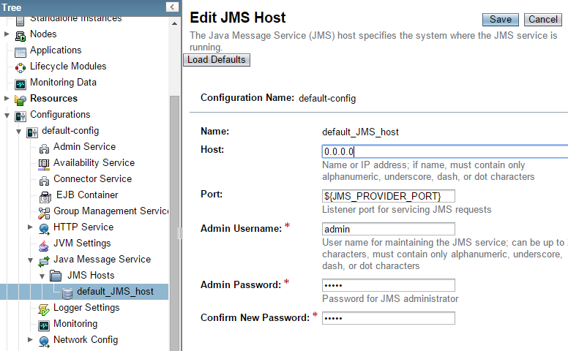
Glassfish setup: host address
Modify to 0.0.0.0

Slide 32
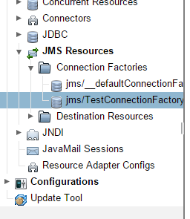
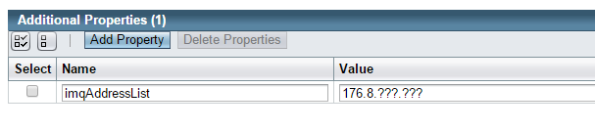
Glassfish setup: imqAdressList
By default the address “localhost” is registered to JNDI
Clients on other machine will not be able to connect to JMS provider even when the JNDI on the remote machine is accessed
The property imqAddressList can be used to override this setting
172.16……….
Modify to the ip address of your machine

Slide 33
Running the program
To do this in lab, you can just copy these files from the glassfish folder installed in the other machine
Prepare a folder with the following content:
the class file
a modules folder from <glassfish folder>/glassfish/modules
a lib folder, with gf-client.jar inside (copy from <glassfish folder>/glassfish/lib)
Also in the lib folder, imqjmsra.jar (copy from <glassfish folder>/glassfish/lib /install/applications/jmsra)
Copy the folder to another machine, execute the program with this command:
java –cp .;lib/gf-client.jar;lib/imqjmsra.jar ChatClient <ip address>
IP of your server
Use “:” on Linux/Mac/Unix
The program need port 3700 and 7676 to work

Slide 34
Submission
All code/script you have modified and screen shots of steps on how to run your program

