Slide 1
Tutorial 3 RMI
CSIS0402/COMP3402 System Architecture and Distributed Computing

Slide 2
Overview
RMI allow clients to invoke a method on the server and collect the result
RMI registry
Register service
Find service
Use service
Serve result
Server works just like a method is being invoked
Client works like it is just invoking a method
3-b generate request to server
3-c invoke method
3-a invoke method
Skeleton
Stub
4-b generate response to client
4-c return result
4-a return result

Slide 3
RMI usage
Implementation
Define service (Remote interface)
Server register service
Server implement service
Client find service
Client use service
Compilation
Compile interface, server, client
Generate skeleton with rmic
Execution
Start RMI registry
Start server
Start client(s)
Not needed anymore!

Slide 4
Example: Word counting service
We will be setting up a word counting service
Interface: to be implemented
Server: modifying from WordCounter.java on Moodle
Client: modifying from MessageBox.java on Moodle
Start a new project in Eclipse, import WordCounter.java and MessageBox.java to the new project.

Slide 5
WordCounter.java
Class WordCounter provides a method that can be used to count the number of words in a String.
Executing the program will print:
public class WordCounter {
public static void main(String[] args) {
WordCounter app = new WordCounter();
int count = app.count("The quick brown fox jumps over a lazy dog");
System.out.println("There are "+count+" words");
}
public int count(String message) {
return message.split(" +").length;
}
}
This will be our service
There are 9 words

Slide 6
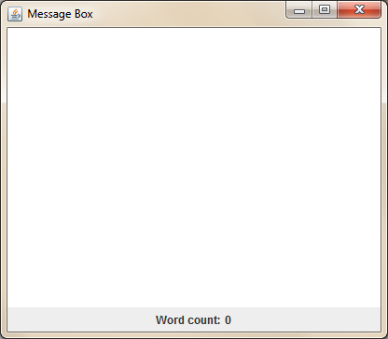
MessageBox.java
Class MessageBox is a program with a single message box
Method updateCount() is yet to be implemented
public void updateCount() {
// TODO: update variable wordCount according to the content in msgBox
}

Slide 7
Interface WordCount
Create new interface “WordCount”
import java.rmi.Remote;
import java.rmi.RemoteException;
public interface WordCount extends Remote {
int count(String message) throws RemoteException;
}
Must throw RemoteException
We are making the count() in WordCounter class a service

Slide 8
Implementing the server
import java.rmi.*;
import java.rmi.server.*;
Modify WordCounter.java:
Import RMI packages
Extends UnicastRemoteObject, Implements WordCount interface
constructor WordCounter() and count() should throw RemoteException
Register the service in main()
And comment out the two lines of code
public class WordCounter extends UnicastRemoteObject
implements WordCount
public WordCounter() throws RemoteException
public int count(String message) throws RemoteException
Define security manager so that a policy can be enforced. This is required in order to register a service to the RMI registry.
Register a service (the WordCounter object) to the RMI registry on the same machine.
System.setSecurityManager(new SecurityManager());
Naming.rebind("WordCounter", app);
System.out.println("Service registered");
// int count = app.count("The …
// System.out.println("There …
Comment out these two lines

Slide 9
Implementing the client
Find a service from the RMI registry on the same machine.
ModifyMessageBox.java
Import RMI packages
Get WordCount object from RMI registry in constructor
Implement updateCount()
import java.rmi.*;
private WordCount wordCounter;
public MessageBox() {
try {
wordCounter = (WordCount)Naming.lookup("WordCounter");
} catch(Exception e) {
System.err.println("Failed accessing RMI: "+e);
}
}
Update: Please remove “synchronized” from this method.
public synchronized void updateCount() {
if(wordCounter != null) {
try {
wordCount = wordCounter.count(msgBox.getText());
} catch (RemoteException e) {
System.err.println("Failed invoking RMI: ");
}
}
}
Using the service

Slide 10
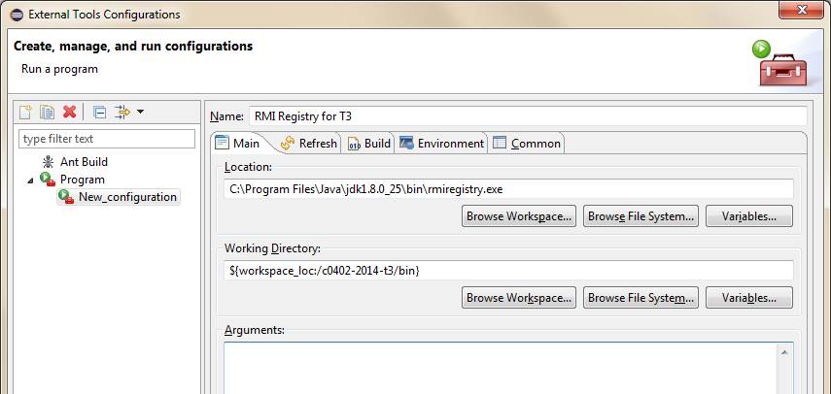
Staring RMI registry in Eclipse
Alternatively, you can either:
Execute “rmiregistry” in the “bin” folder of your current project in a command prompt/terminal
Set up the CLASSPATH environment variable in your system so that rmiregistry knows where to find the class files
Run → External Tools → External Tools Configurations…
2. Give a name, you need to setup one configuration for each project
3. Pick rmiregistry.exe from the latest JDK/JRE installation
1. Right click here to add new configuration
4. Pick the “bin” folder of your current project

Slide 11
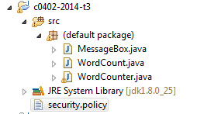
Security.policy
If you run the server now, you will get “AccessControlException” because of the security setting!
Create file security.policy and put it under the Eclipse project (NOT under src folder)
Your project folder should looks something like this:
grant {
permission java.net.SocketPermission "*:1024-65535", "connect,accept";
permission java.net.SocketPermission "*:80", "connect";
};

Slide 12
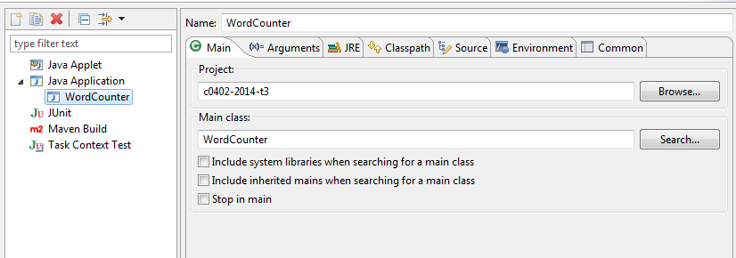
Configure server execution
Right-click WordCounter.java → Run As → Run Configurations…
Make sure that you are configuring the execution of WordCounter in your current project
If it is not the case, Right click “Java Application” → New and set up the Project and Main Class accordingly

Slide 13
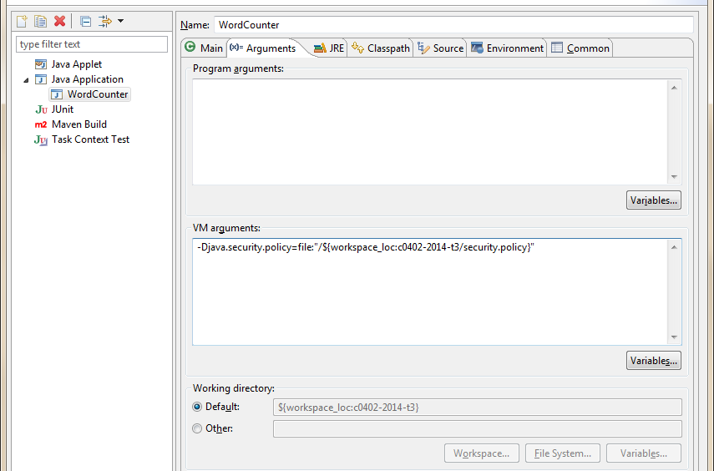
Execution parameter
Click on the “Arguments” tab and set up the VM arguments as follow:
Project name
-Djava.security.policy="${workspace_loc:*******/security.policy}"
Update: Please omit “file:” and the “/” afterwards, as it is not necessary and may cause problem on MacOS
You can refer to this field

Slide 14
Client configuration
You should do the same configuration for the execution of MessageBox.java
The server and client should be working now
Note that rmic is not needed now, stub and skeleton are now set up automatically.

Slide 15
Exercise
Modify MessageBox.java so that it can be executed in another machine
Use command line argument to determine the location of RMI registry
Import the registry package which is required by the new code
Take the first command line argument and pass it to MessageBox object
public static void main(String[] args) {
SwingUtilities.invokeLater(new MessageBox(args[0]));
}
Take the parameter passed in
public MessageBox(String host) {
try {
Registry registry = LocateRegistry.getRegistry(host);
wordCounter = (WordCount)registry.lookup("WordCounter");
} catch(Exception e) {
System.err.println("Failed accessing RMI: "+e);
}
}
Access the registry at the specific location
Look up from that registry
import java.rmi.registry.*;

Slide 16
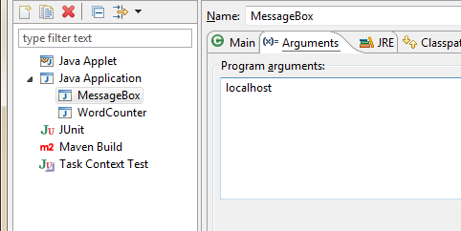
Exercise (cont’d)
Set up the execution of MessageBox to test the program
Type “localhost” as the argument
Run the client again to test it

Slide 17
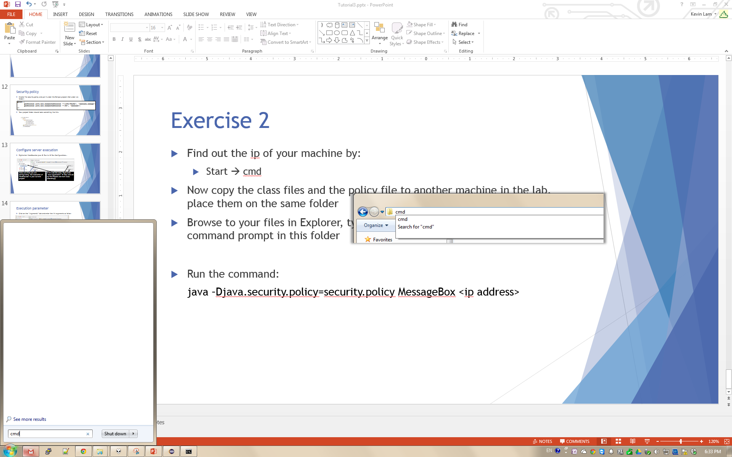
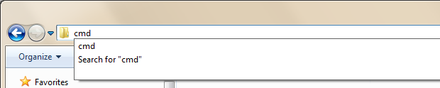
Exercise (cont’d)
Find out the IP of your machine
Open command prompt from start menu → cmd
Issue command “ipconfig” and look for the IP address of your machine (In the lab, it should be 147.8.????.????)
Copy your class files and security.policy to another machine, place them in the same folder
Browse to your files in Explorer, type “cmd” on the location bar to start a command prompt in that folder
Run the command:
java –Djava.security.policy=security.policy MessageBox <ip address>
You may need to type the full path to the java executable
In Windows, java is usually installed under C:\Program Files\Java\jdk???\bin
Enter the IP address you have found in step 4

