Slide 1
Tutorial: JNDI
CSIS0402/COMP3402 System Architecture and Distributed Computing

Slide 2
Naming and Directory Service
Naming Service: associate names with objects
Allow binding (an object to a name) and lookup (an object from a name)
Directory Service: stores, distributes, searches, and retrieve objects
Extension of naming service
Bind object with names, with attributes
Object can be found by attributes

Slide 3
JNDI
An API for naming and directory service
JNDI API
NIS
LDAP
DNS
COS
…
JNDI Naming Manager
JNDI Service Provider Interface (SPI)

Slide 4
Apache DS
A directory server written in Java
LDAPv3 compatible
Download: http://directory.apache.org/apacheds/downloads.html
Install and start Apache DS before you continue

Slide 5
Apache Directory Studio
A tool to configure and maintain Apache DS
Can be installed as a tool, or installed in Eclipse
Download: https://directory.apache.org/studio/downloads.html
Install Apache Directory Studio before you continue

Slide 6
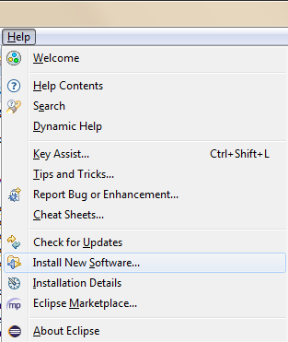
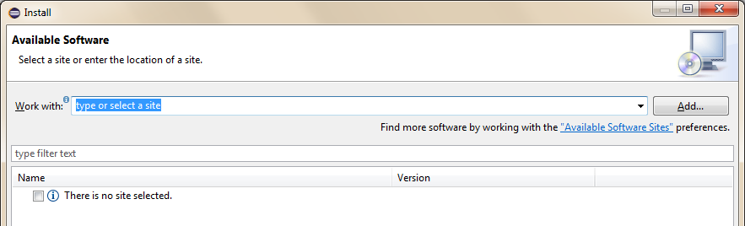
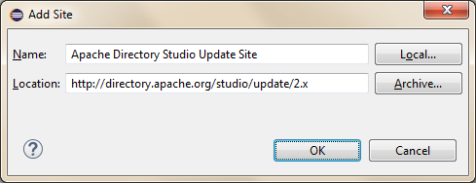
Eclipse Setup (For reference)
Name: Apache Directory Studio Update Site
Location: http://directory.apache.org/studio/update/2.x

Slide 7
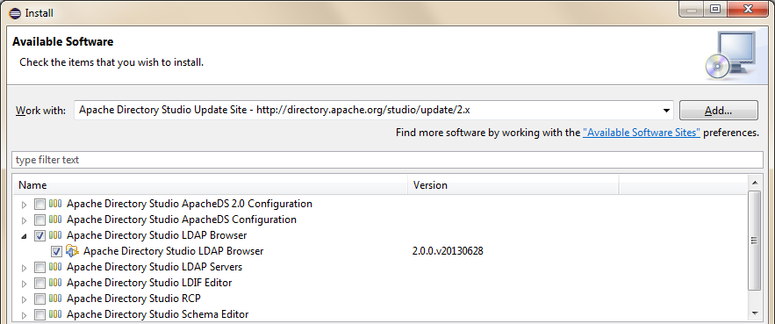
Install software
After installation, you can enable the LDAP perspective (Window → Open perspective → Other… → LDAP) to show the LDAP browser and menu

Slide 8
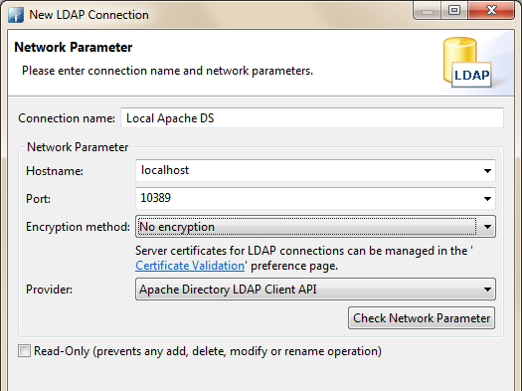
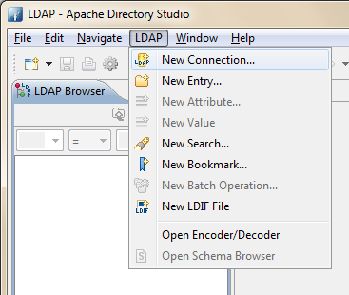
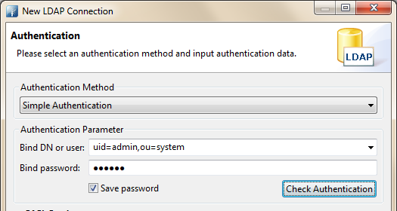
Using Apache Directory Studio
Either using Apache Directory Studio, or in LDAP perspective in Eclipse
LDAP → New Connection…
User: uid=admin,ou=system
Password: secret

Slide 9
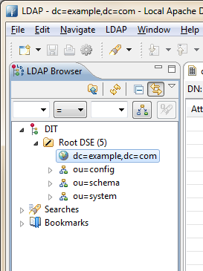
LDAP Browser
You should see this directory

Slide 10
JNDI Example (JNDIExample.java)
Hashtable<String, String> env = new Hashtable<String, String>();
env.put(Context.INITIAL_CONTEXT_FACTORY, "com.sun.jndi.ldap.LdapCtxFactory");
env.put(Context.PROVIDER_URL, "ldap://localhost:10389/dc=example,dc=com");
env.put(Context.SECURITY_AUTHENTICATION, "simple");
env.put(Context.SECURITY_PRINCIPAL, "uid=admin, ou=system");
env.put(Context.SECURITY_CREDENTIALS, "secret");
try {
Context ctx = new InitialContext(env);
String message = "Testing";
ctx.rebind("cn=test", message);
String msg = (String) ctx.lookup("cn=test");
System.out.println(msg);
} catch (NamingException e) {
e.printStackTrace();
}
LDAP context factory
Local directory service
Authentication
Name is cn=test

Slide 11
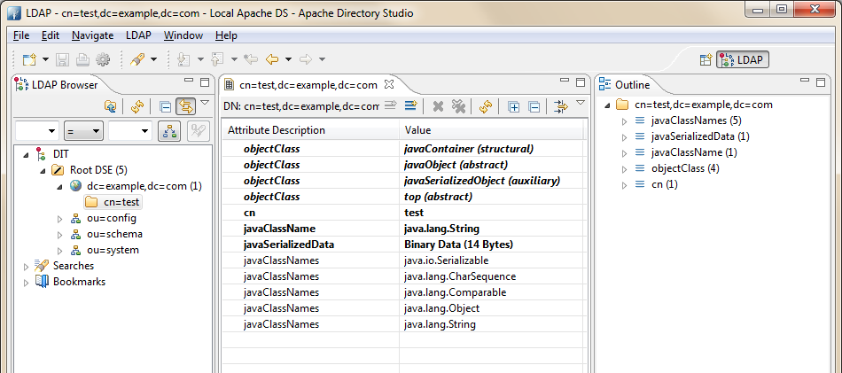
LDAP Browser after execution

Slide 12
Exercise 1
Modify JNDI Example:
Create a class called Message with three fields
String user;
String subject;
String content;
Bind a Message object instead of a string and run the program
What should be done in order to do so?

Slide 13
Remote object example
Download the RMI program from Moodle
TicketMachine.java: Remote interface
TicketServer.java: Server
Customer.java: Client
security.policy: the policy file
Setup Eclipse to run the program

Slide 14
Register remote object to LDAP
Modify TicketServer, replace the content in main
public static void main(String [] args) throws RemoteException,
MalformedURLException,
NamingException {
Hashtable<String, String> env = new Hashtable<String, String>() ;
env.put(Context.INITIAL_CONTEXT_FACTORY, "com.sun.jndi.ldap.LdapCtxFactory");
env.put(Context.PROVIDER_URL, "ldap://localhost:10389/dc=example,dc=com");
env.put(Context.SECURITY_AUTHENTICATION, "simple");
env.put(Context.SECURITY_PRINCIPAL, "uid=admin, ou=system");
env.put(Context.SECURITY_CREDENTIALS, "secret");
Context ctx = new InitialContext(env);
TicketMachine app = new TicketServer();
ctx.rebind("cn=TicketMachine", app);
System.out.println("Service registered");
}

Slide 15
Get Remote object from LDAP
Modify Customer, replace the content in main
public static void main(String[] args) throws MalformedURLException,
RemoteException, NotBoundException,
NamingException {
Hashtable<String, String> env = new Hashtable<String, String>() ;
env.put(Context.INITIAL_CONTEXT_FACTORY, "com.sun.jndi.ldap.LdapCtxFactory");
env.put(Context.PROVIDER_URL, "ldap://localhost:10389/dc=example,dc=com");
env.put(Context.SECURITY_AUTHENTICATION, "simple");
env.put(Context.SECURITY_PRINCIPAL, "uid=admin, ou=system");
env.put(Context.SECURITY_CREDENTIALS, "secret");
Context ctx = new InitialContext(env);
TicketMachine app = (TicketMachine)ctx.lookup("cn=TicketMachine");
int ticket = app.getTicket();
System.out.println("Got ticket number: "+ ticket);
}
Note: This is not RMI, the client get the object from LDAP and use it

Slide 16
Exercise 2
Modify the previous example so that RMI is used
Modify TicketServer
// ctx.rebind("cn=TicketMachine", app);
String rmiurl = "rmi://localhost/TicketMachine";
Reference ref = new Reference("TicketMachine", new StringRefAddr("URL", rmiurl));
ctx.rebind("cn=TicketMachine", ref);
ctx.rebind(rmiurl, app);
We do not need to modify the client

Slide 17
What to Submit for this Tutor
A word document and any source files you modified/created. The word document should contain screen shots on how to run your source code and their execution outputs.

