Slide 1
COMP3402 Tutorial postfix, JAR, ANT
CSIS0402/COMP3402 System Architecture and Distributed Computing

Slide 2
Overview
This tutorial consists of a sequence of exercise that helps you get familiar with Java development tools. It answers three questions:
How to evaluate an expression?
How to generate JAR file for submission?
How to automate the JAR building process?

Slide 3

Postfix notation
Expressions like $6/(1−3/4)$ are represented in the infix notation
It can be difficult to evaluate such expression in a program
An expression can be represented as a binary tree
Postfix notation is the post-order of such tree
Postfix can be easily evaluated
/
6
-
6
1
3
4
/
-
/
1
/
Note that parenthesis is not needed in postfix notation
3
4

Slide 4
Postfix evaluation
6
1
3
4
/
-
/
Scan from left to right
For every operator encountered:
Apply operation to the two preceding values
Replace the two values + operator with the result
Can be implemented with a stack
6
1
¾
-
/
6
¼
/
24
6
1
3
4
/
-
/
6
1
3
4
/
-
/
6
1
¾
-
/
6
¼
/
24

Slide 5
Exercise 1
Download PostFix.java from Moodle and complete the implementation of evaluate()
Assume that the input is always valid

Slide 6
JAR
Sometimes we want to package a program into JAR file
Package class files and resources (e.g., images) to a single .jar file for execution
Allow others to use the classes as external library

Slide 7
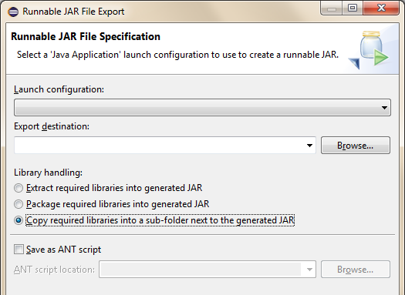
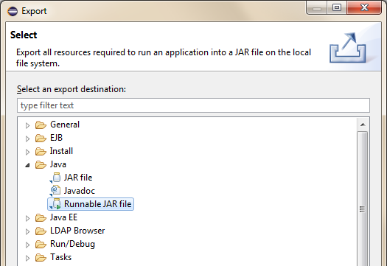
Package to JAR file
Right-click on the project and select “Export...”
Select Runnable JAR file
or JAR file for external library
Pick the launch configuration for your program, need to run the program at least once first
Pick a location to save the file, name it PostFix.jar
Useful to for manual execution

Slide 8
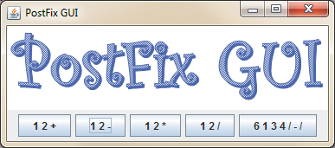
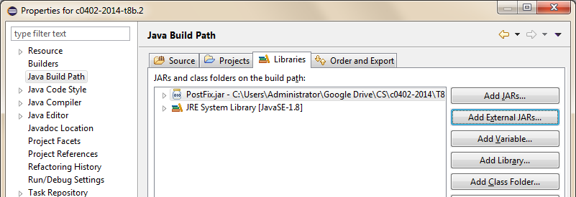
Using JAR file as external library
Create a new project in Eclipse
Download PostFixGUI.java and logo.png from Moodle
Import the file to the new project in Eclipse
Put logo.png in the project root
Right-click on the project and select Properties
Add PostFix.jar as external library

Slide 9
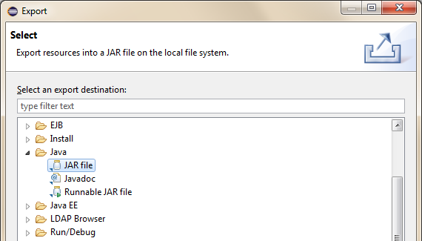
Packaging resources
PostFixGUI.java requires logo.png to be placed at a specific location to run
Which is troublesome, as it requires user to set up the environment
We can package such resources into a JAR file!
Choose “JAR file” this time

Slide 10
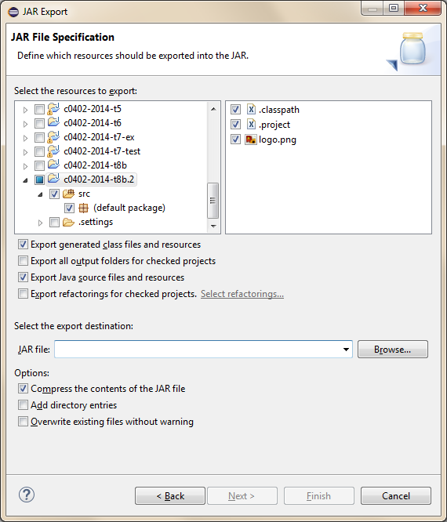


JAR Export
Include logo.png in the project root
Check the “src” folder to include all classes
Include source files also
Pick location to save file
Optional: Click “Next” twice to select the main class, to generate a Runnable JAR file

Slide 11
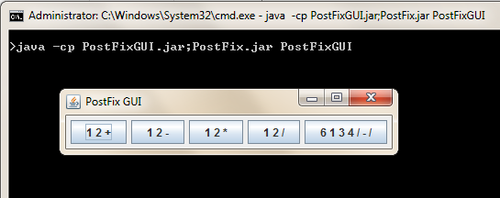
Running the JAR file
Prepare an empty folder, copy PostFix.jar and PostFixGUI.jar to there
Execute the JAR file in command line
java –cp PostFix.jar;PostFixGUI.jar PostFixGUI
The logo is gone!

Slide 12
Exercise 2
We need to change our code to make use of the image in the JAR file
Change
to
private Component getLogo() {
return new JLabel(new ImageIcon("logo.png"));
}
getClass().getResource() is used to access resources in a JAR file
private Component getLogo() {
try {
URL url = getClass().getResource("logo.png").toURI().toURL();
return new JLabel(new ImageIcon(url));
} catch (MalformedURLException | URISyntaxException e) {
}
return new JLabel();
}

Slide 13
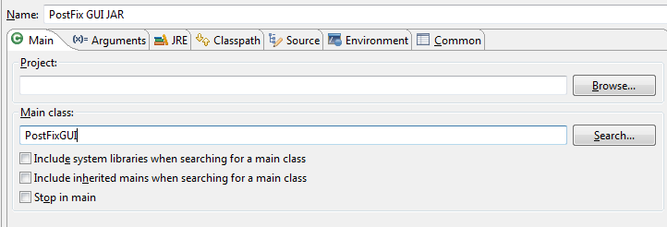
Running JAR file in Eclipse
From menu: Run → Run Configurations…
Right-click on “Java Application” → New
Pick a good name
Clear project name
Type the main class name “PostFixGUI”

Slide 14
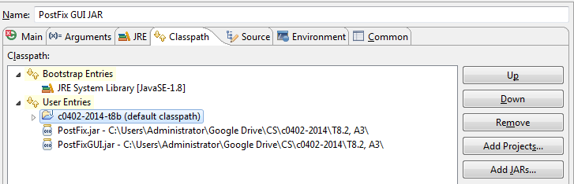

Running JAR file in Eclipse (cont’d)
Add PostFix.jar and PostFixGUI.jar to User Entries
Remove the original default classpath
Apply and Run

Slide 15
ANT builder
Suppose we are going to modify PostFix.java so support more operators, we need to:
Modify PostFix.java
Re-generate PostFix.jar
Change PostFixGUI.java to test the new operators
Re-generate PostFixGUI.jar
Test
We can automate the process using builder scripts
Ant is an example of them
An example script is available on Moodle, we need to setup Eclipse to use it

Slide 16
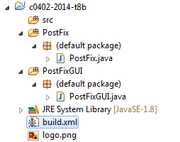
Eclipse project
Start a new project
Right-click on the project and create two new “Source Folder”
Name them PostFix and PostFixGUI
Move/Copy PostFix.java/PostFixGUI.java to the corresponding source folder
Move/Copy logo.png to project root
Download Ant script (build.xml) from Moodle and import to project root

Slide 17
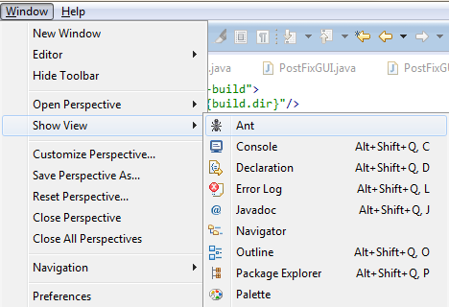
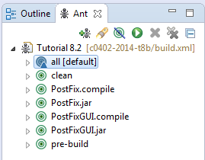
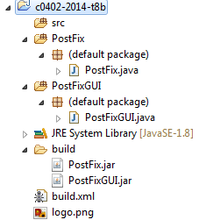
Trial run Ant script
Window → Show View → Ant
Click “Add” and pick the build.xml just added in the project
Double click on “all” to compile the project using the script
You should see the build folder if you refresh the project (press F5)

Slide 18
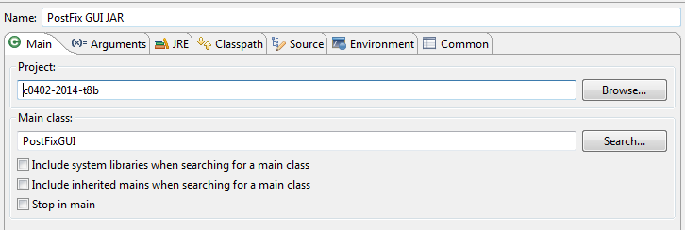
Edit run configuration
Run → Run Configurations…, modify previous run configuration
Choose the current project

Slide 19
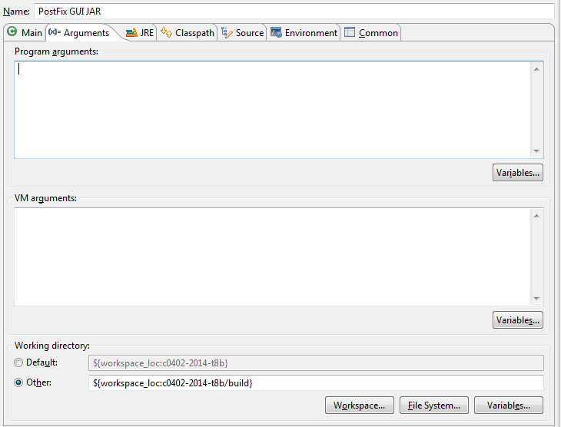
Edit run configuration (2)
Here we specify the working directory
We can specify program arguments or VM arguments (e.g., for security policy)
Click “Workspace…” and choose the build folder

Slide 20
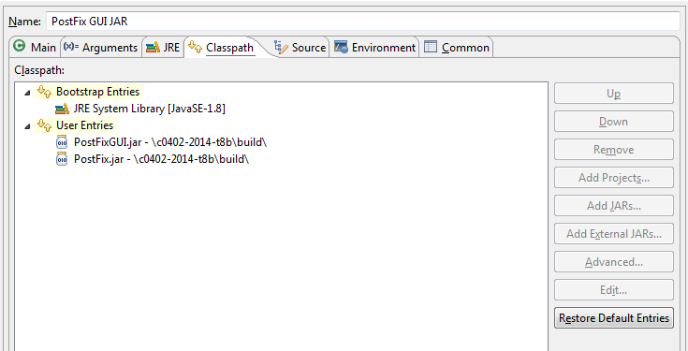
Edit run configuration (3)
Use “Add JARs…” instead of “Add External JARs…”
Add the new JARs first, and remove the original two
Apply and run now!

Slide 21
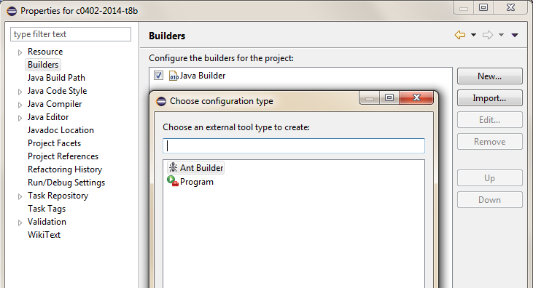
Build automatically
We can set up Eclipse to build the JAR file automatically when you update the program
Right-click on the project and select “Properties”
Builders → New… → Ant Builder

Slide 22
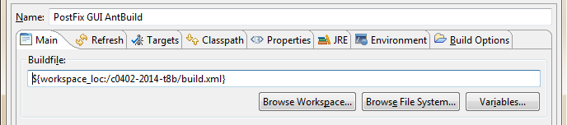
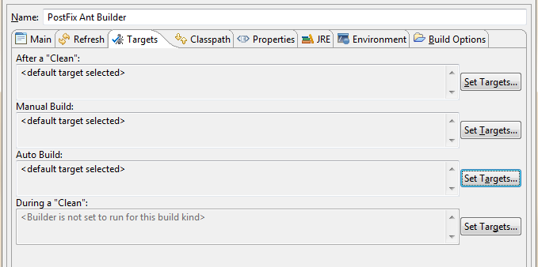
Build automatically (2)
Pick a good name
Click “Browser Workspace…” and pick the build.xml in your project
Click “Set Targets…” for Auto Build, click “OK” to accept the default

Slide 23
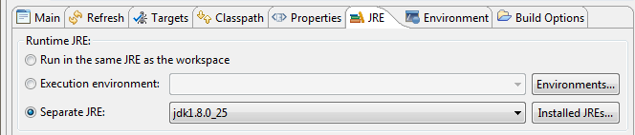
Build automatically (3)
Choose a Separate JRE
You should set up Installed JREs with a JDK environment, refer to tutorial 8 on how to do it!
Apply and save! Eclipse will use the builder when you modify your program

Slide 24
Exercise 3
To see if the JAR files are updated automatically, try to modify the program:
Modify PostFix.java to add operator “^” which means “to the power of”
Modify PostFixGUI.java to add a new case {"2", "10", "^"}

