Slide 1
Assignment 2 JDBC
CSIS0402/COMP3402 System Architecture and Distributed Computing

Slide 2
Overview
Setting up MySQL database
Using MySQL JDBC driver
Writing Java program
Connect to database
Create, read, update, delete

Slide 3
Installing MySQL server
You may use the department MySQL account instead
Get your account at: https://intranet.cs.hku.hk/csintranet/contents/technical/howto/database.jsp
Or download and install MySQL Community Server
http://dev.mysql.com/downloads/mysql/

Slide 4
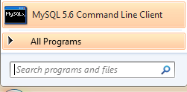
Preparing database (for own installation)
Fire up MySQL command line client
Enter root password (configured during installation)
Enter these commands:
Create database named c0402
CREATE DATABASE c0402;
GRANT ALL ON c0402.* TO 'c0402@localhost' IDENTIFIED BY 'c0402PASS';
USE c0402;
CREATE TABLE c0402_2017_t4 (
name varchar(32) NOT NULL,
birthday date NOT NULL,
PRIMARY KEY name (name)
);
Create user named c0402, who have all access to database c0402
Create table named c0402_2017_t4
You can check it by the command DESCRIBE c0402_2017_t4

Slide 5
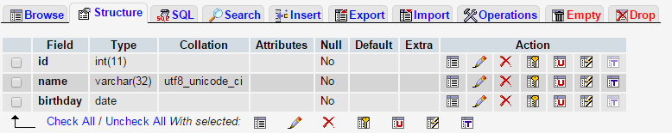
Preparing database (CS account)
Login http://i.cs.hku.hk/tools/phpMyAdmin/
Click on your database (your CS account name)
Click “SQL”
Execute this SQL
CREATE TABLE c0402_2017_t4 (
name varchar(32) NOT NULL,
birthday date NOT NULL,
PRIMARY KEY name (name)
);

Slide 6
JDBC driver
Download MySQL Connector/J (already installed in lab)
http://dev.mysql.com/downloads/connector/j/

Slide 7
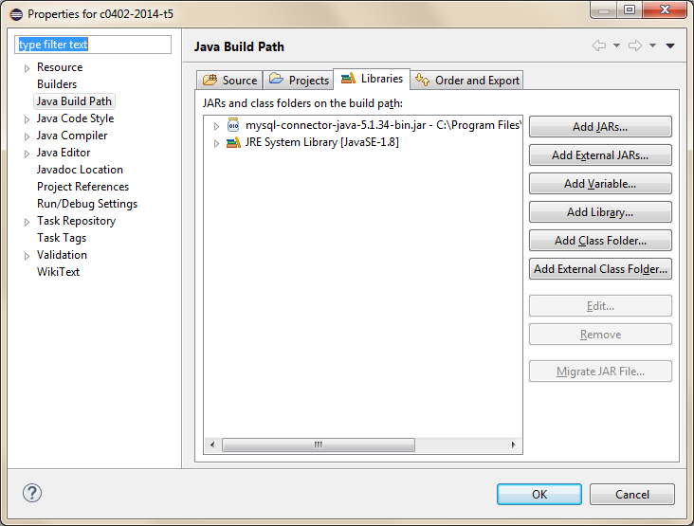
Setting up Eclipse project
Right click on your project → properties
Pick the jar file in Connector/J installation
On Windows: C:\Program Files\MySQL\MySQL Connector J
Alternatively you can add the path to CLASSPATH environment variable

Slide 8
Connecting with Java
 | CS MySQL | Your own server
DB_HOST | sophia | localhost
DB_USER | Your CS id | c0402
DB_PASS | Your MySQL password | c0402PASS
DB_NAME | Your CS id | c0402
Download JDBCDemo.java from Moodle
Set up MySQL login
Set up JDBC connection
private static final String DB_HOST = "sophia";
private static final String DB_USER = "";
private static final String DB_PASS = "";
private static final String DB_NAME = "";
public JDBCDemo() throws … {
Class.forName("com.mysql.jdbc.Driver").newInstance();
conn = DriverManager.getConnection("jdbc:mysql://"+DB_HOST+
"/"+DB_NAME+
"?user="+DB_USER+
"&password="+DB_PASS);
System.out.println("Database connection successful.");
}
Execute the program, type “exit” to end.

Slide 9
insert()
Use prepared statement to input parameters
try {
PreparedStatement stmt = conn.prepareStatement("INSERT INTO c0402_2017_t4 (name, birthday) VALUES (?, ?)");
stmt.setString(1, name);
stmt.setDate(2, java.sql.Date.valueOf(birthday));
stmt.execute();
System.out.println("Record created");
} catch (SQLException | IllegalArgumentException e) {
System.err.println("Error inserting record: "+e);
}
Execute statement

Slide 10
read()
try {
PreparedStatement stmt = conn.prepareStatement("SELECT birthday FROM c0402_2017_t4 WHERE name = ?");
stmt.setString(1, name);
ResultSet rs = stmt.executeQuery();
if(rs.next()) {
System.out.println("Birthday of "+name+" is on "+rs.getDate(1).toString());
} else {
System.out.println(name+" not found!");
}
} catch (SQLException e) {
System.err.println("Error reading record: "+e);
}
Use result set object to retrieve results

Slide 11
list()
Use statement object for queries without parameters
Specify list of columns
try {
Statement stmt = conn.createStatement();
ResultSet rs = stmt.executeQuery("SELECT name, birthday FROM c0402_2017_t4");
while(rs.next()) {
System.out.println("Birthday of "+rs.getString(1)+" is on "+rs.getDate(2).toString());
}
} catch (SQLException e) {
System.err.println("Error listing records: "+e);
}
Use while loop to read all results

Slide 12
update()
try {
PreparedStatement stmt = conn.prepareStatement("UPDATE c0402_2017_t4 SET birthday = ? WHERE name = ?");
stmt.setDate(1, java.sql.Date.valueOf(birthday));
stmt.setString(2, name);
int rows = stmt.executeUpdate();
if(rows > 0) {
System.out.println("Birthday of "+name+" updated");
} else {
System.out.println(name+" not found!");
}
} catch (SQLException e) {
System.err.println("Error reading record: "+e);
}
Use executeUpdate() for update
Return number of rows updated

Slide 13
delete()
Always specify WHERE clause for delete!
try {
PreparedStatement stmt = conn.prepareStatement("DELETE FROM c0402_2017_t4 WHERE name = ?");
stmt.setString(1, name);
int rows = stmt.executeUpdate();
if(rows > 0) {
System.out.println("Record of "+name+" removed");
} else {
System.out.println(name+" not found!");
}
} catch (SQLException | IllegalArgumentException e) {
System.err.println("Error inserting record: "+e);
}
Use executeUpdate() to check number of rows deleted

Slide 14
Exercise
Complete the implementation as suggested in this tutorial
Add a command “birthday” which takes 1 argument (the birthday) and print out the names of all records with the specific birthday
Try to do three operations: create, update and delete records in the database through your program
Submit all your final *.java file(s) and a word document. The document should contain your screen shots (your operation outputs) on running each of the three operations. The format of the doc is flexible.

