Slide 1
Tutorial 8 Assignment 3
CSIS0402/COMP3402 System Architecture and Distributed Computing

Slide 2
Assignment 3
Finishing the game
Actually assignment 3 + 4
Weighted more than assignment 1 or 2
Three major components
The game-play GUI (client)
The game-play mechanism (server + client)
Evaluating (and validating) answer
You must use JMS to support the game-play mechanism

Slide 3
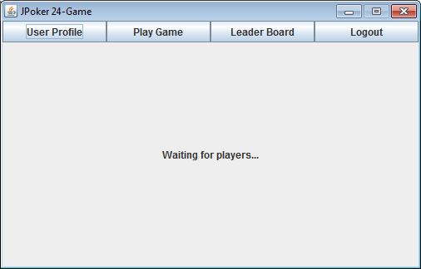
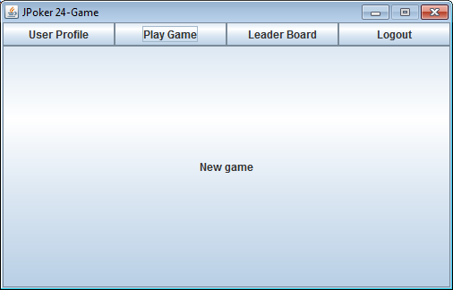
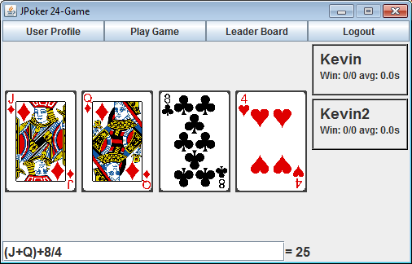
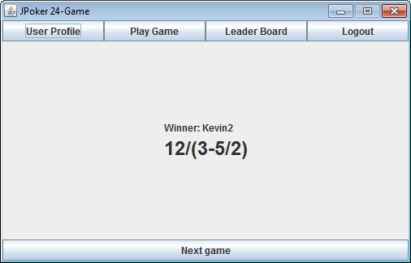
Game Stages
Game-joining
Initial
Game-playing
Game-over

Slide 4
Initial stage
User logged-in client
Clicked “Play Game”
Clicked “New Game”
Game-joining stage

Slide 5
Game-joining stage
Server
Inform server
Match player to game
Wait for game ready to start
Game-playing stage
Inform client

Slide 6
When to start a game?
When there are 4 players, or
When there are 2 players and 10 seconds has passed since the first player joined
0s
3s
7s
9s
Player 1 joined
Player 2 joined
Player 3 joined
Player 4 joined Game start
0s
3s
8s
10s
Player 1 joined
Player 2 joined
Player 3 joined
Game start
0s
10s
13s
Player 1 joined
Player 2 joined
Game start

Slide 7
Game-playing stage
Server
Pick cards and inform client(s)
Submit answer
Validate answer
Update statistics
Game-over stage
Inform client(s)

Slide 8
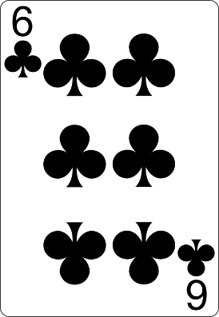
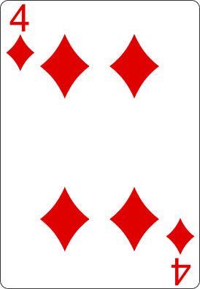


Game rule
4 Cards of different values should be drawn.
Suit doesn’t matters
Goal: an expression that equals 24
Available operations: +,-,×,÷
Parenthesis can be used to override precedence
Fraction may appear in intermediate result
What is the answer?

Slide 9
Game-over stage
Clicked “Next Game”
Game-joining stage

Slide 10
New submission requirements
For this assignment, you can only submit 3 files:
JPoker24Game.jar: the packaged client program, with source
JPoker24GameServer.jar: the packaged server program, with source
lib.zip (optional): external libraries used
For details on how to create JAR file, see part 2 of tutorial 8

Slide 11
JMS setup
JMS provider: GlassFish 4
https://glassfish.java.net/download.html (Download Full Platform)
GlassFish is available in lab under C:\Program Files\glassfish-4.0 folder
Connection factory: jms/JPoker24GameConnectionFactory
Destination: jms/JPoker24GameQueue, jms/JPoker24GameTopic
Read the assignment sheet for details
We will explain the settings through examples in tutorial 9

Slide 12
JMS Demo
You can download a pair of demo program from Moodle
QueueSenderExample.java: Sending message to JMS queue
QueueReceiverExample.java: Receive message from JMS queue
You need to setup GlassFish for the program to be executed
See the following slides

Slide 13
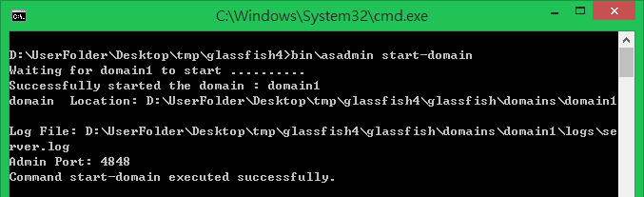
Starting GlassFish server
Server can be started using command line utilities
Command-line utilities: asadmin
In a command console, execute “asadmin start-domain” to start a domain
Admin console will be accessible after a domain is started
Admin console: http://localhost:4848

Slide 14
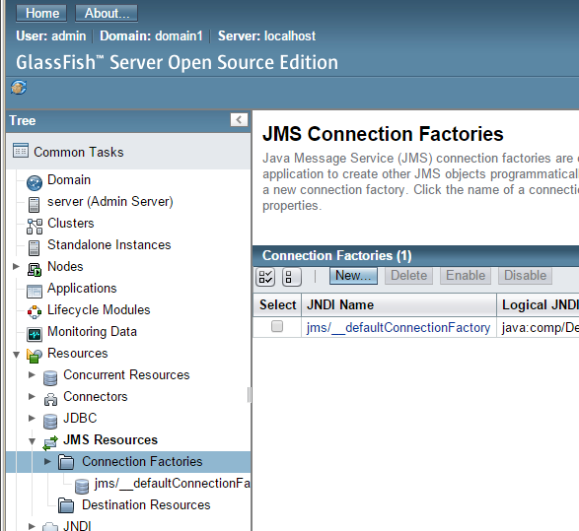
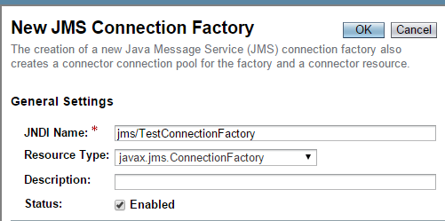
Connection Factory
Admin console: http://localhost:4848
Visit http://localhost:4848
Name: jms/TestConnectionFactory
Type: javax.jms.ConnectionFactory

Slide 15
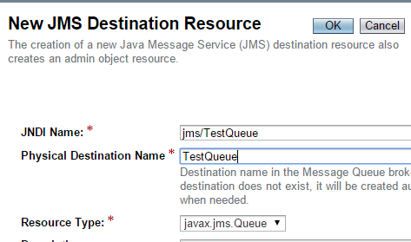
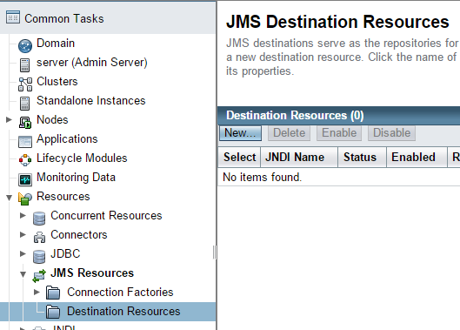
Destination
JNDI Name: jms/TestQueue
Physical name: TestQueue
Type: javax.jms.Queue

Slide 16
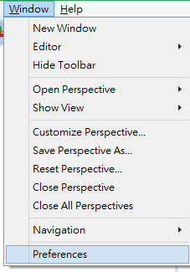
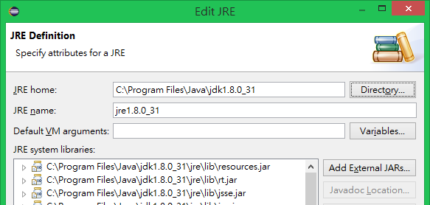
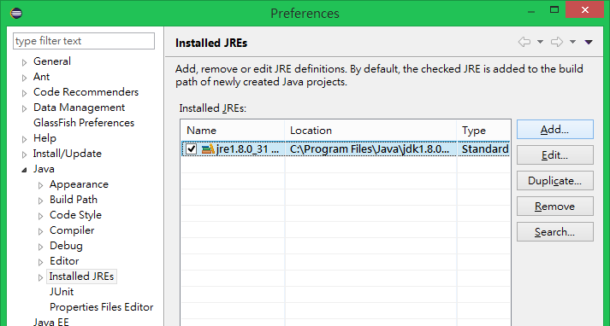
Setting up Eclipse execution environment
It is advised to use the JRE in JDK installation instead of the default JRE installation
Change to JDK installation folder

Slide 17
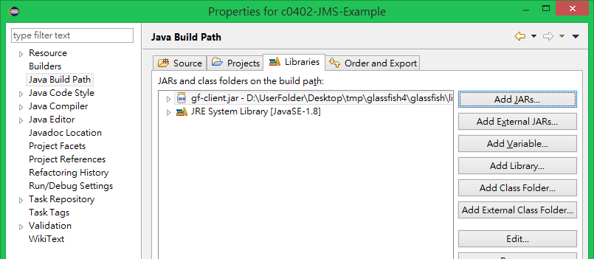
Set up project in Eclipse
Create a new project and import the two Java files
Add gf-client.jar to external library in Eclipse (right-click on project → properties)
It can be found in <GlassFish folder>/glassfish/lib
You can now execute the programs in Eclipse

