Slide 1
VLSI system design
Project presentation
CNN mask detection accelerator
By 謝宜紘 鄭惟 楊承翰
陳韋綸 陳柏廷 王傑世 顧芳宜

Slide 2
Index
System architecture
HW architecture
EPU architecture
PE architecture
NN architecture
1
Verification
EPU verification
Full sys verify
2
Overall results
Speed perf
Accuracy perf
Area perf
3

Slide 3
System architecture
HW architecture
EPU architecture
NN architecture

Slide 4
HW architecture
IM wrapper (Slave1)
DM wrapper (Slave2)
DMA
(master2)(slave5)
CPU
L1 I$ (Master0)
L1 D$ (Master1)
IM
DM
AXI bus
EPU wrapper (slave 6)
Sctrl wrapper (slave 3)
ROM wrapper (slave 0)
DRAM wrapper (slave 4)
Bias
Weight
Input
Output Buffer
Sensor
ROM
DRAM
Off-chip

Slide 5
EPU architecture
EPU wrapper (slave 6)
EPU
EPU
Weight Buffer (180KiB)
Bias Buffer (2 KiB)
Output Buffer (384 KiB)
Input Buffer (384 KiB)
EPU mode
AXI R/W
EPU R/W
EPU functionality
Conv 3x3
Conv 1x1
Max pooling
Conv 3x3
Conv 1x1
Max
Pooling
Weight
Bias
Output
Input
AXI bus

Slide 6
PE architecture
EPU
16 bit
Max
Pooling
Conv 3x3 unit
4 PE, each with 9 MACs
Weight stationary
Conv 1x1 unit
1 PE with 9 MACs
Weight stationary
Max pooling unit
1 PE with 1 comparator
16 bit
PE0
Conv 1x1
Weight
Bias
Output
Input
32 bit
PE0
PE2
18 bit
PE1
PE3
Conv 3x3

Slide 7
NN architecture
CNN for CIFAR-10 | Imap | Kernel | Omap | Note
Conv 0 | 32*32*3 | 3*3*3*96 | 32*32*96 | 3x3 conv
Conv 1 | 32*32*96 | 1*1*96*160 | 32*32*160 | 1x1 conv
Conv 2 | 32*32*160 | 1*1*160*192 | 32*32*192 | 1x1 conv
Max Pool 0 | 32*32*192 | 2x2 | 16*16*192 | 2x2 Max
Conv 3 | 16*16*192 | 3*3*192*96 | 16*16*96 | 3x3 conv
Conv 4 | 16*16*96 | 1*1*96*192 | 16*16*192 | 1x1 conv
Conv 5 | 16*16*192 | 1*1*192*192 | 16*16*192 | 1x1 conv
Max Pool 1 | 16*16*192 | 2x2 | 8*8*192 | 2x2 Max
Conv 6 | 8*8*192 | 3*3*192*384 | 8*8*384 | 3x3 conv
Conv 7 | 8*8*384 | 1*1*384*192 | 8*8*192 | 1x1 conv
Conv 8 | 8*8*192 | 1*1*192*10 | 8*8*10 | 1x1 conv
Max Pool 2 | 8*8*10 | 8x8 | 1*1*10 | 8x8 Max
NIN for CIFAR-10
3x conv 3x3 layer
6x conv 1x1 layer
3x max pooling layer
No FC layer
Remove BN layer
FP NIN with BN layer
89.59% [1]
CLIP-Q without BN
~82%
[1] Lin, M., Chen, Q., & Yan, S. (2013). Network in network. arXiv preprint arXiv:1312.4400.
[2] F. Tung and G. Mori, "CLIP-Q: Deep Network Compression Learning by In-parallel Pruning-Quantization," 2018 CVPR

Slide 8














NN architecture
Custom arch for mask dataset
One conv 3x3 layer
One conv 1x1 layer
One max pooling layer
With CLIP-Q
~82%
MASK | Imap | Kernel | Omap | Note
Conv 0 | 32*32*3 | 3*3*3*60 | 32*32*60 | 3x3 conv
Conv 1 | 32*32*60 | 1*1*60*2 | 32*32*2 | 1x1 conv
Pool 0 | 32*32*2 | 32x32 | 1*1*2 | 32x32 Max

Slide 9
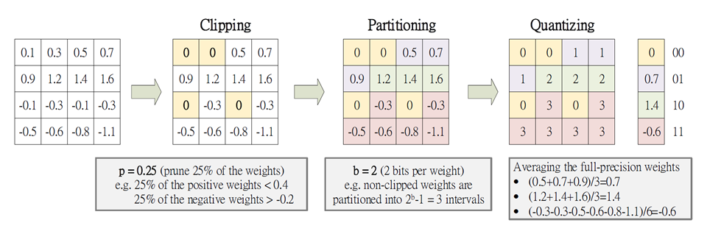
CLIP-Q
Deep Network Compression Learning by In-parallel Pruning-Quantization
8-bit Quantization

Slide 10
Verification
EPU verification
Full sys verify

Slide 11
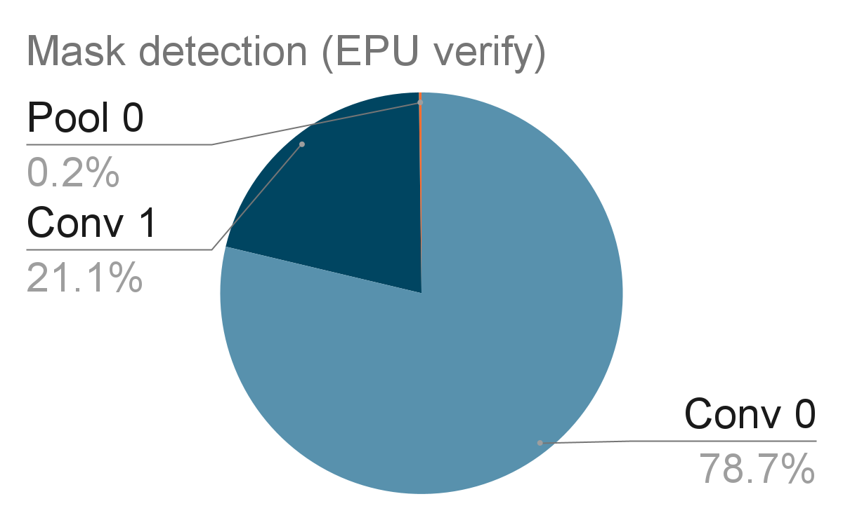
EPU verification
 | Imap | Kernel | Omap | Note | Time (s)
Conv 0 | 32*32*3 | 3*3*3*60 | 32*32*60 | 3x3 conv | 0.009
Conv 1 | 32*32*60 | 1*1*60*2 | 32*32*2 | 1x1 conv | 0.002
Pool 0 | 32*32*2 | 32x32 | 1*1*2 | 32x32 Max | ~0
 |  | Total | 10,909,710 cycles |  | 0.011s (90 fps)
Stand-alone testbench for EPU
TB loads input/weight/bias data into RTL-simulated SRAM buffers.
TB pulls start signal to high
EPU starts computation and writes results to output buffer.
EPU pulls finish signal to high
TB verify the content of output buffer.

Slide 12
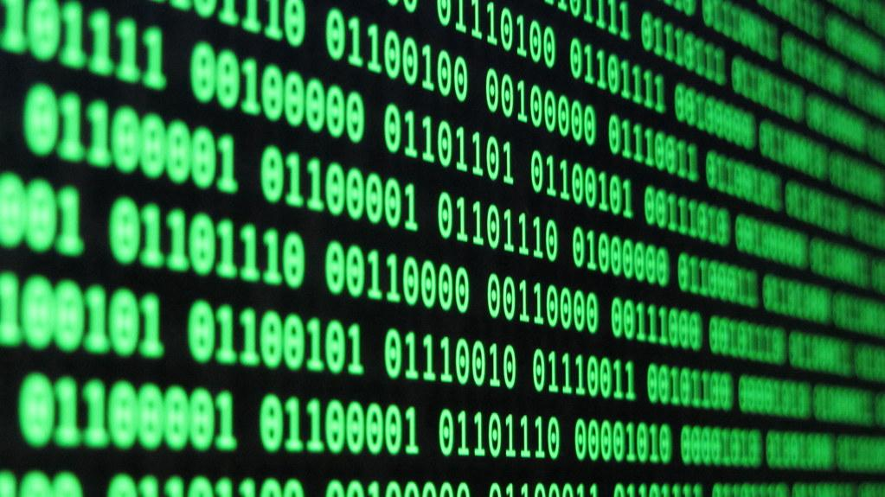
Full sys verification – program flow
IM wrapper (Slave1)
DM wrapper (Slave2)
DMA
(master2)(slave5)
CPU
L1 I$ (Master0)
L1 D$ (Master1)
IM
DM
AXI bus
EPU wrapper (slave 6)
ROM wrapper (slave 0)
DRAM wrapper (slave 4)
Weight
Bias
Output
Input
Input
Output
Conv 3x3
Conv 1x1
Max
Pooling
ROM
DRAM
Off-chip

Slide 13
Full sys verification – program flow
Assume ALL input/weight/bias data in DRAM.
CPU runs booting program with DMA.
Use DMA to move data from DRAM to EPU’s buffer.
CPU writes to EPU ctrl registers.
8-bit weight shared by that layer
“start” signal
EPU writes to output buffer as CPU stuck at WFI.
EPU finishes and send interrupt. CPU continues with ISR.
CPU writes ctrl signals for next layer.
Trigger “In-Output buffer swap”
Output of this layer is the input of next layer
If done, DMA move data from EPU to DRAM.
TB verify the content of DRAM.

Slide 14
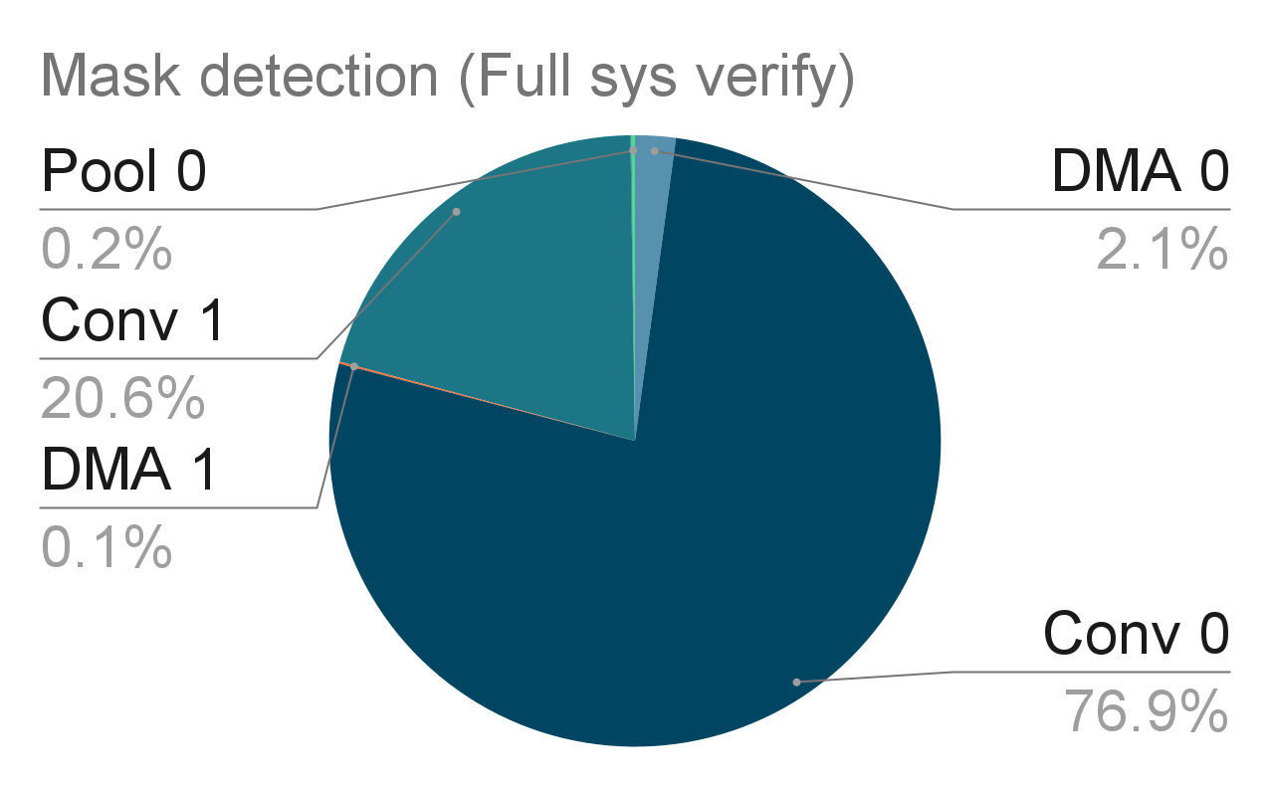
Full sys verification
(EPU full sys) | Imap | Kernel | Omap | Cycle | Time (s)
DMA 0 |  |  |  | 239,305 | ~0
Conv 0 | 32*32*3 | 3*3*3*60 | 32*32*60 | 8,588,693 | 0.009
DMA 1 |  |  |  | 11,693 | ~0
Conv 1 | 32*32*60 | 1*1*60*2 | 32*32*2 | 2,298,321 | 0.002
DMA 2 |  |  |  | 3949 | ~0
Pool 0 | 32*32*2 | 32x32 | 1*1*2 | 22,696 | ~0
 |  |  | Total | 11,459,657 | 0.011s (90 fps)

Slide 15
Overall results
Speed perf
Accuracy perf
Area perf

Slide 16
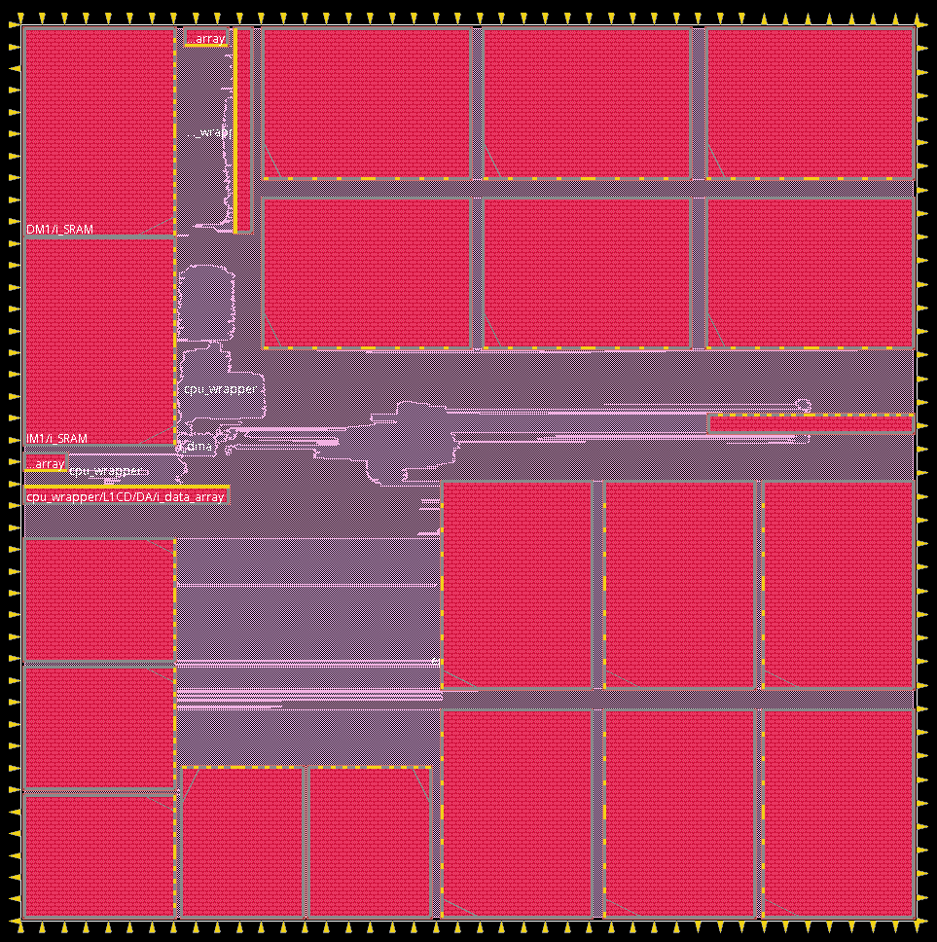
PPA perf
Assumption: Cycle time: 10 ns (100 MHz), U18 process
 |  | Area (um^2)
CPU | CPU+I$+D$ | ~ 1 mm^2
Memory |  | ~ 5.3 mm^2
 | IM (32 KB) | 2,681,940 um^2
 | DM (32 KB) | 2,682,393 um^2
EPU Buffers |  | 40.23 mm^2
 | Bias buffer | 319,990 um^2
 | Weight Buffer | 7,864,482 um^2
 | Input Buffer | 16,035,081 um^2
 | Output Buffer | 16,036,266 um^2
EPU |  | 0.6 mm^2
 | Total area: (SYN) 47.6 mm^2
 | Core area: (APR) 67.9 mm^2

Slide 17
Thanks!
Questions?

