Slide 1
Introduction to Sequential Circuits
EIC 0844091
Digital Circuit and Logic Design
Associate Prof. Luo Jie
Huazhong University of Science & Technology

Slide 2
Presentation Outline
Introduction to Sequential Circuits
Synchronous versus Asynchronous
Latches
Flip-Flops
Characteristic Tables and Equations

Slide 3
Combinational versus Sequential
Two classes of digital circuits
Combinational Circuits
Sequential Circuits
Combinational Circuit
Outputs = F(Inputs)
Function of Inputs only
NO internal memory
Sequential Circuit
Outputs is a function of Inputs and internal Memory
There is an internal memory that stores the state of the circuit
Time is very important: memory changes with time
Combinational
Circuit
Inputs
Outputs

Slide 4
Introduction to Sequential Circuits
A Sequential circuit consists of:
Memory elements:
Latches or Flip-Flops
Store the Present State
Combinational Logic
Computes the Outputs of the circuit
Outputs depend on Inputs and Current State
Computes the Next State of the circuit
Next State also depends on the Inputs and the Present State
Inputs
Combinational
Logic
Outputs
Present
State
Next
State
Memory
Elements

Slide 5
Two Types of Sequential Circuits
Synchronous Sequential Circuit
Uses a clock signal as an additional input
Changes in the memory elements are controlled by the clock
Changes happen at discrete instances of time
Asynchronous Sequential Circuit
No clock signal
Changes in the memory elements can happen at any instance of time
Our focus will be on Synchronous Sequential Circuits
Easier to design and analyze than asynchronous sequential circuits

Slide 6
Synchronous Sequential Circuits
Inputs
Combinational
Logic
Outputs
Present
State
Next
State
Memory
Elements
Clock
Synchronous sequential circuits use a clock signal
The clock signal is an input to the memory elements
The clock determines when the memory should be updated
The present state = output value of memory (stored)
The next state = input value to memory (not stored yet)

Slide 7
The Clock
Positive
Pulse
Negative
Pulse
Clock cycle
Clock cycle
Time
Clock is a periodic signal = Train of pulses (1's and 0's)
The same clock cycle repeats indefinitely over time(重复多次)
Positive Pulse: when the level of the clock is 1
Negative Pulse: when the level of the clock is 0
Rising Edge: when the clock goes from 0 to 1
Falling Edge: when the clock goes from 1 down to 0

Slide 8
Clock Cycle versus Clock Frequency
Clock cycle
Clock cycle
Clock cycle
Time
Clock cycle (or period) is a time duration (时钟周期一段持续时间)
Measured in seconds, milli-, micro-, nano-, or pico-seconds
1 ms = 10⁻³ sec, 1 µs = 10⁻⁶ sec, 1 ns = 10⁻⁹ sec, 1 ps = 10⁻¹² sec
Clock frequency = number of cycles per second (Hertz)
1 Hz = 1 cycle/sec, 1 kHz = 10³ Hz, 1 MHz = 10⁶ Hz, 1 GHz = 10⁹ Hz
Clock frequency = 1 / Clock Cycle
Example: Given the clock cycle = 0.5 ns = 0.5 ×10⁻⁹ sec
Then, the clock frequency = 1/(0.5×10⁻⁹) = 2×10⁹ Hz = 2 GHz

Slide 9
Memory Elements
Memory can store and maintain binary state (0's or 1's)
Until directed by an input signal to change state(直到被输入信号改变状态)
Main difference between memory elements
Number of inputs they have(它们具有的输入个数)
How the inputs affect the binary state(输入如何影响二进制状态)
Two main types:
Latches are level-sensitive (the level of the clock)
Flip-Flops are edge-sensitive (sensitive to the edge of the clock)
Flip-Flips are used in synchronous sequential circuits
Flip-Flops are built with latches

Slide 10
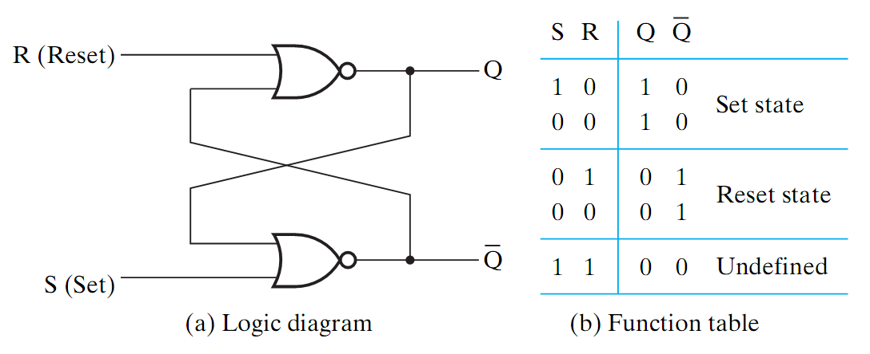
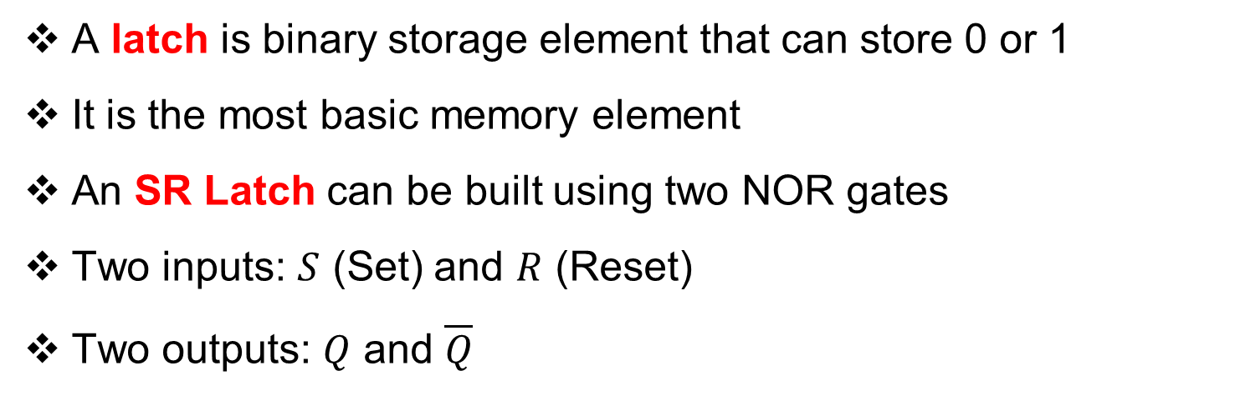
SR Latch
A latch is binary storage element that can store 0 or 1
It is the most basic memory element
An SR Latch can be built using two NOR gates
Two inputs: $S$ (Set) and $R$ (Reset)
Two outputs: $Q$ and $\overline{Q}$

Slide 11
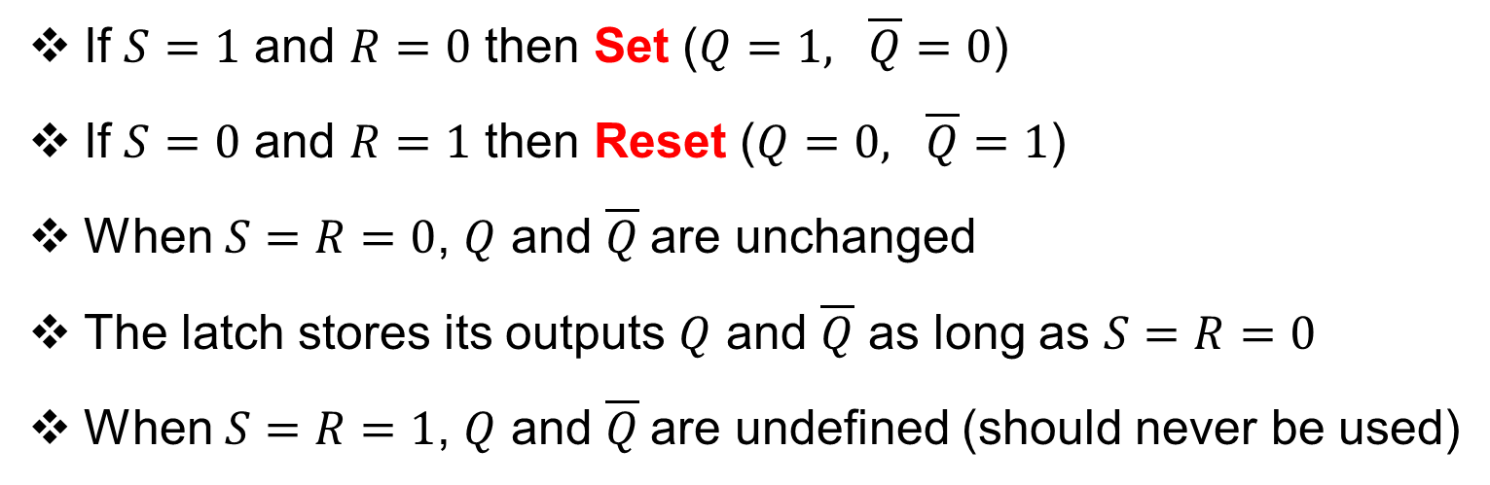
SR Latch Operation
If $S=1$ and $R=0$ then Set ($Q=1, \overline{Q}=0$)
If $S=0$ and $R=1$ then Reset ($Q=0, \overline{Q}=1$)
When $S=R=0$, $Q$ and $\overline{Q}$are unchanged
The latch stores its outputs $Q$ and $\overline{Q}$ as long as $S=R=0$
When $S=R=1$, $Q$ and $\overline{Q}$are undefined (should never be used)

Slide 12
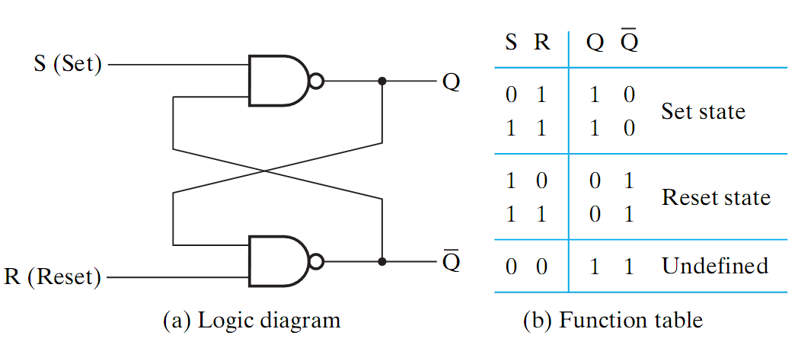

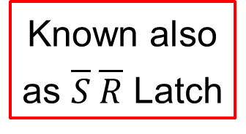
SR Latch with NAND Gates
Known also
as $\overline{S} \overline{R}$ Latch
If $S=0$ and $R=1$ then Set ($Q=1, \overline{Q}=0$)
If $S=1$ and $R=0$ then Reset ($Q=0, \overline{Q}=1$)
When $S=R=1$, $Q$ and $\overline{Q}$are unchanged (remain the same)
The latch stores its outputs $Q$ and $\overline{Q}$ as long as $S=R=1$
When $S=R=0$, $Q$ and $\overline{Q}$are undefined (should never be used)

Slide 13
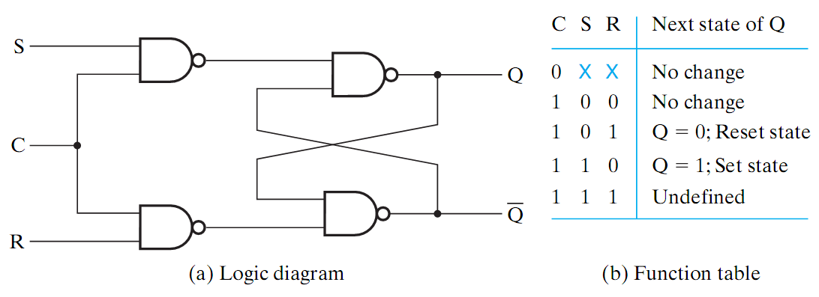
SR Latch with a Clock Input
An additional Clock input signal C is used
Clock controls when the state of the latch can be changed
When C=0, the S and R inputs have no effect on the latch
The latch will remain in the same state, regardless of S and R
When C=1, then normal SR latch operation

Slide 14
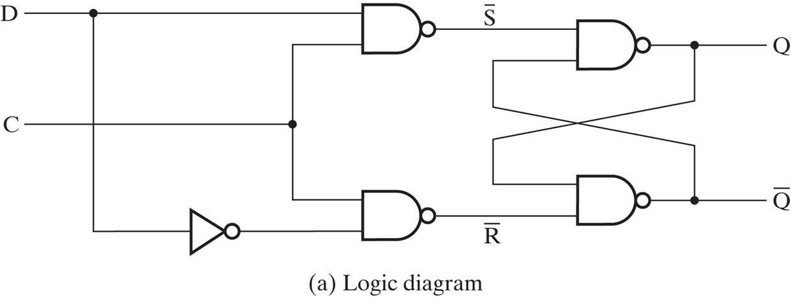
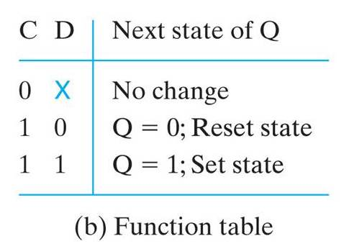
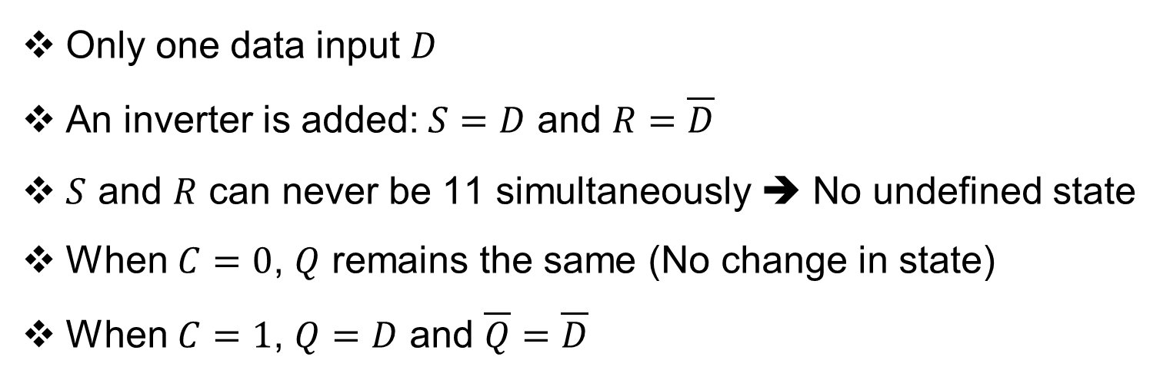
D-Latch with a Clock Input
S
R
Only one data input $D$
An inverter is added:$S=D$ and $R=\overline{D}$
$S$ and $R$ can never be 11 simultaneously ➔ No undefined state
When $C=0$, $Q$ remains the same (No change in state)
When $C=1$, $Q=D$ and $\overline{Q}=\overline{D}$

Slide 15




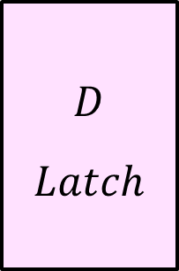

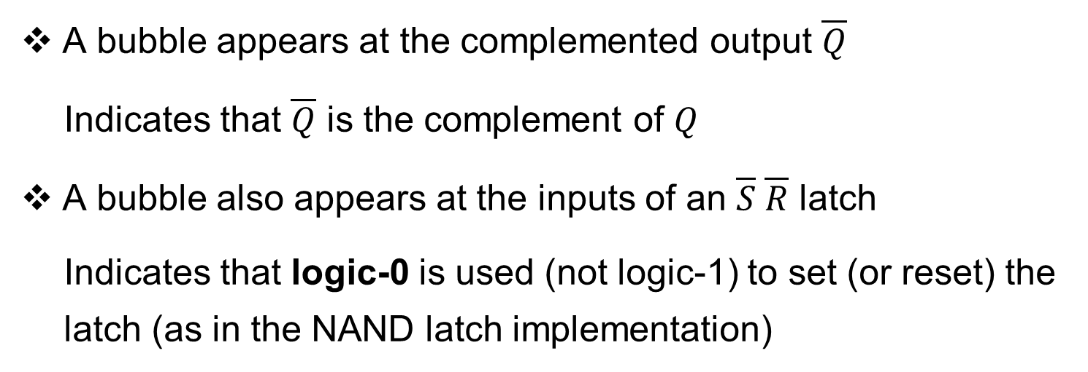






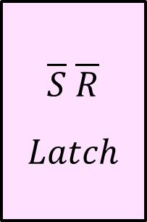




Graphic Symbols for Latches
$$S$$
$S R$
$Latch$
$$Q$$
$$S$$
$\overline{S} \overline{R}$
$Latch$
$$Q$$
$$D$$
$D$
$Latch$
$$Q$$
$$C$$
$$C$$
$$R$$
$$\overline{Q}$$
$$R$$
$$\overline{Q}$$
$$C$$
$$\overline{Q}$$
A bubble appears at the complemented output $\overline{Q}$
Indicates that $\overline{Q}$ is the complement of $Q$
A bubble also appears at the inputs of an $\overline{S} \overline{R}$ latch
Indicates that logic-0 is used (not logic-1) to set (or reset) the latch (as in the NAND latch implementation)

Slide 16


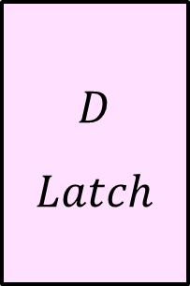
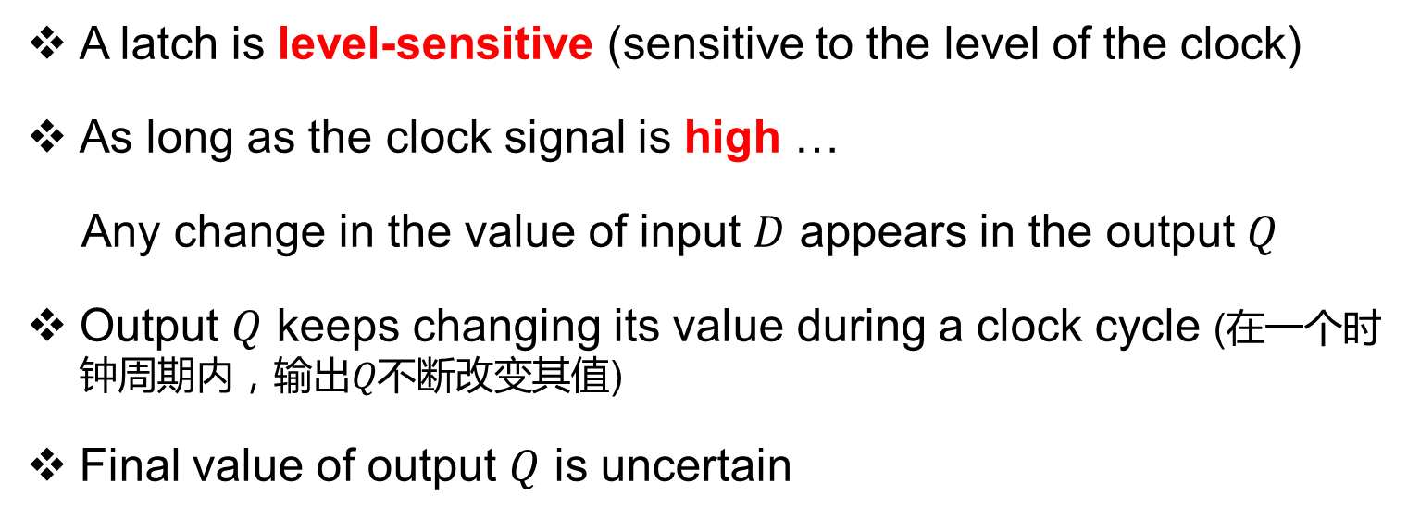



Problem with Latches
A latch is level-sensitive (sensitive to the level of the clock)
As long as the clock signal is high …
Any change in the value of input $D$ appears in the output $Q$
Output $Q$ keeps changing its value during a clock cycle (在一个时钟周期内，输出𝑄不断改变其值)
Final value of output $Q$ is uncertain
Due to this uncertainty, latches are not used as memory elements in synchronous circuits
$$D$$
$D$
$Latch$
$$Q$$
$$X=1$$
$$Clk$$
$$\overline{Q}$$

Slide 17
Flip-Flops
A Flip-Flop is a better memory element for synchronous circuits
Solves the problem of latches in synchronous sequential circuits
A latch is sensitive to the level of the clock
However, a flip-flop is sensitive to the edge of the clock
A flip-flop is called an edge-triggered memory element
It changes it output value at the edge of the clock
High
Level
Low
Level
Rising edge
Falling edge
Rising edge
Falling edge
Time

Slide 18
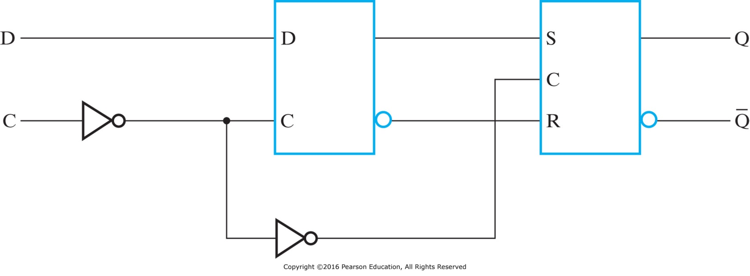
Positive Edge-Triggered D Flip-Flop
Built using two latches in a master-slave configuration
A master latch (D-type) receives external inputs
A slave latch (SR-type) receives inputs from the master latch
Only one latch is enabled at any given time
When C=0, the master is enabled and the D input is latched (slave disabled)
When C=1, the slave is enabled to generate the outputs (master is disabled)
Outputs change when C changes from 0 to 1
Master
Slave

Slide 19
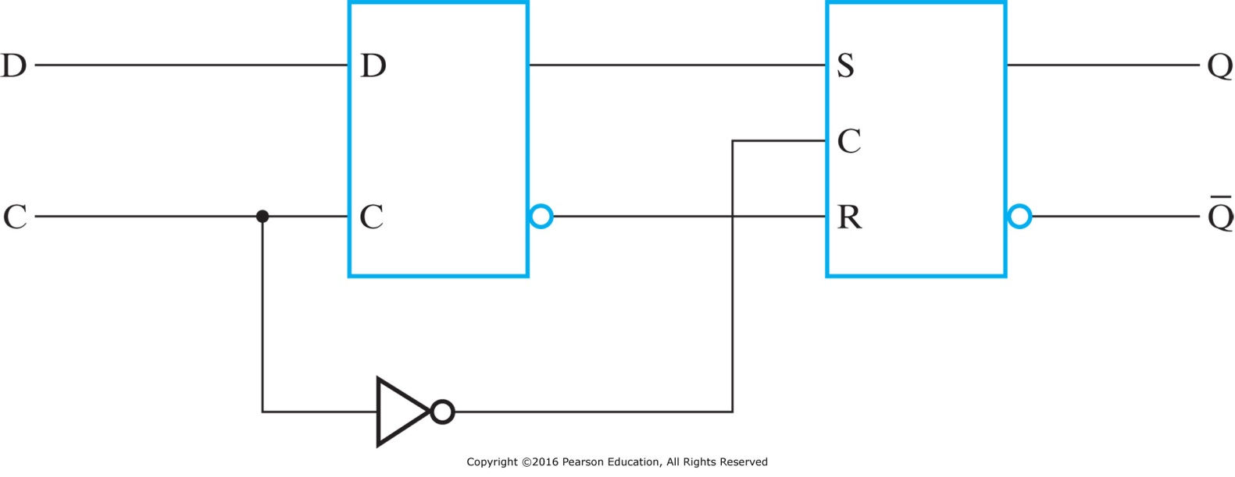
Negative Edge-Triggered D Flip-Flop
Similar to positive edge-triggered flip-flop
The first inverter at the Master C input is removed
Only one latch is enabled at any given time
When C=1, the master is enabled and the D input is latched (slave disabled)
When C=0, the slave is enabled to generate the outputs (master is disabled)
Outputs change when C changes from 1 to 0
Master
Slave

Slide 20
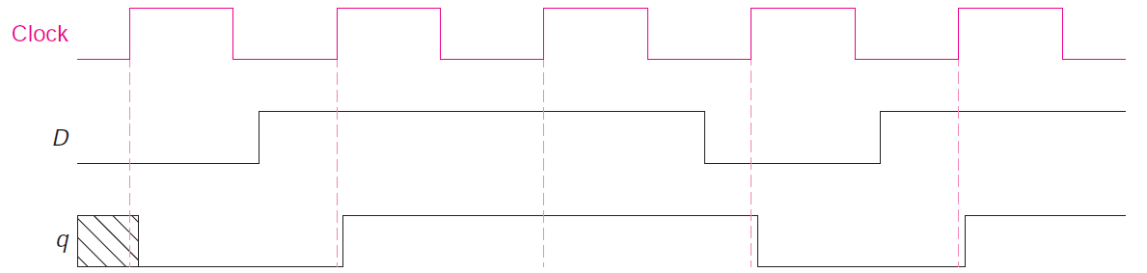
D Flip-Flop Timing Diagram
The diagram shows the timing of a positive edge D Flip-Flop
The rising edge of the clock triggers the D Flip-Flop
Initially, the value of q might be unknown
Notice the slight delay in the output q (after the rising edge)

Slide 21

Graphic Symbols for Flip-Flops
$$D$$
D Flip
Flop
$$Q$$
$$D$$
D Flip
Flop
$$Q$$
$$C$$
$$\overline{Q}$$
$$C$$
$$\overline{Q}$$
A Flip-Flop has a similar symbol to a Latch
The difference is the arrowhead at the clock input C
The arrowhead indicates sensitivity to the edge of the clock
A bubble at the C input indicates negative edge-triggered FF

Slide 22
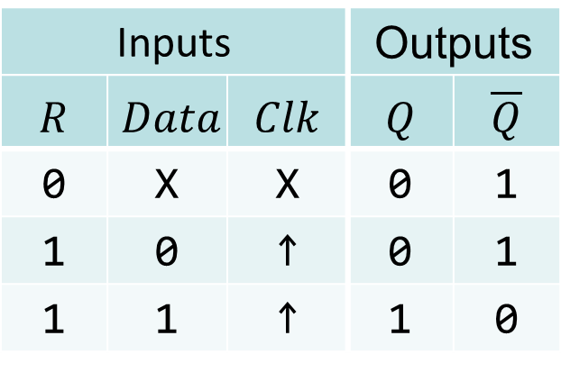





D Flip-Flop with Asynchronous Reset
When Flip-Flops are powered, their initial state is unknown
Some flip-flops have an Asynchronous Reset input R
Resets the state (to logic value 0), independent of the clock
This is required to initialize a circuit before operation
If the R input is inverted (bubble) then R = 0 resets the flip-flop
D Flip
Flop
Inputs |  |  | Outputs
$$R$$ | $$Data$$ | $$Clk$$ | $$Q$$ | $$\overline{Q}$$
0 | X | X | 0 | 1
1 | 0 | ↑ | 0 | 1
1 | 1 | ↑ | 1 | 0
$Data$
$$Q$$
$Clk$
$$\overline{Q}$$
$$R$$
Function Table

Slide 23













JK Flip-Flop
The D Flip-Flop is the most commonly used type
The JK is another type of Flip-Flop with inputs: J, K, and Clk
When JK = 10 ➔ Set, When JK = 01 ➔ Reset
When JK = 00 ➔ No change, When JK = 11 ➔ Invert outputs
JK can be implemented using two Clocked SR latches and gates
Master
Slave
$$Q_{1}$$
SR Latch
SR Latch
$$S$$
$$S$$
$$Q$$
$$J$$
$$Clk$$
$$C$$
$$C$$
$$K$$
$$\overline{Q_{1}}$$
$$R$$
$$R$$
$$\overline{Q}$$

Slide 24
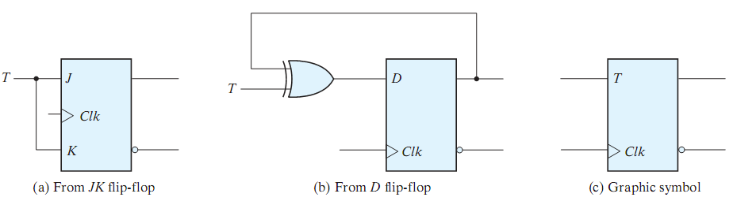
T Flip-Flop
The T (Toggle) flip-flop has inputs: T and Clk
When T = 0 ➔ No change, When T = 1 ➔ Invert outputs
The T flip-flop can be implemented using a JK flip-flop
It can also be implemented using a D flip-flop and a XOR gate

Slide 25
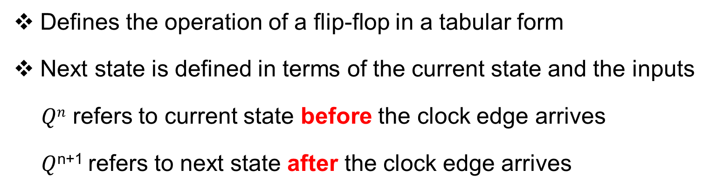
Flip-Flop Characteristic Table
Defines the operation of a flip-flop in a tabular form
Next state is defined in terms of the current state and the inputs
$Qn$ refers to current state before the clock edge arrives
$Q$^{n+1} refers to next state after the clock edge arrives
D Flip-Flop
D | Q^{n+1}
0 | 0 Reset
1 | 1 Set
JK Flip-Flop
J K | Q^{n+1}
0 0 | Q^{n} No change
0 1 | 0 Reset
1 0 | 1 Set
1 1 | Q^{n} Complement
T Flip-Flop
T | Q^{n+1}
0 | Q^{n} No change
1 | Q^{n} Complement

Slide 26
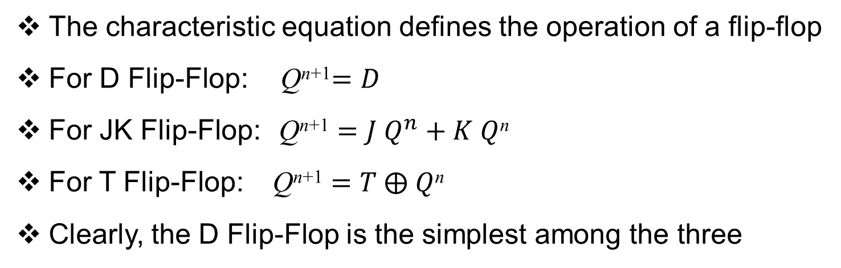
Flip-Flop Characteristic Equation
The characteristic equation defines the operation of a flip-flop
For D Flip-Flop: Q^{n+1}$=D$
For JK Flip-Flop: $\text{Q}\text{n}\text{+1}=J Q^{n}+K Q$^{n}
For T Flip-Flop: $\text{Q}\text{n}\text{+1}=T ⨁ Q$^{n}
Clearly, the D Flip-Flop is the simplest among the three
D Flip-Flop
D | Q^{n+1}
0 | 0 Reset
1 | 1 Set
JK Flip-Flop
J K | Q^{n+1}
0 0 | Q^{n} No change
0 1 | 0 Reset
1 0 | 1 Set
1 1 | Q^{n} Complement
T Flip-Flop
T | Q^{n+1}
0 | Q^{n} No change
1 | Q^{n} Complement

Slide 27
Timing Considerations for Flip-Flops
Setup Time (T_{s}): Time duration for which the data input must be valid and stable before the arrival of the clock edge.
Hold Time (T_{h}): Time duration for which the data input must not be changed after the clock transition occurs.
T_{s} and T_{h} must be ensured for the proper operation of flip-flops
Rising
Edge
Clock
T_{s}
T_{h}
Valid data-in
Data Can be Modified after T_{h}

Slide 28
Summary
In a sequential circuit there is internal memory
Output is a function of current inputs and present state
The stored memory value defines the present state
Similarly, the next state depends on current inputs and present state
Two types of sequential circuits:
Synchronous sequential circuits are clocked (easier to implement)
Asynchronous sequential circuits are not clocked
Two types of Memory elements: Latches and Flip-Flops
Latches are level-sensitive, flip-flops are edge-triggered
Flip-flops are better memory elements for synchronous circuits
A flip-flop is described using a characteristic table and equation

