Slide 1
Abnormally Detection To Network Traffic

Slide 2
What is Network Traffic?
Network traffic refers to the amount of data moving across a network at any given time. It includes all the data sent and received by devices connected to the network, such as computers, smartphones, servers, and other devices. Network traffic can consist of various types of data, including web browsing, file transfers, emails, streaming media, and more.
Types of networks traffic:
Inbound Traffic: Data that is coming into the network from external sources.
Outbound Traffic: Data that is being sent out from the network to external destinations.
Unicast Traffic: Data sent from one sender to one specific receiver.
Multicast Traffic: Data sent from one sender to multiple specific receivers.
Broadcast Traffic: Data sent from one sender to all devices on the network.

Slide 3
Issue Face by Network Traffic
Network traffic can encounter several issues that affect the performance, security, and reliability of a network.
Common problem:
Congestion
Description: When too much data is sent over the network at once, it can exceed the network's capacity, leading to delays and packet loss.
Impact: Slower network performance, increased latency, and reduced throughput. In severe cases, it can cause network crashes.
Latency
Description: The delay between sending and receiving data. High latency can result from long distances between devices, network congestion, or slow processing speeds.
Impact: Poor user experience, especially in real-time applications like video conferencing, online gaming, and VoIP calls.

Slide 4
Literature Review
Gaussian Mixture Models (GMM)
HDBSCAN
DBSCAN
Autoencoder Neural Network
Isolation Forest

Slide 5
Gaussian Mixture Models (GMM)
to model a dataset as a mixture of several Gaussian (normal) distributions, each representing a cluster. Unlike K-Means, which assigns each data point to exactly one cluster, GMM provides a probabilistic approach where each data point is assigned a probability of belonging to each cluster.
Objective
Utilize a probabilistic approach to model the underlying distribution of network traffic data
Method
Outcome
Provides a flexible and robust method for identifying clusters in the network traffic data.
Capturing complex data distributions and in detecting subtle anomalies that might be overlooked by more rigid clustering techniques.
Purpose

Slide 6
Application of Gaussian Mixture Models
Discover meaningful patterns and relationships by grouping similar data points into clusters
Mining Data
Analyze the structure of data by clustering based on statistical similarities
Statistical Analysis
Machine Learning
Applied to group data points into clusters based on their similarities
Characterize their customer groups based on the purchasing patterns
Pattern Recognition
(Alauddin et al., 2022)

Slide 7
DBSCAN
Data like protocol_type, src_bytes, dst_bytes, and serror_rate can effectively identify the noise in the dataset and remove them due to the distance to other points
Objective
Groups points that are closely related to each other while marking points in low density regions as outliers, is having a high potential are anomalies
Method
Understanding the patterns of network traffic , the points that has been labeled as outliers In network traffic can be listed out.
Outcome
Improve the accuracy of abnormal detection by identifying the abnormal traffic patterns that could lead to problems and harms
Purpose

Slide 8
Application of DBSCAN
Market Research
Discover distinct groups in their customer base
Helps identify patterns and outliers
Data Analysis
Image Processing
Segmentation and object detection.
Characterize their customer groups based on the purchasing patterns
Pattern Recognition
(DBSCAN | Engati, n.d.)

Slide 9
HDBSCAN
Objective
Identify clusters of varying densities within data without requiring a predefined number of clusters
Extends DBSCAN by using a hierarchical approach and a minimum spanning tree, allowing for the discovery of clusters at multiple density levels
Method
Produces clusters along with outliers, offering more flexibility in finding natural groupings
Outcome
Automatically detect meaningful clusters
Purpose
(Yenigün, 2024)

Slide 10
Application of HDBSCAN
Exploratory Data Analysis
Reveal hidden structures and relationships by grouping similar data points into distinct clusters
Segment images into regions with similar features, aiding in object recognition and scene understanding
Computer Vision
Machine Learning
Applied to group data points into clusters based on their similarities.
Speech Processing
Separate different speakers or phonemes by clustering audio segments
(V, 2024)

Slide 11
Isolation Forest
Objective
Effective for identifying rare events or abnormalities in large datasets by isolating abnormalities through the process of recursive partitioning
Dividing the data recursively, separates anomalies with anomalies isolated closer to the decision trees' roots
Method
Effective at finding anomalies and uncommon occurrences in big datasets, which makes it appropriate for real-time network environment detection
Outcome
Simplifying the high dimensional data and enhancing the abnormal detection by giving a easier visualization of data.
Purpose
Abnormally detection
Analyze transaction data to identify anomalies
Application
(GeeksforGeeks, 2024)

Slide 12
Autoencoder Neural Network
Learn the efficient representation of input data and compress it effectively without specific labels
Objective
After learning a condensed representation of the data, Then recreate it, looking for anomalies in the form of notable reconstruction errors.
Method
Identifying intricate, non-linear abnormalities, picking up on minute variations that other techniques might overlook in dataset
Outcome
Versatile for a range of anomaly detection tasks due to potency in non-linear anomaly identification and ability to work in an unsupervised manner.
Purpose
(GeeksforGeeks, 2023)

Slide 13
Application of AutoEncoders
Dimensionality Reduction
Feature Extraction
Image Denoising
Reduce the dimensionality of data by learning a compressed
Automatically extract relevant features by encoding to lower-dimensional space.
Remove noise from images by learning to reconstruct clean images
Image Compression
Missing Value Imputation
Image Search
Anomaly Detection
Compress images by encoding to a smaller latent representation
Encoding images into feature vectors that can be compared to find similar images.
Fill in missing values in data by reconstructing the complete data
Detect anomalies by measuring the reconstruction error
((Kumar, 2022))

Slide 14
Hyperparameter Tuning
DATA TUNING
MODEL TUNING
Focus on optimizing the parameters and structure of the machine learning model itself
Techniques : Hyperparameter tuning, Model selection, Regularization, and Cross-validation.
Adjusting various aspects of the data to improve the accuracy, efficiency, and overall outcomes of a model or analysis
Techniques : Standard Scaling ，Min Max Scaling .

Slide 15
Evaluation Method
Visualization
TSNE | UMAP | PCA
Purpose: A non-linear technique for visualizing high-dimensional data in 2D or 3D. Method: Transforms high-dimensional distances into probabilities to preserve local data structure. Strengths: Effective at capturing and preserving local relationships. Reveals complex structures and patterns within the data. Limitations: Computationally intensive and may be slow for large datasets. Does not always preserve global structure well. | Purpose: A non-linear dimensionality reduction technique used for visualizing and reducing the dimensionality of data while preserving both local and global structure. Method: It constructs a high-dimensional graph of data points based on their distances and then optimizes this graph layout in a lower-dimensional space to preserve the original structure. Strengths: Captures both local and global data structure effectively. Handles large datasets and scales well. Limitations: Less interpretable compared to linear methods. Computationally intensive for very large datasets. | Purpose: A linear dimensionality reduction technique aimed at transforming data into a new coordinate system where the greatest variance is captured by the first few principal components. Method: It identifies principal components that capture the most variance in the data and projects the data onto these components to reduce dimensionality. Strengths: Simple, fast, and easy to implement. Retains maximum variance and simplifies data interpretation. Limitations: Only captures linear relationships in the data. May not perform well with complex, non-linear data structures.

Slide 16

Evaluation Method
Silhouette Score
Purpose: Evaluates the quality of clustering results.
Measurement: Assesses how similar each data point is to its own cluster compared to other clusters.
Assessment: Helps determine how well-separated and distinct the clusters are.
Interpretation:
1: Data point is well-clustered and close to other points in its cluster.
0: Data point is near the boundary between clusters.
-1: Data point may be misclassified, closer to a different cluster.
Formula:

Slide 17
Evaluation Method
Davies-Bouldin Score
Purpose: Measures clustering quality by evaluating the average similarity ratio between each cluster and its most similar cluster.
Components:
Within-Cluster Dispersion: Measures how tightly data points are grouped within a cluster.
Between-Cluster Separation: Measures the distance between different clusters.
Interpretation:
Lower Scores: Indicate better clustering, with clusters being more compact and well-separated.
Higher Scores: Suggest poorer clustering, with clusters being less distinct and more dispersed.

Slide 18
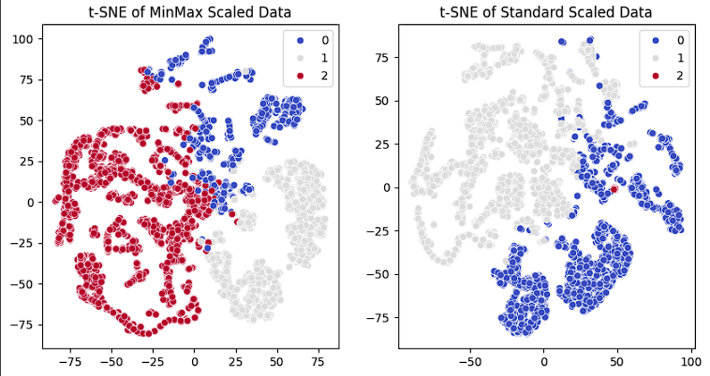
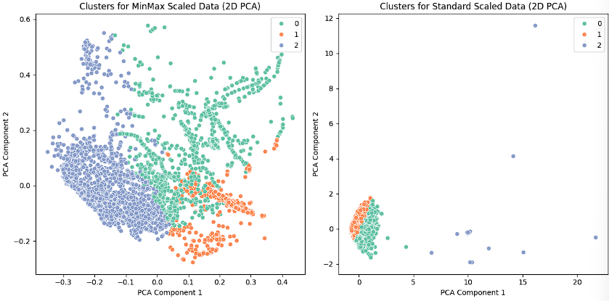
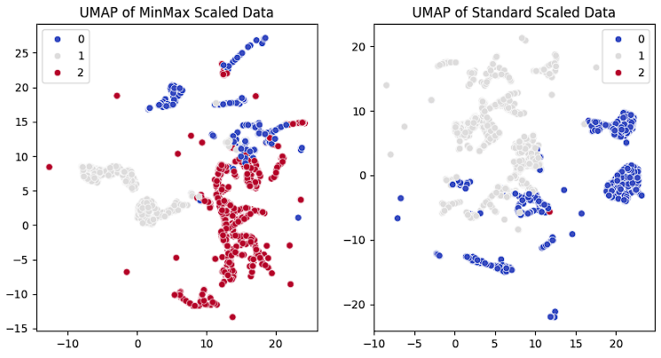
Result & Conclusion
Autoencoder
Min-max Scaler Dataset
Silhouette score = 0.4586
The clustering was performed with n_cluster = 3.
A score of 0.4586 suggests that there is some degree of clustering structure in the data.
In PCA plot, all three clusters (blue, green, and orange) are well-separated with a more balanced spread.
Meanwhile in UMAP plot, The clusters (blue, gray, and red) in the MinMax scaled data appear more intermixed. There is no clear separation between the three clusters in this case. This suggests that while MinMax scaling allows for more variation across the axes, it does not create as distinct a separation for UMAP as it did with PCA.

Slide 19
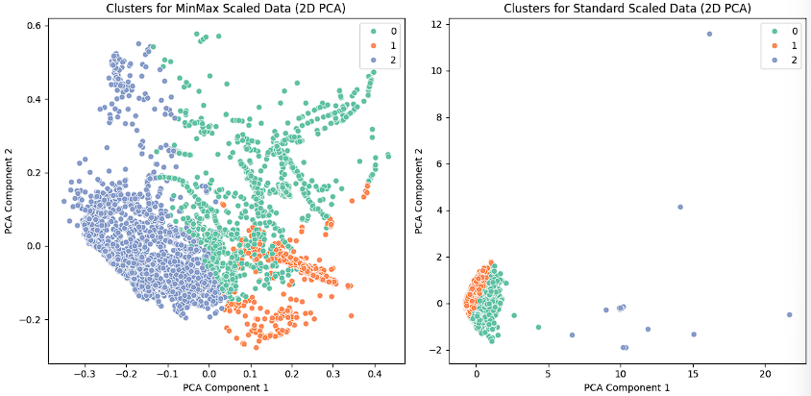
Result & Conclusion
Standard Scaler Dataset
Autoencoder
Silhouette score = 0.3897
The clustering was performed with n_cluster = 3.
The silhouette score of 0.3897 for the autoencoder on the standard scaler dataset indicates that the clustering results are moderately effective.
In T-SNE plot, red cluster appears either very small or overlapped by the other clusters, which suggests poor separation or an imbalance in cluster size.
In PCA plot, Standard scaling which standardizes features by removing the mean and scaling to unit variance, has caused higher variance in the data, impacting the clustering structure.
In UMAP plot, the clusters such as cluster 0 (blue), cluster 1 (gray), and cluster 2 (red), are more clearly separated compared to min-max scaler dataset. Additionally, fewer outliers are present, suggesting that Standard scaling may have enhanced the clustering of similar points.

Slide 20
Result & Conclusion
All in all, we can see that for the min-max scaler dataset, autoencoder is the best performing model and has a higher average silhouette score that create a better PCA plot compared to standard scaler dataset.
However, the Standard scaler dataset achieved better separation in the UMAP plot, demonstrating that the choice of scaling technique can impact clustering outcomes differently depending on the dimensionality reduction method used.
For future improvement , we can use the flexibility of autoencoders to incorporate deep learning architectures that allow them to handle the vast and varied data types found in network environments, further enhancing their detection capabilities.
This is because autoencoders' ability to automatically extract significant features and detect outliers via reconstruction errors makes them preferable for ensuring robust network security in a variety of conditions.

