Slide 1
P&ID Digitization Pipeline
Weekly update: line detection and connectivity
2026-09-21

Slide 2
This week
• Reproduced Xinqi's symbol detector on the four real drawings: macro-F1 0.888, and wired it into the pipeline entry point.
• Line detection: a learned U-Net extractor lifts F1 from 0.81 to 0.98 on held-out synthetic sheets and transfers visually to real drawings.
• Connectivity: a junction-aware assembler replaces endpoint chaining; edge F1 0.12 -> 1.00 with perfect inputs, 0.99 with predicted inputs.
• Blocker: real drawings have symbol ground truth only. Lines and connectivity cannot be scored on nuclear drawings without line / edge labels.

Slide 3
Symbol detection: Xinqi's model reproduced
real4, release protocol: whole image 1280, conf 0.10, keep >= 0.65, F1 at IoU 0.5
Drawing | GT symbols | F1
AFW_NorthANA | 78 | 0.922
AFW_Surry | 74 | 0.932
APR1400 | 85 | 0.824
CVCS_Surry | 37 | 0.873
macro-F1 | 274 | 0.888
Matches the release. The inference protocol is part of the model: tiling the same weights drops it to 0.39, so process_single_pnid.py now uses the release protocol by default.

Slide 4
Line detection: recall was the problem
50 held-out synthetic sheets, all GT lines, 8 px tolerance
Method | P | R | F1
As shipped | 0.895 | 0.755 | 0.817
Classical, tuned constants | 0.994 | 0.876 | 0.931
Learned U-Net (new) | 0.976 | 0.992 | 0.983
• Classical fixes: resolution cap 2200 -> 4096, notes crop detected instead of hardcoded, solidity filter off.
• Still misses 12% of pipe runs: Hough breaks at symbols, text and junctions.

Slide 5
The U-Net line extractor
• Small U-Net over native-resolution 768 px crops; 3 classes: background / solid pipe / dashed pipe.
• Targets are the annotated pipe segments drawn 3 px wide. Frame, tables, text and symbol outlines are negatives, so it learns to ignore them.
• Mask -> Hough -> collinear merge gives segments the graph stage can use.
• 25 minutes on one GPU, 45 training sheets. Recall 0.75 -> 0.99.

Slide 6
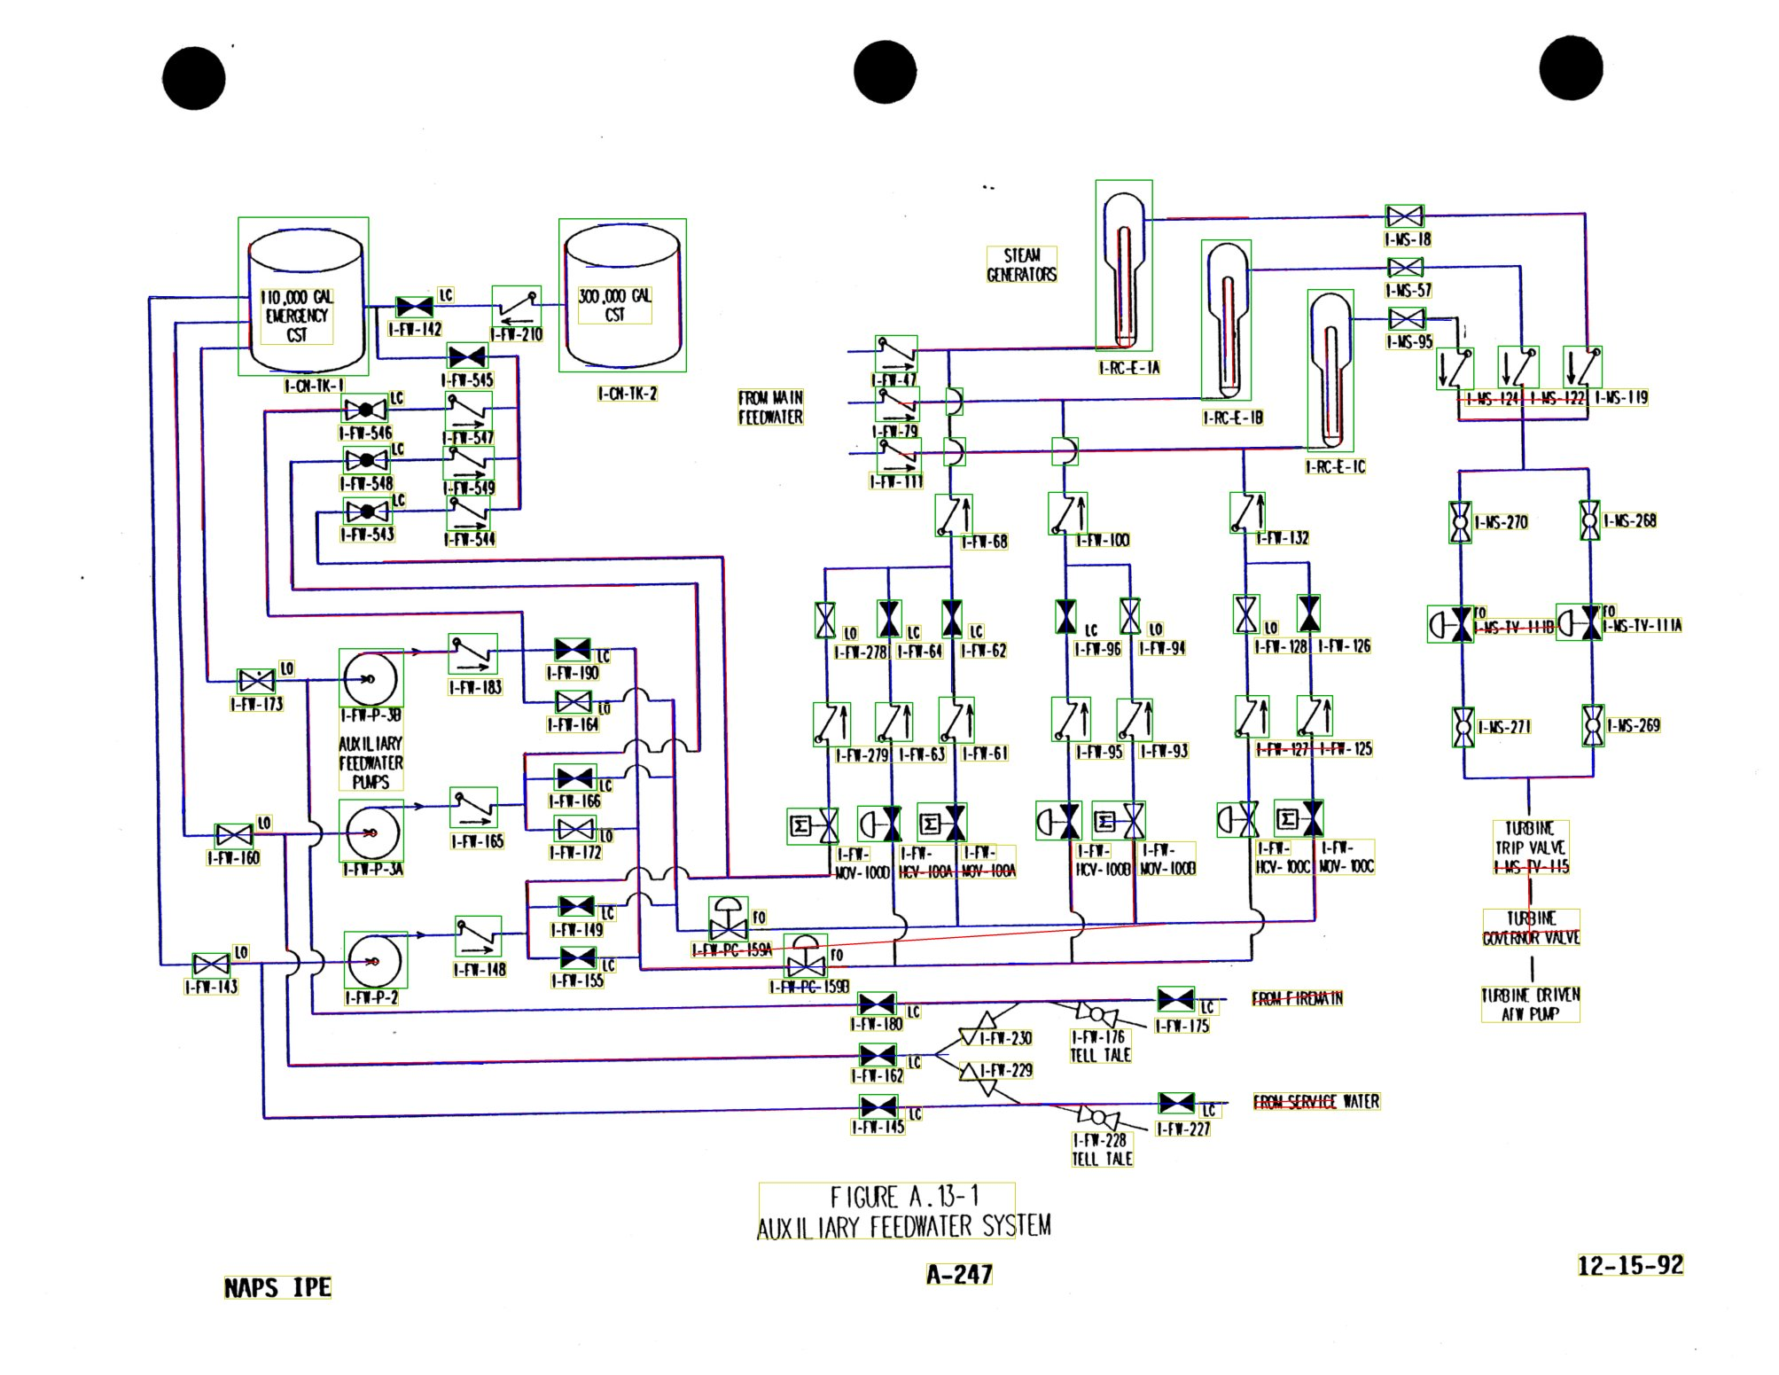
Lines on a real drawing
green = GT symbols, red = classical, blue = U-Net, yellow = OCR
• U-Net traces nearly every pipe, continuous through symbols.
• Classical strikes through some text labels.
• Both miss light-grey pipes on one drawing; U-Net also traces the drawing frame.
• Qualitative only: no line ground truth exists for these drawings.

Slide 7
Connectivity: the assembler was the bottleneck
GT symbols + GT lines, 50 sheets
Assembler | edge F1 | degree exact
As shipped (endpoint chains) | 0.124 | 0.361
New junction-aware topology | 1.000 | 1.000
• Chains cannot represent branches; 189 of 205 pipe runs on a sheet touch a T or crossing.
• New assembler builds junction nodes from shared endpoints, T's and crossings, attaches symbols to the runs through them, and outputs junctions as graph nodes.

Slide 8
Where the remaining error lives
Ablation ladder, 50 sheets, edge F1
Symbols | Lines | edge F1
GT | GT | 1.000
YOLO | GT | 1.000
YOLO | classical | 0.759
YOLO | U-Net | 0.987
Symbols cost nothing. The line stage carries the whole gap, and the U-Net closes most of it.

Slide 9
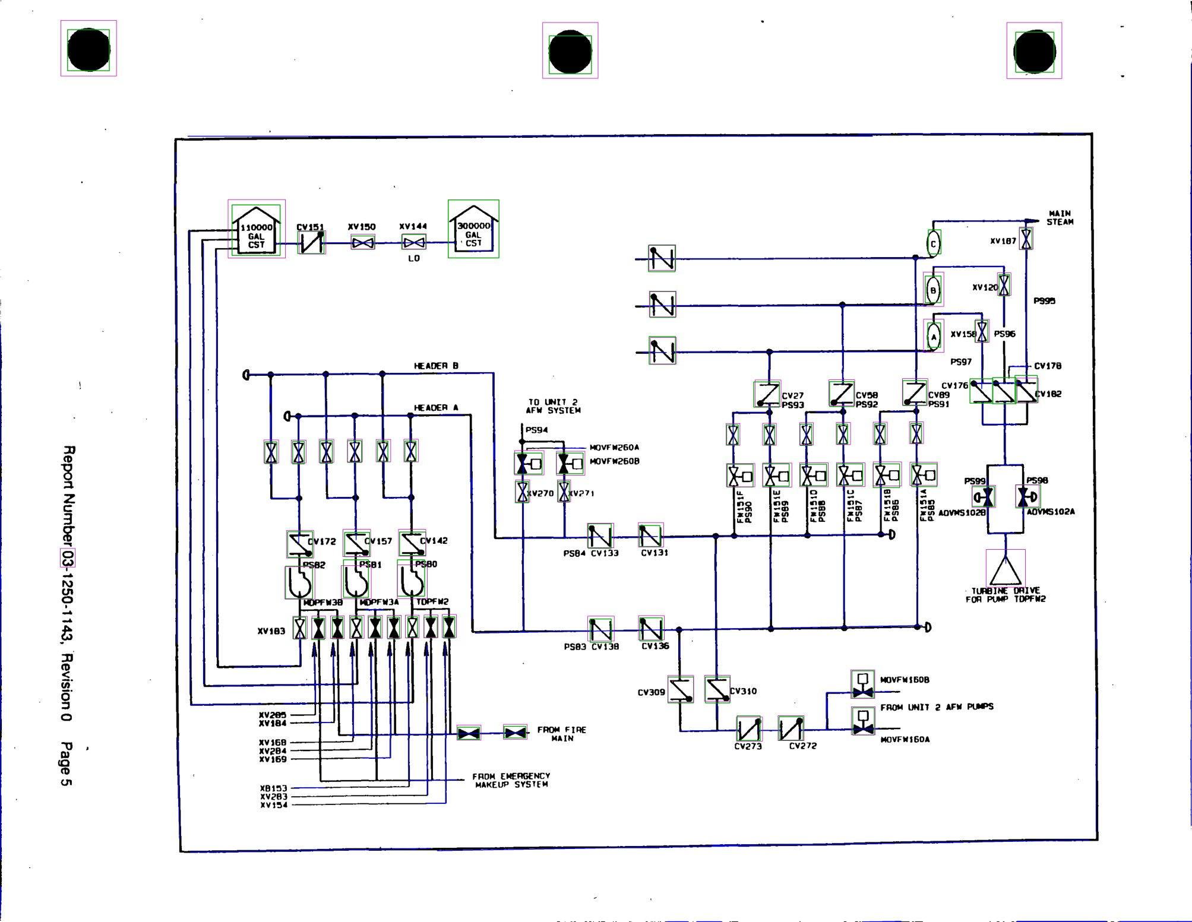
End-to-end on real drawings
Xinqi's symbols + U-Net lines + new assembler. Reference graph = same lines with GT symbol boxes.
Drawing | Symbols found | Edge agreement F1
AFW_NorthANA | 76 / 78 | 0.848
AFW_Surry | 72 / 74 | 0.941
APR1400 | 68 / 85 | 0.694
CVCS_Surry | 34 / 37 | 0.769
Graphs look like P&IDs (most symbols inline at degree 2), but this measures agreement, not accuracy: there is no connectivity ground truth.

Slide 10
What we need: real nuclear-domain data for lines and connectivity
• Today real4 has symbol boxes only. Line detection and connectivity on nuclear drawings are judged by eye.
• Needed: on the 4 drawings (or more), pipe segments as line labels, and edges (which symbol / junction connects to which).
• Unlocks: a real F1 for the U-Net vs classical lines, a real connectivity number instead of agreement, and the decision on the solidity filter, which helps on real scans but hurts on synthetic.
• Everything else is ready: evaluators, the assembler, and the end-to-end entry point run on real drawings today.

Slide 11
Also done, briefly
• OCR: dropped the 1.35x scale and CLAHE, added a 90-degree pass and a tag-grammar corrector. Exact match 0.75 -> 0.84, vertical tags 0.62 -> 0.98 (synthetic).
• Symbol converter rewritten for the 32-class synthetic set (was single class at 640 px): mAP50-95 0.97, but it does not transfer to real drawings.
• process_single_pnid.py runs non-interactively end to end; three bugs fixed, including one that silently produced 0 links.
• Next: finish the annotation download (227 / 500 sheets), retrain the U-Net on all of them, and reproduce Xinqi's training chain once the asset bundle is available.

