Slide 1


OLAP
周烜
华东师范大学
数据科学与工程学院
xzhou@dase.ecnu.edu.cn

Slide 2
回顾：OLTP vs OLAP
二者的数据有何区别？
OLTP：State of the Current World
OLAP：History
二者的负载有何区别？
OLTP：Query & Update
OLAP：Aggregation Query

Slide 3
历史上的一些名词
数据仓库（Data Warehouse）
store current and historical data in one single place that are used for creating analytical reports for workers throughout the enterprise
主要系统：DBMS
商务智能（Business Intelligence）
process for analyzing data and presenting actionable information to help workers of enterprises make informed business decisions
主要工具：OLAP on DBMS
如今：逐步演化成含义更丰富的概念
Data Warehouse → Big Data Platform / Data Lake / Data Repository
BI → Data Analytics / Data Driven Approaches / AI
OLAP成为众多分析工具中的一种

Slide 4
数据仓库的Data Flow
Data is periodically extracted
Data is cleansed and transformed
Users query the data warehouse (OLAP)
Source Systems
Data Staging Area
Data Warehouse
(OLTP)

Slide 5
历史名词：ETL
ETL = Extraction, Transformation, & Load
Extraction: Get the data out of the source systems
Transformation: Convert the data into a useful format for analysis
Load: Get the data into the data warehouse (…and build indexes, materialized views, etc.)
现代的名词：Data Curation Process
Data Integration, Cleansing, Annotation, ….

Slide 6
数据仓库的数据模型

Slide 7
Data Cube
Axes of the cube represent attributes of the data records
Generally discrete-valued / categorical
e.g. color, month, state
Called dimensions
Cells hold aggregated measurements
e.g. total $ sales, number of autos sold
Called facts
Real data cubes have >> 3 dimensions
Auto Sales
Red
Blue
WA
OR
Gray
CA
Jul
Aug
Sep

Slide 8
Slicing and Dicing
Red
Red
Blue
Blue
WA
WA
OR
OR
Gray
Gray
CA
CA
Jul
Aug
Sep
Jul
Aug
Sep

Slide 9
Querying the Data Cube
Number of Autos Sold
Cross-tabulation
“Cross-tab” for short
Report data grouped by 2 dimensions
Aggregate across other dimensions
Include subtotals
Operations on a cross-tab
Roll up (further aggregation)
Drill down (less aggregation)
 | CA | OR | WA | Total
Jul | 45 | 33 | 30 | 108
Aug | 50 | 36 | 42 | 128
Sep | 38 | 31 | 40 | 109
Total | 133 | 100 | 112 | 345

Slide 10
Roll Up and Drill Down
Number of Autos Sold
Number of Autos Sold
 | CA | OR | WA | Total
Jul | 45 | 33 | 30 | 108
Aug | 50 | 36 | 42 | 128
Sep | 38 | 31 | 40 | 109
Total | 133 | 100 | 112 | 345
CA | OR | WA | Total
133 | 100 | 112 | 345
Roll up by Month
Drill down by Color
Number of Autos Sold
 | CA | OR | WA | Total
Red | 40 | 29 | 40 | 109
Blue | 45 | 31 | 37 | 113
Gray | 48 | 40 | 35 | 123
Total | 133 | 100 | 112 | 345

Slide 11
“Standard”Data Cube Query
Measurements
Which fact(s) should be reported?
Filters
What slice(s) of the cube should be used?
Grouping attributes
How finely should the cube be diced?
Each dimension is either:
(a) A grouping attribute
(b) Aggregated over (“Rolled up” into a single total)
n dimensions → 2^{n} sets of grouping attributes
Aggregation = projection to a lower-dimensional subspace

Slide 12
Full Data Cube with Subtotals
Pre-computation of aggregates → fast answers to OLAP queries
Ideally, pre-compute all 2^{n} types of subtotals
Otherwise, perform aggregation as needed
Coarser-grained totals can be computed from finer-grained totals
But not the other way around

Slide 13
Data Cube Lattice
State, Month, Color
State, Month
State, Color
Month, Color
Drill Down
Roll Up
State
Month
Color
Total

Slide 14
数据仓库系统

Slide 15
MOLAP vs. ROLAP
MOLAP = Multidimensional OLAP
Store data cube as multidimensional array
(Usually) pre-compute all aggregates
Advantages:
Very efficient data access → fast answers
Disadvantages:
Doesn’t scale to large numbers of dimensions
Requires special-purpose data store

Slide 16
Sparsity
Imagine a data warehouse for Safeway.
Suppose dimensions are: Customer, Product, Store, Day
If there are 100,000 customers, 10,000 products, 1,000 stores, and 1,000 days…
…data cube has 1,000,000,000,000,000 cells!
Fortunately, most cells are empty.
A given store doesn’t sell every product on every day.
A given customer has never visited most of the stores.
A given customer has never purchased most products.
Multi-dimensional arrays are not an efficient way to store sparse data.

Slide 17
MOLAP vs. ROLAP
ROLAP = Relational OLAP
Store data cube in relational database
Express queries in SQL
Advantages:
Scales well to high dimensionality
Scales well to large data sets
Sparsity is not a problem
Uses well-known, mature technology
Disadvantages:
Query performance is slower than MOLAP
Need to construct explicit indexes

Slide 18
Creating a Cross-tab with SQL
Grouping Attributes
Measurements
SELECT state, month, SUM(quantity)
FROM sales
GROUP BY state, month
WHERE color = 'Red'
Filters

Slide 19
What about the totals?
State Month SUM
CA Jul 45
CA Aug 50
CA Sep 38
OR Jul 33
OR Aug 36
OR Sep 31
WA Jul 30
WA Aug 42
WA Sep 40
SQL aggregation query with GROUP BY does not produce subtotals, totals
Our cross-tab report is incomplete.
Number of Autos Sold
 | CA | OR | WA | Total
Jul | 45 | 33 | 30 | ?
Aug | 50 | 36 | 42 | ?
Sep | 38 | 31 | 40 | ?
Total | ? | ? | ? | ?

Slide 20
One solution: a big UNION ALL
SELECT state, month, SUM(quantity)
FROM sales
GROUP BY state, month
WHERE color = 'Red‘
UNION ALL
SELECT state, "ALL", SUM(quantity)
FROM sales
GROUP BY state
WHERE color = 'Red'
UNION ALL
SELECT "ALL", month, SUM(quantity)
FROM sales
GROUP BY month
WHERE color = 'Red‘
UNION ALL
SELECT "ALL", "ALL", SUM(quantity)
FROM sales
WHERE color = 'Red'
Original
Query
State
Subtotals
Month
Subtotals
Overall
Total

Slide 21
A better solution
“UNION ALL” solution gets cumbersome with more than 2 grouping attributes
n grouping attributes → 2^{n} parts in the union
OLAP extensions added to SQL 99 are more convenient
CUBE, ROLLUP
SELECT state, month, SUM(quantity)
FROM sales
GROUP BY CUBE(state, month)
WHERE color = 'Red'

Slide 22
Results of the CUBE query
State Month SUM(quantity)
CA Jul 45
CA Aug 50
CA Sep 38
CA NULL 133
OR Jul 33
OR Aug 36
OR Sep 31
OR NULL 100
WA Jul 30
WA Aug 42
WA Sep 40
WA NULL 112
NULL Jul 108
NULL Aug 128
NULL Sep 109
NULL NULL 345
Notice the use of NULL for totals
Subtotals at all levels

Slide 23
数据仓库的数据模式

Slide 24
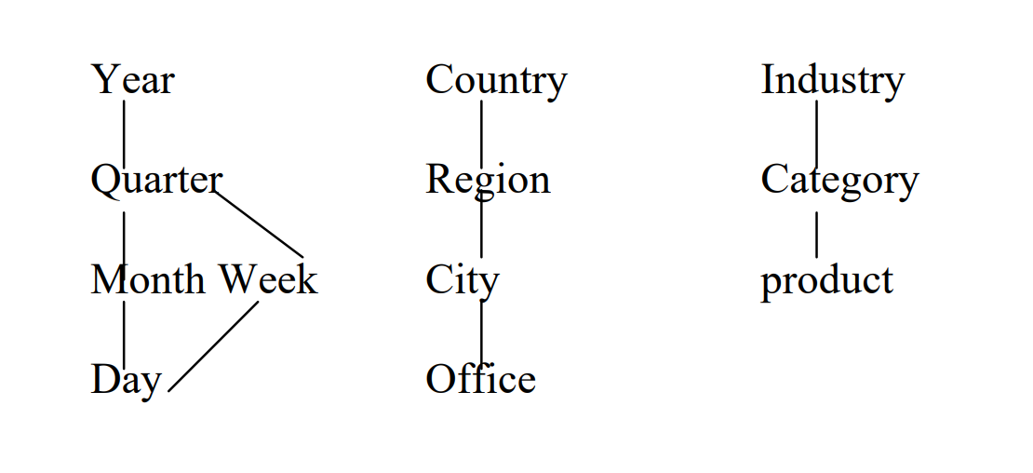
Complex Dimensions
Dimensions usually have associated with them hierarchies that specify aggregation levels and hence granularity of viewing data.

Slide 25
Star Schema (Normalization)
Date
Fact table
Promotion
Sales
Product
Store
Dimension tables

Slide 26
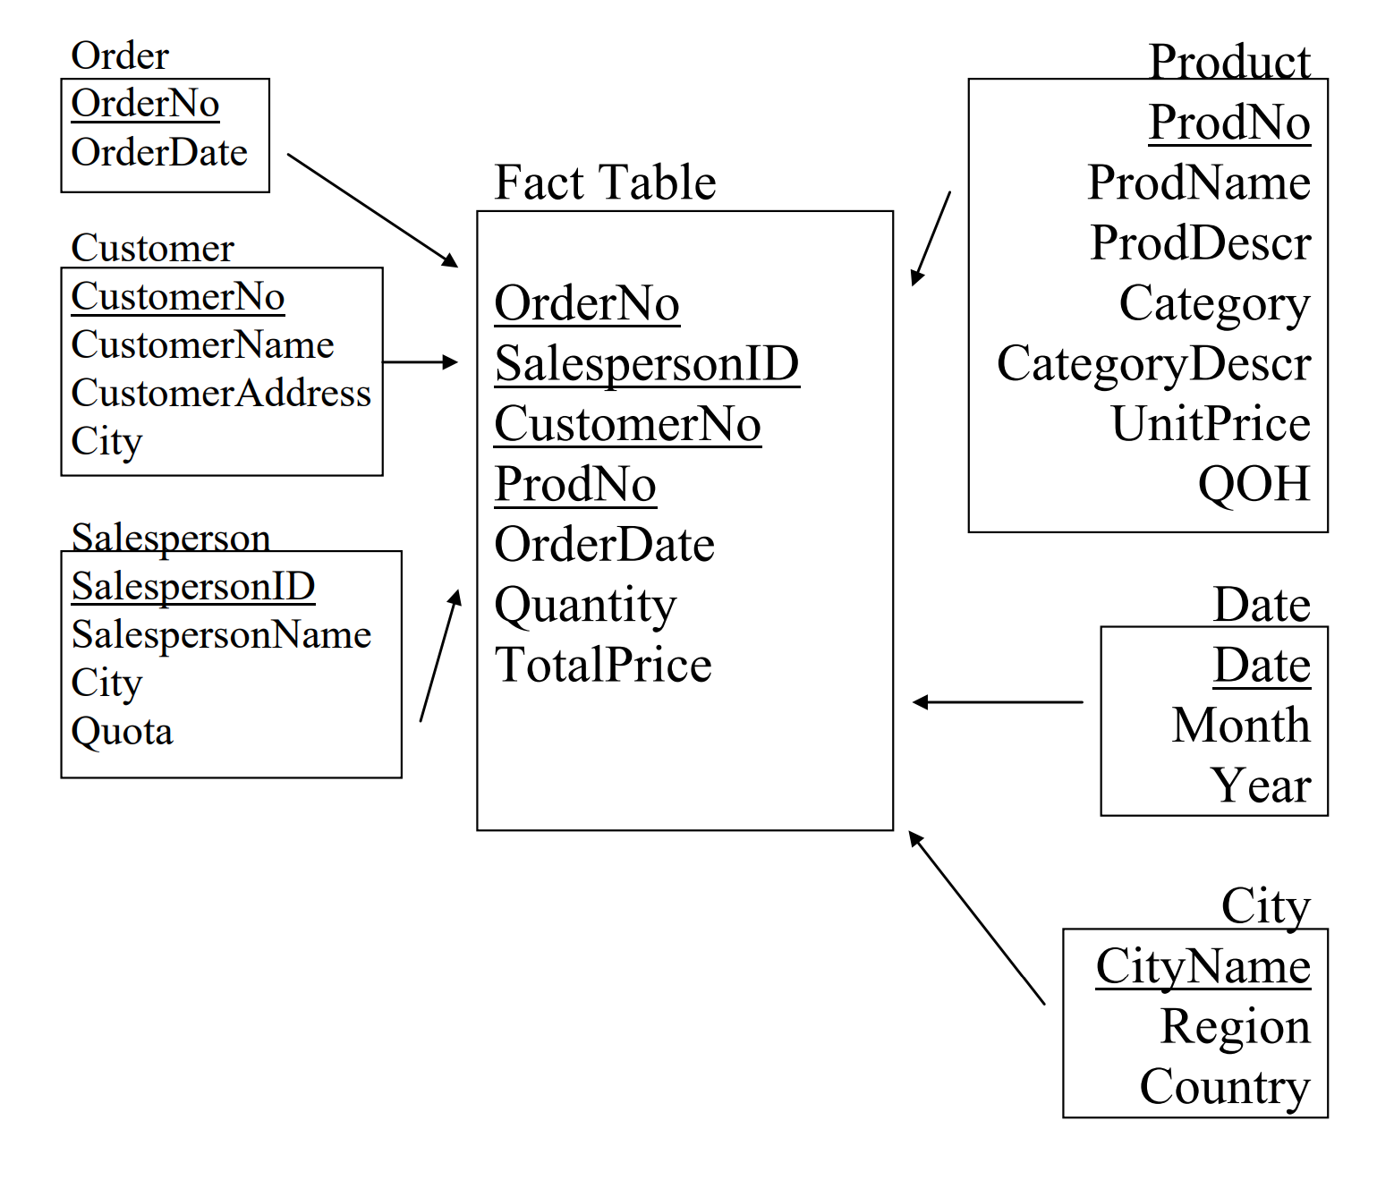
Example

Slide 27
Dimension Tables
Each one corresponds to a real-world object or concept.
Examples: Customer, Product, Date, Employee, Region, Store, Promotion, Vendor, Partner, Account, Department
Properties of dimension tables:
Contain many descriptive columns
Dimension tables are wide (dozens of columns)
Generally don’t have too many rows
At least in comparison to the fact tables
Usually < 1 million rows
Contents are relatively static
Almost like a lookup table
Uses of dimension tables
Filters are based on dimension attributes
Grouping columns are dimension attributes
Fact tables are referenced through dimensions

Slide 28
Fact Tables
Each fact table contains measurements about a process of interest.
Each fact row contains two things:
Numerical measure columns
Foreign keys to dimension tables
That’s all!
Properties of fact tables:
Very big
Often millions or billions of rows
Narrow
Small number of columns
Changes often
New events in the world → new rows in the fact table
Typically append-only
Uses of fact tables:
Measurements are aggregated fact columns.

Slide 29
Comparing Facts and Dimensions
Facts
Dimensions
Narrow
Big (many rows)
Numeric
Growing over time
Wide
Small (few rows)
Descriptive
Static
Facts contain numbers, dimensions contain labels

Slide 30
More Dimension Tables
Product
Merchandise hierarchy
SKU → Brand → Category → Department
Other attributes
Product name, Size, Weight, Package Type, etc.
Store
Geography hierarchy
Store → ZIP Code → County → State
Administrative hierarchy
Store → District → Region
Other attributes
Address, Store name, Store Manager, Square Footage, etc.
Hierarchies
Common in dimension tables
Multiple hierarchies can appear in the same dimension
Don’t need to be strict hierarchies
e.g. ZIP code that spans 2 counties

Slide 31
Snowflake Schema
Dimension tables themselves are not in normal form
Redundant information about hierarchies
Normalizing dimension tables leads to snowflake schema
Avoid redundancy → some storage savings
Snowflaking is not recommended in most cases
More tables = more complex design
More tables → more joins → slower queries
Space consumed by dimensions is small compared to facts
Exception: Really big dimension tables
In some warehouses, customer dimension is really large
We’ll return to this next week.

Slide 32
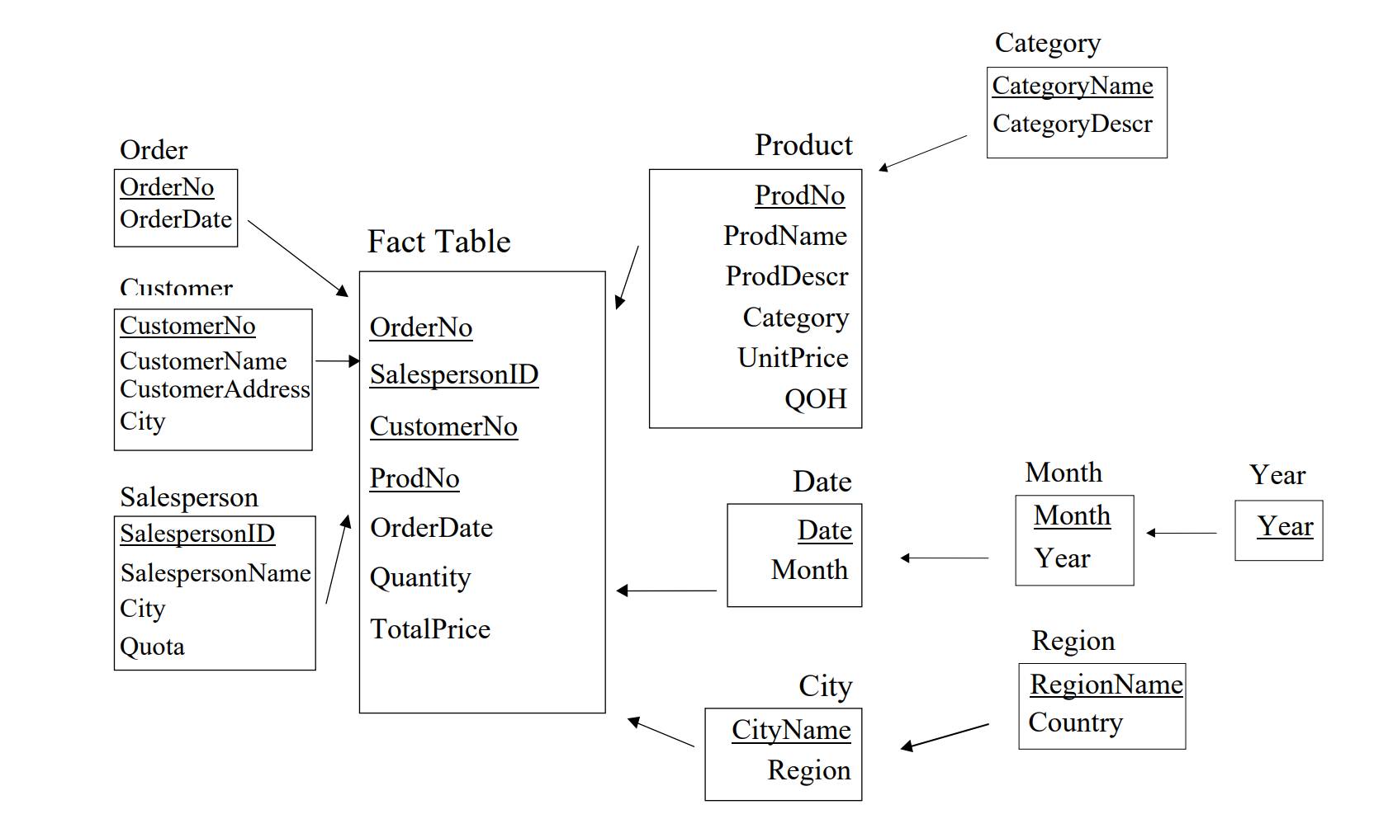
Example

Slide 33
现代语境下的数据分析 – 更广义的概念

Slide 34
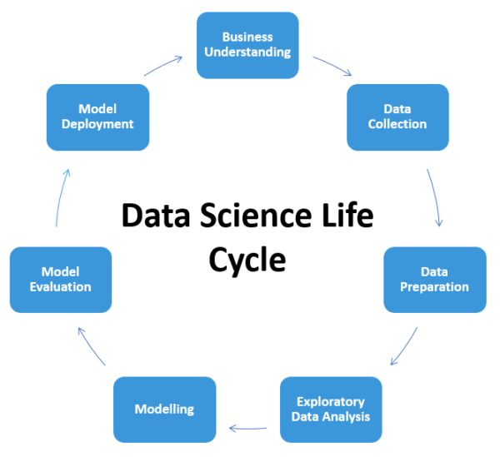
Data App 生命周期

Slide 35
AI App 生命周期（Andrew Ng）
Data
Product
User

Slide 36
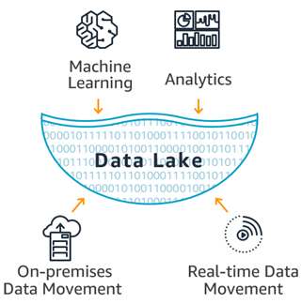
数据湖

Slide 37
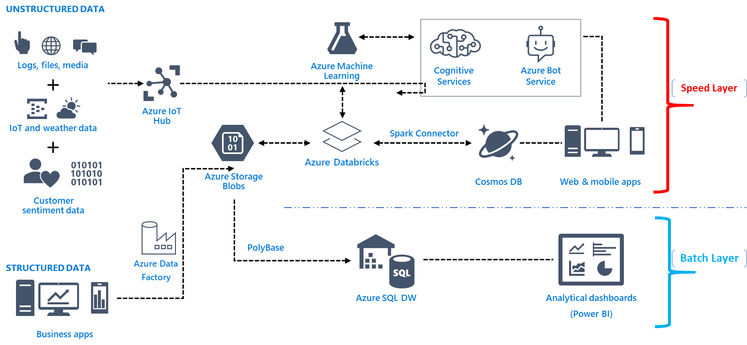
Big Data Ecosystem (Microsoft)

Slide 38
