Slide 1


数据库的扩展
周烜
华东师范大学
数据科学与工程学院
xzhou@dase.ecnu.edu.cn

Slide 2
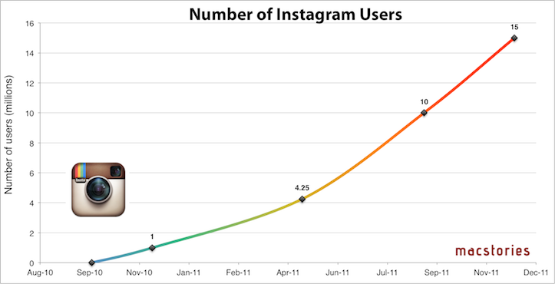
互联网应用的负载激增现象
Instagram发布当天6小时服务器满负荷；首日用户接近4万。

Slide 3
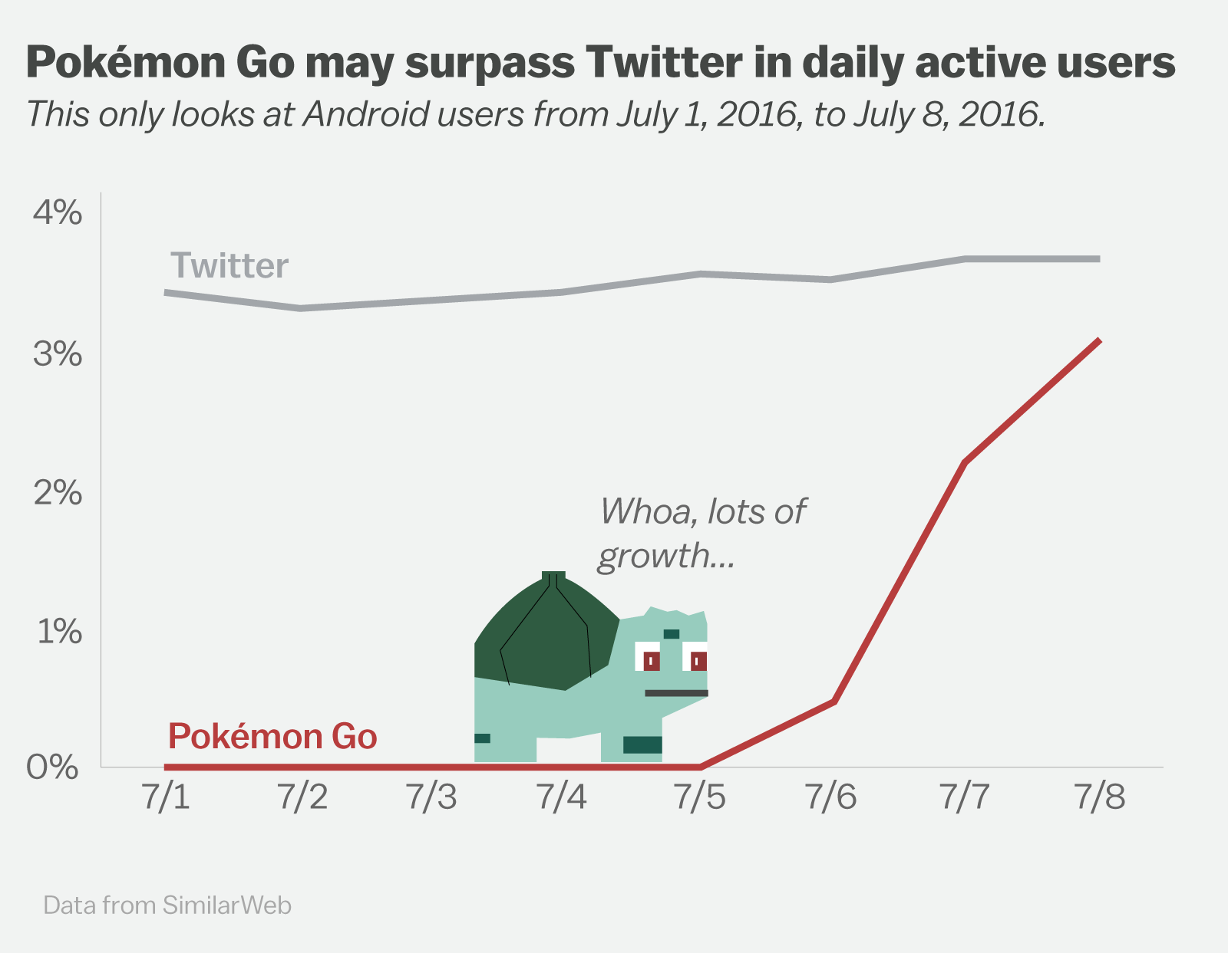

Slide 4
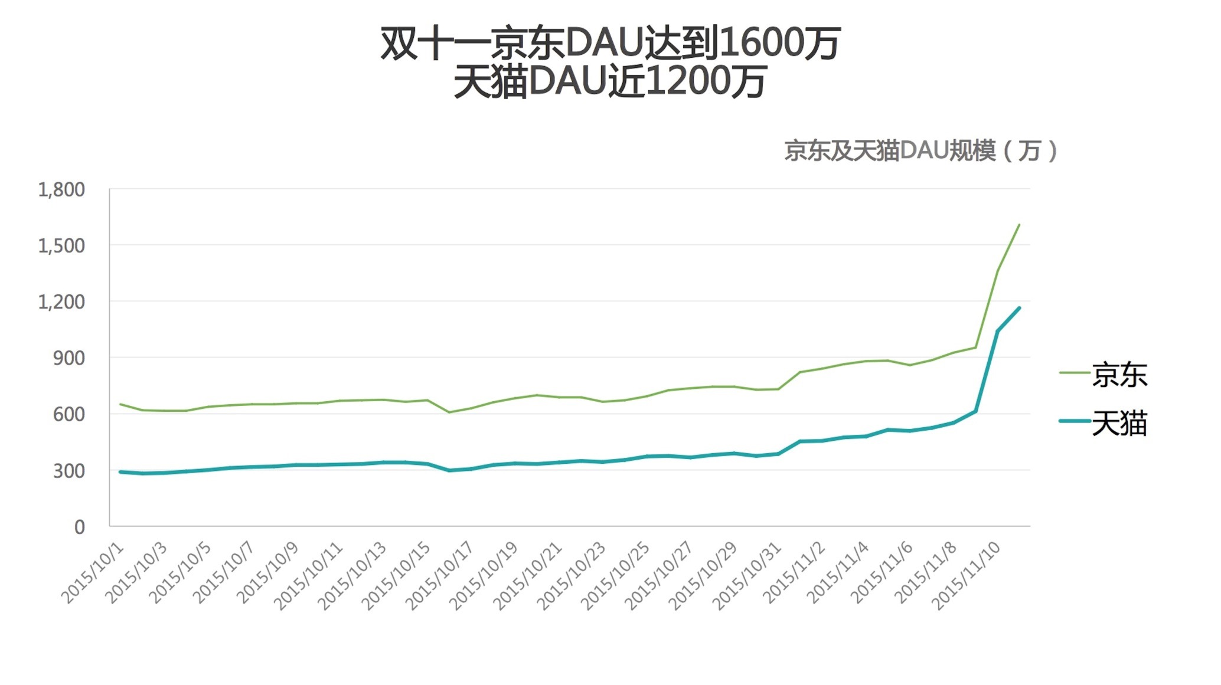

Slide 5
Scale Up!

Slide 6

高性能关系数据库产品

Slide 7

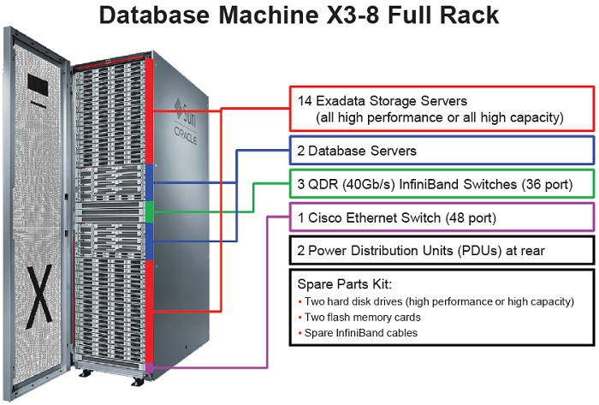
高性能关系数据库产品

Slide 8
Scale Up
CPU
CPU
CPU
CPU
CPU
RAM Buffer
RAM Buffer
DISK
DISK
DISK
DISK
DISK

Slide 9
Scale Out!

Slide 10

更多的计算机

Slide 11
Scale Out
CPU
CPU
CPU
CPU
RAM Buffer
RAM Buffer
RAM Buffer
RAM Buffer
DISK
DISK
DISK
DISK

Slide 12
扩展能力 / Scalability
Scale Up：移植到更强大的服务器上
昂贵
扩展能力有限
Easy
Scale Out：增加节点（commodity computer）
性价比高
扩展能力更强 / 弹性
Difficult

Slide 13
How to Scale Out?

Slide 14

按照业务划分
An online book Store with business across the world

Slide 15
分库/分表的扩展模式
Application
Middleware
DB1
DB2
DB3
DB4
CPU
CPU
CPU
CPU
RAM
RAM
RAM
RAM
DISK
DISK
DISK
DISK

Slide 16
查询的分解
Select * From Customer
Where Cid = ‘30567’ And Area = ‘Asia’;
Area = ‘Asia’
Area = ‘Europe’
DB1
DB2
CPU
CPU
RAM
RAM
DISK
DISK

Slide 17
查询的分解
Select Count(*) From Customer
Where Order_count > 10;
Area = ‘Asia’
Area = ‘Europe’
DB1
DB2
Select Count(*) From Customer
Where Order_count > 10
And Area = ‘Asia’;
Select Count(*) From Customer
Where Order_count > 10
And Area = ‘Europe’;
CPU
CPU
RAM
RAM
DISK
DISK

Slide 18
查询分解
由应用层或中间件实现
将查询分解为各个库上的子查询
在各个库上执行子查询
将查询结果进行汇总
分解可行性或分解过程与数据划分方式高度相关！

Slide 19
查询的分解
Select Pid, sum(price*num) From Order
Group by Pid Having sum(price*num) > 1000;
Select Cid From Order
Where Pid in
( Select Pid, sum(price*num) From Order
Group by Pid Having sum(price*num) > 1000 );
Area = ‘Asia’
Area = ‘Europe’
DB1
DB2
CPU
CPU
RAM
RAM
DISK
DISK

Slide 20
并行/分布式数据库

Slide 21
并行/分布式数据库
Application
Database as a Single System
CPU
CPU
CPU
CPU
CPU
RAM
RAM
RAM
RAM
RAM
DISK
DISK
DISK
DISK
DISK

Slide 22
架构设计
Shared Memory
Shared Everything
Shared Disk
Shared Nothing
CLIENTS
CLIENTS
CLIENTS
Processors
Memory

Slide 23
Shared Memory / Everything
CPU
CPU
CPU
CPU
RAM Buffer
RAM Buffer
RAM Buffer
RAM Buffer
DISK
DISK
DISK
DISK

Slide 24
Shared Disk
CPU
CPU
CPU
CPU
RAM Buffer
RAM Buffer
RAM Buffer
RAM Buffer
DISK
DISK
DISK
DISK

Slide 25
Shared Nothing
CPU
CPU
CPU
CPU
RAM Buffer
RAM Buffer
RAM Buffer
RAM Buffer
DISK
DISK
DISK
DISK

Slide 26
分布式数据库遇到的问题
数据的搬运
节点的稳定性
通信设备的稳定性

Slide 27
分布式数据库种类
分布式事务型数据库
主要目的：应对更高的并发量
更多的读 → 方案：分区/复制
更多的写 → 方案：分区
分布式分析型数据库（并行数据库）
主要目的：缩短查询的耗时
方案：分区

Slide 28
问题1：如何划分数据？
CPU
CPU
CPU
CPU
RAM Buffer
RAM Buffer
RAM Buffer
RAM Buffer
DISK
DISK
DISK
DISK

Slide 29
Round robin
R D0 D1 D2
t1 t1
t2 t2
t3 t3
t4 t4
... t5
Evenly distributes data
Good for scanning full relation
Not good for point or range queries

Slide 30
Hash partitioning
R D0 D1 D2
t1→h(k1)=2 t1
t2→h(k2)=0 t2
t3→h(k3)=0 t3
t4→h(k4)=1 t4
...
Good for point queries on key; also for joins
Not good for range queries; point queries not on key
If hash function good, even distribution

Slide 31
Range partitioning
R D0 D1 D2
t1: A=5 t1
t2: A=8 t2
t3: A=2 t3
t4: A=3 t4
...
Good for point and some range queries on A
Need to select good vector: else unbalance
→ data skew
→ execution skew
partitioning
vector
4
7
V0 V1

Slide 32
问题2：如何执行查询？
CPU
CPU
CPU
CPU
RAM Buffer
RAM Buffer
RAM Buffer
RAM Buffer
DISK
DISK
DISK
DISK

Slide 33
关系代数的并行化

Slide 34
Example A
(1) σE=3
R

Slide 35
(2) σE=3
∪
[R1: E < 10] [R2: E ≥ 10]

Slide 36
(3) ∪
σE=3 σE=3
[R1: E < 10] [R2: E ≥ 10]

Slide 37
(3) ∪
σE=3 σE=3
[R1: E < 10] [R2: E ≥ 10]
⇒ Ø

Slide 38
(4) σE=3
[R1: E < 10]

Slide 39
Example B
(1) A=common
attribute
R S
A

Slide 40
(2)
∪ ∪
A
[R1: A<5] [R2: 5 ≤ A ≤ 10] [R3: A>10]
[S1: A<5] [S2: A ≥ 5]

Slide 41
(3) ∪
[R1:A<5] [S1:A<5] [R1:A<5] [S2:A≥5] [R2:5≤A≤10] [S1:A<5]
[R2:5≤A≤10] [S2:A≥5] [R3:A>10] [S1:A<5] [R3:A>10] [S2:A≥5]
A
A
A
A
A
A

Slide 42
(3) ∪
[R1:A<5] [S1:A<5] [R1:A<5] [S2:A≥5] [R2:5≤A≤10] [S1:A<5]
[R2:5≤A≤10] [S2:A≥5] [R3:A>10] [S1:A<5] [R3:A>10] [S2:A≥5]
A
A
A
A
A
A

Slide 43
(4) ∪
[R1:A<5] [S1:A<5] [R2:5≤A≤10] [S2:A≥5]
A
A
A
[R3:A>10] [S2:A≥5]

Slide 44
R S
A
Option 1: Send R to S, execute Join on S
Option 2: Send S to R, execute Join on R
Option 3: Send S and R to the query site, execute Join on the query site
Which one?

Slide 45
Semi-join
Goal: reduce communication traffic
R S ⇒ (R S) S or
R (S R) or
(R S) (S R)
A
A
A
A
A
A
A
A
R S = Π_{R} (R S)
A
A

Slide 46
Example: R S
A B A C
R S
2 a
3 x
10 b
10 y
Ans:
R S
25 c
15 z
30 d
25 w
32 x
ΠA R = [2,10,25,30]
A C
10 y
25 w
S R =

Slide 47
Broadcasting Join
Ra
Sa
Rb
Sb
Sc

Slide 48
Parallel external sort-merge
Ra
Rb
Rc
Local sort
Ra’
R1
ko
Result
Local sort
Rb’
R2
Local sort
Rc’
k1
R3
In order
Merge

Slide 49
Partitioned Join
Local join
Ra
R1
S1
Sa
Rb
R2
S2
Sb
R3
S3
Sc
f(A)
Result
f(A)

Slide 50
思考题：如何并行执行聚集和排序？

