Slide 1


分布式数据库的事务
周烜
华东师范大学
数据科学与工程学院
xzhou@dase.ecnu.edu.cn

Slide 2
分库/分表的扩展模式
Application
Middleware
DB1
DB2
DB3
DB4
CPU
CPU
CPU
CPU
RAM
RAM
RAM
RAM
DISK
DISK
DISK
DISK

Slide 3
并行/分布式数据库
Application
Database as a Single System
CPU
CPU
CPU
CPU
CPU
RAM
RAM
RAM
RAM
RAM
DISK
DISK
DISK
DISK
DISK

Slide 4
In Distributed DB
T1
T2
X
Y
Z

Slide 5
Distributed Transactions
A distributed transaction T is initiated at one site and spawned subtransactions at several other sites. We distinguish the subtransaction at home site by calling it the coordinator, while the other subtransactions are the participants.
T₁
T₁
T₂
T₂
Site A
Site B
Notes:
T₁ in site A, denoted as T₁^{A}, is the coordinator.
T₂ in site A, denoted as T₂^{A}, is the coordinator.
T₁^{A} waits for T₁^{B}, and T₂^{B} waits for T₂^{A}.

Slide 6
Distributed Transactions
T₁ in site A, denoted as T₁^{A}, is the coordinator.
T₁ in site B, denoted as T₁^{B}, is the participant.
T₂^{B}, is the coordinator. T₂^{A}, is the participant.
T₁^{A} waits for T₁^{B}, and T₂^{B} waits for T₂^{A}.
T₁^{A}
T₁^{B}
T₂^{A}
T₂^{B}
Site A
Site B

Slide 7
分布式并发控制 – ACID

Slide 8
Example
X
Y
constraint: X=Y
Node 1
Node 2
T₁ T₂
1 (T₁) a ← X 5 (T₂) c ← X
2 (T₁) X ← a+100 6 (T₂) X ← 2c
3 (T₁) b ← Y 7 (T₂) d ← Y
4 (T₁) Y ← b+100 8 (T₂) Y ← 2d
Precedence relation

Slide 9
Schedule S1
Precedence: intra-transaction inter-transaction
(node X) (node Y)
1 (T₁) a ← X
2 (T₁) X ← a+100
5 (T₂) c ← X 3 (T₁) b ← Y
6 (T₂) X ← 2c 4 (T₁) Y ← b+100
7 (T₂) d ← Y
8 (T₂) Y ← 2d
If X=Y=0 initially, X=Y=200 at end (always good?)

Slide 10
A non-serializable Schedule S2
(Node X) (Node Y)
(T₁) a ← X (T₂) d ← Y
(T₁) X ← a+100 (T₂) Y ← 2d
(T₂) c ← X (T₁) b ← Y
(T₂) X ← 2c (T₁) Y ← b+100

Slide 11
Serializability in Distributed DBMS
Somewhat more involved. Two types of schedules have to be considered:
local schedules
global schedule
For global transactions (i.e., global schedule) to be serializable, two conditions are necessary:
Each local schedule should be serializable.
All sub-transactions of global transactions appear in the same order in the equivalent serial schedule at ALL sites.
T1→T2 on Site X, T2→T1 on Site Y, then a cycle

Slide 12
How to enforce serializability?
prevent P(S) cycles from occurring
T1 T2 ….. Tn
Scheduler
DB

Slide 13
Locking
Two new actions:
lock (exclusive/share):
unlock:
T1 T2
lock
table
scheduler

Slide 14
Distributed Locking
Centralized 2PL
Distributed 2PL

Slide 15
Centralized 2PL
Single site that maintains all locking information.
One lock manager for whole of DDBMS.
Local transaction managers involved in global transaction request and release locks from lock manager.
Or transaction coordinator can make all locking requests on behalf of local transaction managers.
Advantage: easy deadlock detection
Disadvantage: poor scalability

Slide 16
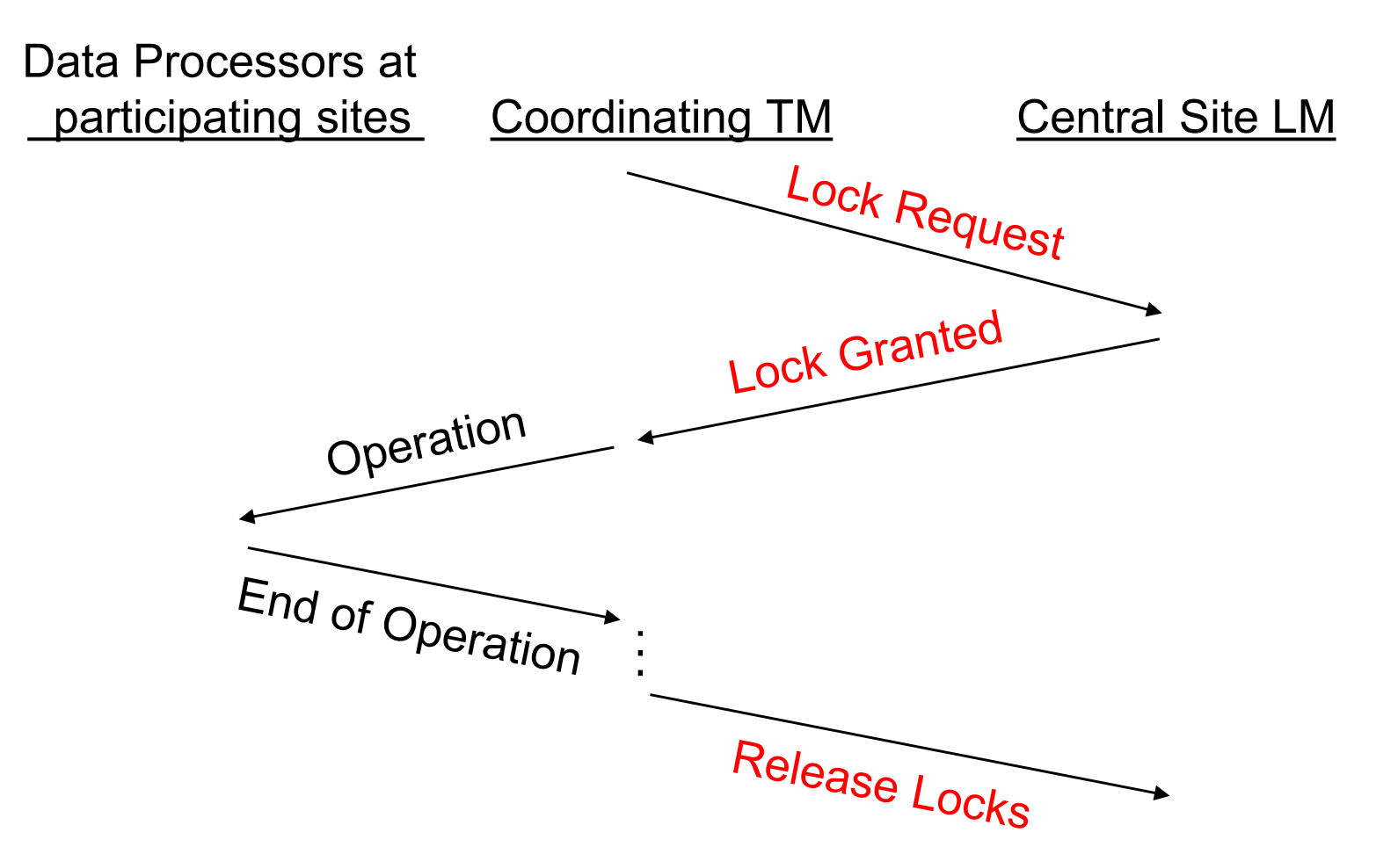
Communication Structure of Centralised 2PL

Slide 17
Distributed 2PL
2PL schedulers are placed at each site.
Each scheduler handles lock requests for data at that site.
Advantage: better scalability
Disadvantage: deadlock detection difficult
Notes:
Conflicting operations will be detected by at least one of the copies.

Slide 18
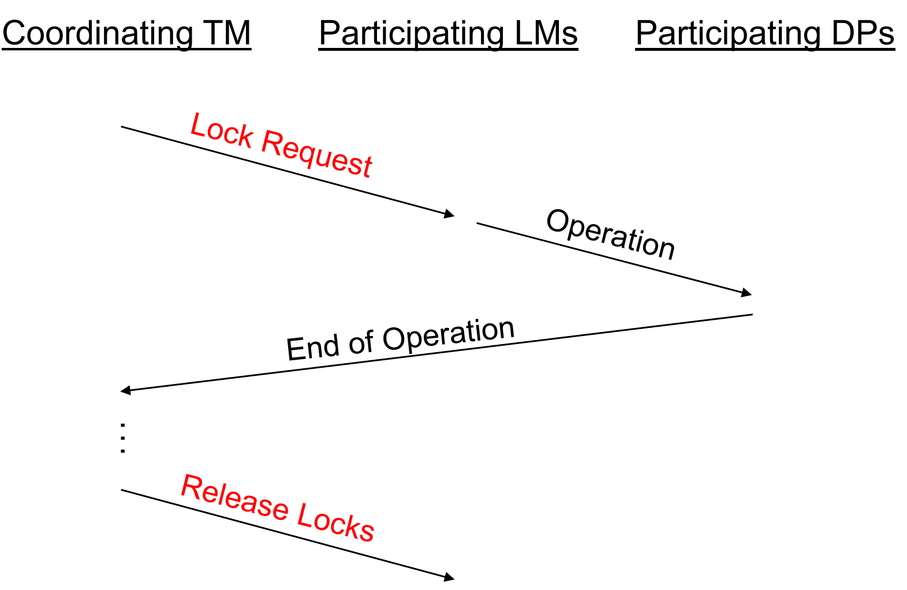
Communication Structure of Distributed 2PL

Slide 19
分布式数据库的A和D

Slide 20
Centralized Mechanism – Logging
Contents of log:
Begin_transaction
Before_state
After_state
Commit
Operations:
Commit
Abort
Recover

Slide 21
Distributed Commit Problem
.
Transaction T
Action:
a1,a2
Action:
a3
Action:
a4,a5
Atomicity and Durability?

Slide 22
Two-Phase Commit (2PC)
Two phases: a voting phase and a decision phase.
Coordinator asks all participants whether they are prepared to commit transaction.
If one participant votes abort, or fails to respond within a timeout period, coordinator instructs all participants to abort transaction.
If all vote commit, coordinator instructs all participants to commit.
Once voted, cannot change the vote.
All participants must adopt global decision.

Slide 23
Two-Phase Commit (2PC)
If participant votes abort, free to abort transaction immediately (unilateral abort)
If participant votes commit, must wait for coordinator to broadcast global-commit or global-abort message.
Protocol assumes each site has its own local log and can rollback or commit transaction reliably.
If participant fails to vote, abort is assumed.
If participant gets no vote instruction from coordinator, can abort.

Slide 24
REQUEST-TO-PREPARE
PREPARED
Coordinator
COMMIT
Participant
DONE

Slide 25
REQUEST-TO-PREPARE
NO
Coordinator
ABORT
Participant
DONE

Slide 26
Centralized 2PC
Coordinator Participant
I
I
request-prepare
no
commit-request
request-prepare*
no
abort*
request-prepare
prepared
W
A
W
A
prepared*
Commit*
done*
commit
done
abort
done
C
F
C
done*

Slide 27
Notation: Incoming message
Outgoing message
( * = everyone)
When participant enters “W” state:
it must have acquired all resources
it can only abort or commit if so instructed by a coordinator
Coordinator only enters “C” state if all participants are in “W”, i.e., it is certain that all will eventually commit
After coordinator receives DONE message, it can forget about the transaction (clean up control structures).

Slide 28
Handling Failures
Types of failures
Node failure
Timeout waiting for expected message
Communication failure

Slide 29
Handling Node Failures
Coordinator and participant logs are used to reconstruct state before failure
State transitions must be logged

Slide 30
Coordinator
Participant
Log start-2PC record
(participant list)
REQUEST-PREPARE*
Log prepared record
(state W)
PREPARED*
Log commit record
(state C)
COMMIT*
Log committed record
(state C)
DONE*
Log done record
(end-2PC)

Slide 31
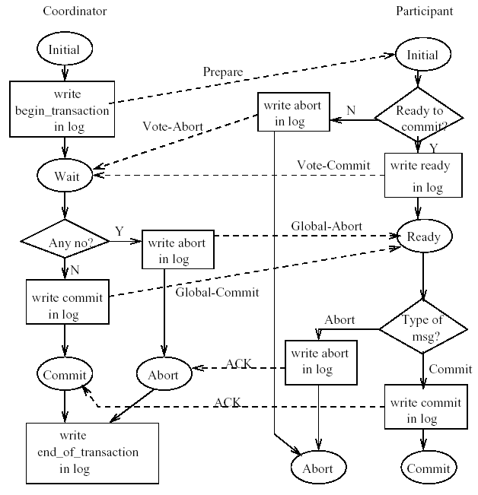
2PC Protocol Actions

Slide 32
Handling Failures
Termination protocols
How operational nodes react
Recovery protocols
How failed nodes behave

Slide 33
Non-blocking Property
Allow a transaction to terminate at the operational site without waiting for recovery of the failed site.

Slide 34
REQUEST-TO-PREPARE
PREPARED
Uncertainty
period
Coordinator
Participant
COMMIT/ABORT
DONE

Slide 35
Blocking
Sample Scenario:
Coord P2
W
P1 P3
W W
P4 W

Slide 36
2PC is a blocking protocol. Is there a non-blocking protocol?

Slide 37
3PC Protocol
Ensures the following non-blocking property:
If ANY operational site is in the “uncertain” state, NO site (operational or failed) could have decided to commit
If all operational sites are uncertain, then they can simply decide abort, i.e., they don’t have to block for other sites to become operational.
Main Idea:
Send (with ack) a PRE-COMMIT to all participants before sending COMMIT.
This ensures that decision is commit only if all sites have first received PRE-COMMIT (and are not uncertain).
Reminder: Assume reliable network

Slide 38
Basic 3PC Protocol
Phase 1:
The coordinator sends VOTE_REQ to all participants.
When a participant receives VOTE_REQ, it responds with YES or NO, depending on its vote. If a participant votes NO, it decides abort and stops.
Phase 2:
The coordinator collects all votes. If any vote was NO, then the coordinator decides abort, sends ABORT to all participants that voted YES, and stops. Otherwise, the coordinator sends PRE_COMMIT messages to all participants.
A participant that votes YES waits for a PRE_COMMIT or ABORT message from the coordinator. If it receives a PRE_COMMIT, then it responds with an ACK message.

Slide 39
Basic 3PC Protocol
Phase 3:
The coordinator collects the ACKs. When they have all been received, it decides commit, sends COMMITs to all participants, and stops.
A participant waits for a COMMIT from the coordinator. When it receives that message, it decides commit and stops.

Slide 40
REQUEST-TO-PREPARE
PREPARED
PRECOMMIT
Coordinator
ACK
Participant
COMMIT
DONE

Slide 41
REQUEST-TO-PREPARE
NO
Coordinator
ABORT
Participant
DONE

Slide 42
Coordinator
Participant
Log start-3PC record
(participant list)
REQUEST-PREPARE
Log prepared record
(state W)
PREPARED
PRECOMMIT
ACK
Log commit record
(state C)
COMMIT
Log committed record
(state C)

Slide 43
Coordinator
Participant
REQUEST-PREPARE
1. Timeout: abort
1. Timeout: Abort
PREPARED
PRECOMMIT
2. Timeout
Termination Protocol
2. Timeout: ignore
ACK
3. Timeout
Termination Protocol
COMMIT

Slide 44
Time-out Actions
If the coordinator does not receive a vote, it decides abort, sends ABORT message to YES voters, and stops.
If the coordinator times-out waiting for an ACK (it knows that the participant is at least ready), then it simply proceeds to send commit.
When the process that owes the ACK recovers, it is responsible for finding out the decision.
In commit state? Ignore

Slide 45
Time-out Actions
If a participant does not receive a VOTE_REQ, it decides abort and stops.
If timeout occurs while a participant is waiting for COMMIT, ABORT, or PRE_COMMIT from coordinator, a new Termination Protocol is used.
Process states, defined next, are used in the Termination Protocol.

Slide 46
Note: 3PC unsafe with communication failures!
W
P
W
P
W

