Slide 1


NewSQL
周烜
华东师范大学
数据科学与工程学院
xzhou@dase.ecnu.edu.cn

Slide 2
NoSQL vs SQL
NoSQL
功能接口
面向对象
Schema
不固定，更新友好
复杂查询（Join）
不支持，交给应用
事务
不支持，交给应用
SQL
功能接口
关系模型
Schema
固定，干净
复杂查询（Join）
支持，扩展限制
事务
支持，扩展限制

Slide 3
NewSQL
传统SQL的功能接口
支持更好的扩展性（Scale-out）
支持分布式环境下的高可用
在低端高并行硬件（commodity hardware）上部署

Slide 4
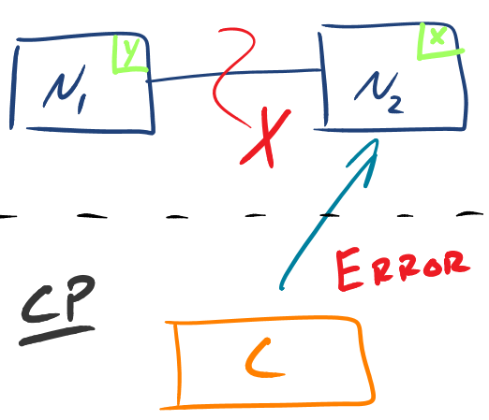
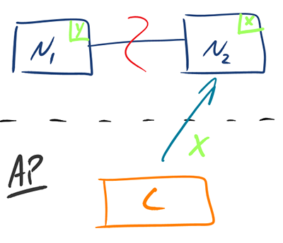
严格意义上的CAP
当通信故障（Partitioning）发生时，我们选择C还是A。
因此，P是给定的。只有CP和AP两种选择。

Slide 5
Node Availability vs Service Availability
Node Availability (nA)
通信故障发生时，任一节点都可用。
Service Availability (sA)
通信故障发生时，部分节点不可用。但是，总有一部分节点可用。系统可以将用户自动切换到可用的节点。
服务不中断。

Slide 6
CnAP vs CsAP
CnAP：只能在CP和nAP中二选一。
CsAP：在某种条件下，可以兼顾。
Raft
Paxos

Slide 7
Spanner：利用CsAP的NewSQL
Distributed multiversion database
General-purpose transactions (ACID)
SQL query language
Schematized tables
Semi-relational data model (F1 is more relational / SQL)
Focus: managing cross-datacenter replication
Features:
Provides externally consistent reads and writes.
Globally consistent reads across database
Running in production: Google’s Ad data

Slide 8
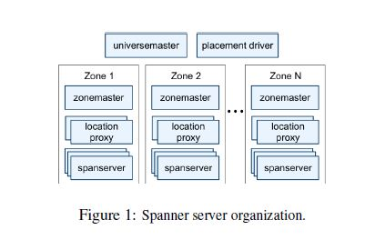
Span server organization
Universe : Spanner deployment
Zones :
Unit of physical isolation
One zonemaster, thousands of spanservers

Slide 9
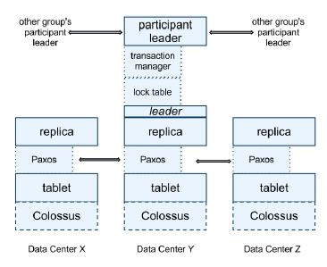
Structure
Data and logs stored on colossus (successor of GFS)
Data is replicated across availability zones.
Using Paxos to get consensus data operations; Paxos is more complex than Raft, but more flexible.
Transaction manager: to support distributed transactions

Slide 10
Transaction Support
Distributed Transaction
Concurrency Control: 2PL
Atomicity & Durability: 2PC
Problem: 2PL causes too much blocking; 2PC makes it worse.
Solution: Multiversion & Timestamp Ordering

Slide 11
Timestamp-Based Protocols
Each transaction is issued a timestamp when it enters the system. If an old transaction T_{i} has time-stamp TS(T_{i}), a new transaction T_{j} is assigned time-stamp TS(T_{j}) such that TS(T_{i}) <TS(T_{j}).
The protocol manages concurrent execution such that the time-stamps determine the serializability order.
In order to assure such behavior, the protocol maintains for each data Q two timestamp values:
W-timestamp(Q) is the largest time-stamp of any transaction that executed write(Q) successfully.
R-timestamp(Q) is the largest time-stamp of any transaction that executed read(Q) successfully.

Slide 12
Timestamp-Based Protocols (Cont.)
The timestamp ordering protocol ensures that any conflicting read and write operations are executed in timestamp order.
Suppose a transaction T_{i} issues a read(Q)
If TS(T_{i}) ≤ W-timestamp(Q), then T_{i} needs to read a value of Q that was already overwritten.
Hence, the read operation is rejected, and T_{i} is rolled back.
If TS(T_{i}) ≥ W-timestamp(Q), then the read operation is executed, and R-timestamp(Q) is set to max(R-timestamp(Q), TS(T_{i})).

Slide 13
Timestamp-Based Protocols (Cont.)
Suppose that transaction T_{i} issues write(Q).
If TS(T_{i}) < R-timestamp(Q), then the value of Q that T_{i} is producing was needed previously, and the system assumed that that value would never be produced.
Hence, the write operation is rejected, and T_{i} is rolled back.
If TS(T_{i}) < W-timestamp(Q), then T_{i} is attempting to write an obsolete value of Q.
Hence, this write operation is rejected, and T_{i} is rolled back.
Otherwise, the write operation is executed, and W-timestamp(Q) is set to TS(T_{i}).

Slide 14
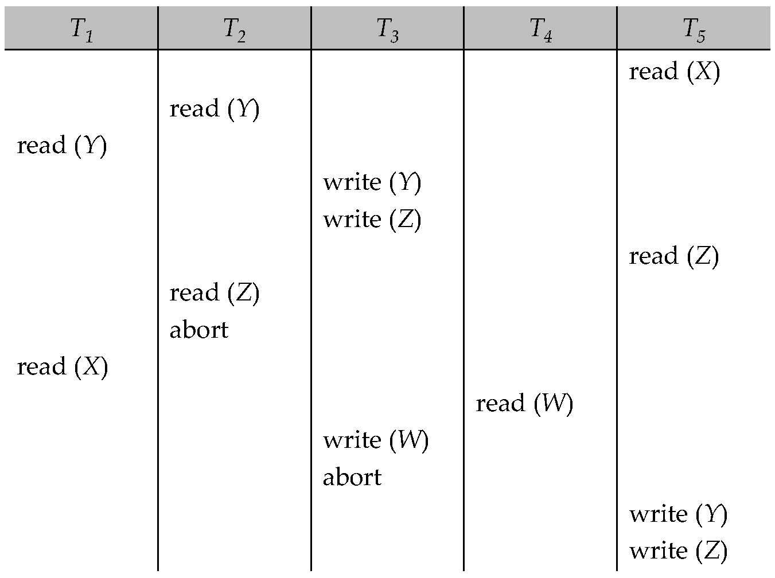
Example Use of the Protocol
A partial schedule for several data items for transactions with
timestamps 1, 2, 3, 4, 5

Slide 15
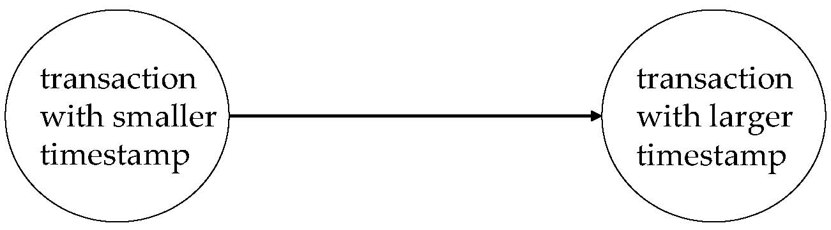
Correctness of Timestamp-Ordering Protocol
The timestamp-ordering protocol guarantees serializability since all the arcs in the precedence graph are of the form:
Thus, there will be no cycles in the precedence graph
Timestamp protocol ensures freedom from deadlock as no transaction ever waits.
But the schedule may not be cascade-free, and may not even be recoverable.

Slide 16
Recoverability and Cascade Freedom
Problem with timestamp-ordering protocol:
Suppose T_{i} aborts, but T_{j} has read a data item written by T_{i}
Then T_{j} must abort; if T_{j} had been allowed to commit earlier, the schedule is not recoverable.
Further, any transaction that has read a data item written by T_{j} must abort
This can lead to cascading rollback --- that is, a chain of rollbacks
Solution 1:
A transaction is structured such that its writes are all performed at the end of its processing
All writes of a transaction form an atomic action; no transaction may execute while a transaction is being written
A transaction that aborts is restarted with a new timestamp
Solution 2: Limited form of locking: wait for data to be committed before reading it
Solution 3: Use commit dependencies to ensure recoverability

Slide 17
Multiversion Schemes
Multiversion schemes keep old versions of data item to increase concurrency.
Multiversion Timestamp Ordering
Multiversion Two-Phase Locking
Each successful write results in the creation of a new version of the data item written.
Use timestamps to label versions.
When a read(Q) operation is issued, select an appropriate version of Q based on the timestamp of the transaction, and return the value of the selected version.
reads never have to wait as an appropriate version is returned immediately.

Slide 18
Multiversion Timestamp Ordering
Each data item Q has a sequence of versions <Q₁, Q₂,...., Q_{m}>. Each version Q_{k} contains three data fields:
Content -- the value of version Q_{k}.
W-timestamp(Q_{k}) -- timestamp of the transaction that created (wrote) version Q_{k}
R-timestamp(Q_{k}) -- largest timestamp of a transaction that successfully read version Q_{k}
When a transaction T_{i} creates a new version Q_{k} of Q, Q_{k}'s W-timestamp and R-timestamp are initialized to TS(T_{i}).
R-timestamp of Q_{k} is updated whenever a transaction T_{j} reads Q_{k}, and TS(T_{j}) > R-timestamp(Q_{k}).

Slide 19
Multiversion Timestamp Ordering
Suppose that transaction T_{i} issues a read(Q) or write(Q) operation. Let Q_{k} denote the version of Q whose write timestamp is the largest write timestamp less than or equal to TS(T_{i}).
If transaction T_{i} issues a read(Q), then the value returned is the content of version Q_{k}.
If transaction T_{i} issues a write(Q)
if TS(T_{i}) < R-timestamp(Q_{k}), then transaction T_{i} is rolled back.
if TS(T_{i}) = W-timestamp(Q_{k}), the contents of Q_{k} are overwritten
else a new version of Q is created.
Observe that
Reads always succeed
A write by T_{i} is rejected if some other transaction T_{j} that (in the serialization order defined by the timestamp values) should read T_{i}'s write, has already read a version created by a transaction older than T_{i}.
Protocol guarantees serializability

Slide 20
Version Management in Spanner
Transactions that write use strict 2PL
Each transaction T is assigned a timestamp s
Data written by T is timestamped with s
Time
<8
8
15
My friends
[X]
[]
My posts
[P]
X’s friends
[me]
[]

Slide 21
Read Write Transactions
Use read locks on all data items that are read
Acquired at leader
Read latest version, not based on timestamp
Writes are buffered, and acquire write locks at commit time (when prepare is done)
Wound-wait protocol to avoid deadlocks
Timestamp is assigned at commit time
Data version written with commit timestamp

Slide 22
Reads in spanner
Snapshot reads
Read in past without locking
Client can specify timestamp for read or an upper bound of timestamp’s staleness
Each replica tracks a value called safe time t_{safe} which is the maximum timestamp at which a replica is up-to-date.
Replica can satisfy read at any t <= t_{safe}
Read-only transactions
Assign timestamp s_{read} and do snapshot read at s_{read}
s_{read} = TT.now().latest() guarantees external consistency (linearizability)
Should assign oldest timestamp preserving external consistency to avoid blocking
For read at single paxos group:
Let LastTS() = timestamp of the last committed write at the Paxos group.
If there are no prepared transactions, the assignment s_{read} = LastTS() trivially satisfies external consistency: the transaction will see the result of the last write,
Simpler choice of TT.now().latest() in general
Notes:
Without locking ensure that writes are not blocked
Spanner chooses timestamp if bound is specified

Slide 23
Timestamp Management
Centralized allocation of timestamps is not feasible in a massive distributed system.
Solution: TrueTime Devices
GPS clock
Atomic clock

Slide 24
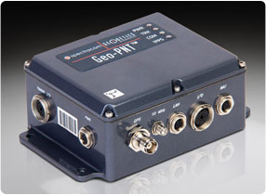
TrueTime Architecture
GPS timemaster
GPS timemaster
GPS timemaster
Atomic-clock timemaster
Client
Datacenter 1
Datacenter 2
…
Datacenter n

Slide 25
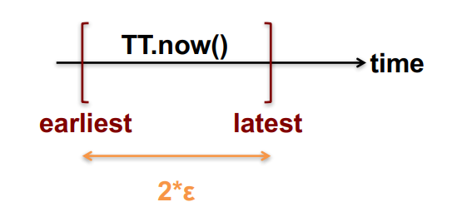
TrueTime Architecture
保证和标准时间在误差 ɛ 以内

Slide 26
Spanner/F1 seems to be the first distributed SQL system claimed to be able to truly scale out.

Slide 27



Other NewSQL Systems

Slide 28

One Size Doesn’t Fit All!
Michael Stonebraker

Slide 29
Can One Size Fit All ?
Perfect if it is possible.
One Size大大简化了软件的开发难度和维护成本。
软件人员只需要学会一种数据库系统。
数据的转移和管理被大大简化。
In reality, we have to compromise.
但仍然需要精简系统。

