Slide 2
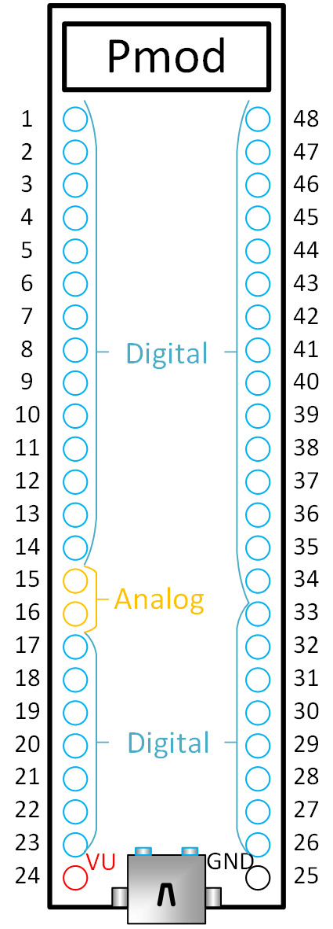
Group A
Group B
0
1
2
3
4
5
6
7
8
9
10
11
12
13
14
15
16
17
18
19
20
Pmod
4 5 6 7 G V
0 1 2 3 G V
0
1
2
3
4
5
6
7
8
9
10
11
12
13
22
21
14
15
16
17
18
19
20

