Slide 1
atfwd daemon
Zach Lin
Connected Home BG
2023/11/09
Jan. 2012

Slide 2
Outline
Roadmap
Purpose
Flow
AT command registration
Process commands
Response
Test
References

Slide 3
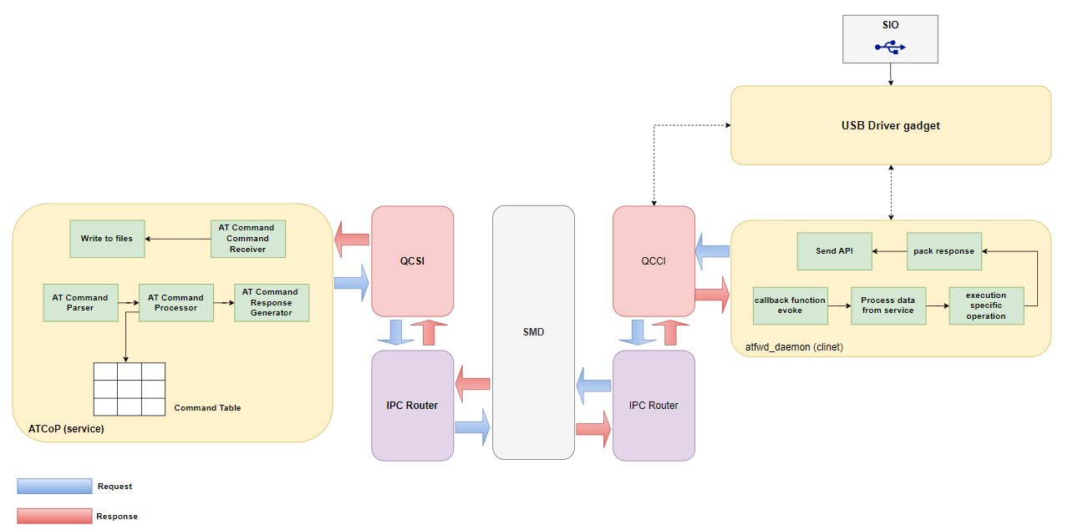
Roadmap

Slide 4
Purpose
AP side
Data transfer process
Register AT Commands
Receive data processing by Modem
Handle specific op in Apps
Send response back to Modem

Slide 5
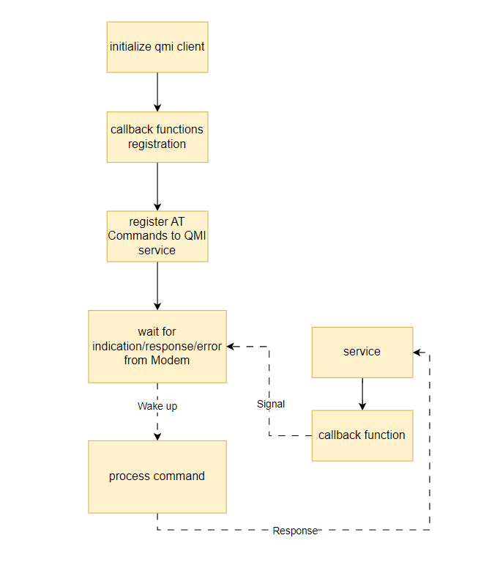
Flow

Slide 6
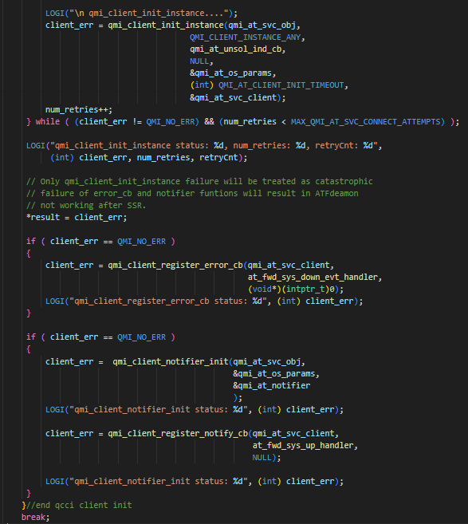
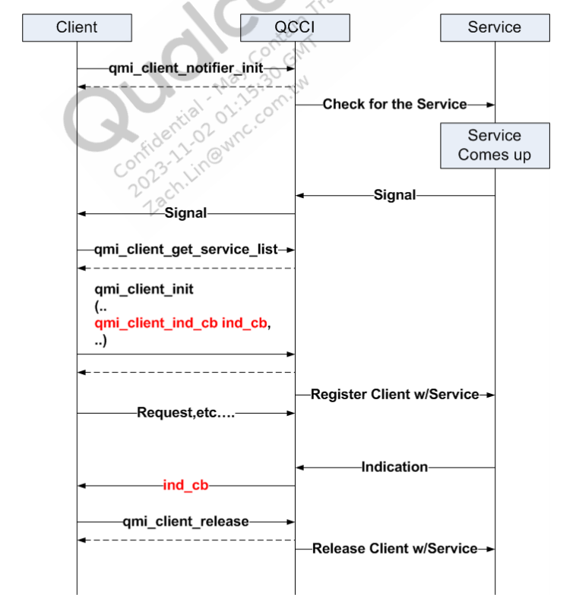
Initialization client

Slide 7
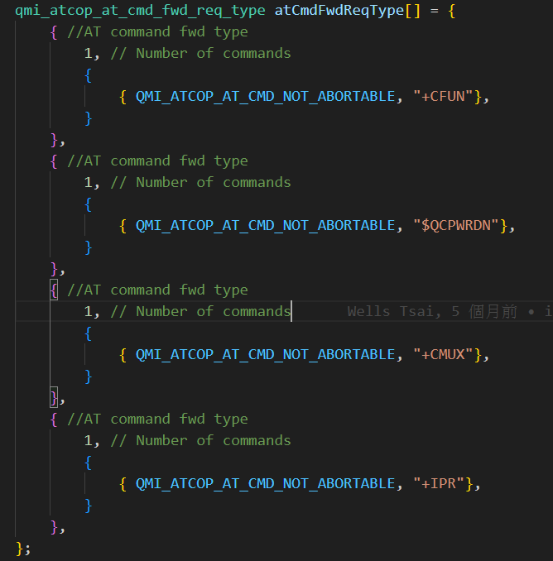
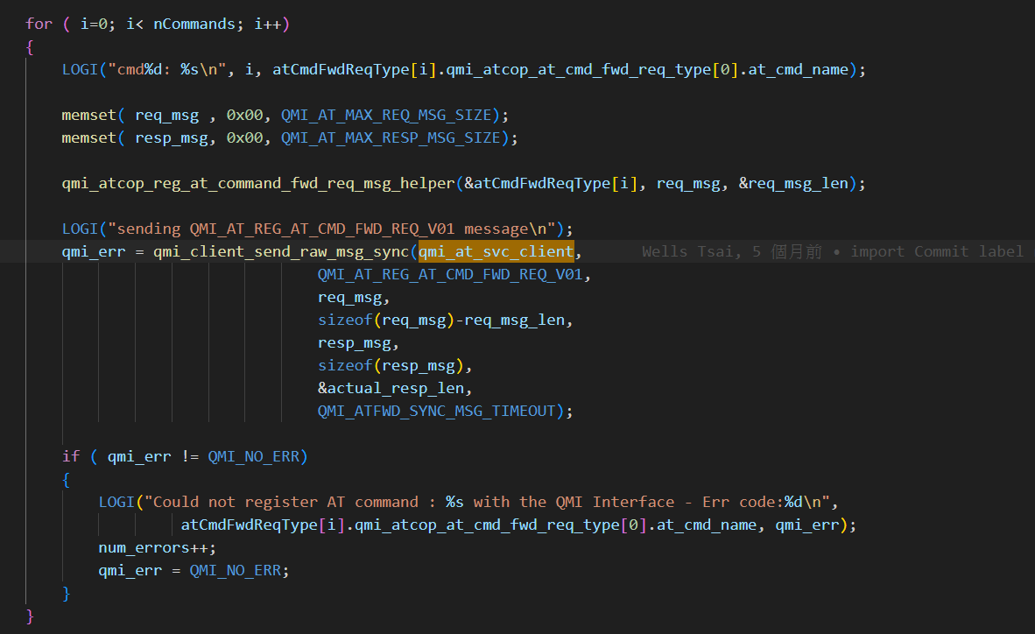
AT Command registration (service side)

Slide 8
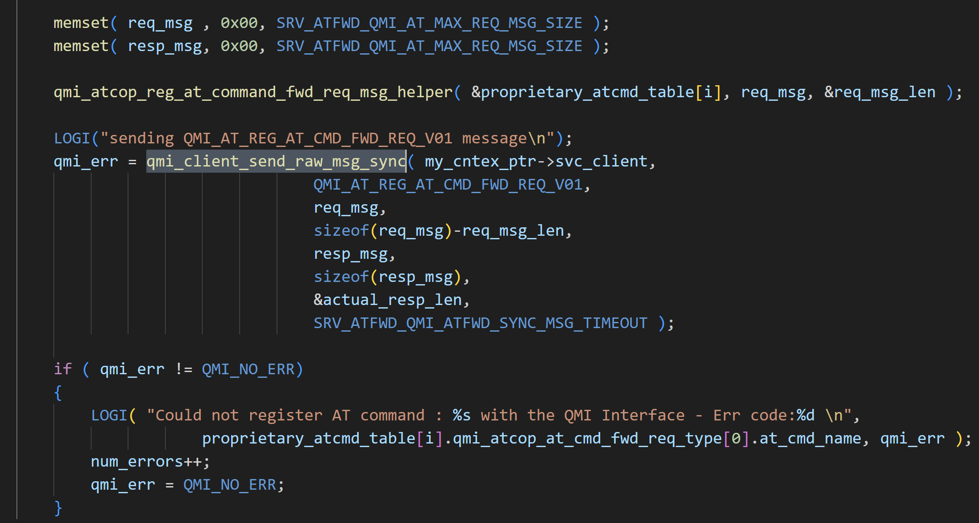
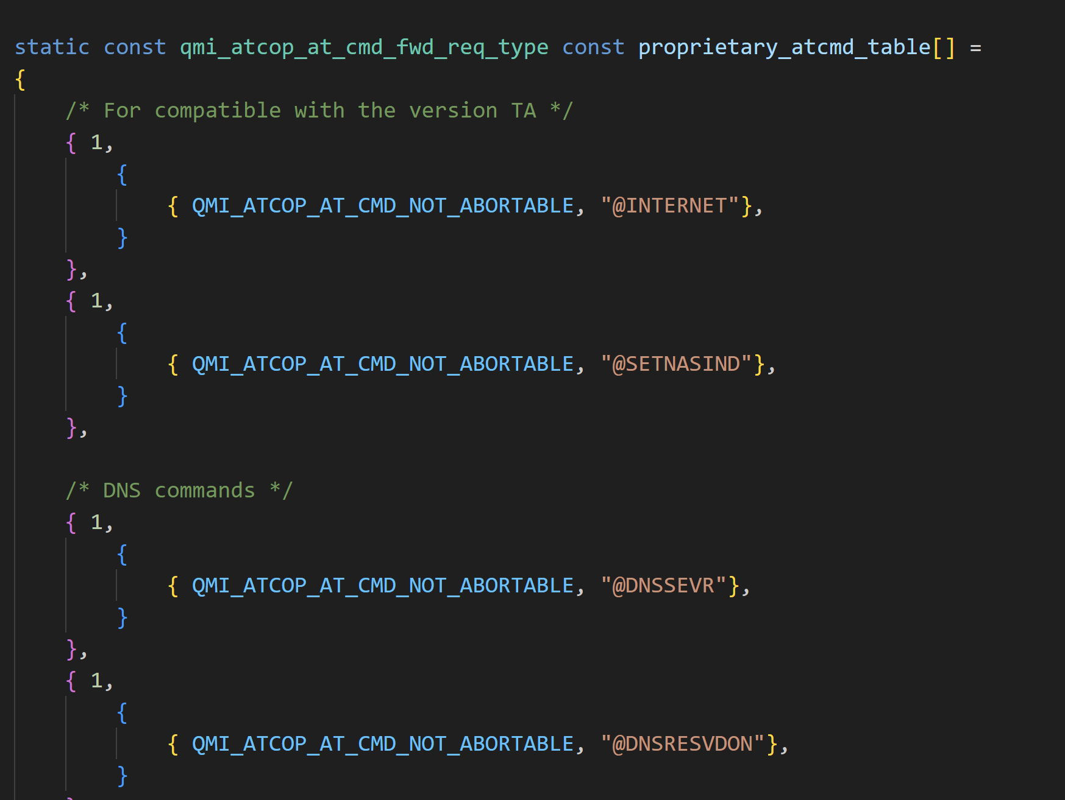
AT Command registration (app side)
Notes:
1. @INTERNET
2. @SETNASIND
3. @DNSSEVR
4. @DNSRESVDON
5. @PINGREQ
6. @SOCKDIAL
7. @SOCKCREAT
8. @SOCKCONN
9. @SOCKWRITE
10. @SOCKREAD
11. @SOCKCLOSE
12. @SOCKDATA
13. @FTPOPEN
14. @FTPCLOSE
15. @FTPGET
16. @FTPGETDATA
17. @FTPPUT
18. @FTPPUTDATA
19. @FTPFILESIZE
20. @FTPDEL
21. @GPIOREQ
22. @GPIOCFG
23. @GPIOGET
24. @GPIOSET
25. @I2CADDR
26. @I2CCFG
27. @I2CREAD
28. @I2CWRITE
29. @SPICFG
30. @SPIREAD
31. @SPIWRITE
32. @THERMO
33. @ADCOP
34. @GPSENGINE
35. @GPSMODE
36. @GPSGLOCD
37. @GPSTTFF
38. @GPSNMEAINDCFG
39. @GPSNMEAMASK
40. @GPSCLRDATA
41. @AGPSURL
42. @PCMCFG
43. @UARTCFG
44. @LPM
45. @USBCFG
46. @SECBOOT
47. @HWINFO
48. @OMADMENABLED
49. @LWM2MENABLED
50. @LWM2MOOR
51. @LWM2MOOF
52. @LWM2MUPDATE
53. @LWM2MCONNECT
54. @FUSENDSTATE
55. @HOSTINFO
56. +ODIS
57. @FURECVFILE
58. @FOTACHECK
59. @FOTAUPGRADE
60. @ECMDHCP
61. @CCHO
62. @CCHC
63. @CGLA
64. @MTU（僅在 ENABLE_AT_MTU 啟用時適用）
65. @BAND_INFO（僅在 ENABLE_AT_BAND_INFO 啟用時適用）
66. @CUR_NW_ST（僅在 ENABLE_AT_CUR_NW_ST 啟用時適用）
67. @TCPKEEPALIVEPAR
68. @TCPKEEPALIVE

Slide 9
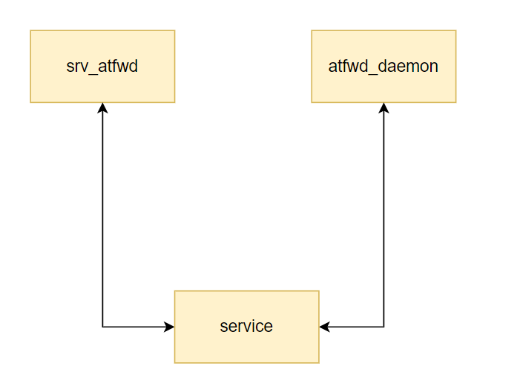
AT Command registration
Qualcomm daemon
+CFUN
$QCPWRDN
+CMUX
+IPR
WNC atfwd
WNC AT Commands

Slide 10
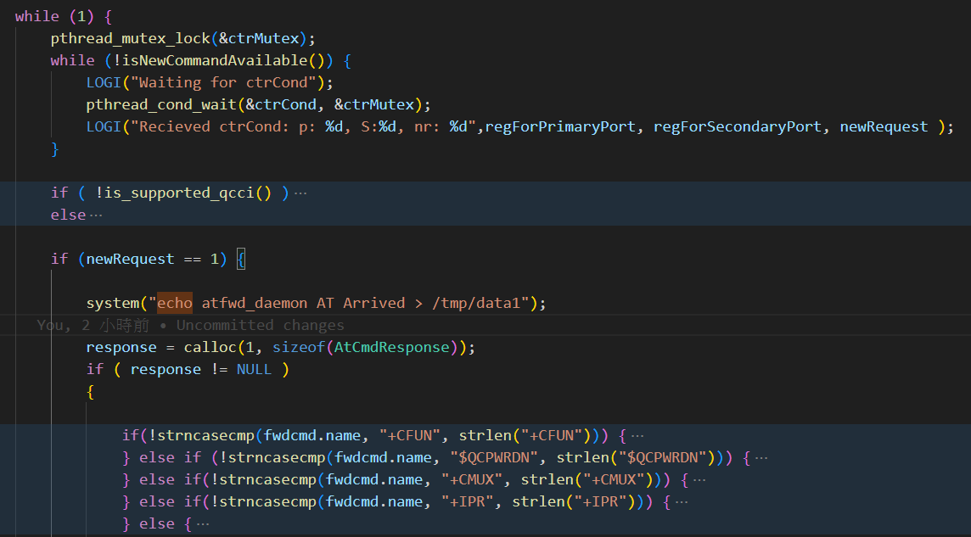
Process Commands (Qualcomm)

Slide 11
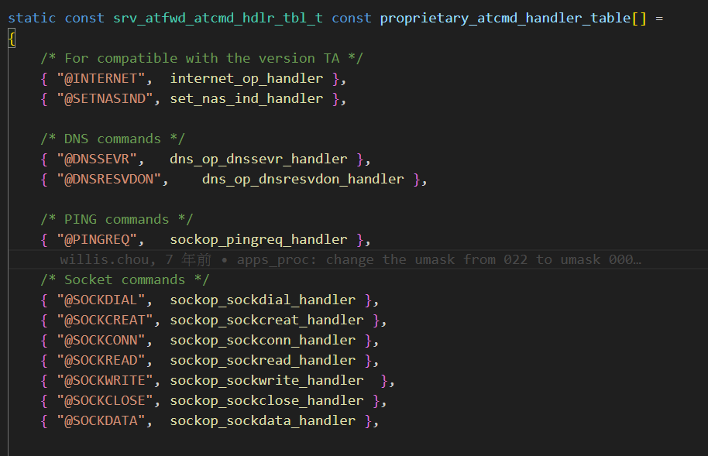
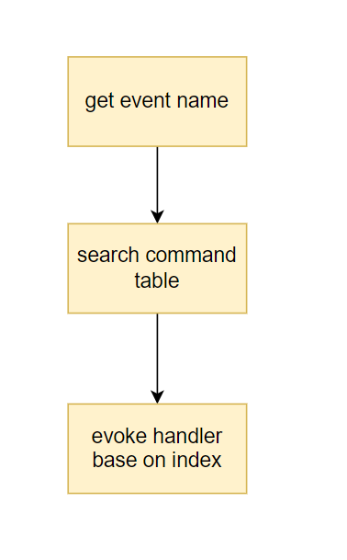
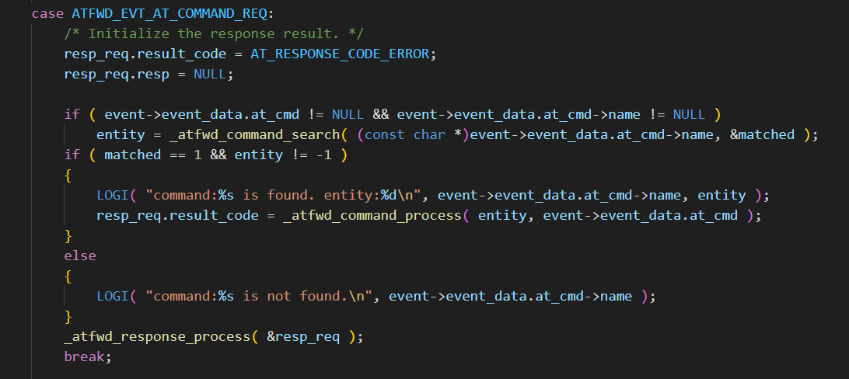
Process Commands (WNC)

Slide 12
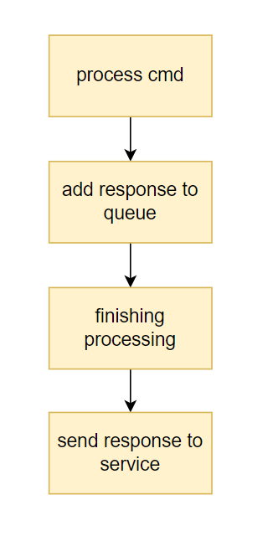
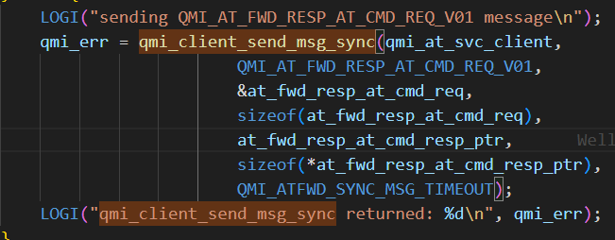
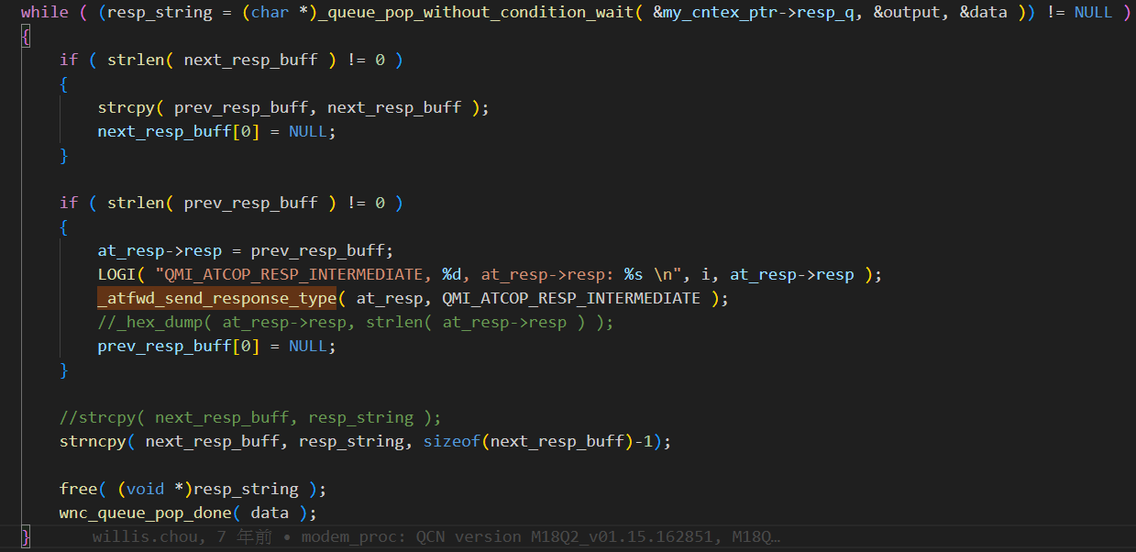
Response
- But WNC version is more rubust, because it use queue to store rep

Slide 13
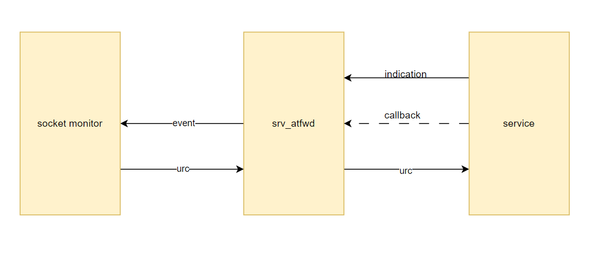
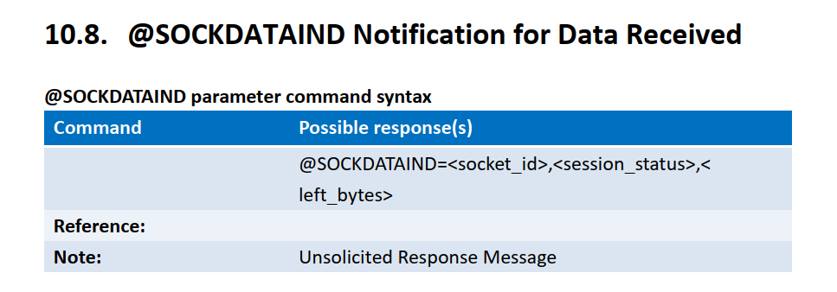
Unsolicited result code

Slide 14
Test
Send at command
If event was triggered, write some data into /tmp/data1
Examine WNC daemon and atfwd_daemon at the same time
Test at+cfun=1,1

Slide 15
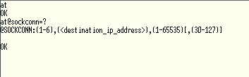

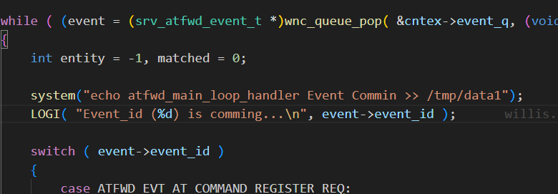
Test
at@sockconn=?
WNC handler will be triggered
srv_atfwd.c

Slide 16
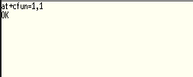
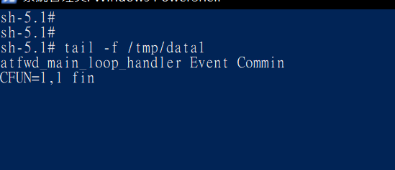
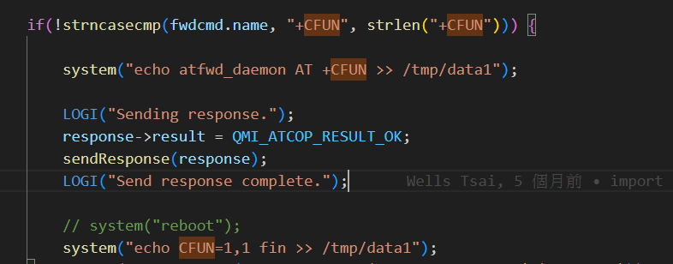
Test
At+cfun=1,1
Remove system reboot
Write info into /tmp/data1

Slide 17
Comparison with WNC version
Two program will run at the same time
Both have the same architecture but slightly different in details
WNC support extended command (ex. socket)
Some socket handler will sent signal to socket monitor
Event-driven structure
WNC has better granularity
WNC has better Parallelism
Qualcomm support Host-PC
Original transport over a tethered USB Ethernet adapter
Notes:
WNC 的 signal 更精準,只通知對應的 thread; Q 的 signal 會通知所有等待的 thread。
WNC 可以平行處理多個 item, Q一次只能處理一個 item。

Slide 18
Thank you for your attention

