Slide 1
bitbake
Zach Lin
Connected Home BG
2023/11/10
Jan. 2012

Slide 2
Outline
Roadmap
Intro
How to use bitbake
Simple example
Inherit
Multiple layers
Useful commands
Project example

Slide 3
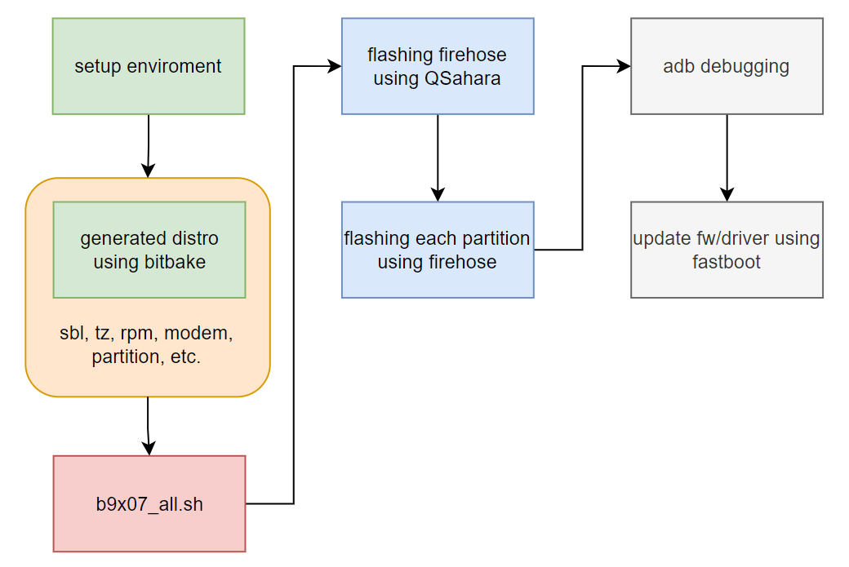
Roadmap

Slide 4
Intro
A build tool used for building Linux distro for embedded system
Within OpenEmbedded and Yocto Project
It executes task according to dependency graphs to build Linux images
Files
.conf
.bbclass
.bb

Slide 5
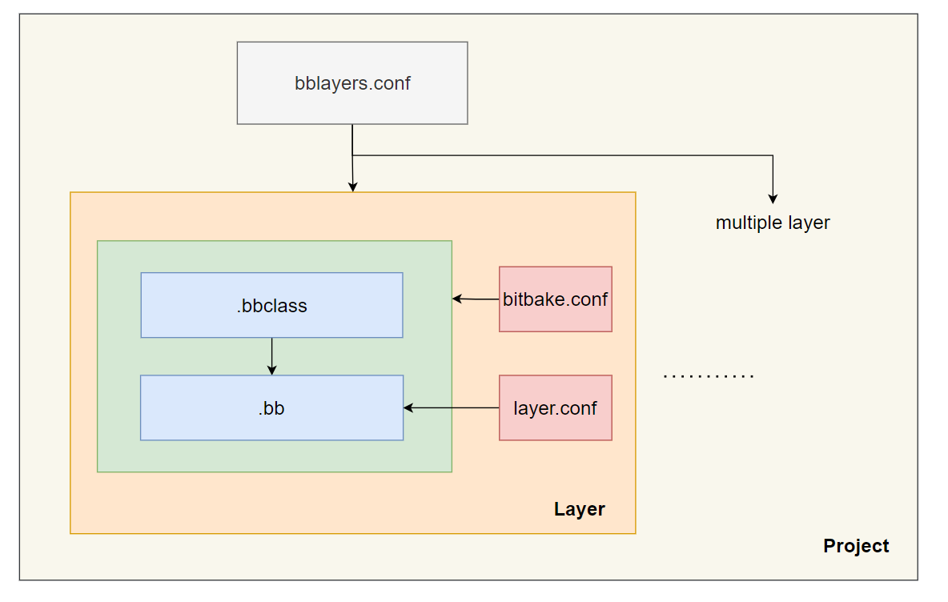
Intro – .bb
Recipe for software building
Dependencies
inherit
task
Notes:
Bitbake 文件的配方，它決定如何下載、配置、編譯程式碼，以及如何打包和安裝 image file

Slide 6
Intro – .bbclass
Class
Automatically share between .bb/.bbclass (if layer is activated)
base.bbclass
Notes:
可以在多個 recipe 以及類中共享類 (透過繼承的方式)，來實現模組化
一個 recipe 可以繼承多個類，類也可以繼承其他類

Slide 7
Intro – bblayer.conf
Allow bitbake to find specific layer
Activate/unactive layer when build

Slide 8
Intro – bitbake.conf
Default bitbake Global configure variables
PN
TMPDIR
CACHE
STAMP
T
B
Notes:
PN → Package Name
TMPDIR → tmp/ 資料夾，編譯時臨時文件存放位置
CACHE → cache/ 資料夾，編譯過程中的各種緩存數據
STAMP → stamp/，當編譯完成時會創建一個標記文件來追蹤任務
T → Task Work 資料夾，編譯中間文件存放處
B → 編譯的最終產品、二進制文件存放處

Slide 9
Intro – layer.conf
Each layer has their own layer.conf
Where to find .bb, .bbclass, .bbappend, etc.

Slide 10
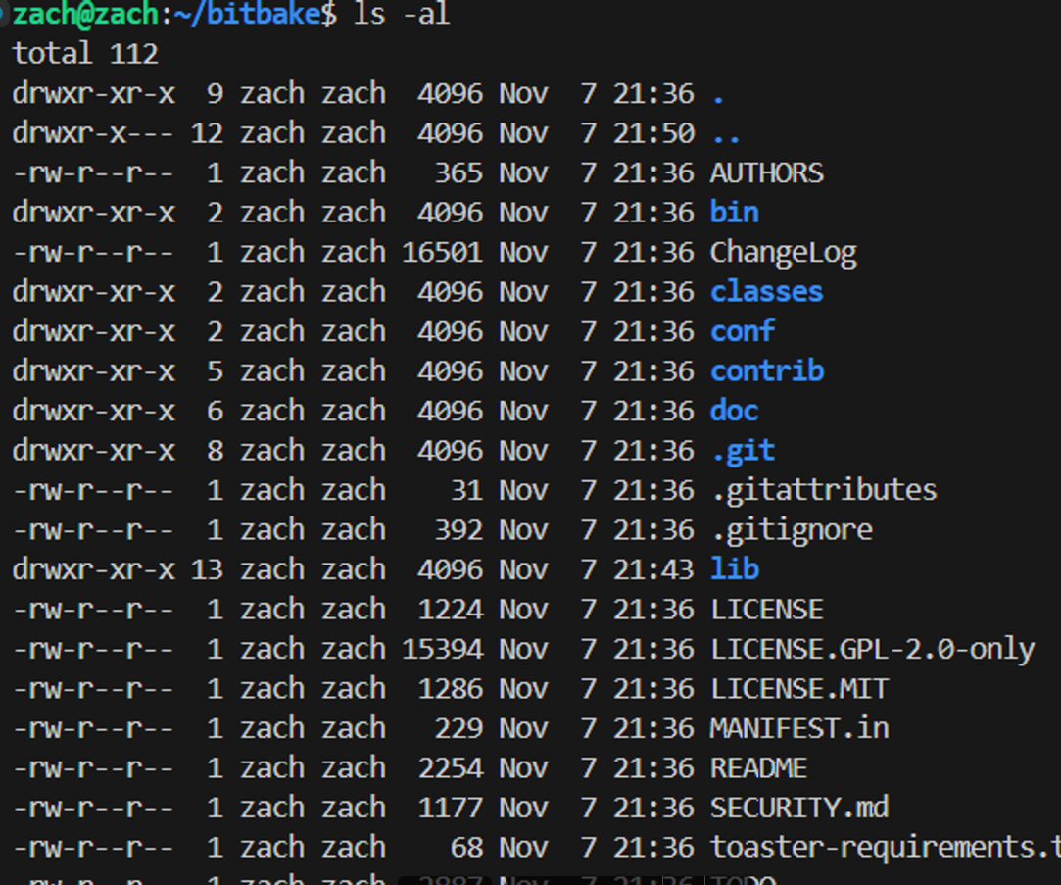
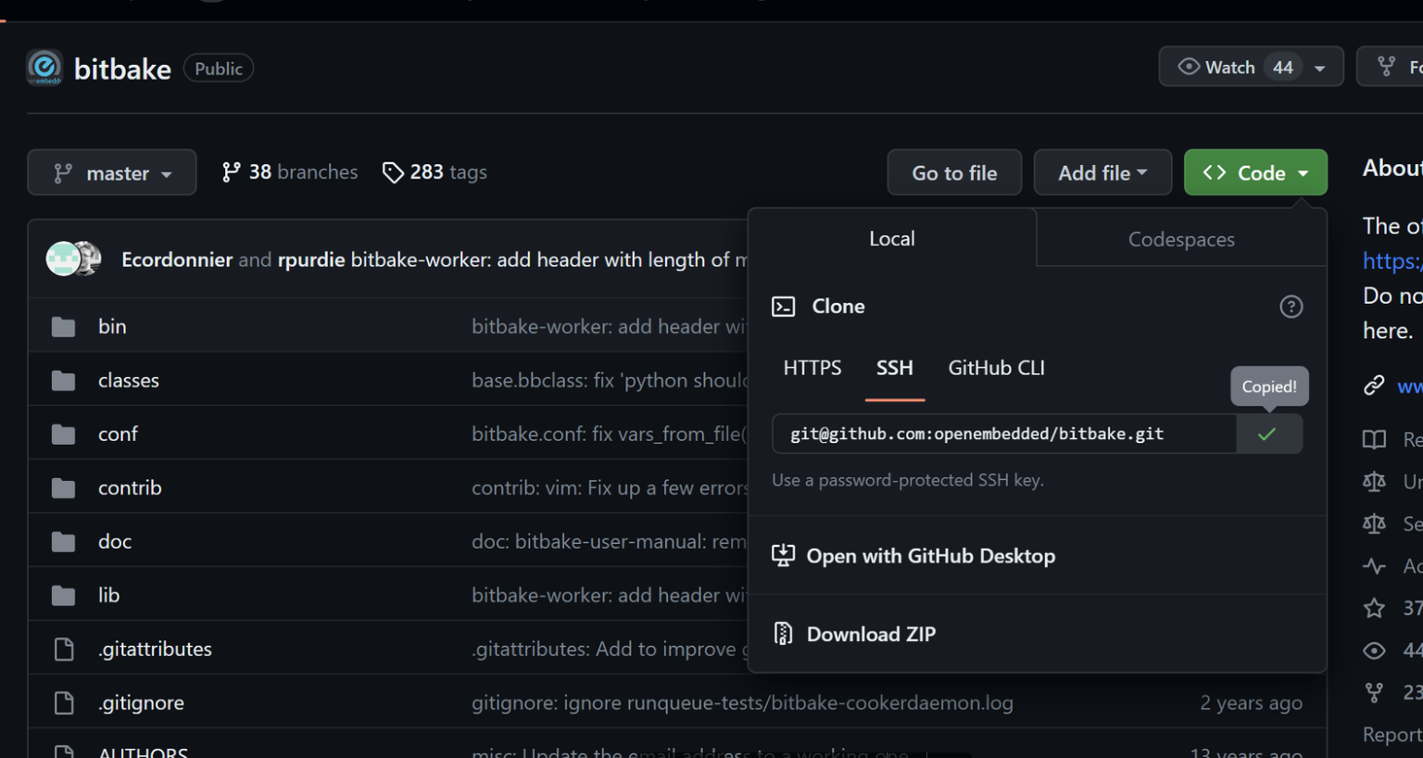
How to use bitbake – download bitbake
git clone https://github.com/openembedded/bitbake.git

Slide 11
How to use bitbake – setup envir
export PATH=/home/zach/bitbake/bin:$PATH
export PYTHONPATH=/home/zach/bitbake/lib:$PYTHONPATH
Create test folder
mkdir test
BBPATH=”/home/zach/tset”
export BBPATH

Slide 12
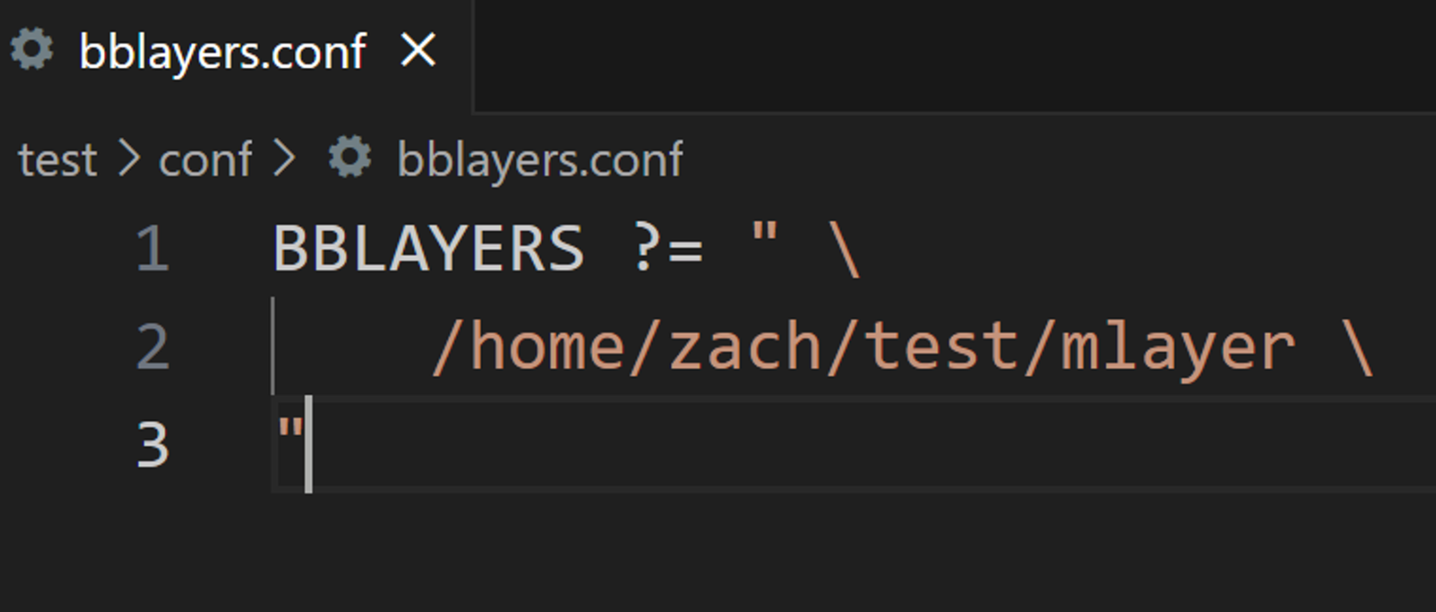
How to use bitbake – create bblayers.conf
Create conf
mkdir conf
Create bblayers.conf
touch bblayers.conf

Slide 13
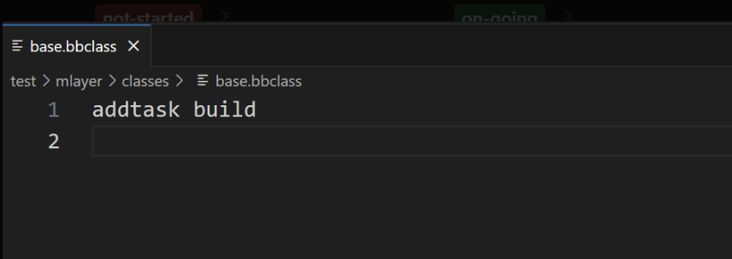
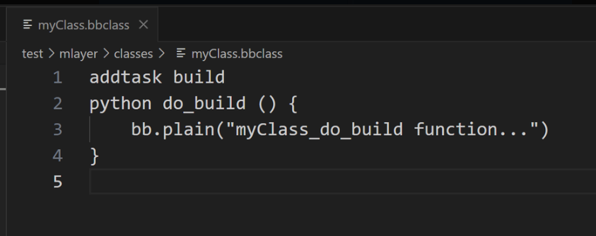
How to use bitbake – create layer
Create layer
mkdir /mlayer
Create classes
mkdir /mlayer/classes/
Create base.bbclass
touch /mlayer/base.bbclass
Create myClass.bbclass
touch /mylayer/myClass.bbclass

Slide 14
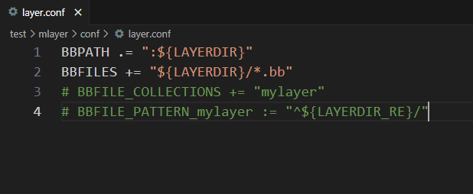
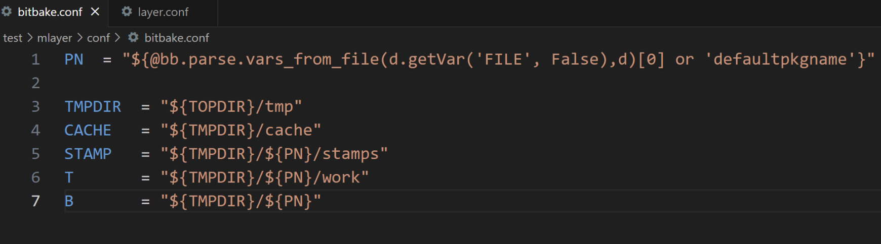
How to use bitbake – create layer
Create conf
mkdir /mlayer/conf
Create bitbake.conf
touch /mlayer/bitbake.conf
Create layer.conf
touch /mlayer/layer.conf

Slide 15
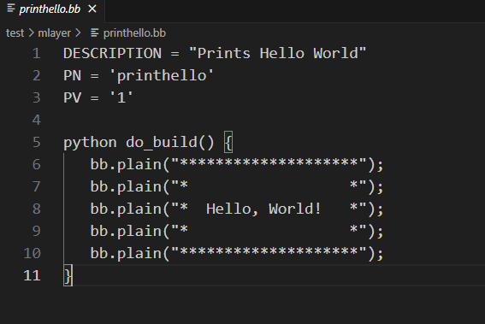
How to use bitbake – create recipe

Slide 16
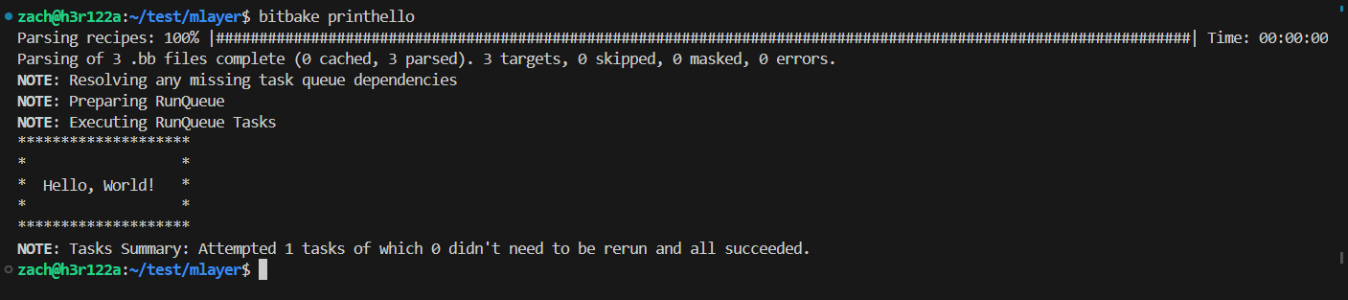
How to use bitbake – build
Remember to rm –r tmp/ before build

Slide 17
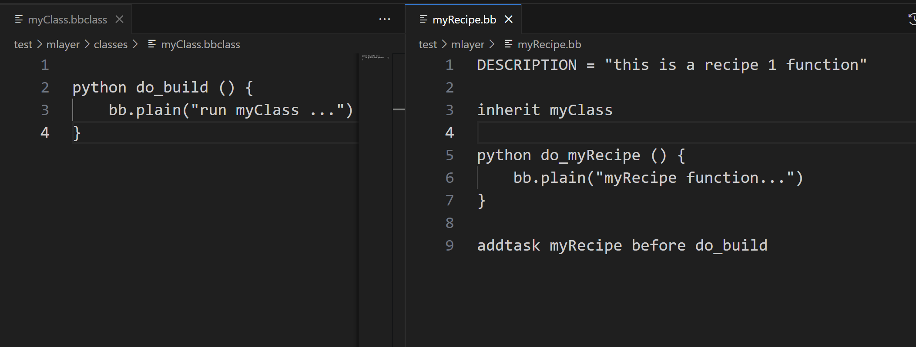
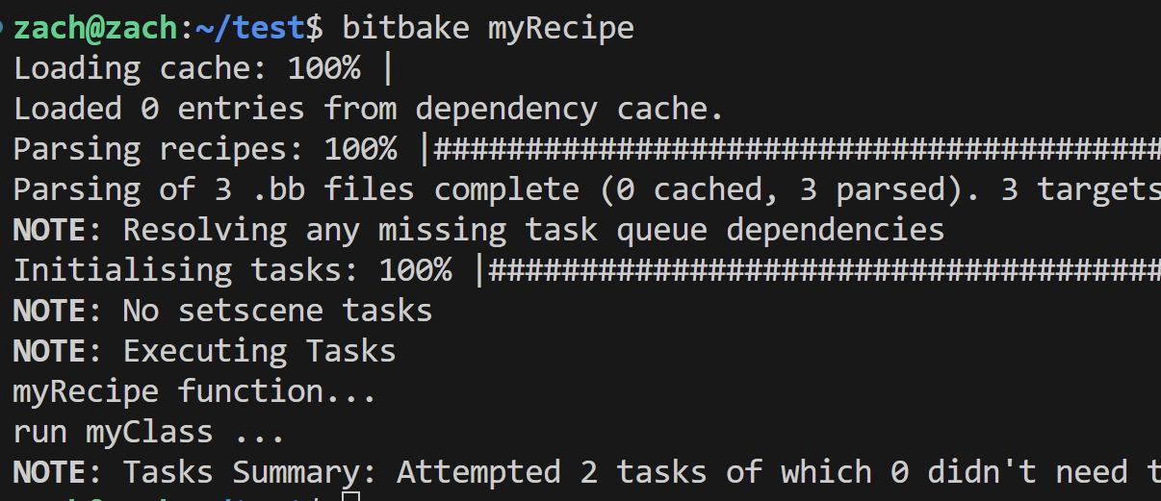
How to use bitbake –inherit myClass
classes/
inherit myClass
Use addtask
Use before/after

Slide 18
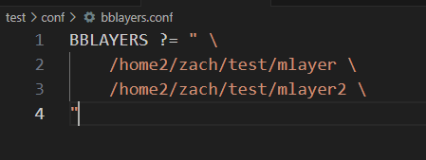
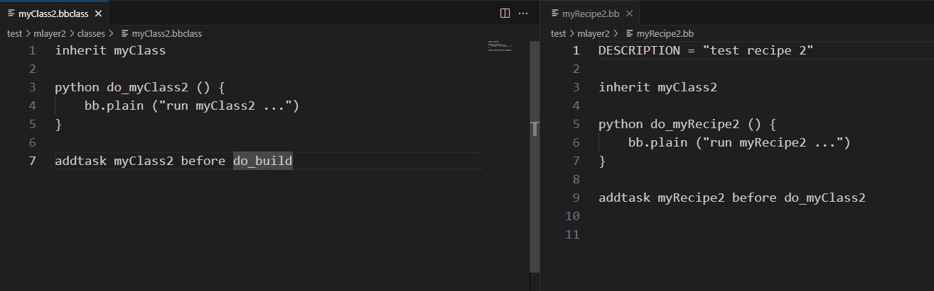
How to use bitbake – Multiple layers
Create a same layer like mlayer
mlayer2
Use different .bb file & .bbclass
Modify bblayer.conf

Slide 19
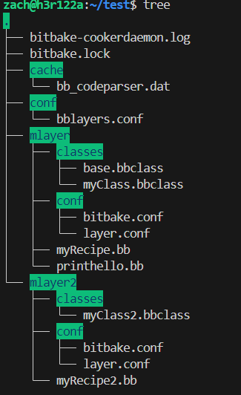
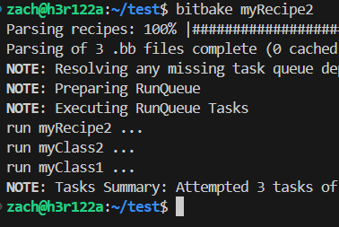
How to use bitbake – build

Slide 20
Useful commands
bitbake --version
bitbake –s
bitbake <recipe>
bitbake –c <task> <recipe>
bitbake-layers show-layers
bitbake –c cleansstate <recipe>
Notes:
顯示 bitbake 版本
顯示當前的 recipes
執行 recipe 中的任務
同3，但可以指定執行 recipe 中的任務
這個命令會顯示當前構建環境中所有層的詳細信息
清除 recipe 的緩存，讓下次編譯重新執行所有任務

Slide 21
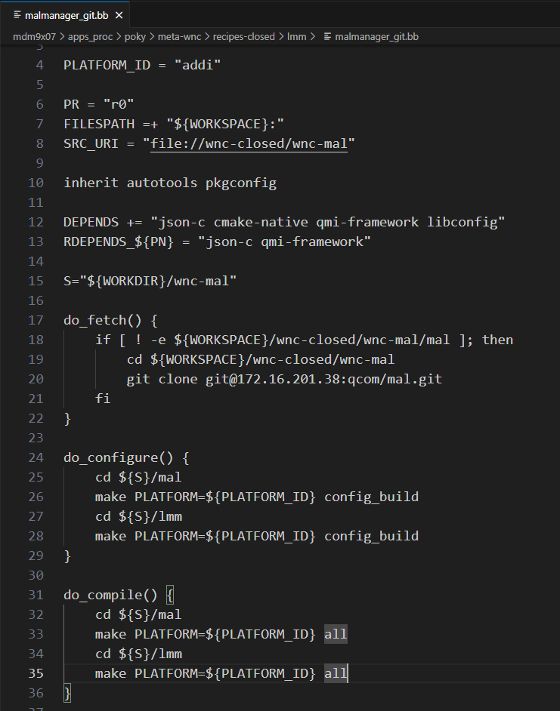
Project example

Slide 22
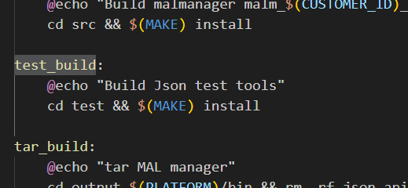
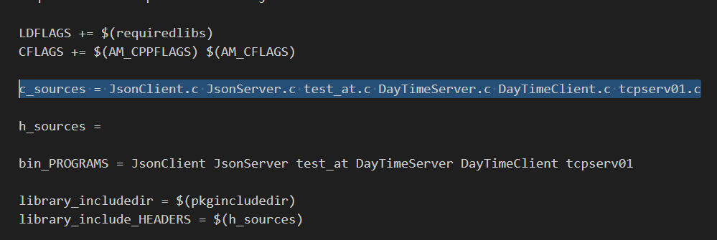
Project example

Slide 23
Thank you for your attention

