Slide 1
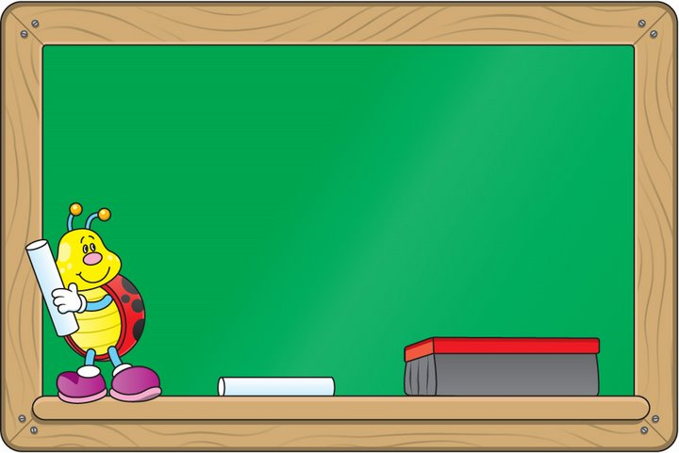
LET’S GO SHOPPING

Slide 2
Vocabulary Words
Budget Gadget
Discount Alteration
Refund Souvenir
Exchange Gift
Warranty Present
Guarantee
Policy
Debit Card
Cashier
Sales Tax
Affordable
Reasonable
Over Price
Salesperson
Durable
Stylish
Unbeatable price
Rock-Bottom-Price
Scarf
Pyjamas
Blouse
Sweater
A pair of shoes
A pair of slippers
A tie
A pair of Scissors
Envelopes
Paper clips
Clipboard
Pencil
Marker Pencil Sharpener
Backpack
Ruler
Briefcase
Calculator
Stapler
Eraser/Rubber
Mango
Cantaloupe
Avocado
Dragon Fruit
Dragon Eyes
Lychees
Cherry
Grape
Mango Steen
Tangerine
Honeydew
Broccoli
Cauliflower
Cabbage
Corn
Eggplant
Green peas
Snow Peas
Avocado
Spinach
Celery
Onion
Nachos
English Muffin
Bagel
Waffles
Pancake
Syrup
Sauce
Ketchup
Soft Tacos
Marshmallows
Preserve canned foods
Appetizer

Slide 3
Useful Expressions about Shopping
How can I help you?
Do you need help with anything?
Do you have this in size…..
I would like/I’d like
Do you have any
Do you have any in stock
Could I please have…
I’m looking for a …..
Do you need anything else today?
Will that be all for you?
Thank you. Have a nice day
That’s a rip-off
I’m just browsing
Let’s go window shopping
Cash or Credit Card
Is there any discount?
Is this on sale?

Slide 4
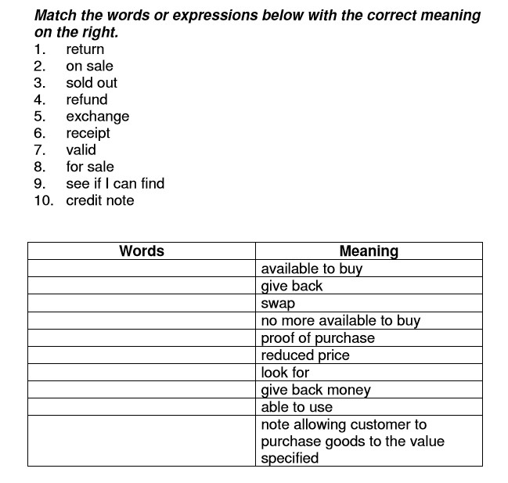

Slide 5
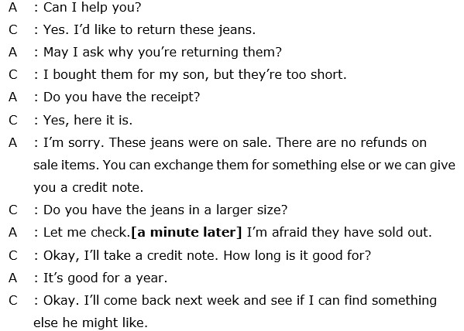
When you Return an Item to a shop

Slide 6
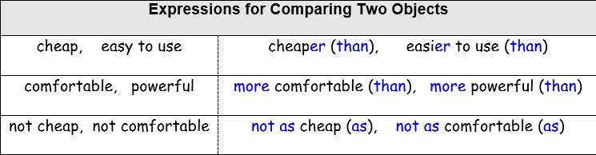

Slide 7
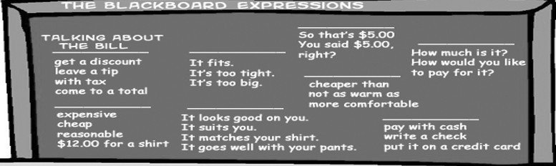

Slide 8
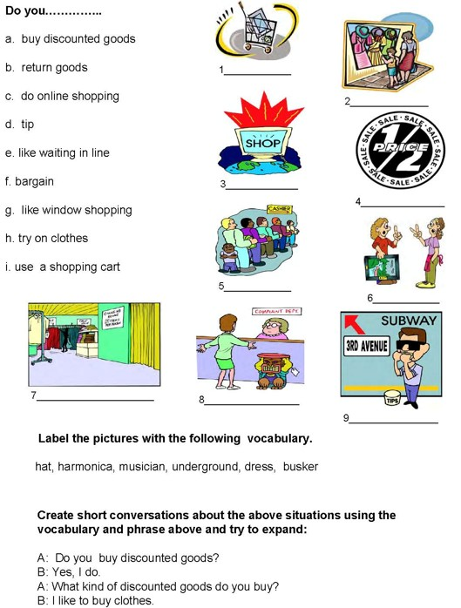

Slide 9
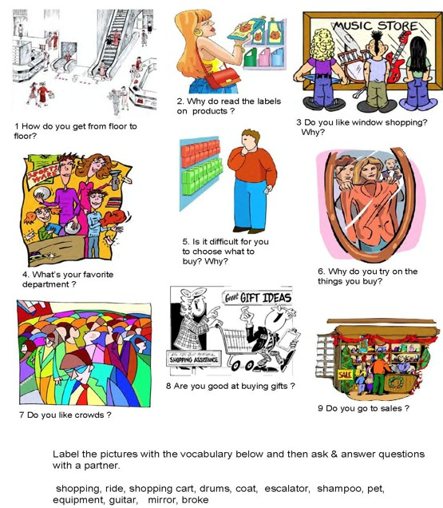

Slide 10

Number the lines in the correct order.
__Yes. How much is this baseball cap, please?
___Here you are.
___Good morning! Can I help you?
___That’s 10 pounds, then, please.
___Anything else?
___Can I have two baseball caps, please?
___It’s five pounds.
___Thank you.
___No, Thank you.
___Good bye.

Slide 11
Number the lines in the correct order.
2. Yes. How much is this baseball cap, please?
8. Here you are.
1. Good morning! Can I help you?
7. That’s 10 pounds, then, please.
5. Anything else?
4. Can I have two baseball caps, please?
3. It’s five pounds.
9. Thank you.
6. No, Thank you.
10. Good bye.

Slide 12
Role-play: Shopping
In this activity I'd like students to remain in their respective group as previous activity to create a drama (role-play) on the topic of Shopping. You will need to use props （道具）for your drama play. This drama should last no more than 5-8 minutes long and should be well prepared. Each student's should speak more than 10 sentences and ask over 10 questions during the role-play, I do not want a stand-up dialogue where all of you just talk or one person ask and one answer only, it should be interactive. Absolutely no reading from the paper or mobile phone, no Chinese, and there must be eye contact when talking with each other...
Your score will be given base on the cooperation of the team, grammar, pronunciation, vocabulary, content, and performance.
Here are some topics I suggest or you may choose your own:
Shopping for clothes
Shopping for household necessities
Shopping for shoes
Shopping for Computer
Grocery shopping
Birthday gift
School necessities

Slide 13
