Slide 1
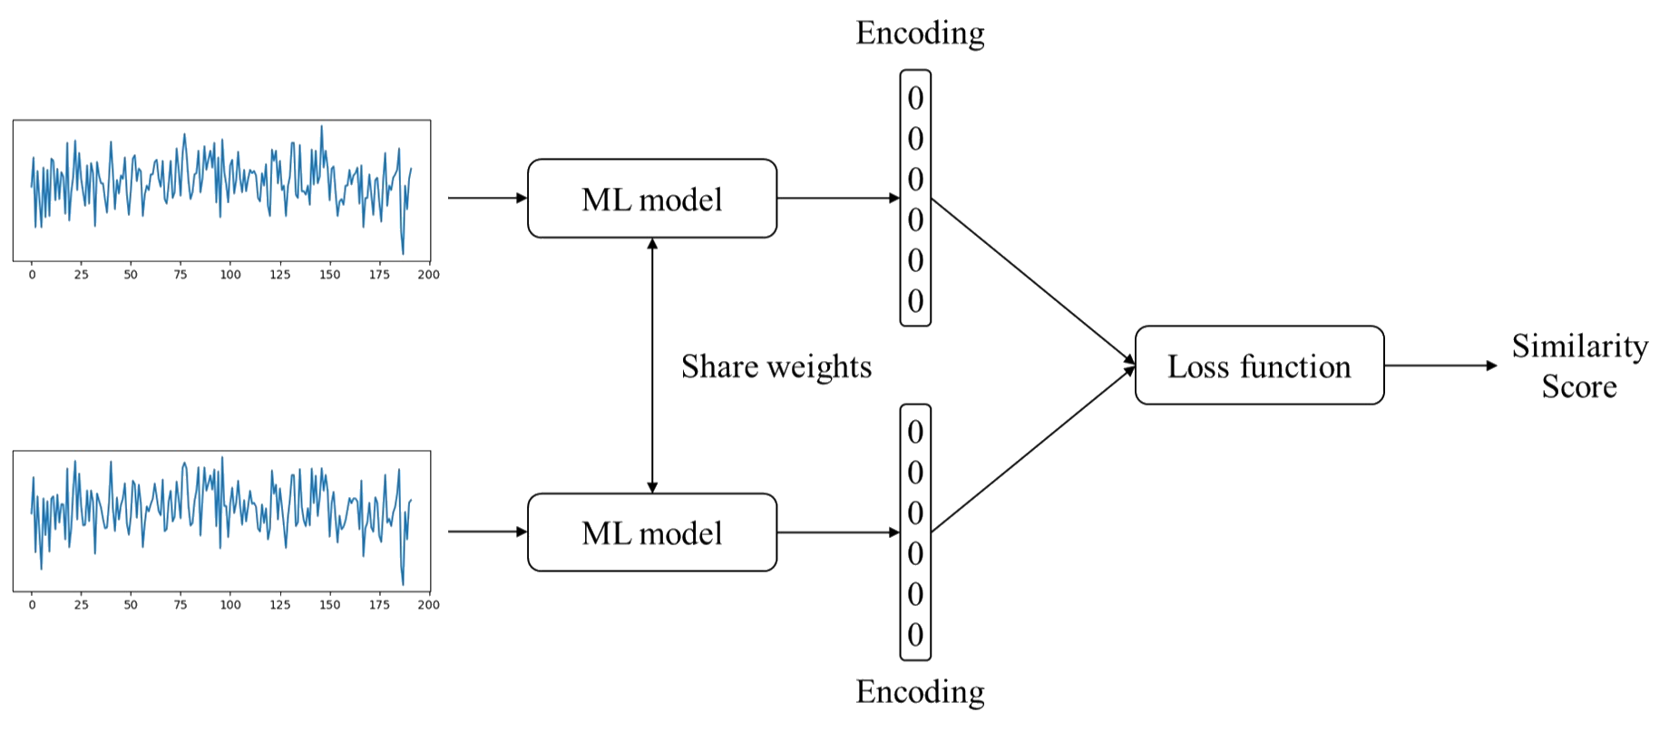
Preliminary
Introduction
Related Work
Proposed Method
Experiments
Discussion
Conclusion
Siamese Networks represent a common architecture used in self-supervised learning, which allows the comparison of two input samples through shared parameters weight.
Model can learn to identify useful features and representations from the input data, which can be used for a variety of downstream tasks.

Slide 2
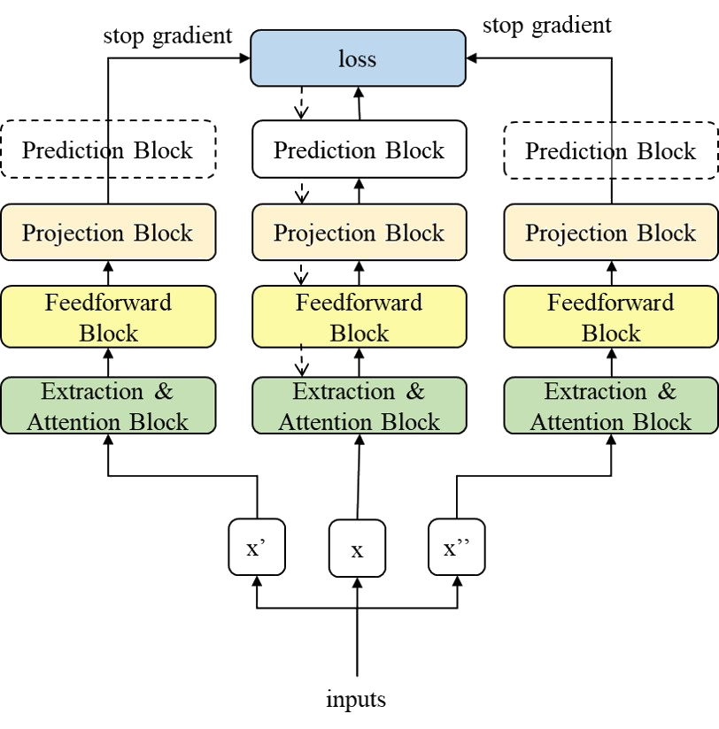
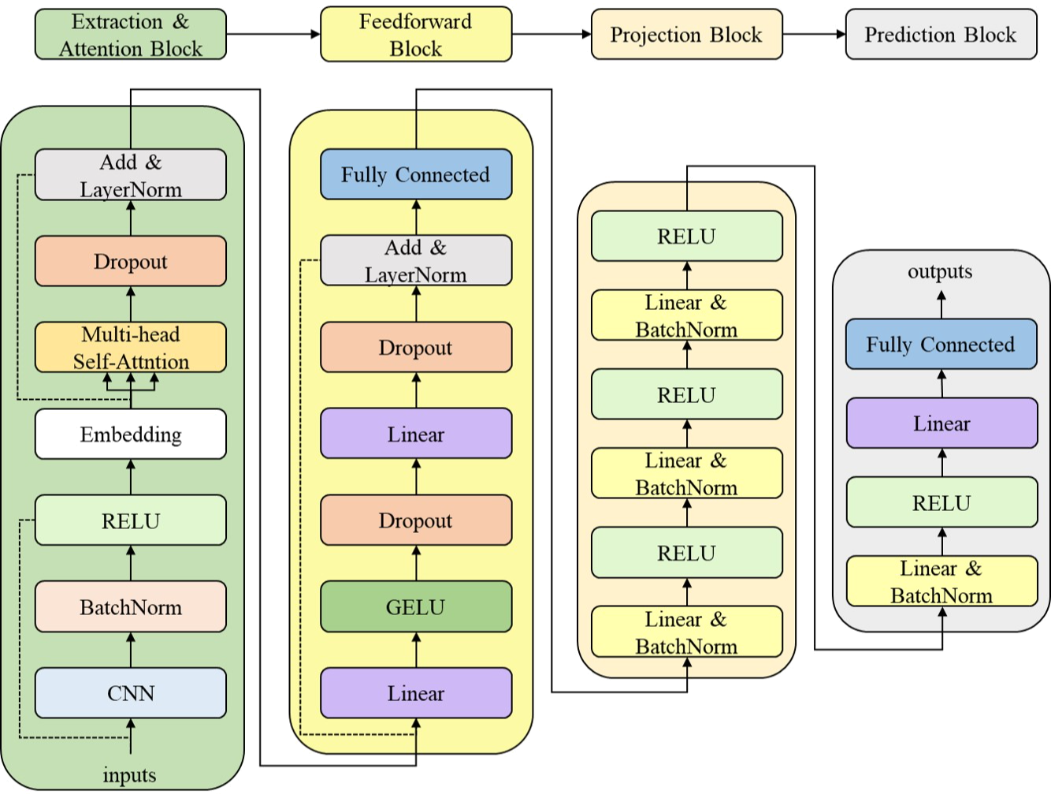
Proposed Framework
Introduction
Related Work
Proposed Method
Experiments
Discussion
Conclusion

Slide 3
Feature Extraction
Introduction
Related Work
Proposed Method
Experiments
Discussion
Conclusion
The wavelet packet transform (WPT) is a technique that is used to decompose a signal into its frequency components.
It starts by analyzing the signal at the highest frequency band, then subdividing the signal into smaller segments, and analyzing each segment at a lower frequency band.
The main advantages of the WPT over the Fourier transform is its ability to provide a more detailed analysis of the signal by allowing for the analysis of different frequency bands at different levels of resolution.

Slide 4
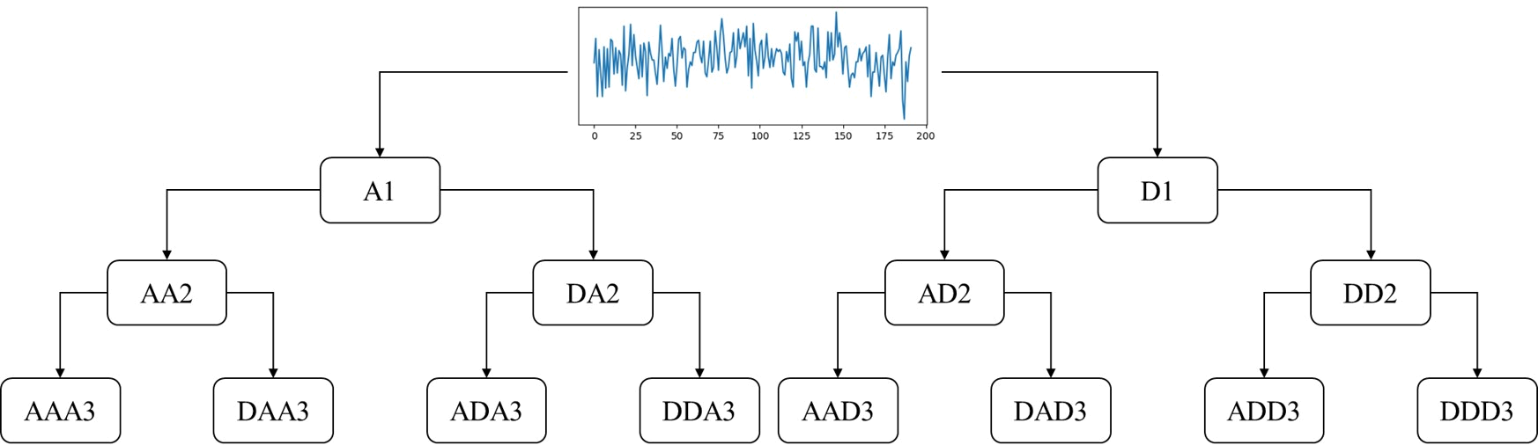
Feature Extraction
Introduction
Related Work
Proposed Method
Experiments
Discussion
Conclusion
We apply WPT using the following steps:

Slide 5
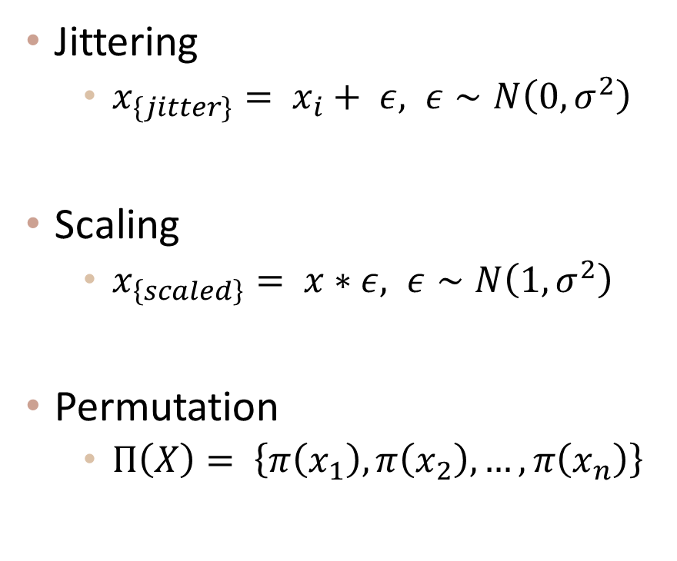
Data Augmentation
Introduction
Related Work
Proposed Method
Experiments
Discussion
Conclusion
Jittering
$x_{\{jitter\}}= x_{i}+ ε, ε∼N\left(0, σ^{2}\right)$
Scaling
$x_{\left\{scaled\right\}}= x∗ε, ε∼N\left(1, σ^{2}\right)$
Permutation
$Π\left(X\right)= \left\{π\left(x_{1}\right), π\left(x_{2}\right), …, π\left(x_{n}\right)\right\}$
Magnitude warping
dividing data by the standard deviation of the reference signal
Time warping
stretching or compressing data by the reference signal

Slide 6
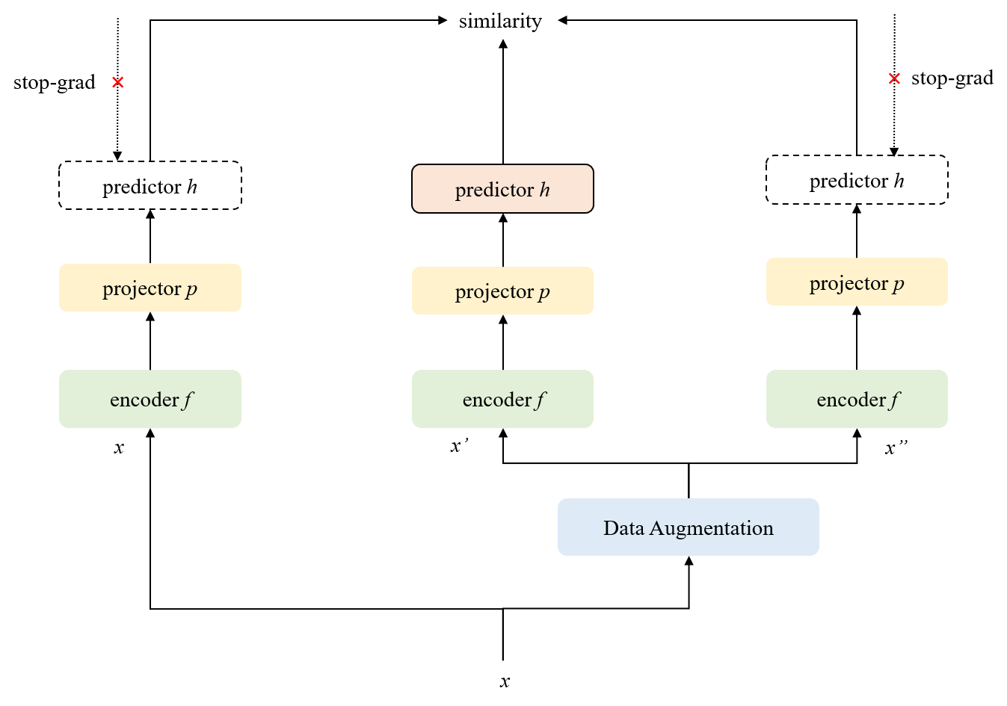


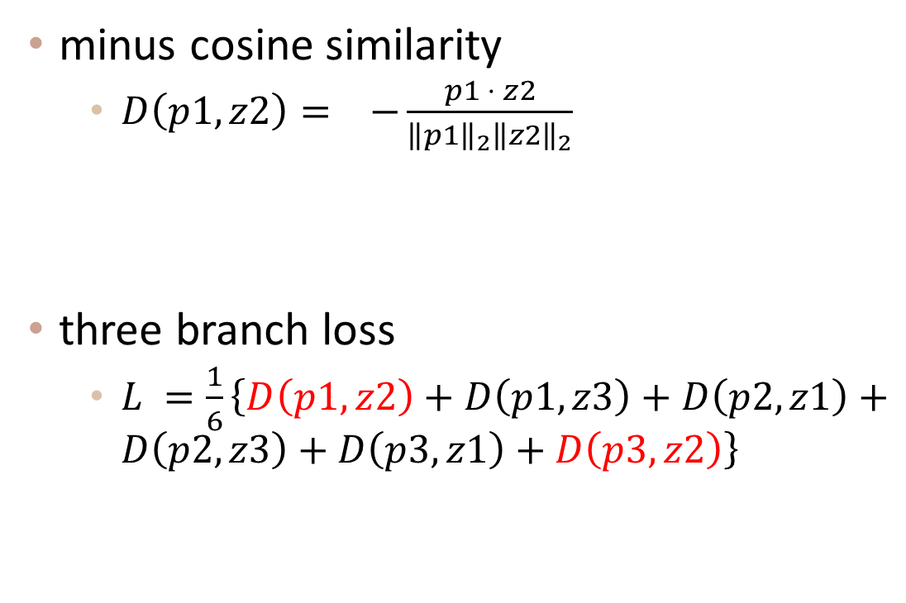







Loss Function
Introduction
Related Work
Proposed Method
Experiments
Discussion
Conclusion
minus cosine similarity
$D\left(p1,z2\right)= −\frac{p1 ⋅ z2}{{\left\|p1\right\|}_{2}{\left\|z2\right\|}_{2}}$
three branch loss
$L =\frac{1}{6}\left\{D\left(p1,z2\right)+D\left(p1,z3\right)+D\left(p2,z1\right)+D\left(p2,z3\right)+D\left(p3,z1\right)+D\left(p3,z2\right)\right\}$
$$p1$$
$$z2$$
$$θ$$
$$z1$$
$$z2$$
$$z3$$
$$p1$$
$$p2$$
$$p3$$

Slide 7
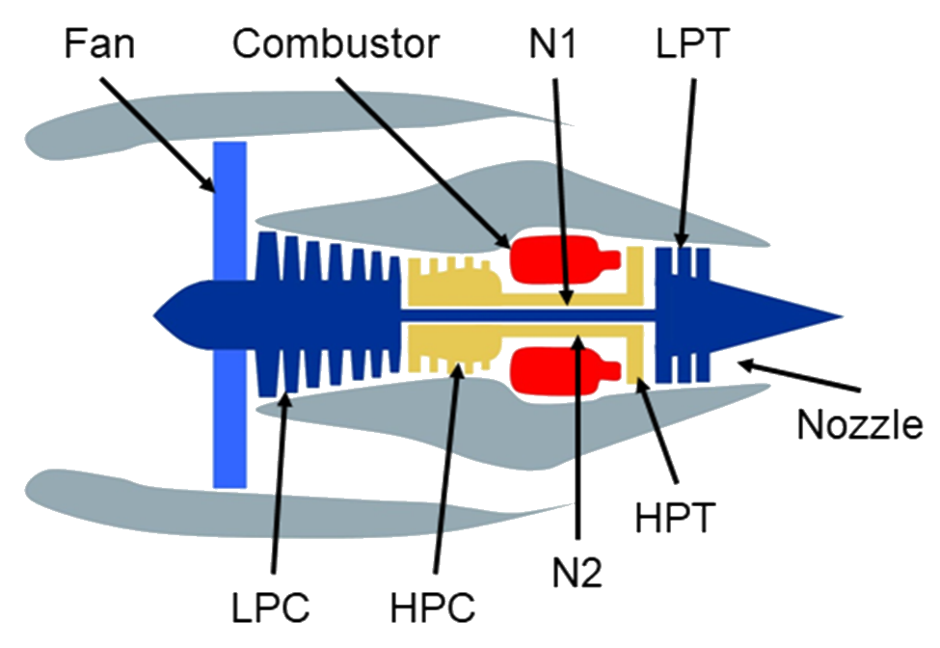
Dataset -- NASA-CMAPSS dataset
Introduction
Related Work
Proposed Method
Experiments
Discussion
Conclusion
index | Symbol | Description | Units
1 | T2 | Total temperature at fan inlet | °R
2 | T24 | Total temperature at LPC outlet | °R
3 | T30 | Total temperature at HPC outlet | °R
4 | T50 | Total temperature at LPT outlet | °R
5 | P2 | Pressure at fan inlet | psia
6 | P15 | Total pressure in bypass-duct | psia
7 | P30 | Total pressure at HPC outlet | psia
8 | Nf | Physical fan speed | rpm
9 | Nc | Physical core speed | rpm
10 | epr | Engine pressure ratio | –
11 | Ps30 | Static pressure at HPC outlet | psia
12 | Phi | Ratio of fuel ﬂow to Ps30 | pps/psi
13 | NRf | Corrected fan speed | rpm
14 | NRc | Corrected core speed | rpm
15 | BPR | Bypass ratio | –
16 | farB | Burner fuel-air ratio | –
17 | htBleed | Bleed enthalpy | –
18 | Nf_dmd | Demanded fan speed | rpm
19 | PCNfR_dmd | Demanded corrected fan speed | rpm
20 | W31 | HPT coolant bleed | lbm/s
21 | W32 | LPT coolant bleed | lbm/s
Source : Multiple Sensors Based Prognostics With Prediction Interval Optimization via Echo State Gaussian Process

Slide 8
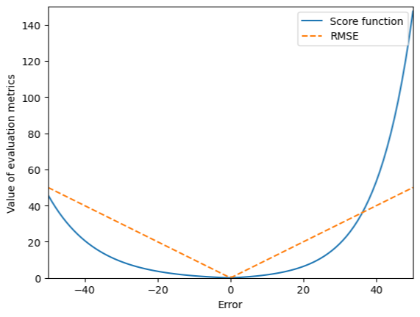
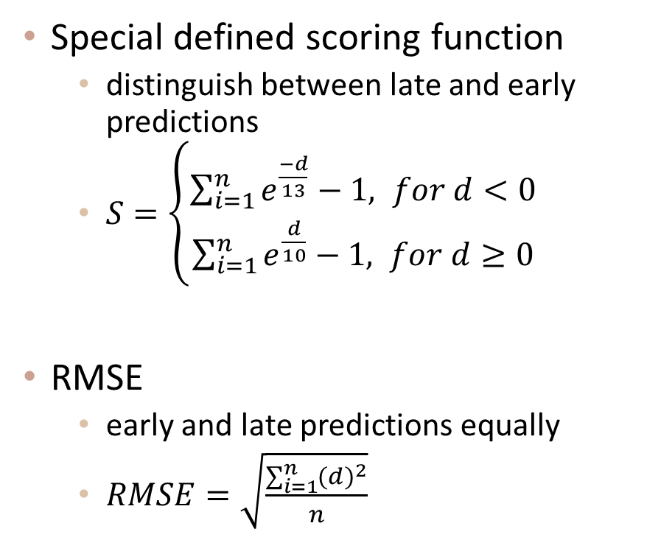
Evaluate Metrics
Introduction
Related Work
Proposed Method
Experiments
Discussion
Conclusion
Special defined scoring function
distinguish between late and early predictions
$S=\left\{\begin{matrix}\sum_{i=1}^{n}{e^{\frac{−d}{13}}−1, for d<0} \\ \sum_{i=1}^{n}{e^{\frac{d}{10}}−1, for d≥0}\end{matrix}\right.$
RMSE
early and late predictions equally
$RMSE=\sqrt{\frac{\sum_{i=1}^{n}{{(d)}^{2}}}{n}}$
$d$ represents the difference between the predicted RUL and the true RUL

