Slide 1
Single Shot Multibox Detector SSD
Teacher :Jyh-Ching Juang
Student : Jia-Nian Chen

Slide 2
Outline
Introduction
Benchmark
Goal
VGG16 & AlexNet
Architecture SSD
Conclusion
Reference

Slide 3
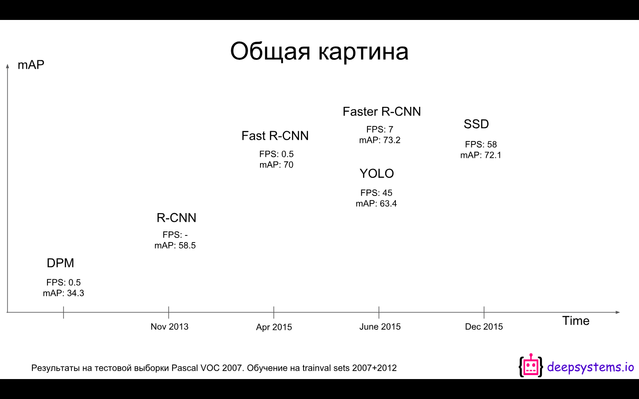
Introduction-Benchmark

Slide 4
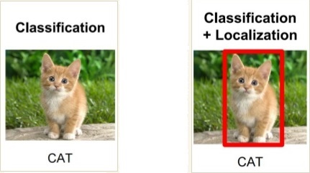
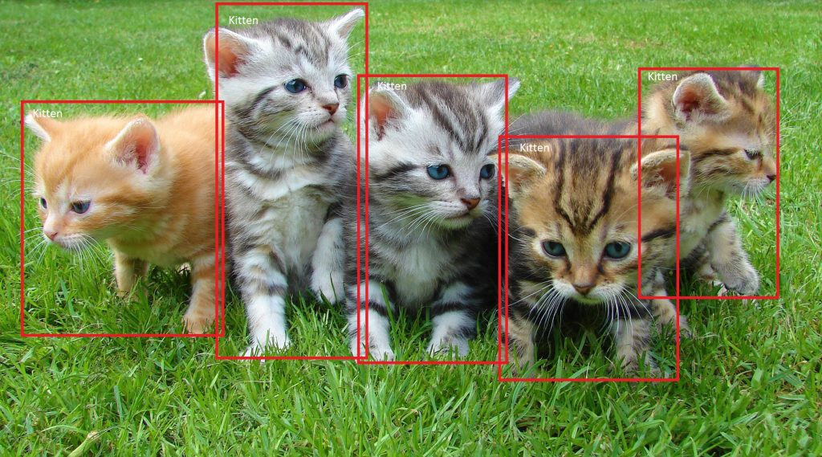
Introduction-Goal

Slide 5
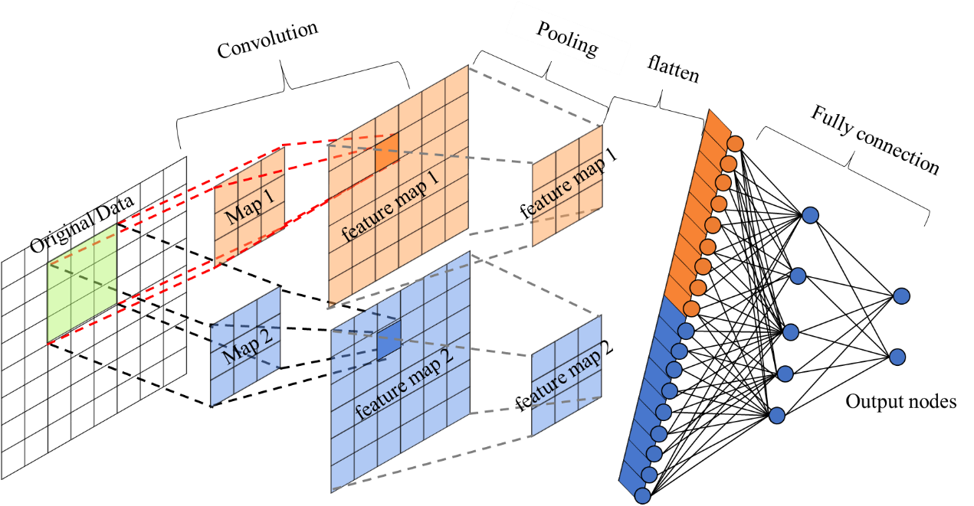
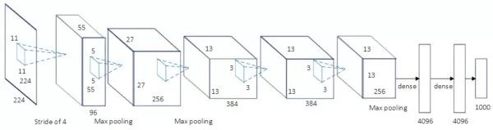
Introduction-VGG16
Oxford : Visual Geometry Group
Goal: Increasing the depth of the network affect network performance
Architecture
3*3 kernel map
2*2 pooling

Slide 6
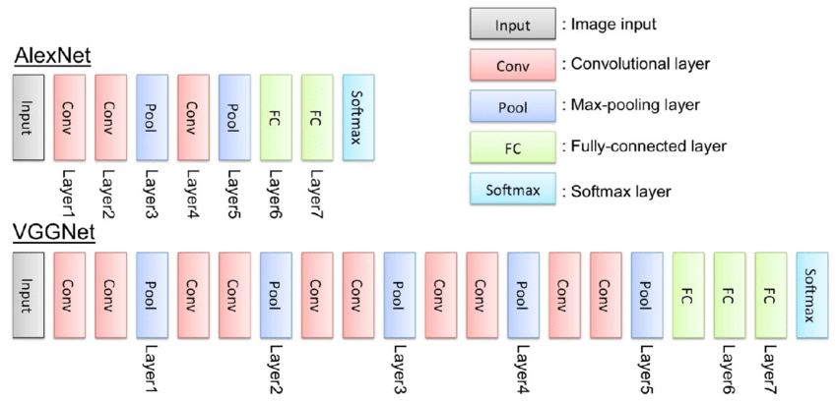
VGG16 v.s. AlexNet
AlexNet : Layer1 : 11*11 Layer1 : 5*5 kernel map
VGG16 : 3*3 kernel map

Slide 7
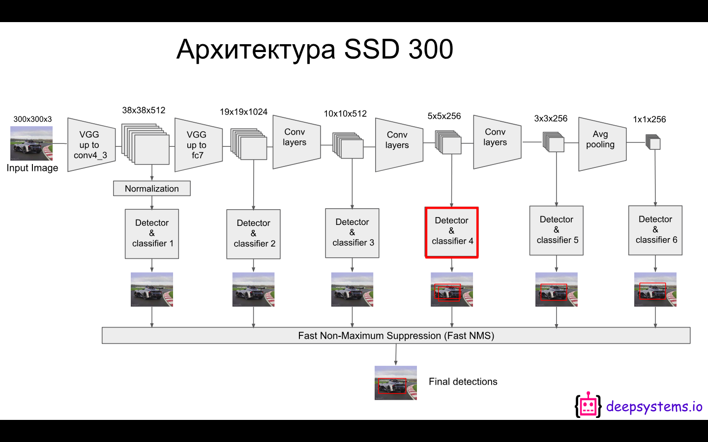
Architecture-SSD

Slide 8
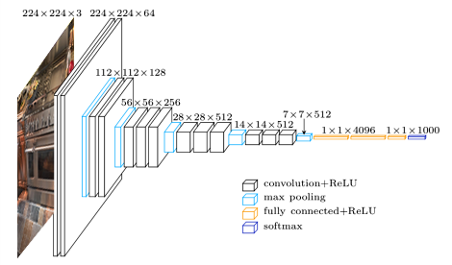
Architecture-SSD
Notes:
Softmax 将向量 等比例压缩 到 [0, 1]之间，且保证 所有元素之和 为1 。

Slide 9
Architecture-SSD

Slide 10
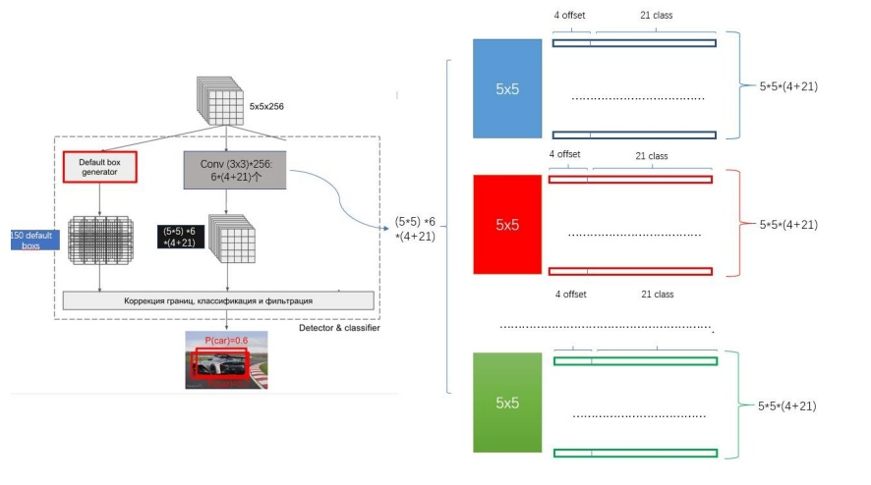
Architecture-SSD

Slide 11
Architecture-SSD

Slide 12
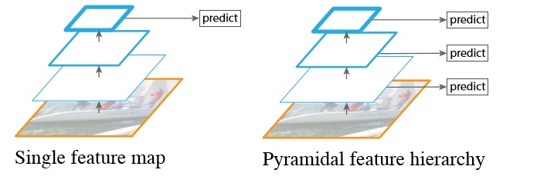
Architecture-SSD

Slide 13
Architecture-SSD

Slide 14
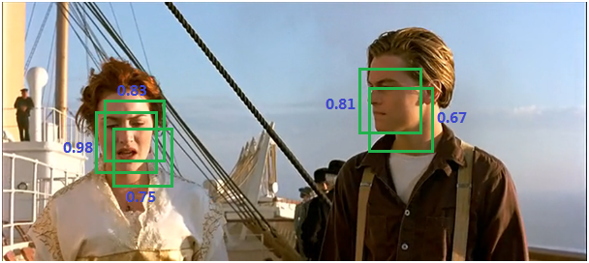
Architecture-SSD-NAMs

Slide 15
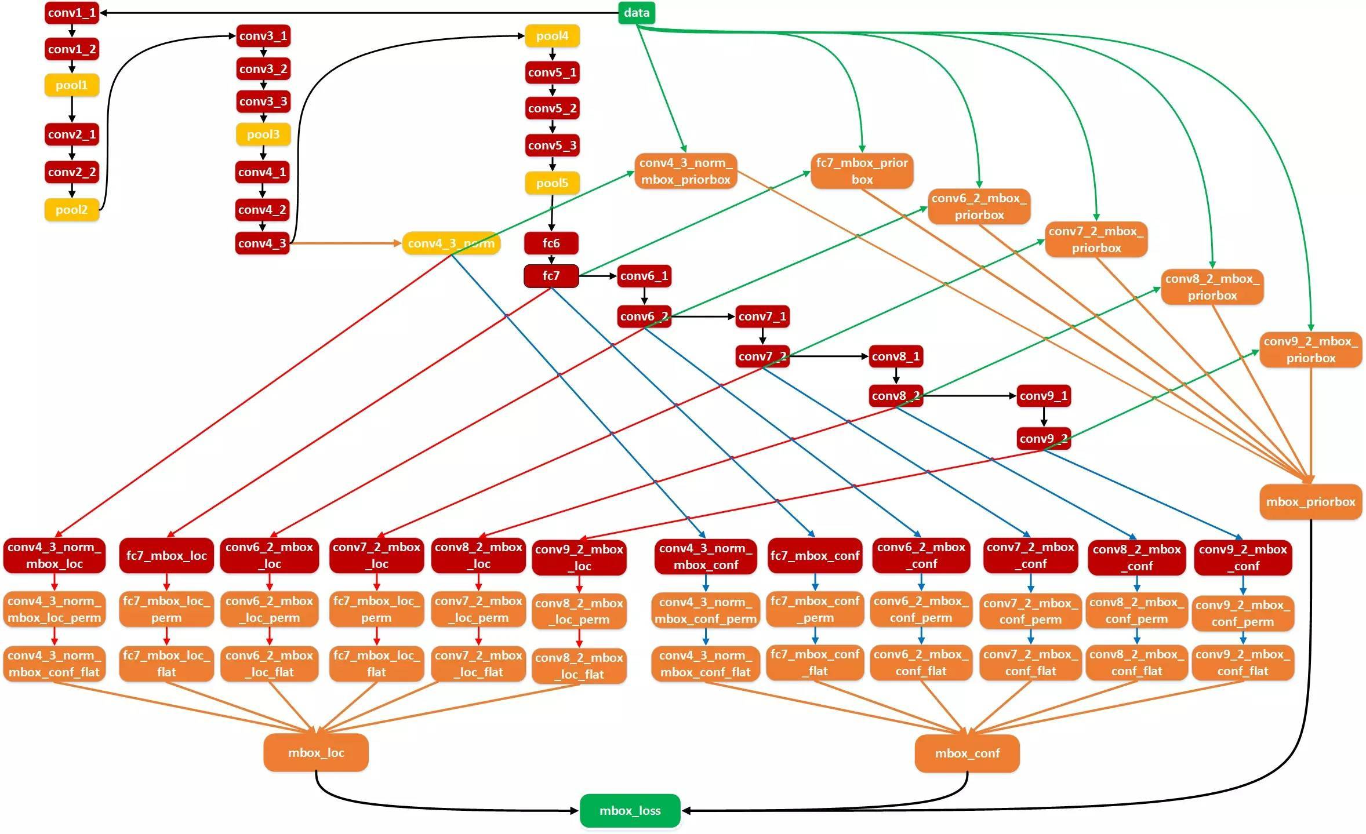
Architecture-SSD

Slide 16


Default Box Parameter

Slide 17
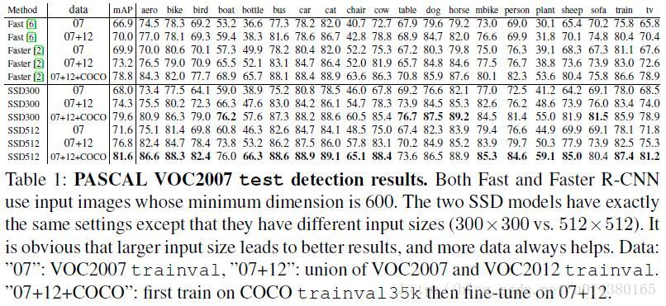
Conclusion

Slide 18
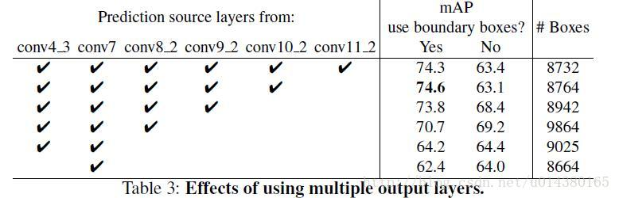
Conclusion

Slide 19
Reference
Paper : https://arxiv.org/pdf/1512.02325.pdf
Deepsystem.io : https://goo.gl/g7JoxV
Non Maximum Suppression : https://blog.csdn.net/shuzfan/article/details/52711706
SSD Blog : https://zhuanlan.zhihu.com/p/31427288
SSD Blog : https://blog.csdn.net/wfei101/article/details/78176322

