Slide 1
Algorithms & Data Structures (M)
2025-2026
Prof Alice Miller
Office: S133 (second floor, Lilybank Gardens)
Moodle: Computing Science → Algorithms & Data Structures (M)
© 2008 David A Watt, University of Glasgow

Slide 2
Aims
To study the concepts of:
algorithms
  and how to analyse their efficiency.
abstract data types (ADTs)
  the ADTs most commonly used in software development (stacks, queues, lists, sets, maps).
data structures
  most commonly used to represent these ADTs (arrays, linked-lists, binary-search-trees, hash-tables)
  + algorithms operating on these data structures.

Slide 3
This is what the course leads to…
e.g.
push, pop
e.g.
getFirst, addLast
e.g.
get(i),
iterate
e.g.
contains, addAll
e.g.
put, putAll
operations:
ADTs:
stack
queue
list
set*
map*
implementation
data structure:
array
binary search tree
hash table
linked list
It won’t mean anything now – but print it out and put it on your wall – we will gradually get there!

Slide 4
Contents (Rough plan)
Topic
Introduction Week 1
Algorithms and Complexity Week 1-2
The Array Data Structure Week 2-3
Linked-List Data Structures Week 4
Abstract Data Types (ADTs) Week 5
Stack ADT Week 5
Queue ADT Week 5
List and Iterator ADTs Week 6
Set ADT Week 7
The Binary-Search-Tree Data Structure Week 8
10A. AVL trees Week 9
11. Map ADT Week 10
12. Hash-Table Data Structures Week 10

Slide 5
Course operation: synchronous sessions
One live session with me:
Monday 15:00-17:00. Live lecture summaries (i.e. not dwelling on code), Q&A and examples.
Thurs 15:00-16:00 and 17:00-18:00
  Labs Labs
Class rep: ?

Slide 6
Course operation: asynchronous delivery 1
Lecture slides and videos and lab (tutorial) questions
  All available via Moodle
  Material divided into sections (see next slide for example)

Slide 7
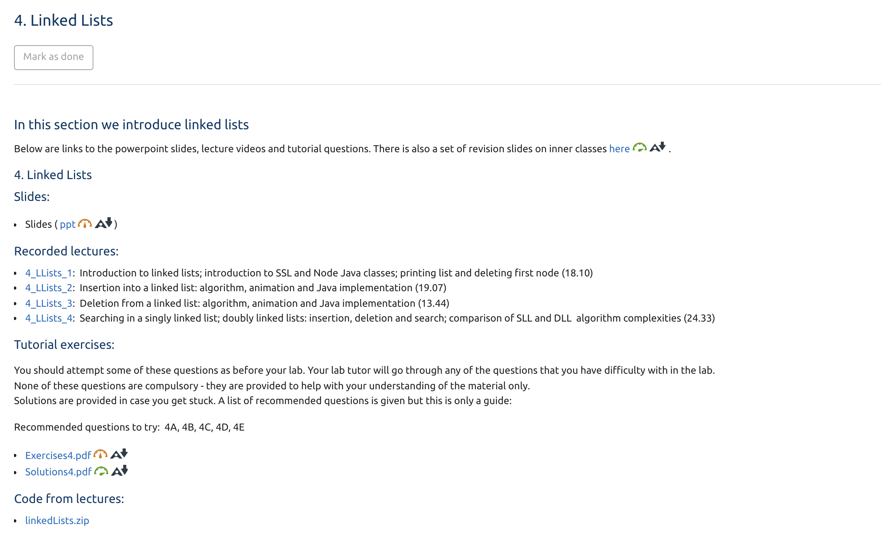

Slide 8
Course operation: asynchronous delivery 2
Lecture slides and videos.
  You should work through these at your own pace. A suggested schedule (colour codes) is given on slides 4 and 15, but you may wish to go faster one week and slower the next.
  I will make material available for several weeks ahead.
Tutorial questions
  There are a lot of these (provided for each section)
  Suggestions given for which to do
  Will be used in the tutorial/labs, but they are there for you to look at when you have been through the videos/slides for each section. They are not compulsory. Don’t prepare complete solutions for them all, just use them to force you to think about the material (and sketch out solutions). Solutions provided if you get stuck.

Slide 9
Course operation important points:
The videos include a lot more clarification than the slides themselves, so make sure you watch them the first-time round.
A 10-credit course demands 100 hours of effort (not including exams). So, you should be spending more than the allotted 3 hours a week going through the material
Tutorials/labs (see next slide) are very different to ProgIT labs. It is:
    not a case of “here is a sheet of questions you must do them and sit at a computer writing Java”
    More a case of “think about how things are working and draw pictures/sketch out some algorithms”
    Programming/Coding should not be done in the lab sessions.

Slide 10
Tutorials/labs
You will have 1 hour per week for lab/tutorial class (Thursdays).
Although it’s referred to as a lab (as it’s in the lab), it’s more of a tutorial
Your tutor may go through some of the tutorial questions on the board ASK THEM if you want them to do this
Will be as interactive as possible (that’s up to you!)
First labs are this Thursday (Thursday 15th)
  All labs are live – the tutor will roam amongst you and ask you questions about what you are doing. They may also go through some of the solutions on the board or in a small group
. This Thursday, start looking at the questions in the Introduction section. 1A, 1B, 1D, 1F

Slide 11
Tutorials/labs continued
There are two tutors: Danielius Sukys and Frekerik Glitzner.
All tutors will be in both lab groups
I will also come along to the labs and help out if busy
Don’t just sit in lab and work on an assessment for another course
  Or far away from the rest of the class – or I might not know you are part of the class
  We will throw people out of the lab if they are not doing ADSIT work and the lab is busy

Slide 12
Office hours
I will be available Thursday 12:00-13:00 for office hour. Just come along to my office – (S133) or pre-arrange a teams meeting. See map on next slide.
But I can only guarantee to be free if you let me know that you are coming at a certain time (email me or send me a message via teams). Happy to meet at other times by appointment.
Meanwhile you can leave questions on the Q&A padlet for me, but I will only answer when free (I won’t be available 24 hours a day!). You can also answer questions on there, and I will pick questions from there to address in the Q&A sessions

Slide 13
Map to my office
Entrance Sir Alwyn Williams Building
Level 0 Sir Alwyn Williams Building
Teaching office
Stairs
Stairs (or lift) to level S (LBG)
(second floor – not 2)
robot
Lift
Level S Lilybank Gardens
stairs
S162
S133

Slide 14
Assessment
Assessed Exercise – single exercise, will be handed out 9/3/2025*. Hand in Mon 23/3/2025 by 16.30 (but it should take you around 6-8 hours to complete)
  weight = 0.2
Examination (this will be computer based but supervised in the lab)
  weighting 0.8.
  Probably quiz/multiple choice (sample exam will be available on Moodle). Will let you know nearer the time. The resit will be non-multiple choice.
* Subject to change. Waiting on confirmation from the school. Will probably release earlier than that date.

Slide 15
Timetable will be on Moodle (it might change)

Slide 16
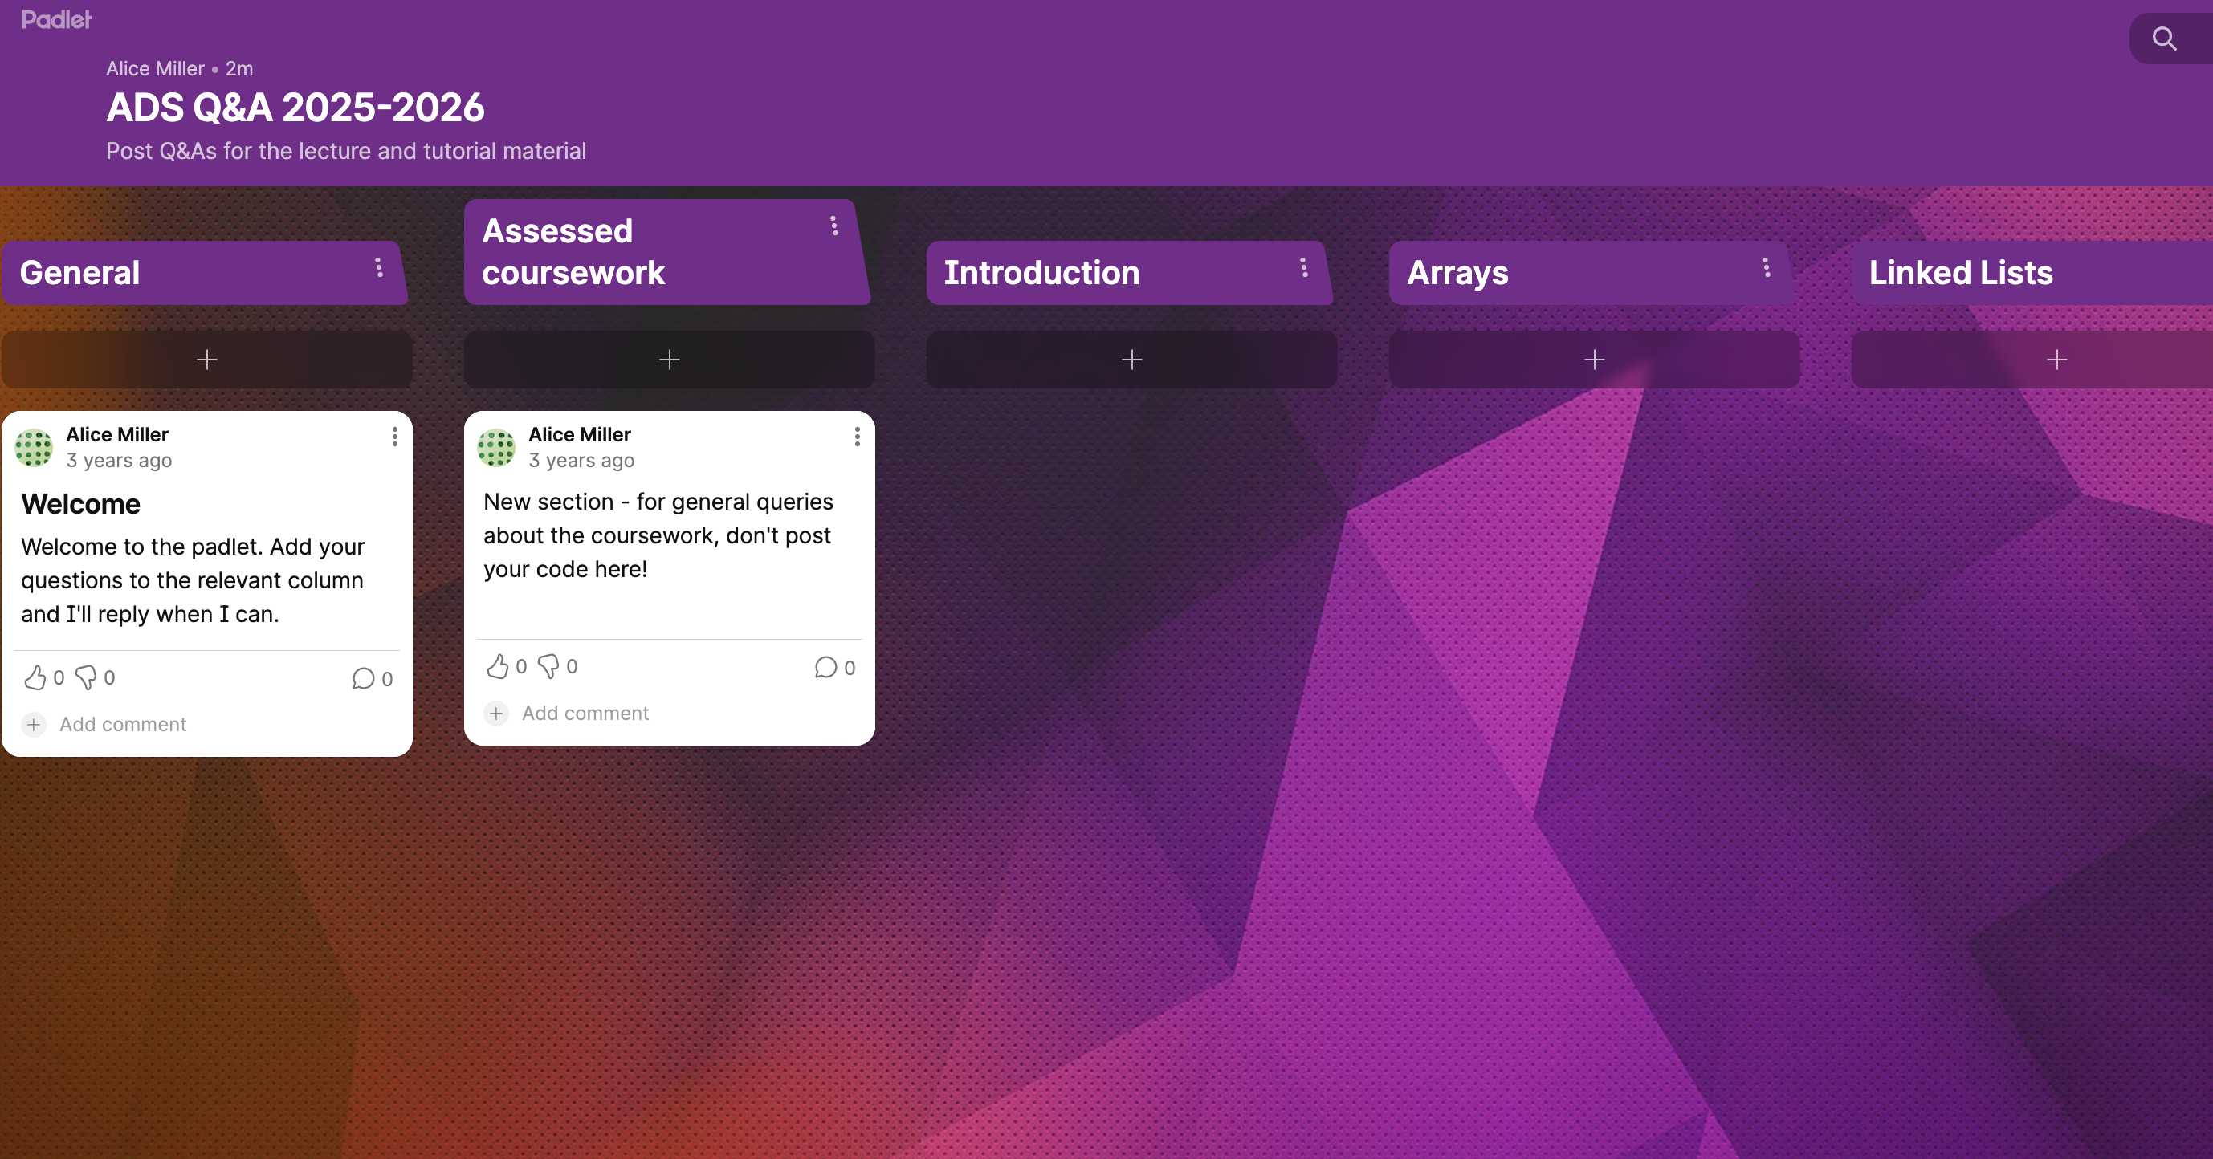
Q&As via padlet
  For you to ask general questions, or questions about any of the topics
  Ask in the correct column
  If a longer answer or explanation required, I may defer to lecture/Q&A session on the following Friday
  You can answer questions as well as ask them (I’ll monitor your answers…). I will respond when I am available, tutors will too
  Keep it polite and respectful! Link is: https://padlet.com/alicemiller3/ads-q-a-2025-2026-fnbhdf932ndafahv

Slide 17
What should I do now?
After this lecture start going through the slides and videos
  There are also revision slides – (adding, logs, generics) refer to these when you need to (most people will be unfamiliar with logs so read this one first if that is you)
  This week’s lab will be on the introduction and the start of the arrays – so take a look at the relevant questions beforehand. The assumption is that you will have also looked at the first part of the arrays slides before the lecture next week (I’ll clarify every week at the lecture).
  Remember the schedule is only a guide
Drop into my office hour on Thursday if you want a chat (helps if you let me know when you are coming, to make sure I am there).
  Will be nice to meet you. I can see how you are getting on – and sort out any early problems,
This Thursday: labs, Next Monday: Q&A+lecture

Slide 18
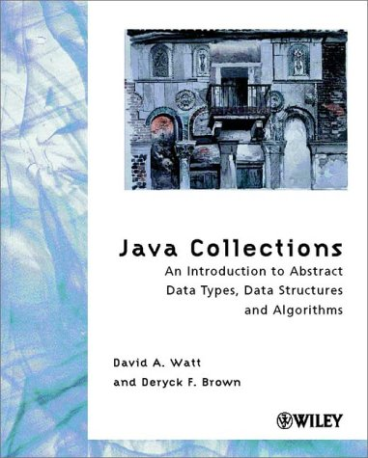
Reading (1)
D.A. Watt & D.F. Brown
Java Collections
Wiley (2002)
  Useful if you can get hold of a 2nd
  hand copy but I wouldn’t rush out and
  buy
    Doesn’t cover generic classes
    Some of the later example programs
  are not “correct” (we’ll discuss this later
  in the course).

Slide 19
Reading (2)
M.T. Goodrich & R. Tamassia
Data Structures and Algorithms in Java (4th edn)
Wiley (4th edition 2006 or later)
  optional background reading
  (more advanced and mathematical)
Any algorithms and data structures book using Java from the library
C. Horstmann, Big Java (3rd edn), Wiley (2008)
  supplementary reading on Java
  (covers interfaces, collections, inner classes, generic classes, etc.)
  You might have this already

Slide 20
Summary of chapters 1&2
Chapter 1: introduction
  Whistle-stop tour of the concepts of algorithms, data structures and ADTs.
  Don’t expect to understand this in detail – but refer back to this lecture throughout the course
  Some example algorithms and algorithm notation (will do algorithms in chapter 2)
  Some example data structures – we will introduce linked lists in chapter 4
  Brief introduction to the idea of ADTs – will do this properly in chapter 5
  Example ADTs (list and set) and how we use Java versions of them – very advanced (chapters 8 and 9) – novice programmers think they understand it when they don’t
Chapter 2: algorithms and complexity
  Introduction to principles of algorithms (some repetition from ProgIT)
  Gentle informal intro to efficiency analysis (how can we compare two algorithms)
  More formal approach
  Lots of examples – refer back to the revision lectures on adding and logs if you get confused
  Big O notation

