Slide 1
13. GeNERAL Algorithms
Algorithms & Data Structures (M)
Some algorithms out of the context of ADTs
Graphs:
Depth-first search and breadth-first search
Shortest path
Bin packing

Slide 2
Introduction –why these slides
There are some common algorithms that you might be asked about in a job interview (for example)
Many of these are graph-based
Just a few slides so far, may extend in future years
I will not go through the slides completely. But the bin packing slides are examinable (rest are not).

Slide 3
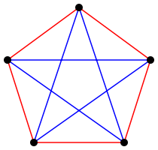
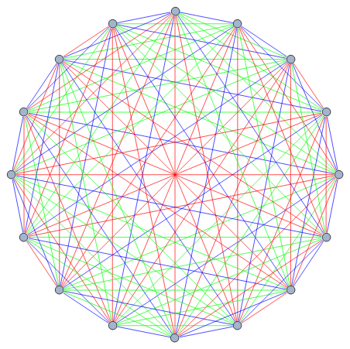
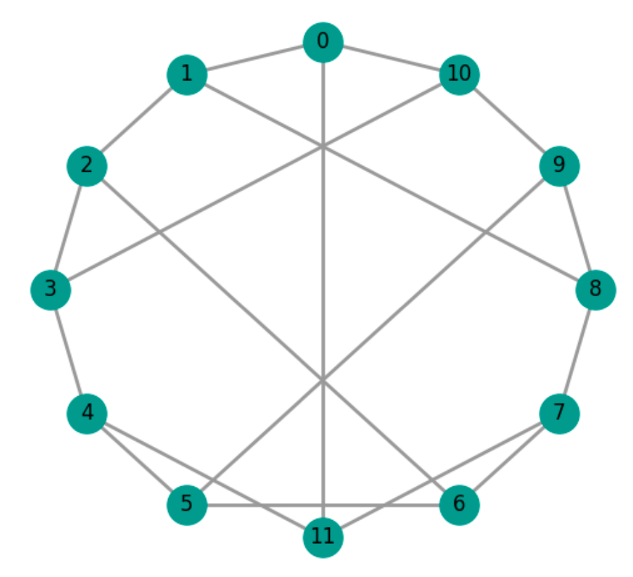
Graphs
A graph G consists of a set of vertices V and a set of edges E
A tree is a graph that has no cycles
Examples:
With labelled vertices

Slide 4
Graph traversal (2)
A graph traversal algorithm could reach the same vertex along several different paths.
So it must “mark” each vertex the first time it is reached, to avoid visiting the same vertex repeatedly. (Otherwise traversal of a cyclic graph would never terminate.)
Alternative ways to mark vertices:
  Store a boolean flag in each vertex, initially false. To mark a vertex, set this flag to true.
  Maintain a separate set of vertices, initially empty. To mark a vertex, add it to this set.

Slide 5
Depth-first traversal (1)
Depth-first traversal will traverse one possible path as far as possible, before traversing any alternative paths.
Illustration (starting from London):
Belfast
√
√
√
Possible order of visits:
Liverpool
Manchester
Leeds
London
Dublin
√
√
Bristol
Birmingham
Rugby
Swansea
√
√
√
Birmingham
Swansea
Bristol
London
Manchester
Liverpool
Leeds
Rugby

Slide 6
Depth-first traversal (2)
Depth-first graph traversal algorithm:
To traverse graph g in depth-first order, starting at vertex start:
1. Make vertex-stack contain only vertex start, and mark start
as reached.
2. While vertex-stack is not empty, repeat:
2.1. Remove the top element of vertex-stack into v.
2.2. Visit vertex v.
2.3. For each unreached successor w of vertex v, repeat:
2.3.1. Add vertex w to vertex-stack, and mark w as
reached.
3. Terminate.

Slide 7
Breadth-first traversal (1)
Breadth-first traversal will visit all successors of a vertex, before visiting any of their successors. It will traverse shorter paths before longer paths.
Illustration (starting from London):
Possible order of visits:
Belfast
√
√
√
Liverpool
Manchester
Leeds
London
Dublin
√
√
Bristol
Birmingham
Rugby
Birmingham
√
√
Rugby
√
Swansea
Swansea
Bristol
London
Manchester
Leeds
Liverpool

Slide 8
Breadth-first traversal (2)
Breadth-first graph traversal algorithm:
To traverse graph g in breadth-first order, starting at vertex start:
1. Make vertex-queue contain only vertex start, and mark start
as reached.
2. While vertex-queue is not empty, repeat:
2.1. Remove the front element of vertex-queue into v.
2.2. Visit vertex v.
2.3. For each unreached successor w of vertex v, repeat:
2.3.1. Add vertex w to vertex-queue, and mark w as
reached.
3. Terminate.

Slide 9
Graph search (1)
A graph search problem entails finding a path between two given vertices. E.g.:
  Is there a road route from Glasgow to Dublin?
  What is the length of the shortest route from Glasgow to London?
Graph search algorithms are similar to graph traversal algorithms, except that they terminate as soon as a solution is found.

Slide 10
Graph search (2)
Depth-first search will explore one possible path as far as possible, before exploring any alternative paths.
Breadth-first search will explore shorter paths before longer paths.

Slide 11
Shortest path (1)
Problem: Given a road network, find the shortest path between place start and place dest.
Idea:
  Use breadth-first search.
  For each place p, let pred[p] be the predecessor of p on the shortest path so far found from start to p, and let dist[p] be the distance along that path.
  Initialize each dist[p] to ∞ (infinity).
  Thereafter reduce dist[p] (and update pred[p]) whenever a shorter path to p is found.

Slide 12
Shortest path (2)
Shortest-path algorithm:
To find the shortest path through a road network from place start to place dest:
1. Make places contain all places in the road network.
2. Set dist[start] to 0 and set pred[start] to none.
3. For each place p other than start:
3.1. Set dist[p] to ∞ and set pred[p] to none.
4. …

Slide 13
Shortest path (3)
Shortest-path algorithm (continued):
4. While places is not empty, repeat:
4.1. Remove from places the place p with least dist[p].
4.2. If p = dest:
4.2.1. Terminate with the path
«start, …, pred[pred[dest]], pred[dest], dest».
4.3. For each road connecting p and another place q,
such that q is in places, repeat:
4.3.1. Let d be dist[p] + (distance from p to q).
4.3.2. If d < dist[q], set dist[q] to d and set pred[q] to p.
5. Terminate with no path.
At this point, we have already found the shortest path to dest.

Slide 14
Shortest path (4)
Ma
70
Le
Illustration –
shortest path from
Lo(ndon) to Le(eds):
130
170
Bi
60
Ru
140
220
150
Br
190
Lo
dist[Bi]
pred[Bi]
Bi Br Le Lo Ma Ru places
none,∞ none,∞ none,∞ none,0 none,∞ none,∞ {Bi,Br,Le,Lo,Ma,Ru}
Lo,220 Lo,190 none,∞ none,0 none,∞ Lo,150 {Bi,Br,Le,Ma,Ru}
Ru,210 Lo,190 Ru,320 none,0 none,∞ Lo,150 {Bi,Br,Le,Ma}
Ru,210 Lo,190 Ru,320 none,0 none,∞ Lo,150 {Bi,Le,Ma}
Ru,210 Lo,190 Ru,320 none,0 Bi,340 Lo,150 {Le,Ma}
Shortest path is «Lo, Ru, Le».

Slide 15
Bin-packing (1)
Suppose we have a number of objects that are to be placed in bins which have fixed capacity
Objects have different sizes, and we want to use as few bins as possible
…but there is no limit to the number of bins available
What is the most efficient way to pack the bins? We want to minimise wasted space (and consequently minimise the number of bins required).
There are various simple algorithms to use
No one method is best for all data

Slide 16
Bin packing (2)
Algorithms include:
Best fit: place next item into the bin with the maximum load it fits into (or open a new bin)
Worst fit: place next item into the bin with the minimum load it fits into (or open a new bin)
First fit: place next item into the first bin it will fit into (or open a new bin)
(there are many more)
Lower bound on number of bins used is cei[(total load)/capacity]
ceiling (a) = smallest integer >= a
Measure of how well an algorithm packs the bins:
average waste =
(total unused space in used bins)/(number of bins used)
Examples, see over

Slide 17
Example 1
loads = {9,5,6,1,7,2,4,1};
Lower bound for number of bins is 4.00
Using first fit bins contain: [10, 8, 10, 7]
Average waste is: 1.25
Using best fit bins contain: [10, 5, 10, 10]
Average waste is: 1.25
Using worst fit bins contain: [9, 8, 10, 8]
Average waste is: 1.25

Slide 18
Example 2
loads = {1,2,3,4,5,6,7,8,9,5,1,4};
Lower bound for number of bins is 6.00
Using first fit bins contain: [10, 10, 7, 7, 8, 9, 4]
Average waste is: 2.14
Using best fit bins contain: [10, 10, 10, 7, 8, 10]
Average waste is: 0.83
Using worst fit bins contain: [10, 10, 7, 7, 8, 9, 4]
Average waste is: 2.14
See generalAlgorithms/binPacking.java (or write your own!)

