Slide 1
UrbanSound Classification
(ECE228 SP2020 Final Project)
Group Number: 13
Group Members: Hangquan Zhao
Tianyu Zhao
Wei Wang

Slide 2
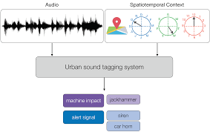
Background
The problem it can solve
Hangquan Zhao
monitoring of noise pollution at city scale
description of acoustic environments
broadening citizen participation in noise reporting
enabling city agencies to work effective for noise mitigation
Notes:
The automatic classification of environmental sound is a growing research field with multiple applications to largescale, content-based multimedia indexing and retrieval.
create technological solutions for: (1) the systematic, constant monitoring of noise pollution at city scale; (2) the accurate description of acoustic environments in terms of its composing sources; (3) broadening citizen participation in noise reporting and mitigation; and (4) enabling city agencies to take effective, information-driven action for noise mitigation.

Slide 3
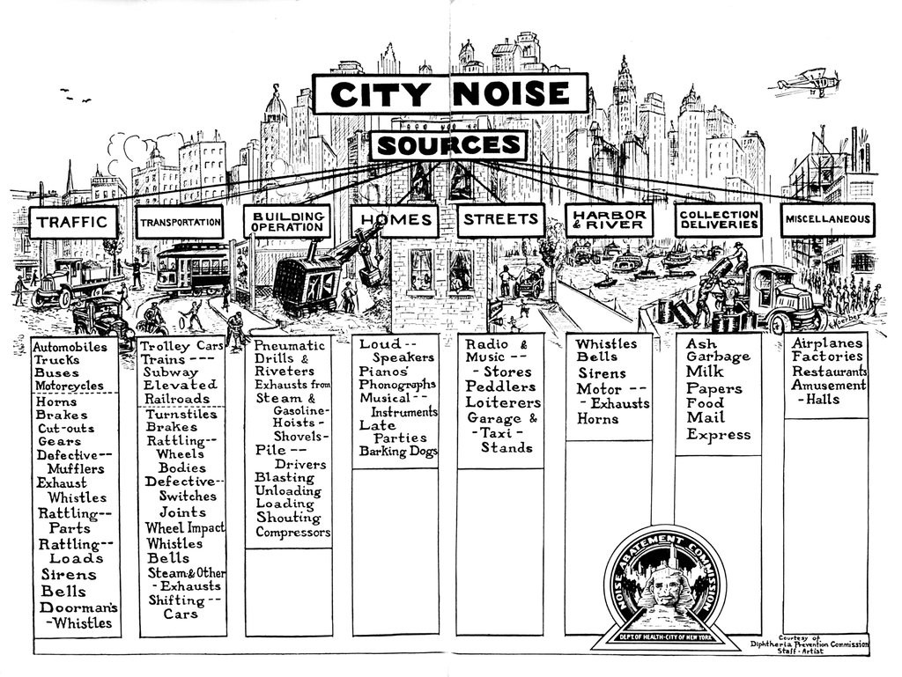
Background
Why it is so important
Hangquan Zhao
Sensor networks
Smart-home projects
Surveillance
Noise source identification
Notes:
Therefore, The automatic content-based classification of complex and dynamic urban sound is an important aspect of various emerging applications, such as surveillance, urban soundscape understanding and noise source identification, city sensor networks, and smart-home projects

Slide 4
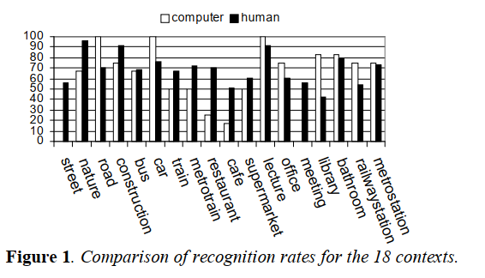
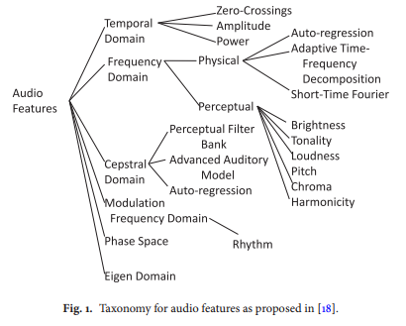
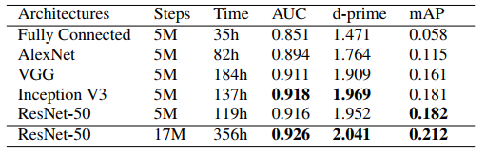
Releted work
Hangquan Zhao
Audio-Based Context Awareness – Acoustic Modeling And Perfectual Evaluation
CNN Architectures For Large-Scale Audio Classification --Shawn Hershey
Environmental sound recognition:
A survey --Chachada et.al
Notes:
Machine learning literature on sound classification generally and environmental sound classification specifically range in scope and methods from data representation, feature extraction, and algorithms used.
in the paper,Audio-Based Context Awareness,A listening test is made to study the performance of system compared to human accuracy
2 .show that features extracted from frames can be used as an instance of training, Chachada put forward feature extraction using power spectral density and filter-banks, training and testing via a simple nearest-neighbor algorithm and RNN
2. how popular Deep Neural Network (DNN) architectures compare on video soundtrack classification; how performance varies with different training set and label vocabulary sizes;
3. AUDIO-BASED CONTEXT AWARENESS – ACOUSTIC MODELING AND
PERCEPTUAL EVALUATION discovered that the MFCC feature that based on human recognition of soundscape and how human ears discern different frequencies.

Slide 5
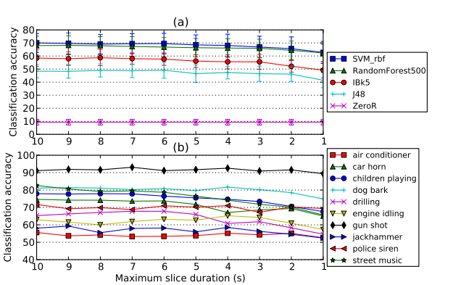
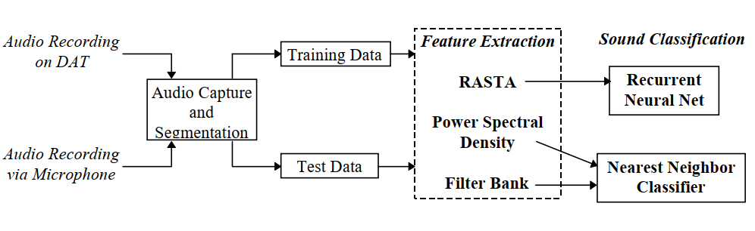
Releted work
Hangquan Zhao
A dataset and taxonomy for urban sound research --Shawn Hershey
Situational awareness from environmental sounds --Sawhney et .al
Notes:
4. modeling the temporal evolution of audio features and use recurrent neural networks and a k-nearest neighbor criterion. Eronen et al.

Slide 6
Why Deep Learning
Tianyu Zhao
Traditional machine learning methods experience underfit in high dimensional data.
Dimension Reduction may loss detailed information.
Deep networks have stronger representational ability.
Converting the problem to computer vision and sequence recognition problem to leverage powerful deep models emerged in recent years.
Notes:
传统方法在高维数据上很困难（underfit，拟合能力不够）。如果我们把数据降维到适合传统方法的维度，又会损失许多信息。
深度学习有更强表示能力（解决underfit），所以我们可以把问题转化为计算机视觉或者序列识别（包括自然语言等）问题，以利用近年出现的强大模型。

Slide 7
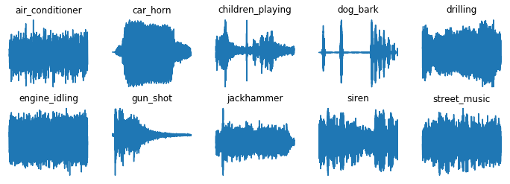
Dataset: Urbansound8k
Tianyu Zhao
Urbansound8k dataset contains 8732 labeled sound of urban sounds from 10 classes
Using 10-fold cross validation to evaluate our methods
Correlation between different folds
Notes:
10 fold 难易不均。10 fold 之间有相关性，混合后会产生错误的准确率，我们发现了许多人的实验都有这样的问题。

Slide 8

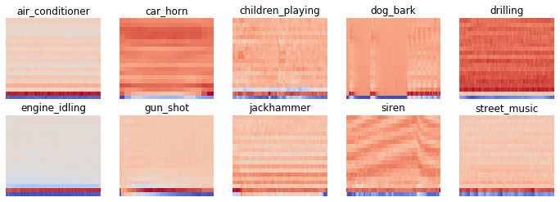
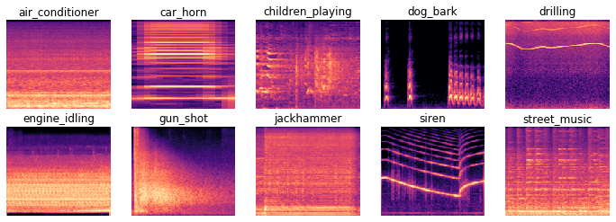
Feature extraction
Wei Wang
For Deep Learning Methods:
For Traditional Methods:
Mel-frequency spectrum
Dimensionality Reduction
feature == "mel_mean":
data = np.mean(librosa.feature.melspectrogram
(y=samples, sr=sample_rate), axis=1)
feature == "mel_mean_db":
data=np.mean(librosa.power_to_db(librosa.feature.melspectrogram
(y=samples, sr=sample_rate), ref=np.max), axis=1)
feature == "mfcc_mean_40":
data = np.mean(librosa.feature.mfcc(y=samples, sr=sample_rate,
n_mfcc=40), axis=1)
feature == "mfcc_mean_80":
data = np.mean(librosa.feature.mfcc(y=samples, sr=sample_rate,
n_mfcc=80), axis=1)
Mel-frequency cepstrum coefﬁcients (MFCC)

Slide 9
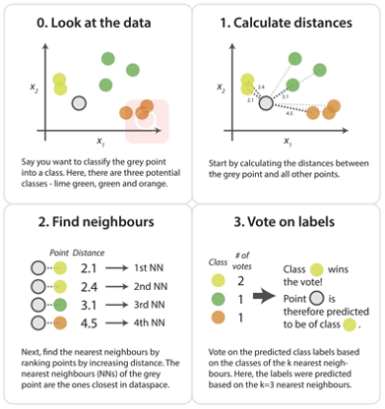
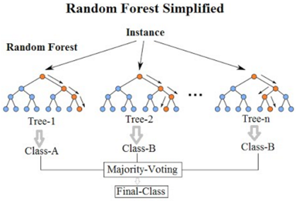

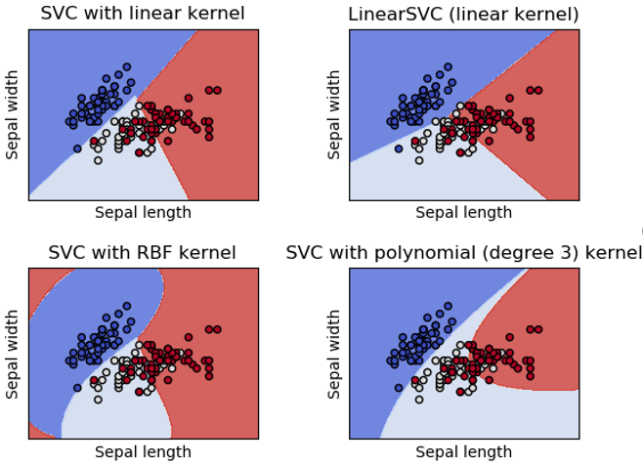
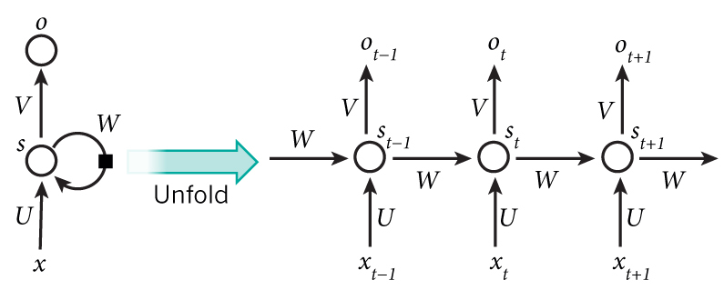
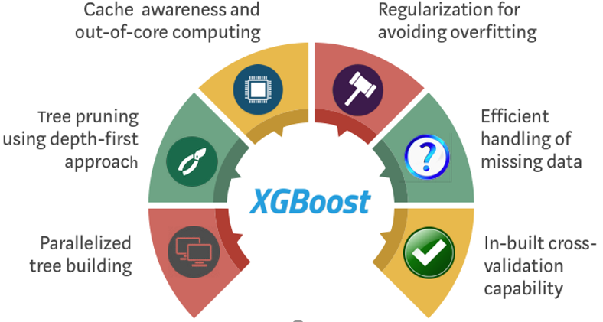
Details on the model used
Wei Wang, Tianyu Zhao
Traditional Methods:
Recurrent Neural Network:
KNN:
RF:
LSTM:
SVM:
XGBoost:
Notes:
LSTM：考虑同时提取空间和时间上特征

Slide 10
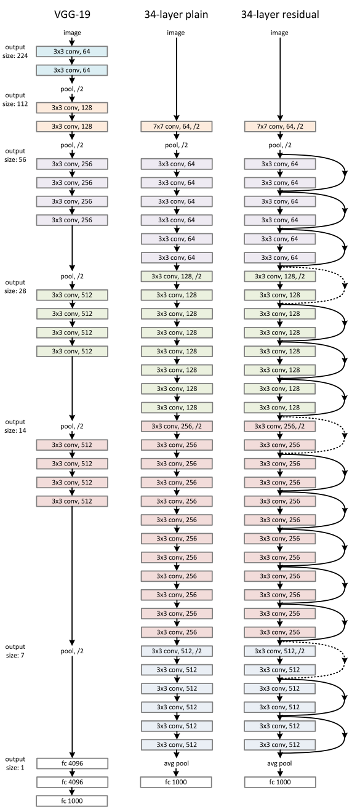
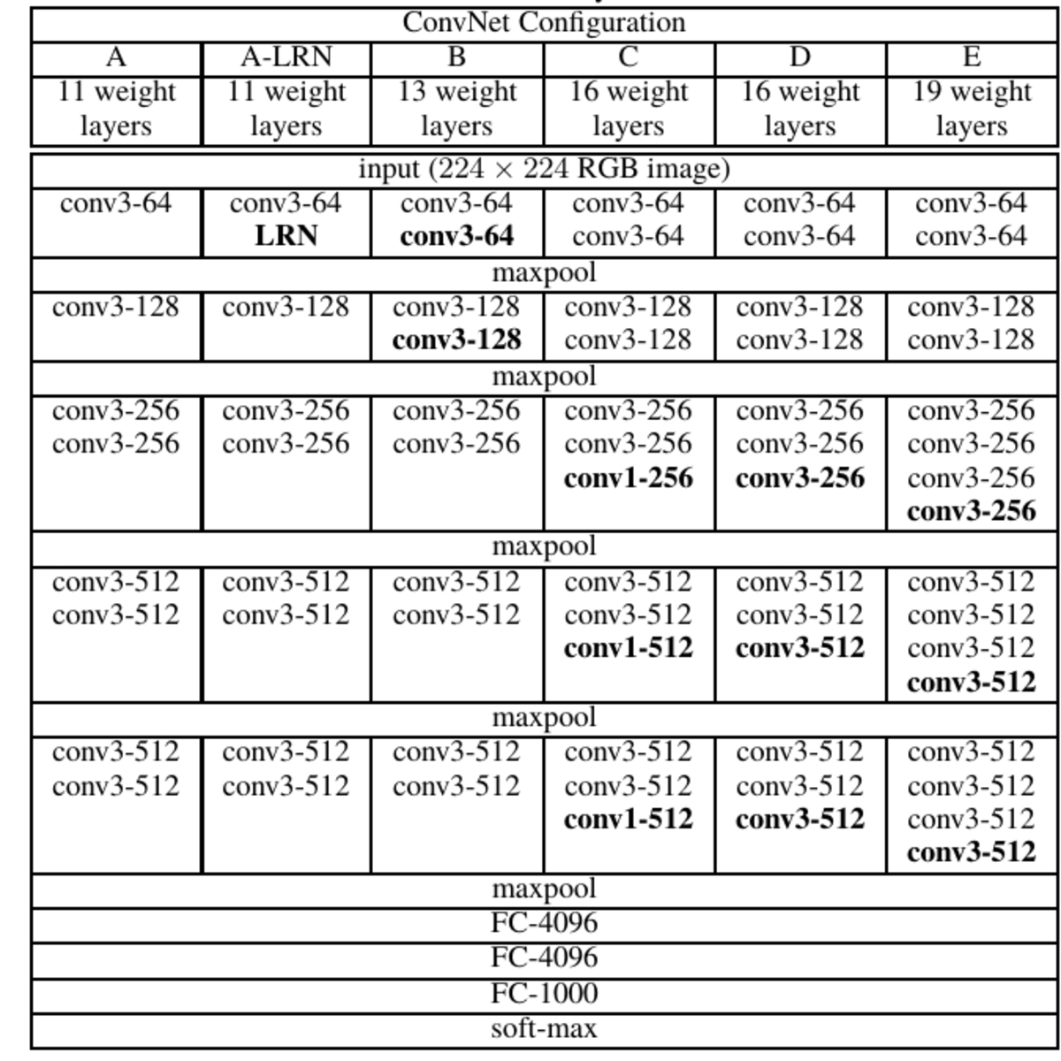
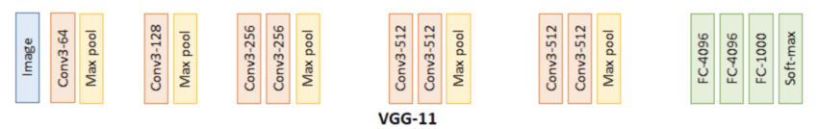
Details on the model used
Tianyu Zhao
Convolutional Neural Network:
VGG11:
ResNet:
Notes:
CNN中我们主要使用VGG和Resnet
VGG：一句带过
ResNet：short connection的存在可以让我们使用更深度的网络

Slide 11
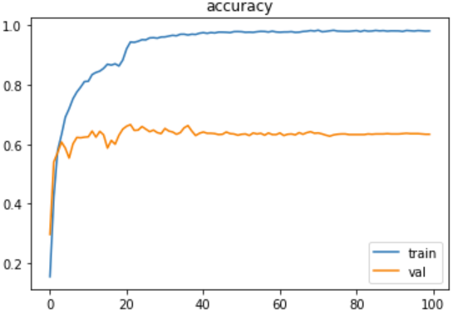
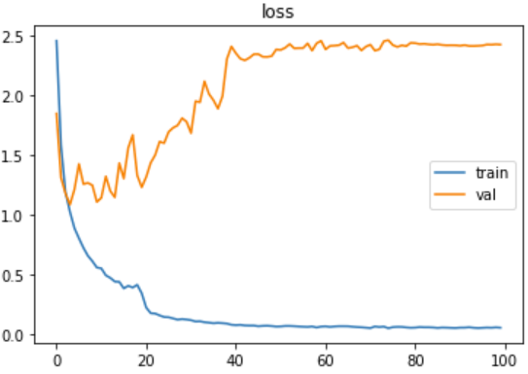
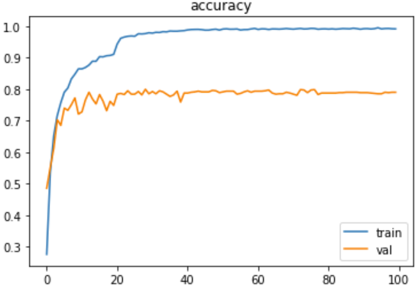
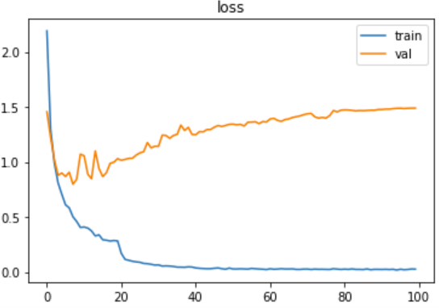
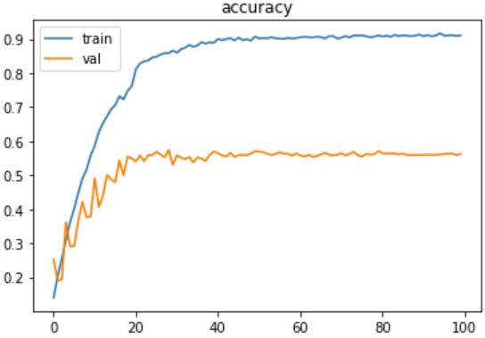
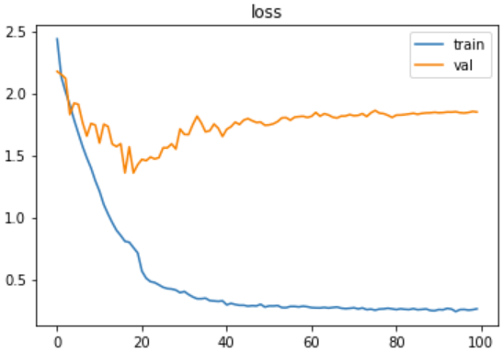
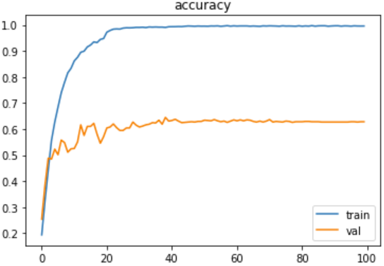
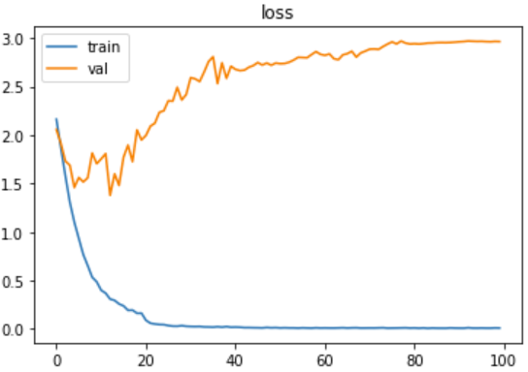
Results/Observations
Wei Wang
VGG 11:
Accuracy
Loss
Accuracy
Loss
Spec
MFCC

Slide 12
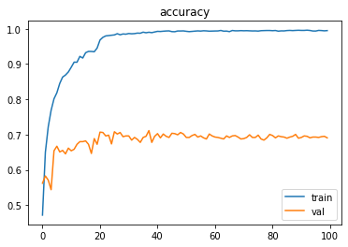
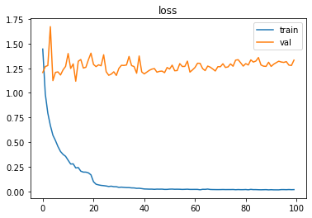
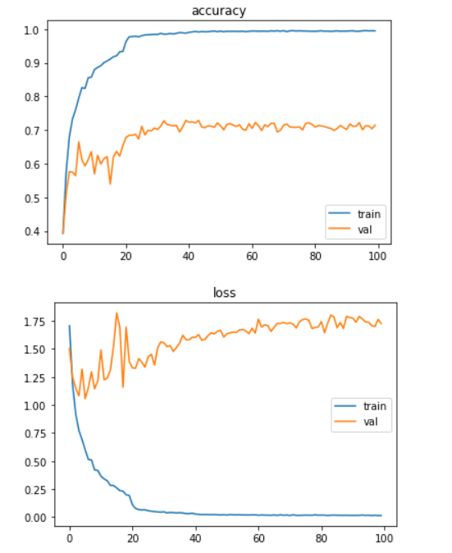
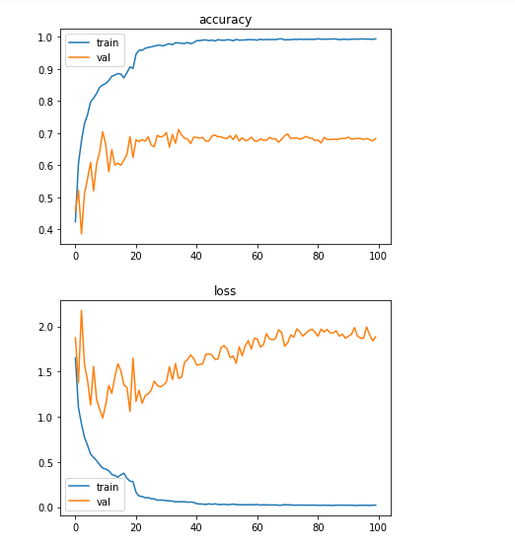
Results/Observations
Hangquan Zhao
Accuracy
Loss
ResNet18:
ResNet34:
ResNet50:

Slide 13
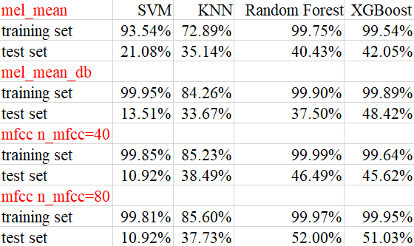
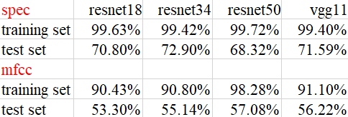
Results/Observations
Tianyu Zhao
Traditional Methods
Deep Learning Methods

Slide 14
Further Items
Wei Wang
Perform 10-fold cross validation
Try more features and more models
Compare the results of our different experiments and some results online

Slide 15
References
Wei Wang
He K, Zhang X, Ren S, et al. Deep residual learning for image recognition[C]//Proceedings of the IEEE conference on computer vision and pattern recognition. 2016: 770-778.
Gers F A, Schmidhuber J, Cummins F. Learning to forget: Continual prediction with LSTM[J]. 1999.
Karen Simonyan, Andrew Zisserman. Very Deep Convolutional Networks for Large-Scale Image Recognition. ICLR 2015
Yu Su, Ke Zhang, et al. Environment Sound Classification Using a Two-Stream CNN Based on Decision-Level Fusion. Sensors (Basel). 2019 Apr; 19(7): 1733.
Graves A, Jaitly N, Mohamed A. Hybrid speech recognition with deep bidirectional LSTM[C]//2013 IEEE workshop on automatic speech recognition and understanding. IEEE, 2013: 273-278.

Slide 16
Thank you!

