Slide 1
Issues or traits?
Understanding Americans’ partisan favorability and animosity through open-ended survey responses
01 May 2026
Group 15: Wei (David) Wang, Rehan Mirza, Ying Zhang

Slide 2



Agenda
Section A: RESEARCH QUESTIONS AND DATA
How can we predict partisan animosity and favorability?
ANES (American National Election Studies) dataset
Section B: METHODS
Study 1: Text mining analysis to predict partisan favorability and animosity
Study 2: Who responds to open-ended questions on the parties?
Section C: Findings and Key insights
Exploratory Data Analysis
Study 1: Text mining analysis to predict partisan favorability and animosity
Study 2: Who responds to open-ended questions on the parties?

Slide 3
Motivation and Research Questions
Democrats and Republicans increasingly dislike each other over the past 20 years
Subsequent problems: unwilling to find political compromise, rise in political violence, less support for democratic norms, etc.
Why
Trait-based account: Americans see out-party supporters as immoral, having poor character, no integrity, etc., simply because they support the out-party.
Problematic!
Issue-based account: Americans dislike out-party supporters’ policy opinions and political values, on which the two parties have moved further apart.
Less problematic
RQ1: Why do Americans like their in-party and dislike the out-party, in their own words?
RQ2: What predicts whether someone provides an explanation in the first place?

Slide 4
Data: ANES 2008-2024
Source & Coverage
American National Election Studies (Time Series data), 2008-2024 (5 election cycles)
Fresh, cross-sectional pre-election probabilistic samples
Pooled N=26,307
Key variables
Study 1 Outcome: Feeling thermometers for Democrats and Republicans (0-100 scale), recoded into 5-class indicator for LASSO
Study 1 predictors: Open-ended reasons for favorability or animosity toward each party
“Why do you dis/like the Democratic/Republican party?”
skip-grams (for robustness checks: also n-grams, stems)
Study 2 Outcome: Whether respondent provided open-ended text response, coded as binary
~40-60% of respondents gave non-responses
Study 2 predictors: Political attitudes (e.g., country on right track?) and demographics
variable inclusion criteria: measured all five years; substantively relevant for RQ1&2

Slide 5
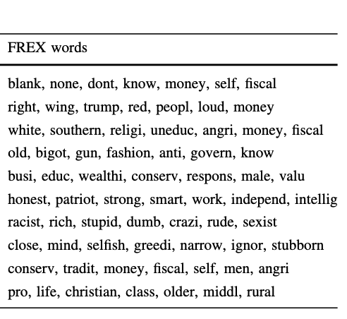
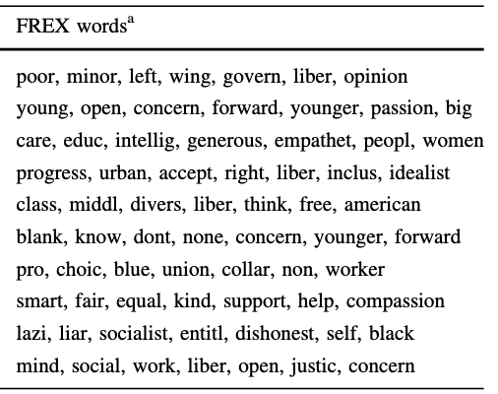
‘‘words that typically describe people who support the [Democratic/Republican] party’’
Rothschild et al., 2019
Democratic Party descriptions
Republican Party descriptions
Notes:
What do we mean by trait- versus issue-based words? Our analysis in this project is mainly descriptive, where we will examine the prominent words from our LASSO model and give a face-value interpretation of whether these words are about policy issues or personality traits. But here’s one example of what trait- and issue-based words look like, based on a structural topic modeling approach in prior literature.
[First set of boxes] In the first set of words, you see a list of trait-based words that mainly describe inferences about the personality, morality, and character of partisans.
[Second set of boxes] This is very different from the second set of words that are mainly about either specific policies like union rights, or about broader political values like freedom.

Slide 6
Agenda
Section A: RESEARCH QUESTIONS AND DATA
How can we predict partisan animosity and favorability?
ANES (American National Election Studies) dataset
Section B: METHODS
Study 1: Text mining analysis to predict partisan favorability and animosity
Study 2: Who responds to open-ended questions on the parties?
Section C: Findings and Key insights
Exploratory Data Analysis
Study 1: Text mining analysis to predict partisan favorability and animosity
Study 2: Who responds to open-ended questions on the parties?

Slide 7
Study 1: Text Mining Approach
Study Design
Feeling thermometers were recoded into a 5-class scale: “highly unfavorable” (0–19) to “highly favorable” (80–100)
Separate models for Democrat and Republican thermometers
Skip-grams selected as primary method due to better sentiment handling (negation, within-sentence connections), and robustness to conversational language
2-skip-2-grams: Word pairs within a 2-word window
e.g., “I love data science” -> “I_love”, “I_data”, “I_science”
Multinomial LASSO with year fixed effects for variable selection (~100-150 terms per model) -> Relaxed LASSO (GLM) on LASSO-selected terms
Robustness checks
Partisan stratification: Re-conducted analysis on out-party-only samples (Republicans rating Democrats, Democrats rating Republicans) - consistent with full sample results
CSES party liking scale (alternative DV): Consistent with thermometer models
Notes:
The fixed effect essentially makes it so that the model only compares observations from the same year (demeaned by the mean of the year’s respondents).

Slide 8
Study 2: Open-ended Response Predictors Approach
Study Design
Logistic LASSO: cv.glmnet, alpha = 1, family = binomial, λ = lambda.1se
Year fixed effects forced in via penalty.factor = 0 for year dummies
Multi-level ordinals collapsed to 3 levels (pid7, ideology, dem_ideo, rep_ideo, educ7) for interpretability; middle category as reference
Relaxed LASSO: refit selected variables with glm() for valid inference
Repeat per outcome
Pooled robustness check on y_pooled = any usable text
Notes:
The fixed effect essentially makes it so that the model only compares observations from the same year (demeaned by the mean of the year’s respondents).

Slide 9
Agenda
Section A: RESEARCH QUESTIONS AND DATA
How can we predict partisan animosity and favorability?
ANES (American National Election Studies) dataset
Section B: METHODS
Study 1: Text mining analysis to predict partisan favorability and animosity
Study 2: Who responds to open-ended questions on the parties?
Section C: Findings and Key insights
Exploratory Data Analysis
Study 1: Text mining analysis to predict partisan favorability and animosity
Study 2: Who responds to open-ended questions on the parties?
Notes:
For the final section, we’d like to focus on our findings and their implications.

Slide 10
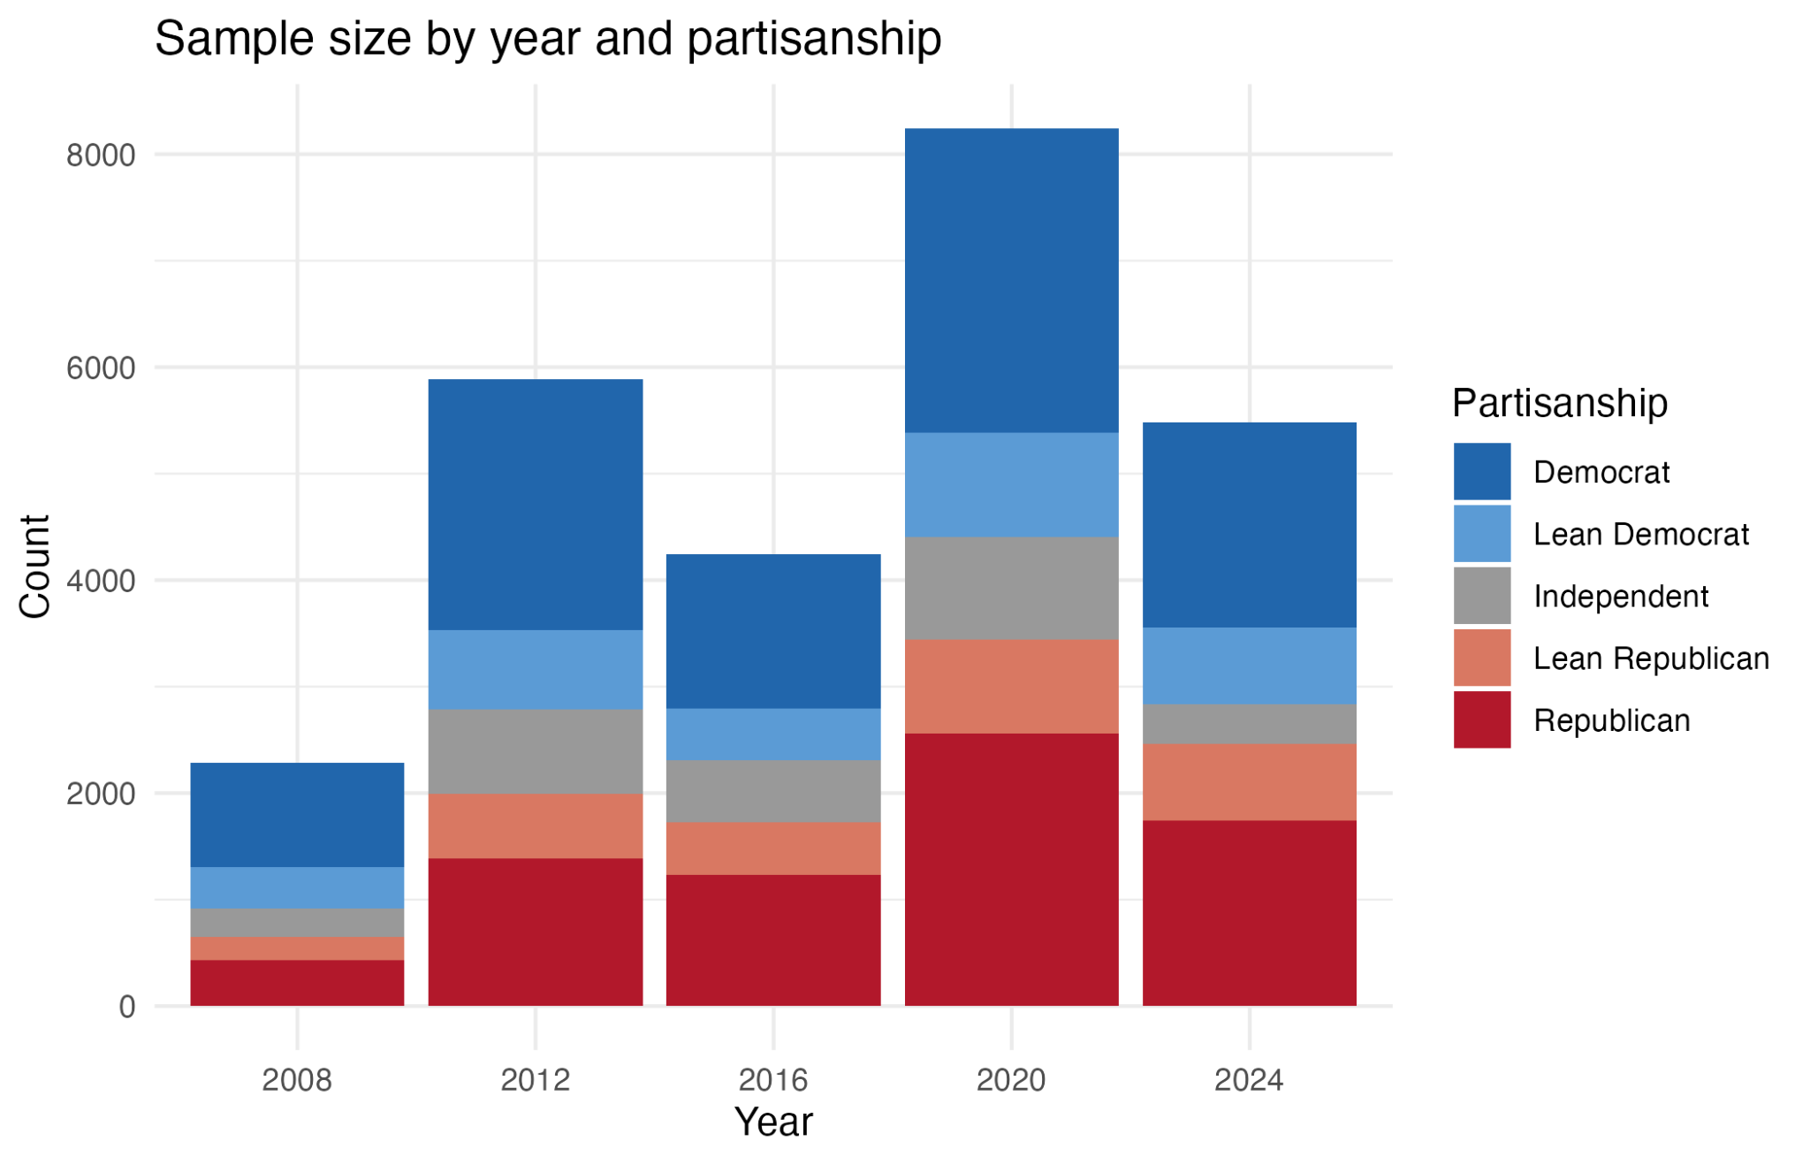
Sample size and composition differ by year
Notes:
Note here that the sample sizes for each year are widely different.

Slide 11
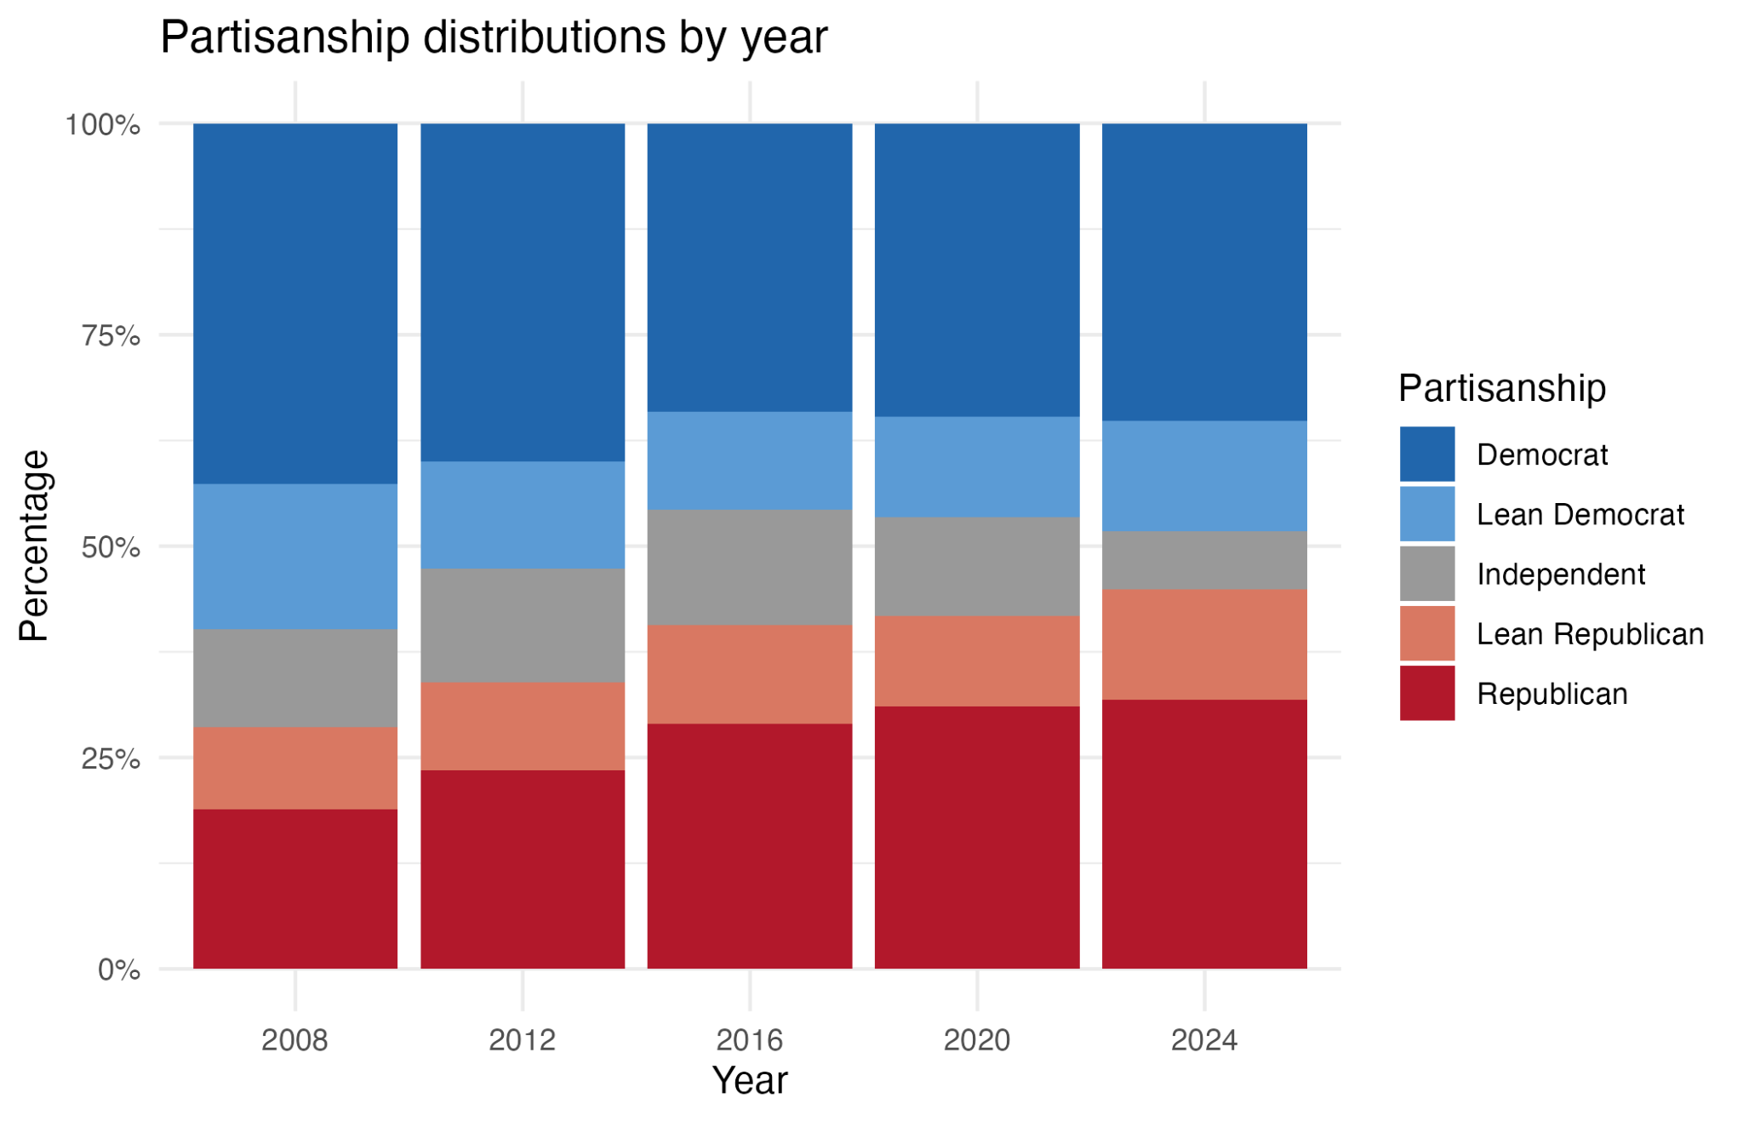
Partisanship distributions also differ by year
Notes:
Note here that the sample has included more and more Republicans over time.
These year-to-year differences are why we added a time (year) fixed effect in our models so that we can account for year-specific patterns.

Slide 12
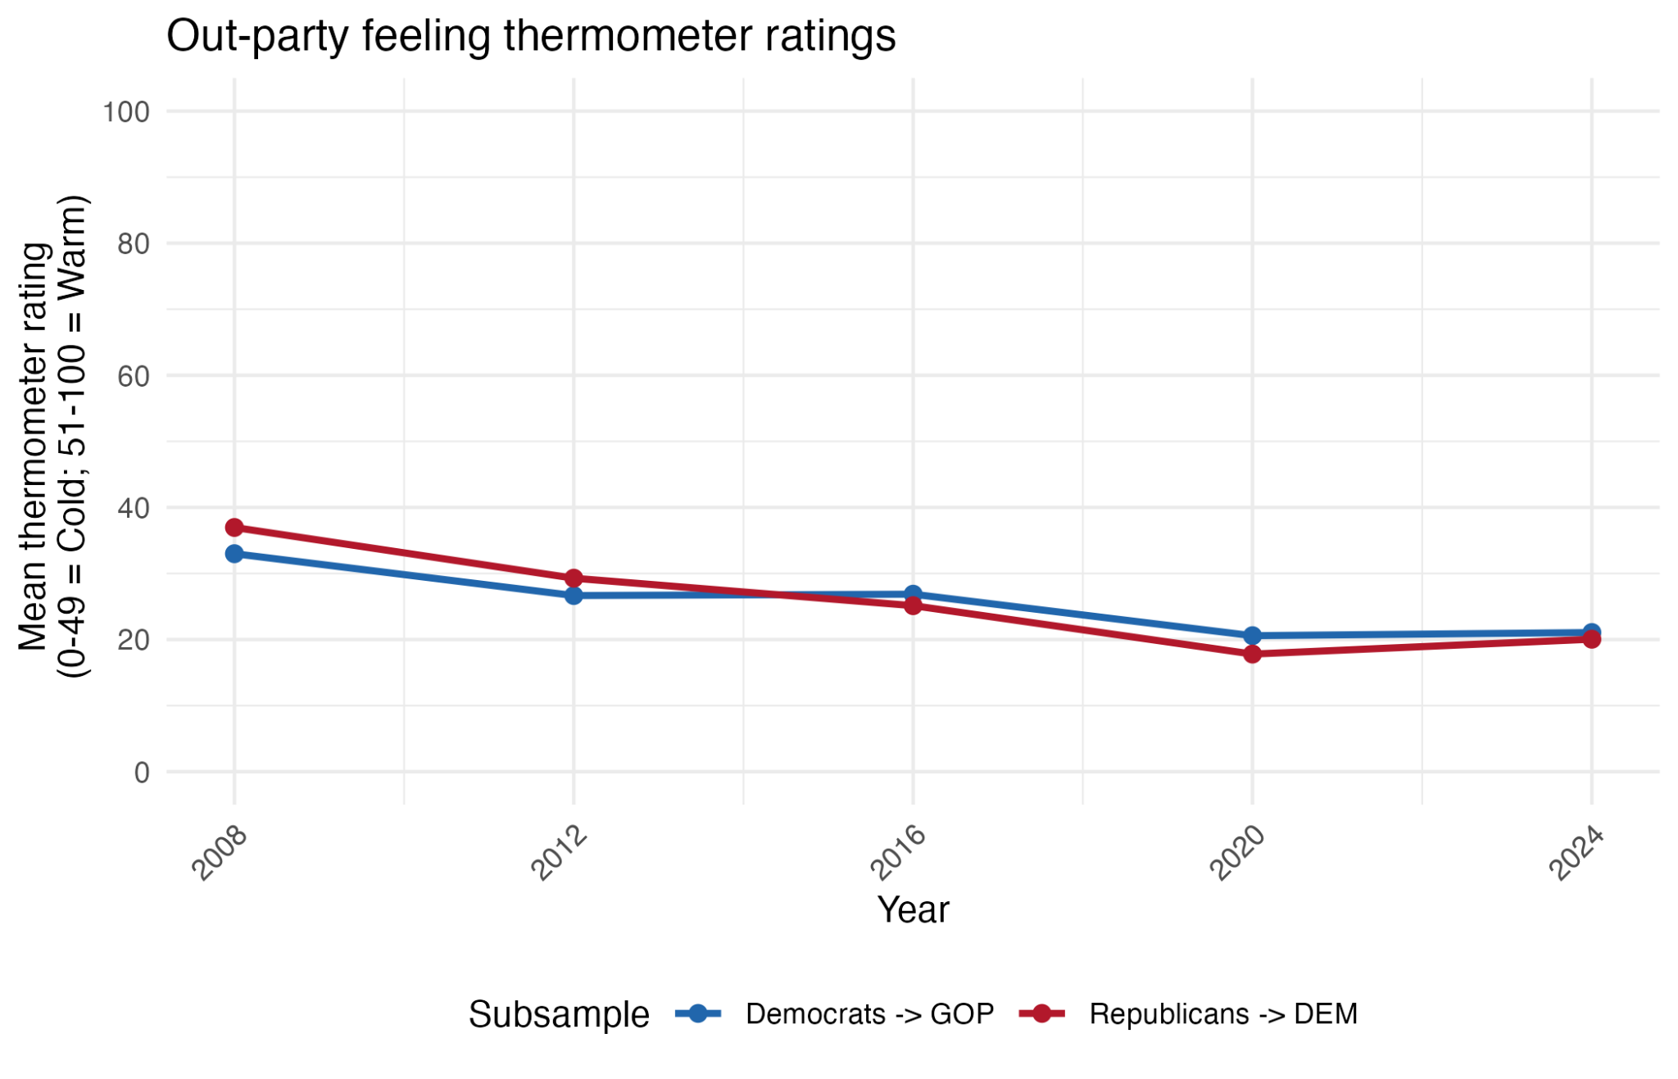
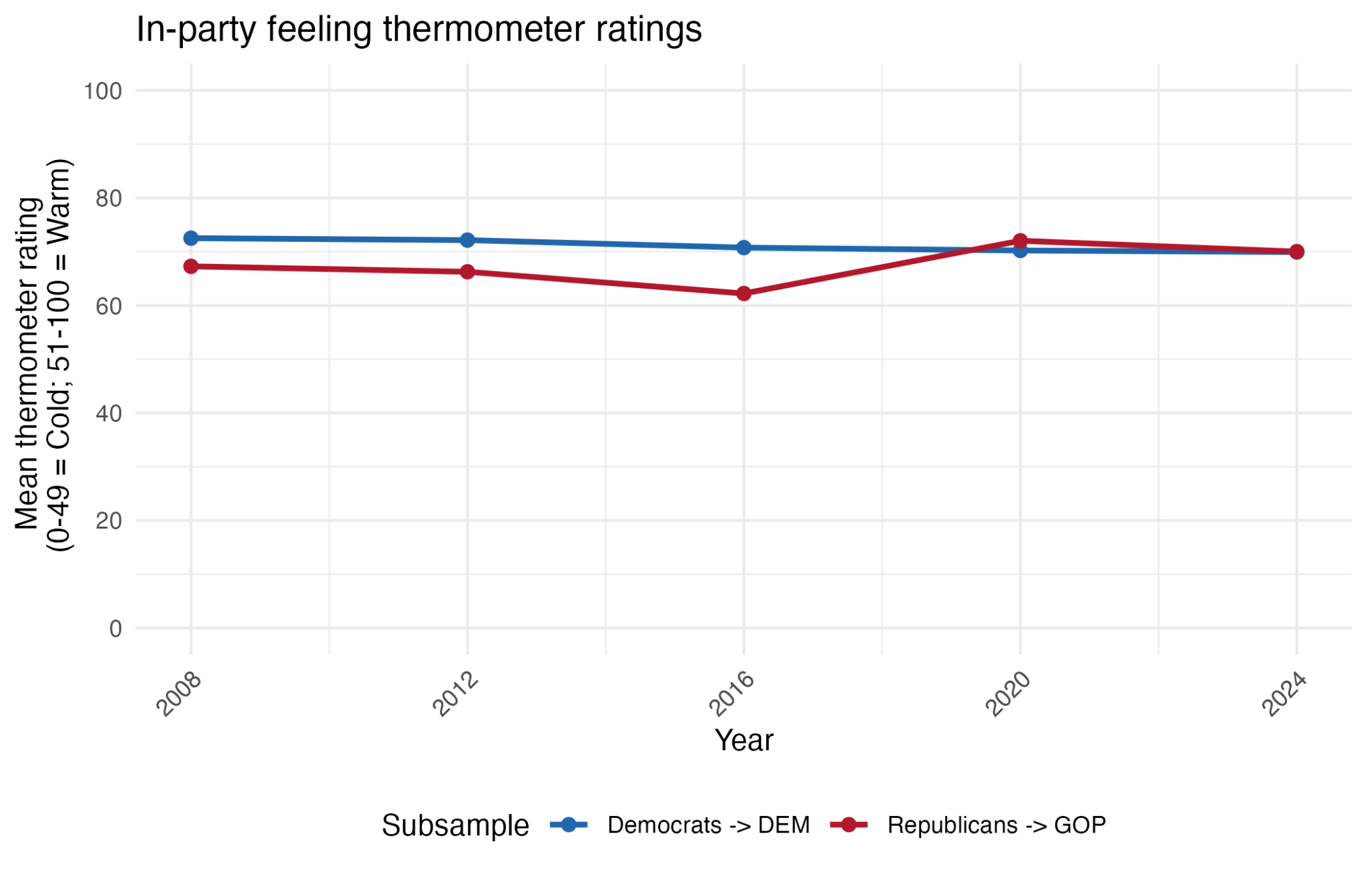
Steady decline of out-party warmth,
while in-party warmth holds level.

Slide 13
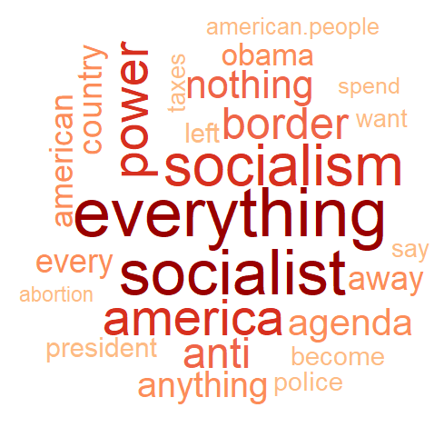
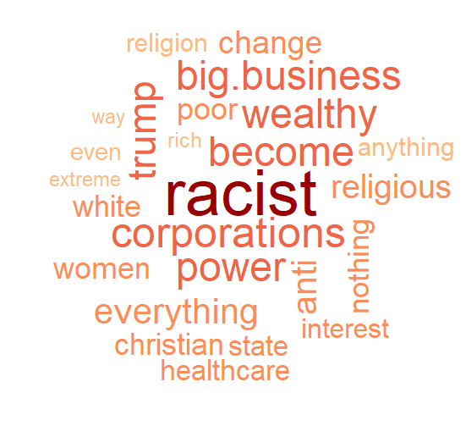
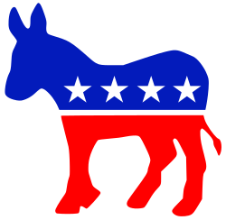
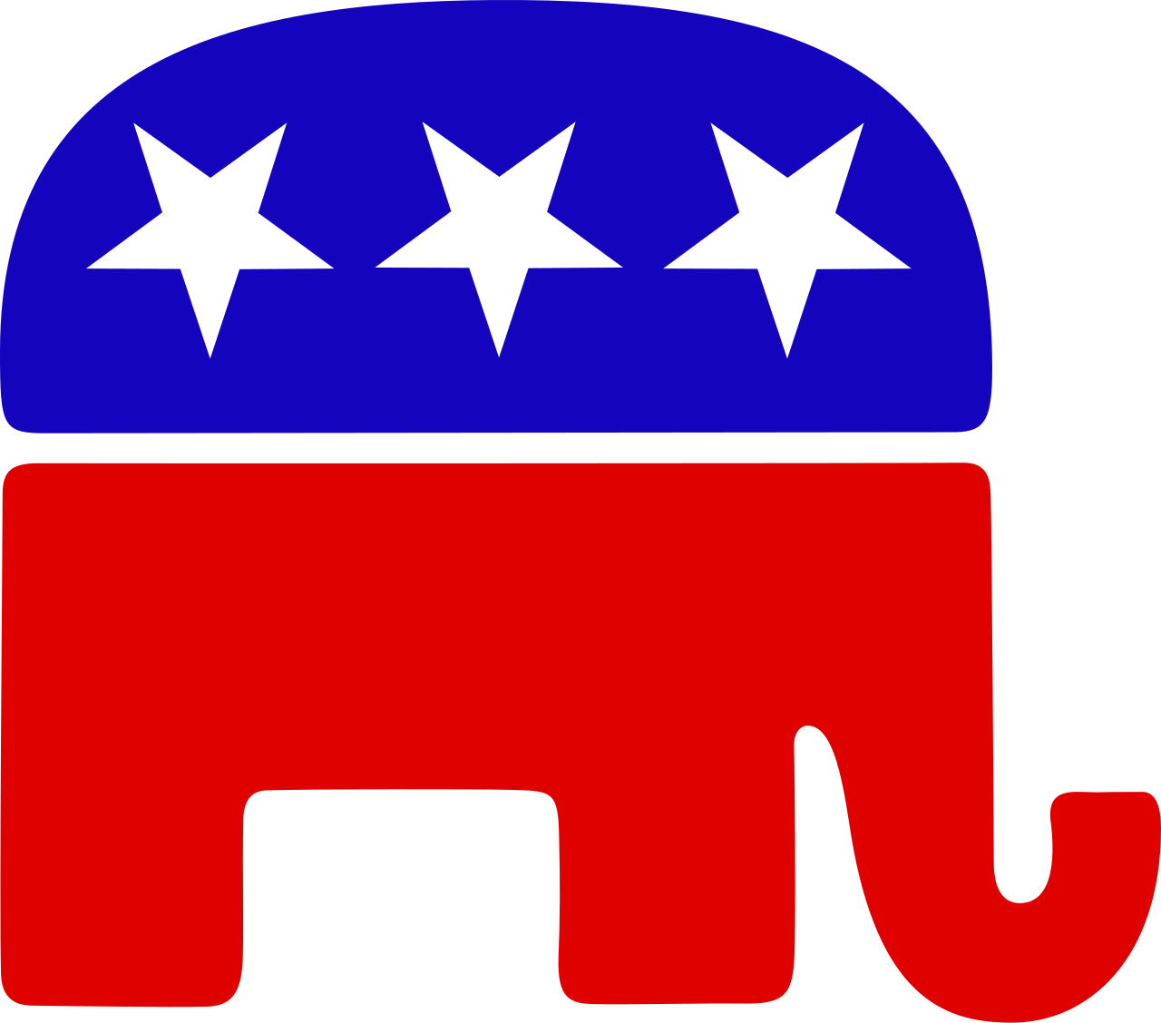
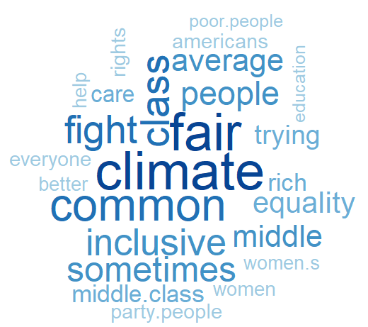
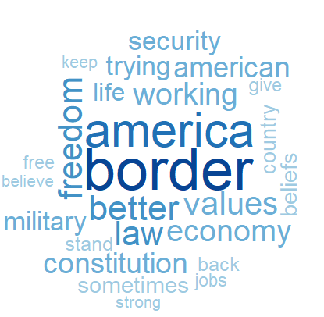
Study 1: Issue/Value-based words are dominant
Democrat animosity
Republican animosity
Democrat favorability
Republican favorability
Notes:
However, it’s also worth noting that these dominant words are not the same. Words associated with favorability are more specific and policy-related (climate, border), whereas words associated with animosity are more abstract and value-based (socialist, racist).

Slide 14
Study 1: Why do Americans like and dislike the two parties, in their own words?
We find issue-based terms to be the predominant predictors of party favorability and animosity.
Words associated with favorability are more specific and policy-related (climate, border), whereas words associated with animosity are more abstract and value-based (socialist, racist).
Unlike Rothschild et al. (2019)’s structural topic modeling, we don’t find strong evidence for Americans describing either party in terms of traits.

Slide 15
Agenda
RESEARCH QUESTIONS AND DATA
How can we predict partisan animosity and favorability?
ANES (American National Election Studies) dataset
METHODS
Study 1: Text mining analysis to predict partisan favorability and animosity
Study 2: Who responds to open-ended questions on the parties?
RESULTS
Exploratory Data Analysis
Study 1: Text mining analysis to predict partisan favorability and animosity
Study 2: Who responds to open-ended questions on the parties?

Slide 16
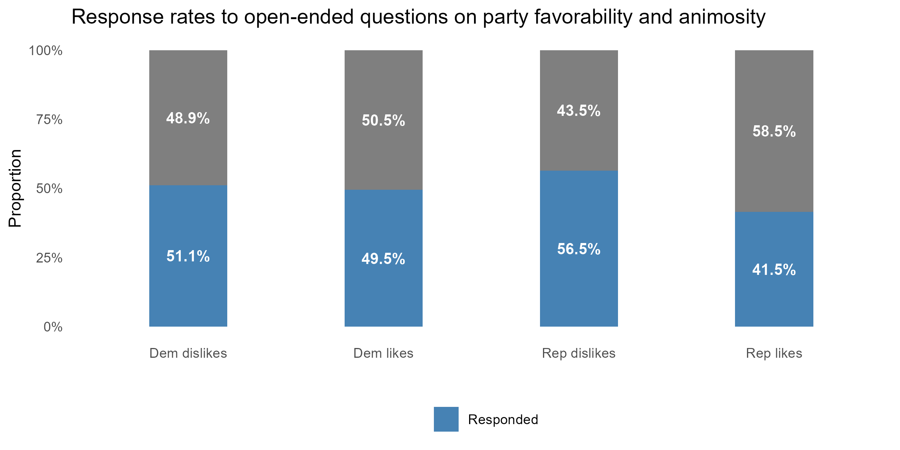
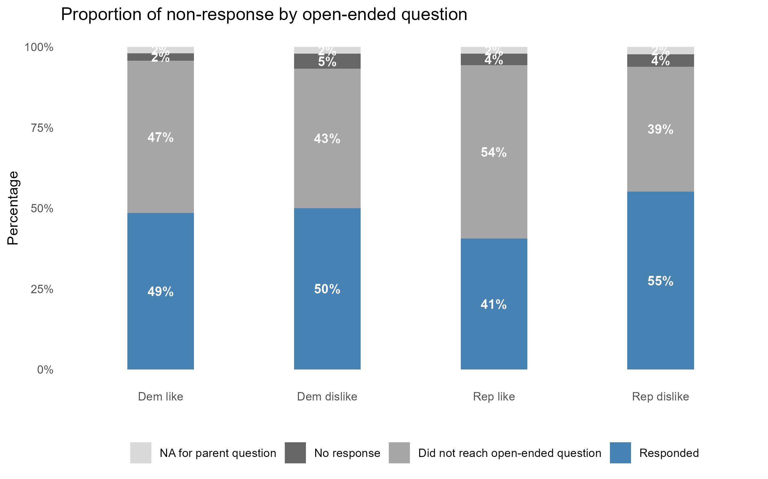
~40-60% of respondents did not provide open-ended text responses
Notes:
As this descriptive analysis shows, half or more of the sample is not included in our analysis. Our subsequent Study 2 analysis focuses on the most dominant type of non-response: Not reaching the open-ended question because the respondent previously said they do not have anything they like or dislike about either party.

Slide 17
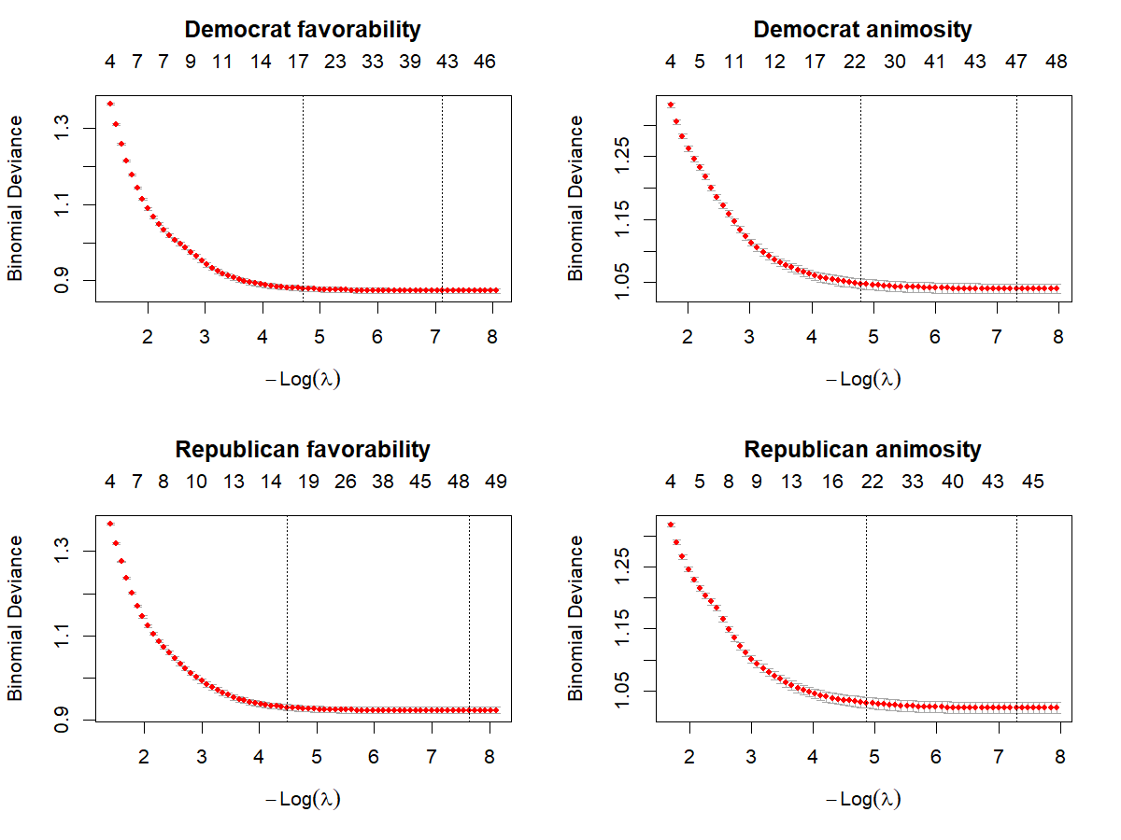
LASSO selects ~15-50 predictors per model (depending on choice of λ)
Use λ.1se-selected terms for relaxed LASSO
(enhanced parsimony)

Slide 18
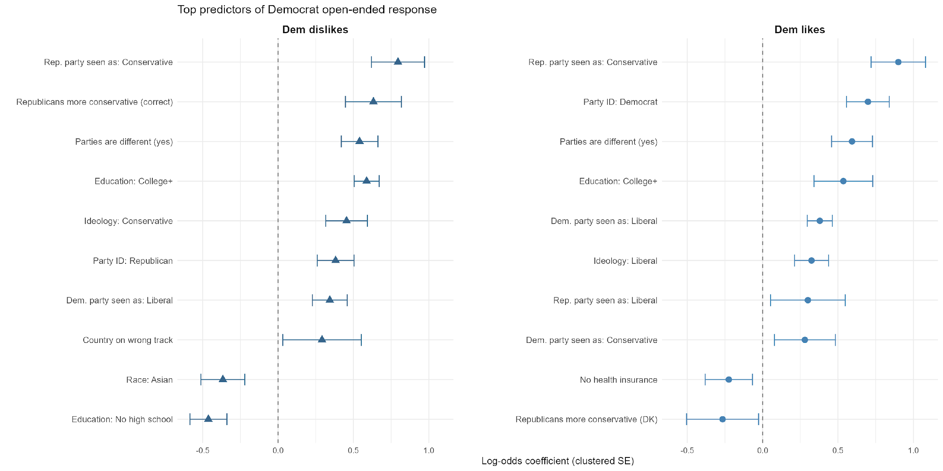
Democrat open-ended responses are driven by partisanship, ideology, and education
Top 10 predictors only
Notes:
First set of red boxes: political informedness is the best predictor of expressing Democratic favorability and animosity.
Second set: Education is a strong predictor, where college-educated people are more likely to respond, and people with less than high school education are less likely to express animosity.
Third set: Outparty members are more likely to express animosity, and inparty members are more likely to express favorability.

Slide 19
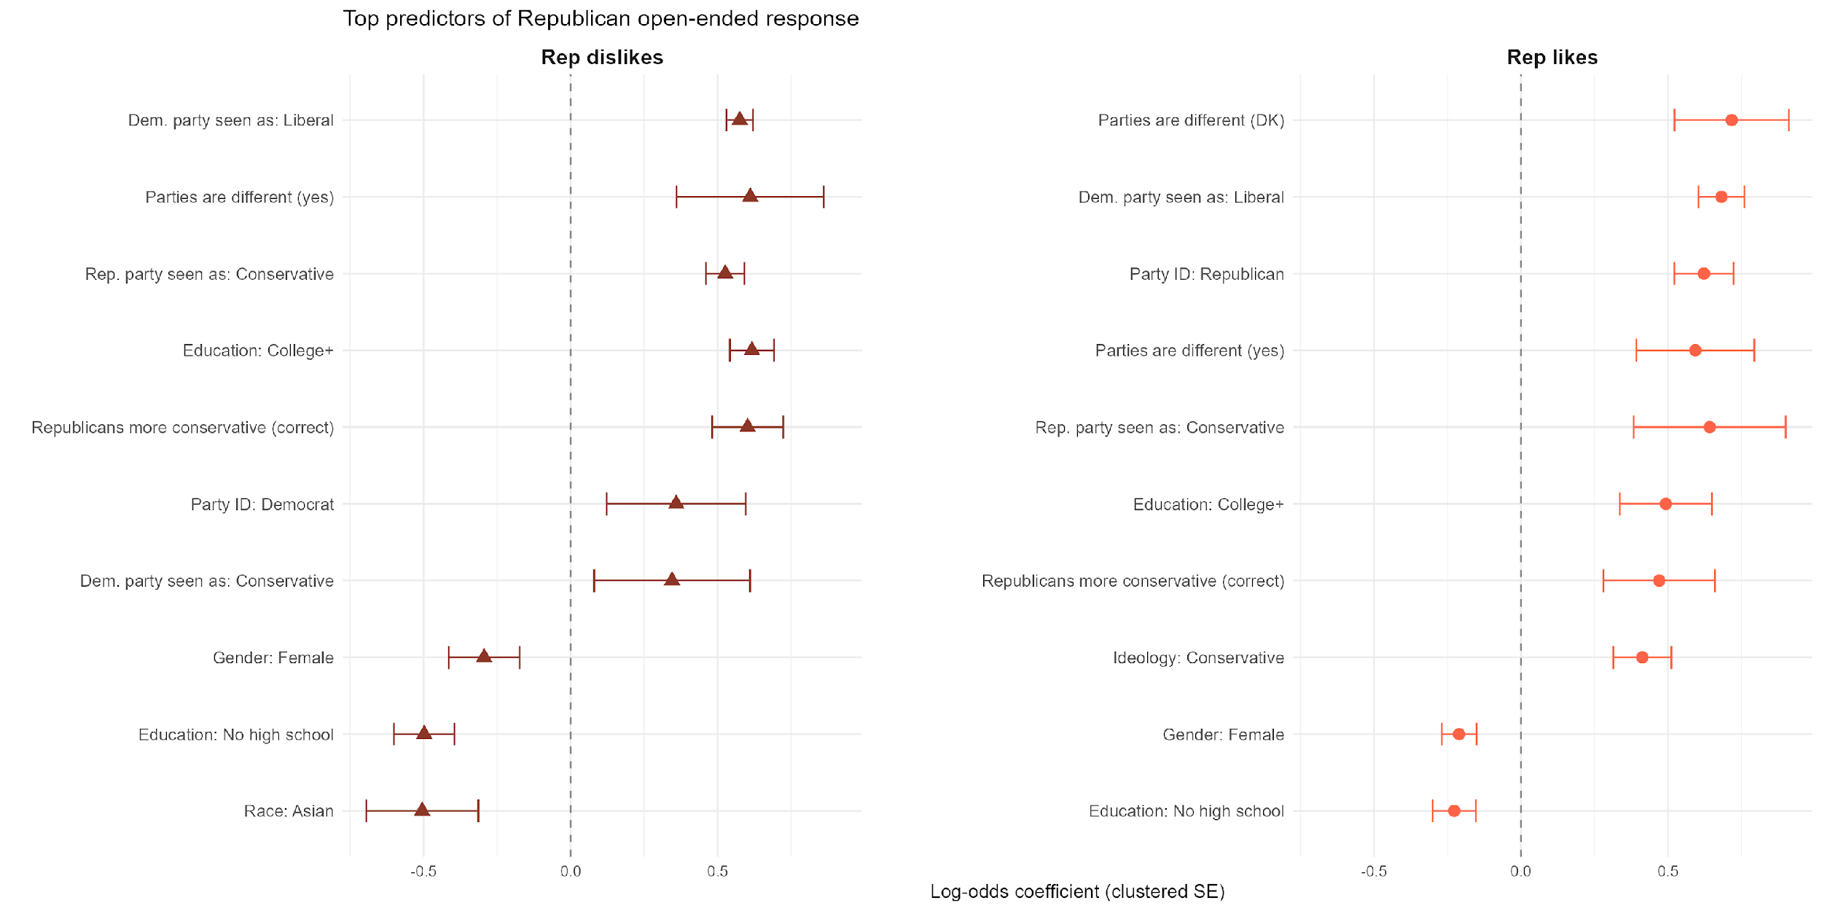
Republican open-ended responses are driven by political engagement
Top 10 predictors only
Notes:
First set of red boxes: Again, political informedness is the best predictor of expressingRepublican favorability and animosity.
Second set: Education is again a strong predictor, where college-educated people are more likely to respond, and people with less than high school education are less likely to do so.
Third set: Here two important demographic predictors emerge. Women and Asian Americans are less likely to express favorability toward Republicans than men and white people, with the same holding for women w.r.t. expressing animosity.
Fourth set: And again, outparty members are more likely to express animosity, and inparty members are more likely to express favorability.

Slide 20
Non-response to open-ended questions is systematic and non-random
Education: college-educated respondents are more likely to respond across all items; less-than-high-school respondents less likely
Non-response may not be because of a lack of thought, but because of a lack of articulation.
Political informedness: largest effects across models
E.g., Republicans as conservative; parties are different
Partisanship: Out-party members are more likely to express animosity and in-party members are more likely to express favorability.
Demographics: Gender and race/ethnicity predict non-response to animosity Q’s
Implications: Our Study 1 findings generalize to people who are politically interested, highly educated, male, white, and partisan.

Slide 21
Conclusions and extensions
Americans* primarily use issue-based words to rationalize their partisan favorability and animosity.
However, this only generalizes to people who are politically interested, highly educated, male, white, and partisan.
Future steps
Manual coding of LASSO-derived words using established codebook
LLM coding of raw open-ended responses, using manually labeled training data
Deeper literature search and conceptualization of “trait-based” versus “issue-based” stereotypes
or more fundamentally: expressive versus instrumental partisanship

Slide 22
Thank you!
01 May 2026
Group 15: Wei (David) Wang, Rehan Mirza, Ying Zhang

